Slide 1
FINAL PROJECT · OPTIMIZATION METHODS
Optimal Siting of EV Charging Stations
$589k
A source-audited facility-location MILP
over 20 licensed candidate sites in Chicago
THE KNEE
6 stations · 100% covered
Illustrative result: $589k builds 6 sites; model coverage is 100%.
Illustrative result — validate cost, capacity and grid readiness before commitment.
Optimization Methods — Final Project · 2026 · RJ Xia, Kevin Fan
01 / 14
Notes:
Good afternoon everyone. Our project asks a practical planning question. If Chicago wants to screen possible locations for public EV charging, which sites should it choose when money, capacity, and service distance are limited? We built a mixed integer optimization model over twenty licensed candidate facilities. The headline result on this slide is six sites and five hundred eighty nine thousand dollars. I want to be careful about what that means. It is the cheapest full coverage solution under our current model assumptions. It is not a construction quote or a final city recommendation. During this presentation, I will show where the data comes from, how the optimization works, what changes when assumptions change, and which inputs need real validation before anyone makes a commitment.
[Sources]
Revised project notebook executed on August 16 2026

Slide 2
02 · DECISION CONTEXT
A city planner's source-aware budget-vs-coverage problem
A city screens licensed garages and filling
stations as candidate charging sites under a
fixed construction budget. Site cost and
capacity remain scenario assumptions.
DECISION AT A GLANCE
DECISION-MAKER
Municipal transport planner / utility
ACS community population density supplies a
spatial demand proxy — not measured EV use.
The model compares coverage, cost and
straight-line assignment distance.
LEVERS
Which sites to build (yⱼ); how demand is served (xᵢⱼ)
HARD CONSTRAINT
A fixed construction budget
Too few sites → demand left unserved
SUCCESS
Right-sized → best model coverage per dollar
A reproducible screening scenario
Surplus budget → leave it unspent
Optimization type: a MILP; CBC returned Optimal under configured tolerances.
EV Charging Siting · Optimization Methods
02 / 14
Notes:
Let me start with the decision context. Imagine that the city or a utility has a fixed construction budget and a list of possible facilities. The planner needs to decide which locations to build and how much demand each location should serve. Building too few sites leaves demand unserved. Building sites in the wrong places creates long assignments. Building unnecessary sites wastes money. Our model compares those outcomes in one consistent framework. The success measure is not simply spending the entire budget. The goal is to find the best feasible service plan and leave money unused when extra spending creates no benefit. This is why we describe the project as a screening tool. It helps a planner compare scenarios before doing detailed engineering, ownership, and grid studies.
[Sources]
City of Chicago Business Licenses Current Active
City of Chicago ACS Five Year Data by Community Area

Slide 3
03 · PROBLEM FORMULATION
The model: a capacitated facility-location MILP
DECISION VARIABLES
CONSTRAINTS
yⱼ ∈ {0, 1}
build a station at site j
Demand Σⱼ xᵢⱼ = 1
xᵢⱼ ∈ [0, 1]
every point fully served (≤ 1 in coverage mode)
fraction of demand i served by j
Linking xᵢⱼ ≤ yⱼ
demand can go only to a site that was built
LEXICOGRAPHIC · MIN_COST MODE
Radius xᵢⱼ = 0 if dᵢⱼ > R
no assignment exceeds the radius
1) min Σⱼ cⱼyⱼ 2) min Σᵢⱼ wᵢdᵢⱼxᵢⱼ at minimum cost
Capacity Σᵢ wᵢ xᵢⱼ ≤ capⱼ yⱼ
a station cannot serve more than its capacity
max_coverage: max demand → min cost
Budget Σⱼ cⱼ yⱼ ≤ B
→ min distance, under a fixed budget.
construction stays within the budget
EV Charging Siting · Optimization Methods
03 / 14
Notes:
Here is the mathematical structure. The first decision variable is y. It equals one when we build candidate site j and zero when we do not. The second variable is x. It records the fraction of demand at location i that is assigned to site j. The demand constraint makes sure each demand point is fully served in the full service model. The linking constraint prevents assignment to a site that was not built. The radius constraint blocks assignments that are too far away. The capacity constraint prevents a station from serving more demand than it can handle. The budget constraint limits total construction cost. For the minimum cost mode, we first minimize construction cost and then minimize distance among solutions with that same cost. For maximum coverage, we maximize served demand, then minimize cost, and finally minimize distance.
[Sources]
Revised project notebook
Project model file

Slide 4
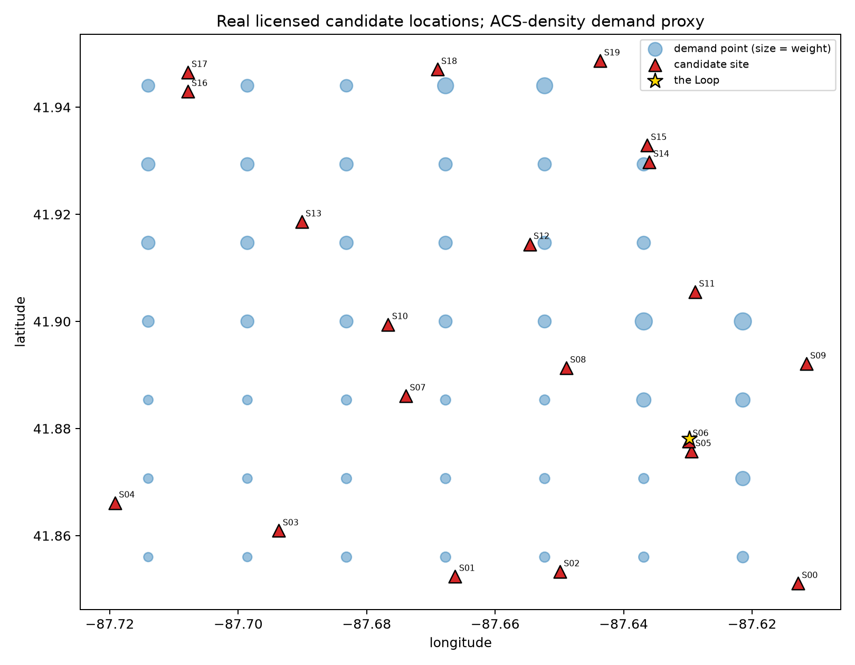
04 · DATA DESCRIPTION
20 licensed sites · 45 demand cells
OBSERVED SOURCE DATA
553 active City license rows → 20-site spatial sample
45 grid cells after clipping to official City boundaries
Haversine distances, 0.09–13.29 km — not road travel
PROXY + SYNTHETIC PARAMETERS
Demand pattern = 2023 ACS population density proxy
total scaled to 23,248 model units — not EV sessions
Cost ≈$210k central → ≈$60k edge (assumed)
envelope compared with DOE/AFDC ranges; no site bids
Capacity 4,000 garage · 2,200 filling (model units)
not verified throughput, port count or grid capacity
Total demand 23,248 · capacity 69,200
Real candidate locations; ACS-density demand proxy clipped to the City boundary.
≈3.0× demand by design · assumed build-all cost $2.40M
EV Charging Siting · Optimization Methods
04 / 14
Notes:
This slide is important because it separates what is real from what is assumed. The candidate coordinates and facility types come from active City of Chicago business license records. We began with five hundred fifty three relevant license rows and selected twenty spatially distributed candidates. The city boundary is also official. For demand, we created forty five grid cells and used community population density from the 2023 ACS as a spatial proxy. This tells us where population is concentrated, but it does not measure EV charging sessions. The total demand scale, site costs, capacities, budget, and service radius are scenario assumptions. The distance is a straight line Haversine distance, not driving time. A business license also does not prove that a site has available land, owner approval, or enough electric grid capacity.
[Sources]
City of Chicago Business Licenses Current Active
City of Chicago Community Area Boundaries
City of Chicago 2023 ACS Five Year Data
United States Department of Energy Alternative Fuels Data Center

Slide 5
05 · SOLUTION METHOD
Solved lexicographically with PuLP + CBC
Three small MILP phases remove objective degeneracy; CBC returns
Optimal under configured tolerances — no heuristic needed.
1
2
3
FORMULATION
ALGORITHM
WHY EXACT IS FINE
PuLP builds one MILP; objectives
are solved in ordered phases.
1) maximize coverage
2) minimize cost
3) minimize distance
20 binary + 900 continuous
vars and ~966 constraints
baseline solves in ~1.3 s.
CBC status is reported as Optimal; no unsupported 0.0% gap claim is made.
EV Charging Siting · Optimization Methods
05 / 14
Notes:
We solve the model with PuLP and the CBC solver. The problem is small enough for exact mixed integer optimization. It has twenty binary build variables and nine hundred continuous assignment variables. The main improvement in this version is the ordered objective process. For maximum coverage, the first solve finds the highest possible coverage. The second solve holds that coverage fixed and finds the cheapest plan. The third solve holds both results fixed and finds the shortest assignment distance. This removes arbitrary spending when several solutions have the same coverage. CBC reports an Optimal status under the configured tolerances. We also check every important constraint after the solve. We do not claim a separately verified zero percent optimality gap because the solver output does not provide enough evidence for that stronger statement.
[Sources]
Revised project notebook
PuLP and CBC solver output

Slide 6
06 · IMPLEMENTATION & REQUIREMENTS
A snapshot-based, reproducible workflow
data_prep.py
model.py
notebook
loads City licenses + ACS + boundaries;
builds sites, demand and distance
solve_model() — the one function everything calls
baseline + corrected sweeps +
validation + recommend()
MODELING CHOICE
REQUIREMENTS TO RUN
Every analysis uses the same solve_model()
with a different budget, radius, capacity
OS
macOS (Darwin, arm64) · portable
or objective mode — constraints stay
consistent.
PYTHON
3.9+ · executed on 3.13.5
LIBRARIES
NumPy 2.5.2 · pandas 3.0.5
Matplotlib 3.11.1 · PuLP 3.3.2
REPRODUCIBILITY
SOLVER
CBC — bundled with PuLP
Source snapshots are stored in data/; clean Run All passes.
EV Charging Siting · Optimization Methods
06 / 14
Notes:
The implementation is designed so another person can reproduce the analysis. The data preparation file loads the official snapshots, selects the candidates, creates the demand grid, and calculates the distance matrix. The model file contains one solve_model function. Every scenario calls that same function with a different budget, radius, capacity scale, or objective mode. The notebook then runs the baseline, validation checks, sensitivity analyses, charts, and recommendation function. The official source snapshots are included in the data folder, so the notebook does not need internet access. The delivered notebook runs from top to bottom with eighteen executed code cells and no hidden state. We also record the exact Python and package versions and keep CBC bundled with PuLP, which makes the project easier to rerun.
[Sources]
Revised project notebook
Project requirements file
Project data source record

Slide 7
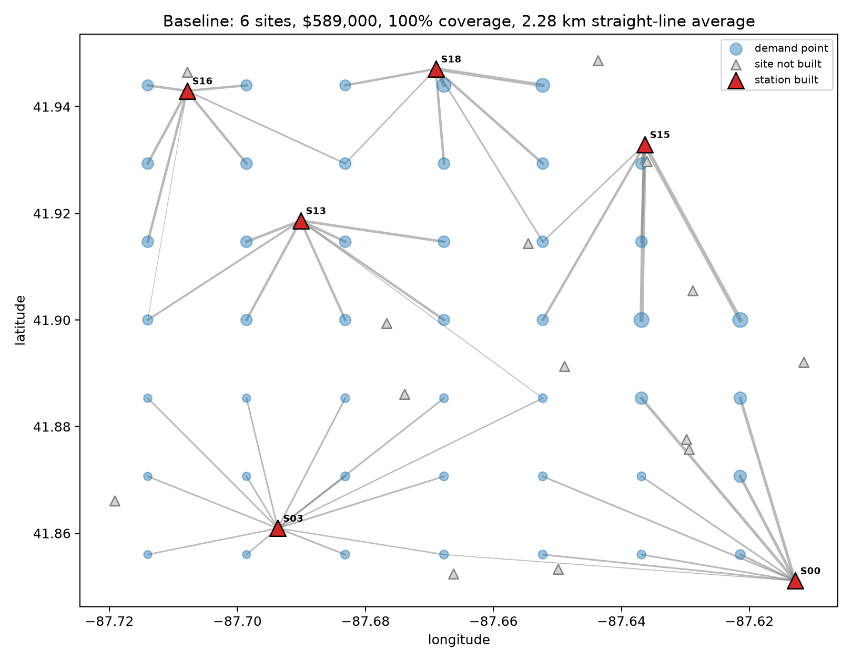
07 · RESULTS
Baseline: 6 sites, $589k, 100% model coverage
6 / 20
$589,000
stations built
construction cost
100.0%
2.28 km
demand covered
avg straight-line distance
CBC status: Optimal · all residual checks pass
BUILT SITES
S00 S03 S13 S15 S16 S18 — all 4,000-unit garages
Primary objective: $589k capex; secondary:
52,921 demand-km at minimum capex.
Six selected licensed facilities; costs/capacities remain scenario assumptions.
EV Charging Siting · Optimization Methods
07 / 14
Notes:
Now we can look at the baseline result. With the current capacities and a five kilometer service radius, the minimum cost model selects six locations. They are S00, S03, S13, S15, S16, and S18. The total assumed construction cost is $589,000. Together, these sites serve one hundred percent of the model demand. The demand weighted average assignment distance is 2.28 kilometers. The map shows each demand point connected to the station serving it. Thicker lines represent larger demand assignments. All six selected sites happen to be garage type candidates with four thousand model capacity units. CBC reports an Optimal status, and our checks confirm that the solution respects the budget, capacity, assignment, linking, and radius constraints. Again, these numbers describe our model scenario rather than observed daily charging operations.
[Sources]
Revised project notebook baseline analysis

Slide 8
08 · RESULTS — TWO MODES
min_cost vs max_coverage: one model, two questions
Same data, different modelling choice — the two agree above the knee and diverge below it.
BUDGET
min_cost
max_coverage
$300k
Infeasible
51.6% covered · $255k
$500k
Infeasible
86.0% covered · $457k
$589k
6 stations · 100%
6 stations · 100% (identical)
min_cost
max_coverage
What does full service cost?
The budget is fixed — now what?
At and above $589k both return the same minimum-cost plan; below it, max_coverage remains usable.
EV Charging Siting · Optimization Methods
08 / 14
Notes:
These two modes answer different planning questions. The minimum cost mode asks how much money is required to serve all model demand. If the budget is below $589,000, that requirement is infeasible. The maximum coverage mode asks how much demand can be served when the budget is fixed. At $300,000, it covers about 51.6 percent of demand volume and spends $255,000. At $500,000, it covers about 86 percent and spends $457,000. At $589,000, both modes reach the same six site plan with full coverage. This comparison matters because an infeasible full service model does not mean the project has no useful answer. It means the budget cannot support complete service, so the planner should switch to a transparent partial coverage question.
[Sources]
Revised project notebook mode comparison

Slide 9
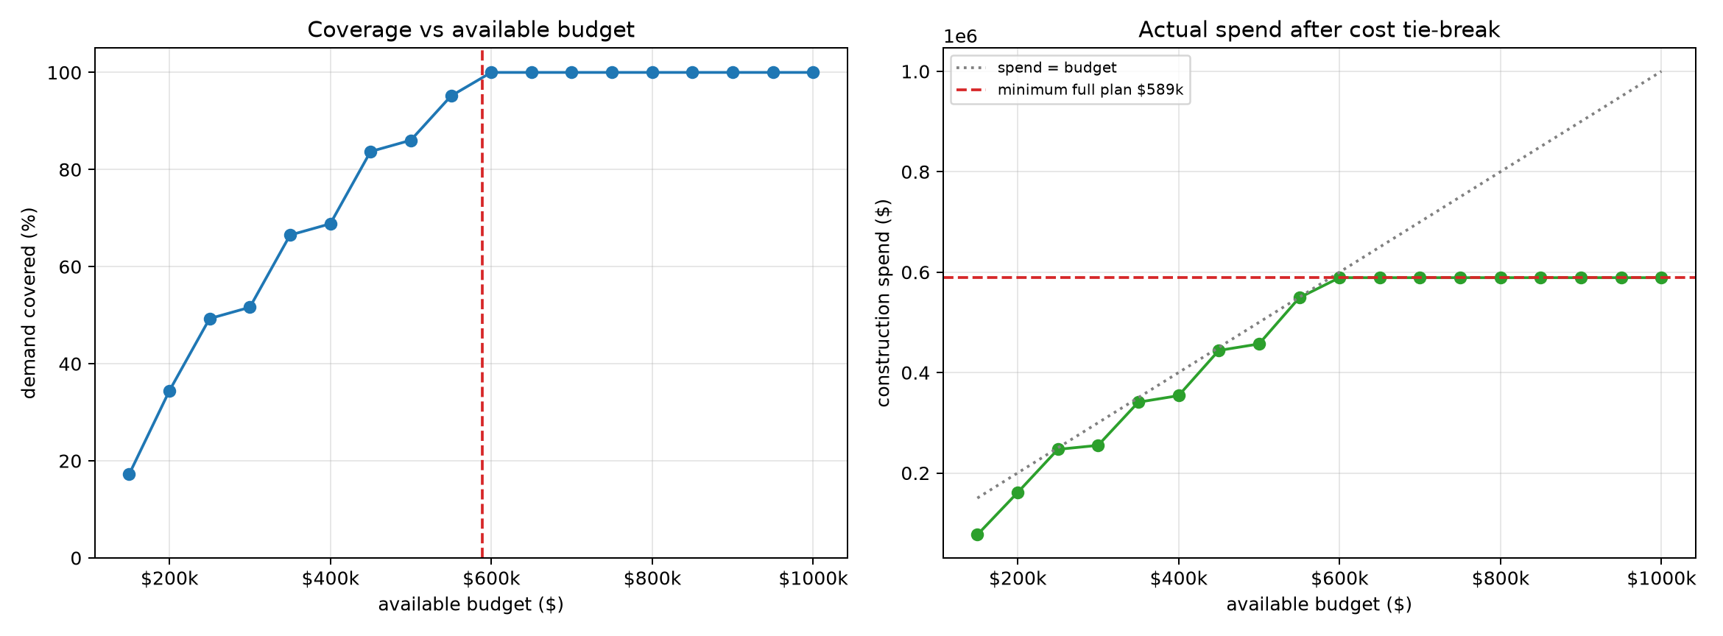
09 · SENSITIVITY — BUDGET (HEADLINE)
Coverage saturates at $589k
Coverage reaches 100% at $589k; the cost tie-break keeps actual spend flat above the knee.
THE KNEE
$589,000
cheapest plan covering everyone
$1.0M available; model spends $589k
and leaves $411k unused —
the former above-knee degeneracy is removed.
BELOW THE KNEE
Coverage is capacity-dominated, but
radius and geography still affect
which combination is feasible.
EV Charging Siting · Optimization Methods
09 / 14
Notes:
This budget curve gives us the main headline. Coverage rises as more money becomes available and reaches one hundred percent at $589,000. We call this the knee because it is the cheapest plan that serves everyone in the model. The chart on the right shows something equally important. Once the available budget goes above the knee, actual spending stays at $589,000. For example, if the planner has one million dollars available, the model still spends only $589,000 and leaves $411,000 unused. The earlier formulation could spend extra money without improving coverage because it did not break ties by cost. The corrected formulation removes that behavior. The practical message is simple. More available budget does not automatically justify more construction when the service objective is already achieved.
[Sources]
Revised project notebook budget sensitivity analysis

Slide 10
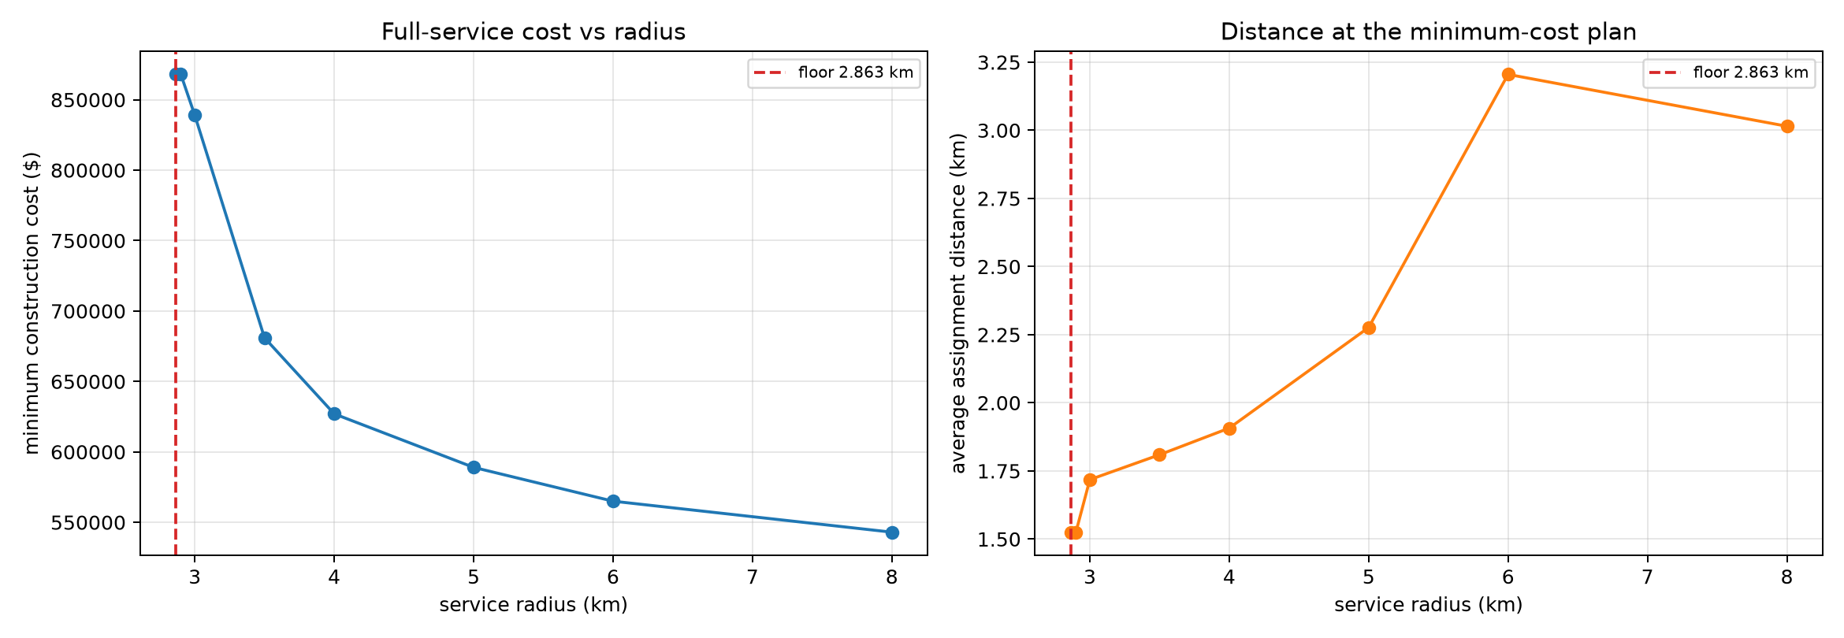
10 · SENSITIVITY — SERVICE RADIUS
A 2.863 km floor, then a cost-distance dial
The limiting demand cell is 2.863 km from its nearest candidate; the threshold is not 4 km.
THE FLOOR
Below 2.863 km: structurally infeasible.
D24 (Humboldt Park) is 2.863 km from its
nearest sampled candidate facility.
It's the candidate list, not money.
A CHEAP DIAL
5 → 3 km costs $250k
FROM 3 km UP
5 → 8 km saves $46k
Radius is no longer a uniformly cheap dial.
Full-service cost: $839k @ 3 km → $543k @ 8 km.
Average distance rises 1.72 → 3.01 km; build count falls 7 → 6.
Candidate coverage changes close to the floor.
EV Charging Siting · Optimization Methods
10 / 14
Notes:
Next we vary the maximum service radius. The smallest feasible radius is approximately 2.863 kilometers. This threshold comes from demand cell D24 in Humboldt Park. Its nearest sampled candidate is about 2.863 kilometers away. Below that value, the model is infeasible even with unlimited money because no allowed assignment can reach that cell. This is a geography problem, not a budget problem. Once the radius becomes feasible, there is a clear tradeoff. At three kilometers, full service costs about $839,000 and needs seven sites. At five kilometers, it costs $589,000 and needs six sites. At eight kilometers, cost falls to about $543,000, but average assignment distance increases. A wider radius gives the model more flexibility, while a smaller radius provides more local service at a higher construction cost.
[Sources]
Revised project notebook service radius analysis

Slide 11
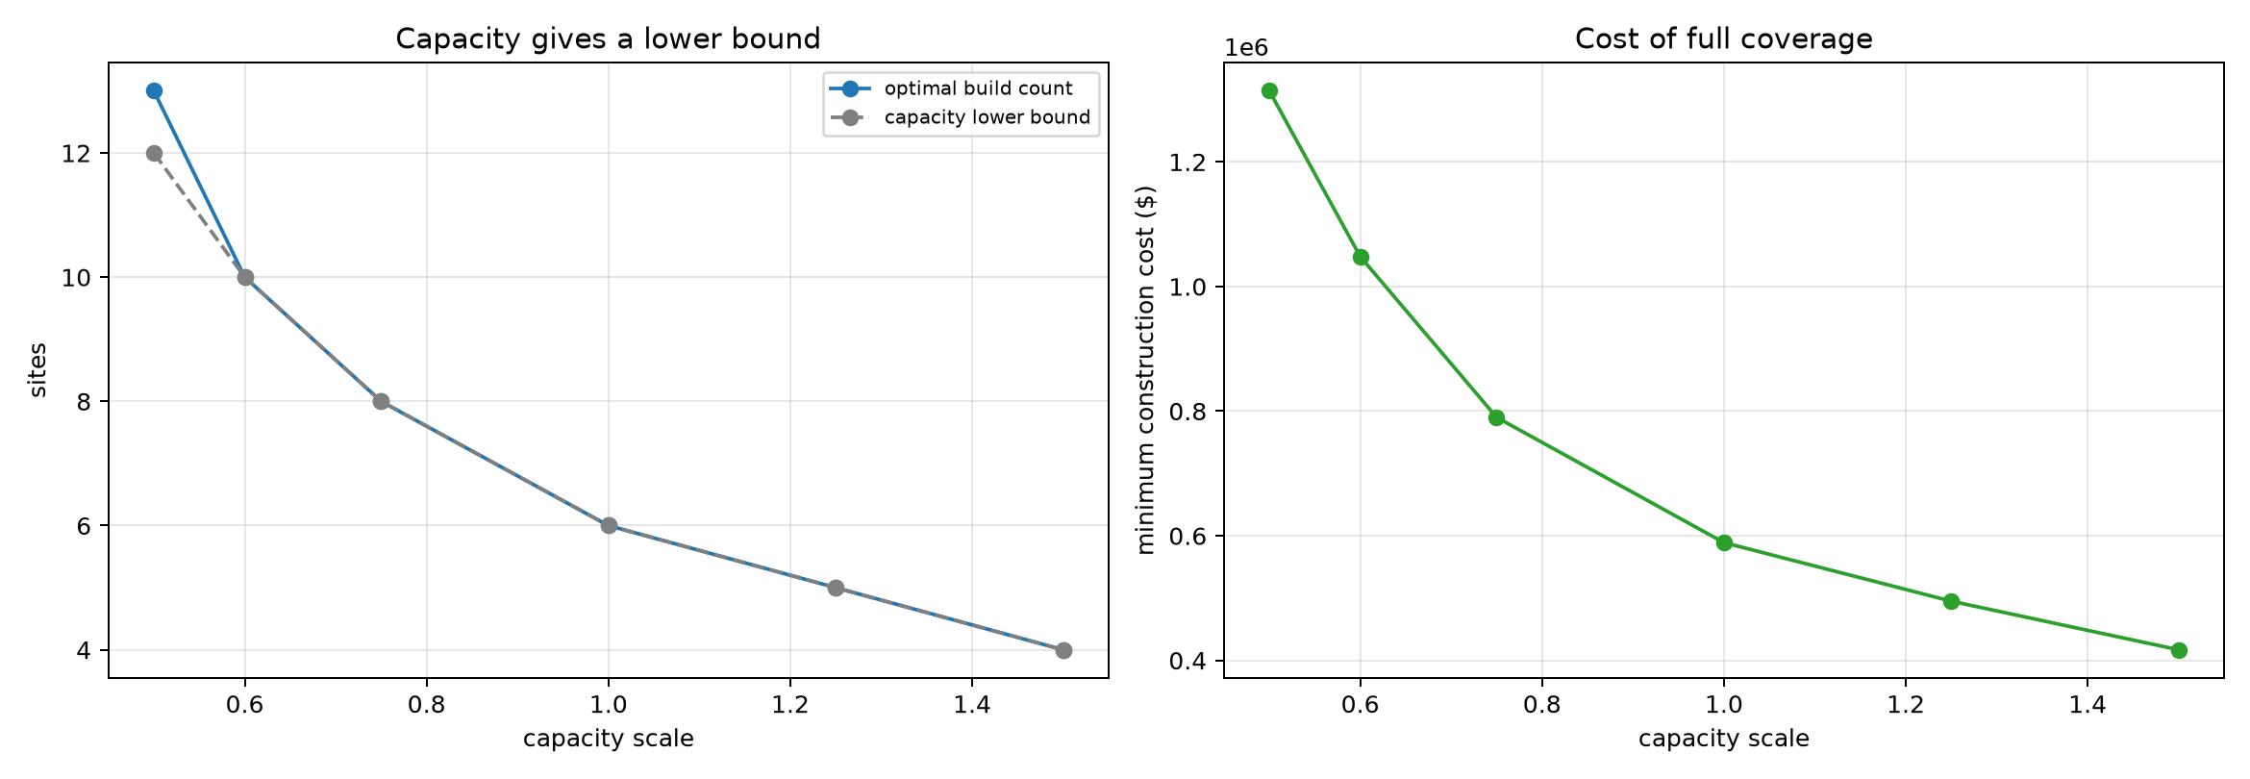
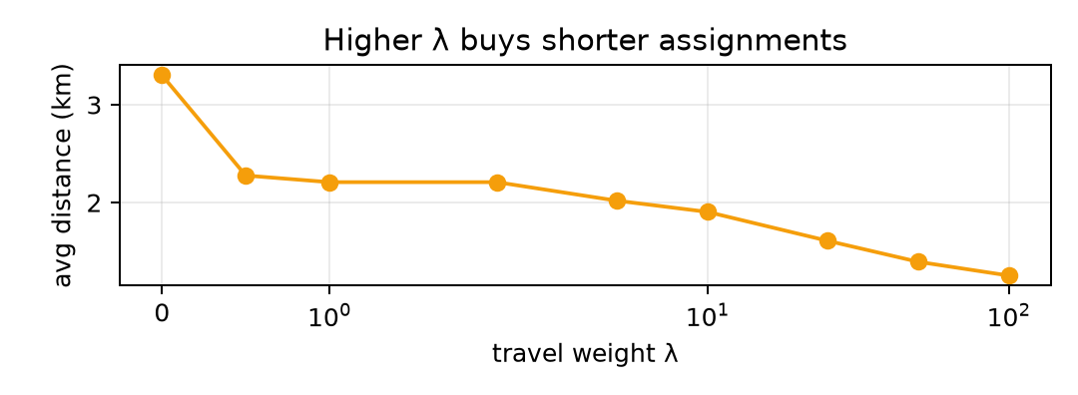
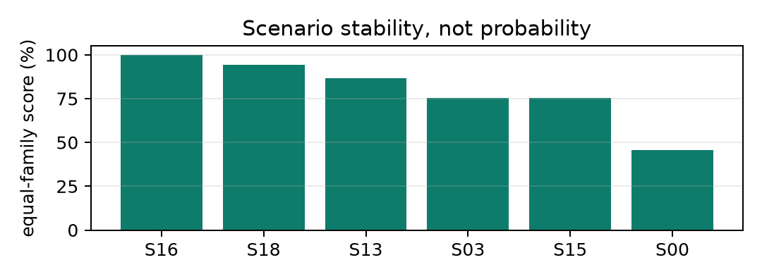
11 · SENSITIVITY — CAPACITY & ROBUSTNESS
Capacity is the assumption the answer turns on
Halving capacity moves the plan from 6 sites to 13; the arithmetic bound is only 12.
RISKIEST ASSUMPTION
Halving capacity:
6/$589k → 13/$1.314M
Capacity-only lower bound:
12 sites at 0.5×; optimum needs 13
Capacity drives the count —
geography can force extra sites.
λ · TRAVEL WEIGHT
SCENARIO STABILITY
Weighted objective is separate
Equal-weight score across
λ trades capex for shorter
budget, radius and capacity;
assignments; not the baseline.
diagnostic, not probability.
EV Charging Siting · Optimization Methods
11 / 14
Notes:
Capacity is the assumption that changes our answer the most. Capacity means the maximum amount of model demand that one station can serve. In the baseline, garage candidates have four thousand units and filling station candidates have two thousand two hundred units. With those assumptions, six sites are enough. If every capacity is cut in half, the model needs thirteen sites and the assumed cost rises to $1.314 million. A simple total capacity calculation suggests that twelve sites might be enough, but geography and the service radius force one additional site. This is why capacity is more than a total arithmetic question. Demand must be served by sites that are close enough and still have available capacity. Since our capacity values are synthetic, the six site recommendation should remain provisional until charger throughput and grid capacity are measured.
[Sources]
Revised project notebook capacity analysis

Slide 12
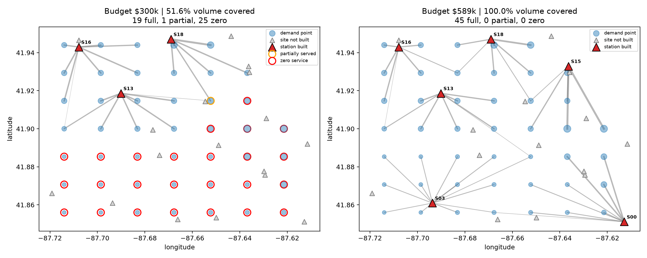
12 · SCENARIO ANALYSIS
What $334k of extra spend actually buys
At $300k the model builds 3 sites: 19 of 45 cells are full, 1 partial, and 25 zero-service;
the extra $334k of actual spend to reach $589k fully serves all 45 model cells.
Red = zero service; orange = partial. Reported coverage is demand volume, not a count of fully served cells.
EV Charging Siting · Optimization Methods
12 / 14
Notes:
This comparison makes the budget tradeoff more concrete. With a $300,000 available budget, the model builds three sites and actually spends $255,000. It serves about 51.6 percent of total demand volume. Nineteen of the forty five demand cells are fully served, one cell is partially served, and twenty five cells receive zero service. The red circles on the left identify zero service cells, while the orange circle identifies the partial cell. At the $589,000 knee, all forty five cells are fully served. The extra actual spending needed to move from the low budget plan to the full coverage plan is $334,000. Notice that coverage is measured by demand volume, not by counting cells. A large cell and a small cell do not contribute equally to the percentage.
[Sources]
Revised project notebook scenario comparison

Slide 13
13 · DEPLOYMENT — DECISION SUPPORT
recommend(budget): one call, transparent scope
Tries min_cost first — it never overspends — and falls back to
max_coverage only when full coverage is unaffordable.
BUDGET
MODE PICKED
OUTCOME
VERDICT
$300k
max_coverage
51.6% volume · $255k · 25 zero + 1 partial
Honest partial plan
$589k
min_cost
100% covered · $589k · $0 unused
Illustrative knee
$900k
min_cost
same 6 sites · $311k budget unused
Leave surplus unspent
Automatic fallback answers each budget consistently —
and always returns the data/assumption scope warning.
EV Charging Siting · Optimization Methods
13 / 14
Notes:
To make the analysis easier to use, we added a recommend function. The user enters an available budget. The function first tries the minimum cost full service problem. If the budget is sufficient, it returns the cheapest full coverage plan. If the budget is too low, it automatically switches to maximum coverage and returns the best partial plan. It also reports actual spending, unused budget, coverage, selected sites, and the data scope warning. At $300,000, it recommends the honest partial plan. At $589,000, it identifies the illustrative knee. At $900,000, it still selects the same six sites, spends $589,000, and leaves $311,000 unused. This is decision support rather than automatic approval. The planner still needs to validate all real world inputs before using the result.
[Sources]
Revised project notebook recommendation function

Slide 14
14 · CONCLUSIONS
Use the knee as a scenario; validate before commitment
1
THE KNEE
Current proxy: $589k for 6 sites at 100% model coverage;
above the knee, the cost tie-break leaves surplus unspent.
2
THE ROBUST CORE
S16 / S18 / S13 score 100% / 94% / 87% after equal weighting;
treat as provisional until grid, ownership and equity checks.
3
RISKIEST ASSUMPTION
Capacity gives a strong lower bound; geography can require
additional sites and determines which combination works.
KEY TRADE-OFF
LIMITATIONS / WHAT WE'D ADD
Real licensed geography plus ACS population proxy;
Road-network travel time + existing chargers
site costs, capacities and total EV demand remain
Utility/grid feasibility + ownership + equity
scenario assumptions rather than measured inputs.
Measured EV demand + charger-count and phasing decisions
EV Charging Siting · Optimization Methods
14 / 14
Notes:
I will close with three points. First, under the current proxy and assumptions, the minimum cost full coverage scenario is six sites and $589,000. Spending above that knee does not improve modeled coverage. Second, S16, S18, and S13 appear most consistently across the tested budget, radius, and capacity scenarios. That makes them sensible priorities for further investigation, not guaranteed winners. Third, capacity is our riskiest assumption. If real throughput is lower, both the site count and the cost can rise sharply. The model gives us a clear and reproducible way to compare scenarios, but it is still an early screening tool. Before any commitment, we would add road travel time, existing chargers, measured EV demand, grid feasibility, ownership, equity requirements, and explicit charger count decisions. Thank you, and we are happy to take questions.
[Sources]
Revised project notebook
United States Department of Energy Alternative Fuels Data Center

