Slide 1
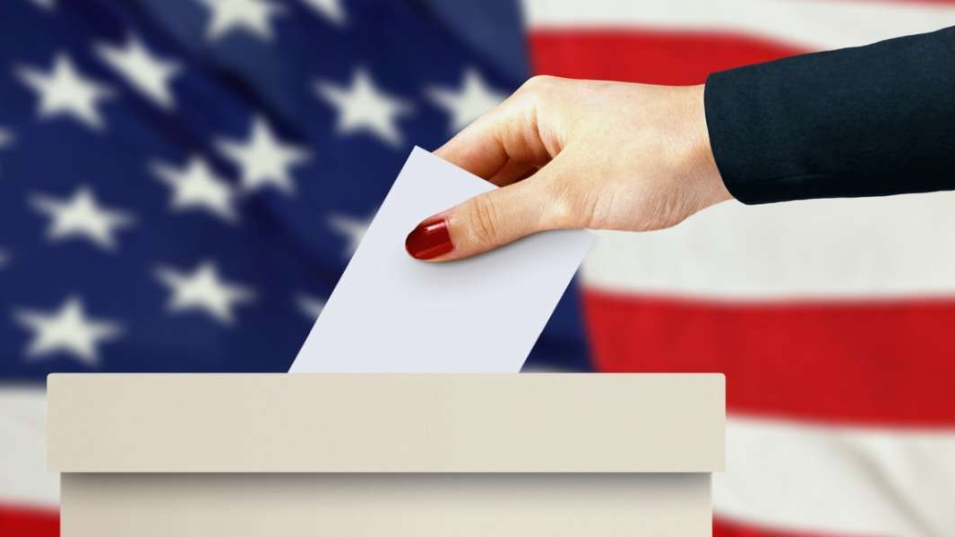
US Presidential Elections 2020
The Omicrons Team
Anonymous. (Date unknown). A voting poll with US flag [Image]. Source. https://www.infoplease.com/us/government/elections

Slide 2

Introduction
A Republican, Trump was a businessman and reality television personality from New York City at the time of his 2016 presidential election victory over Democratic nominee Hillary Clinton.
Joseph Robinette Biden Jr. is an American politician who served as the 47th vice president of the United States in the Obama administration from 2009 to 2017. A member of the Democratic Party, he served as United States Senator for Delaware from 1973 to 2009.
The winner of the 2020 presidential election is scheduled to be inaugurated on January 20, 2021.
BBC. (2020). [The Two Candidates]. [Image]. Source. https://www.bbc.com/news/election-us-2020-53785985

Slide 3
What we did with our data?

Slide 4
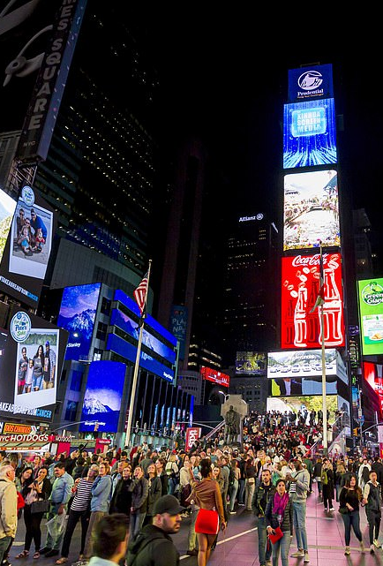
Demographics
Data analyzed: Total voting population, Gender participation, Race participation, Age Ranges participation.
For the ranges 25 to 44 and 45 to 64 years old, we’ll experience a growth in participation around 1%, while the ranges for 18 to 24 and 65 and over, an almost nil change will be perceived (growth and decrease are no larger than 1% respectively).
Change in participation for races include White, White non-Hispanic, Black, Asian and Pacific Islander and Hispanics.
Predicted change won’t be perceived in this section as no more than 1% would be realized, except for Hispanics.
Getty Images. [Times Square at night] [Photograph] Daily Mail UK. https://www.dailymail.co.uk/news/article-8120739/Times-Square-attracts-330k-visitors-day-lies-deserted-New-Yorks-coronavirus-lockdown.html

Slide 5
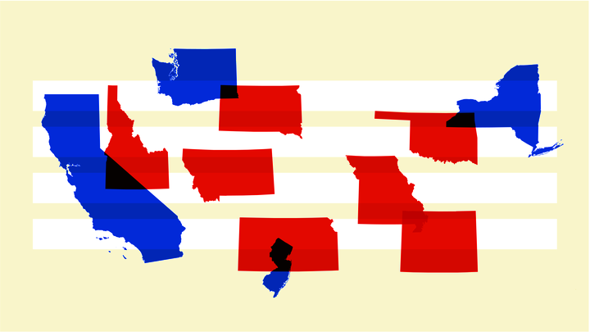
Voting Trends
We analyzed the historical average of votes per state for each of the parties, focusing on the six states with the most relevance in terms of electoral votes.
By sorting votes per state, applying a mean function, and building a bar graph, results showed the following preferences for each state.
- California (55) = Democrat
- Texas (38) = Republican
- New York (29) = Democrat
- Florida (29) = Democrat
- Illinois (20) = Democrat
- Pennsylvania (20) = Democrat
YUSKIKI . (2020). States. [Image]. The Atlantic. https://www.theatlantic.com/politics/archive/2020/03/how-republicans-and-democrats-think-about-coronavirus/608395/

Slide 6
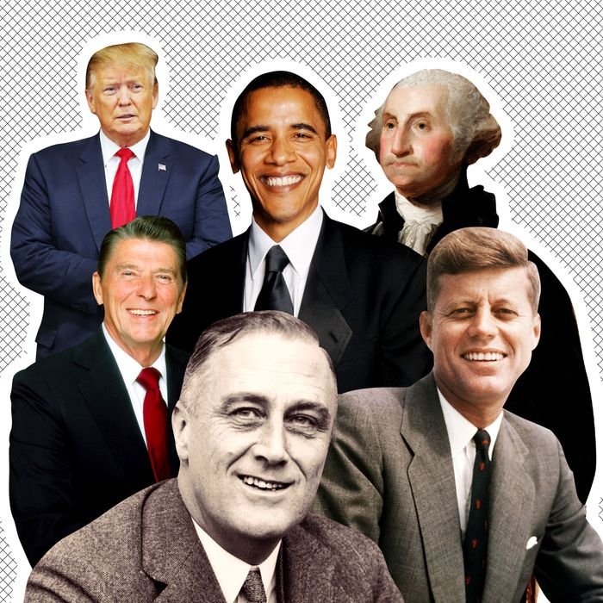
Historical Data
When we looked at the historical data for the last 11 years (1976-2016), we can tell the level of participation thru the course of the last years has been increased.
Based only on the vote count in which Republican party has won 5 out of the 11 US elections, leaving 6 to Democrats.
We observed the volume of votes does not always tell the winner of the election; it will depend on which state those votes were registered. This has a strong relationship with the US Electoral college system where each state gets a certain number of electors.
Getty Images . (2020). Wife Guys?. [Image]. The Cut. https://www.thecut.com/2019/06/u-s-president-wife-guys.html

Slide 7
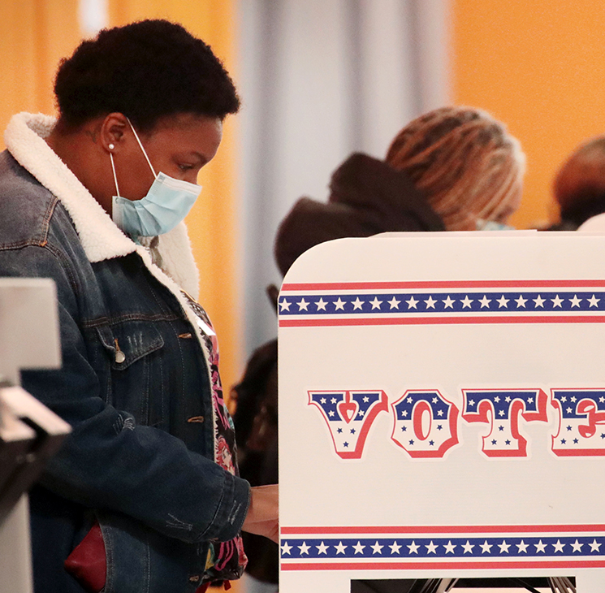
Polls
We can perceive significant changes in public preferences over the months preceding the election.
When we compare the polls with the election result, we realize that these are not a determinant, due to the American election system
2020 shows the biggest separation between candidates (almost 10 points) in the last 20 years (Presidential Elections since 2000).
Scott Olson. (2020). Residents vote at a polling place on Oct. 20, 2020. [Photograph]. Pew Research Center. https://www.pewresearch.org/fact-tank/2020/10/29/what-we-can-trust-2020-election-polls-to-tell-us/

Slide 8
Our Graphics
Screenshots and Output files

Slide 9
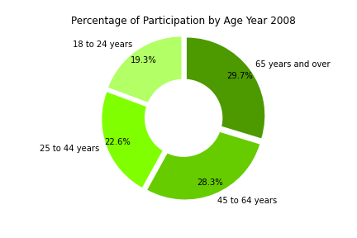
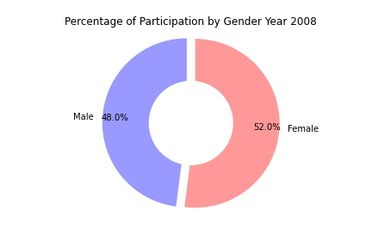
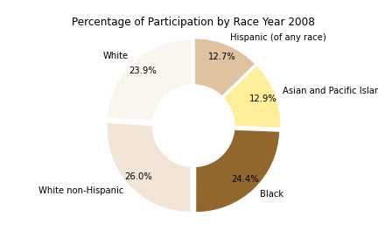
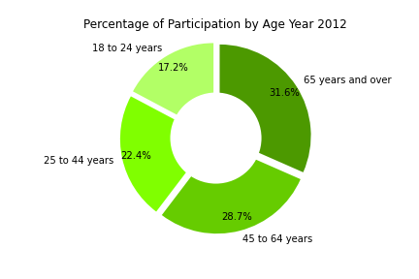

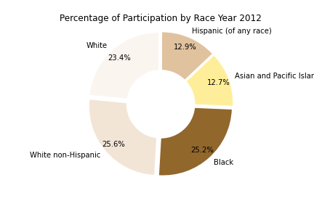
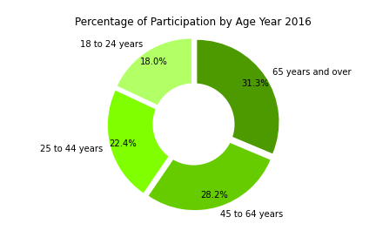


Demographics

Slide 10
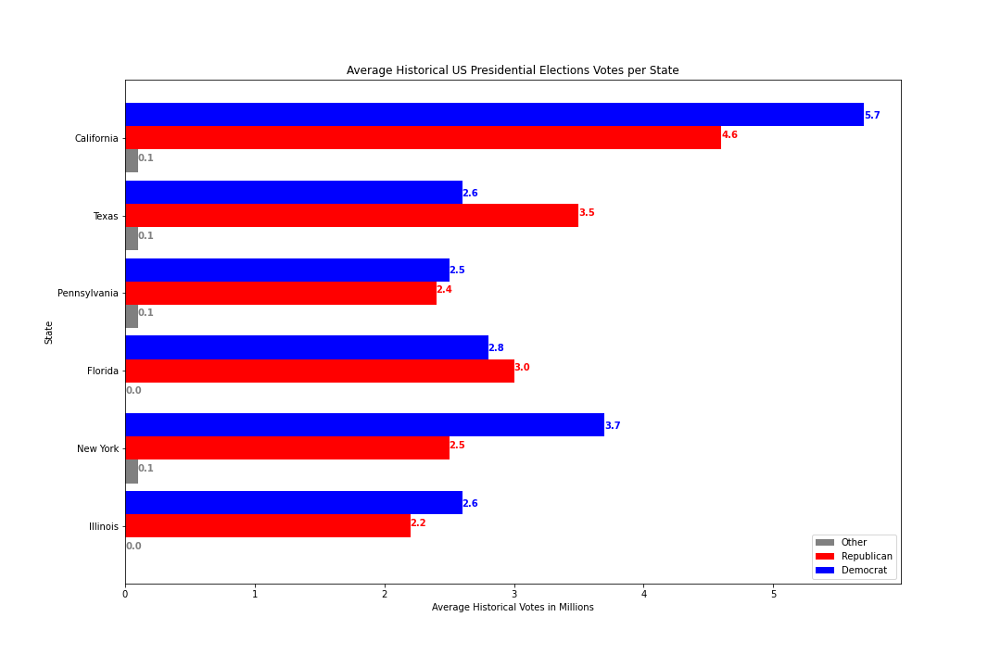
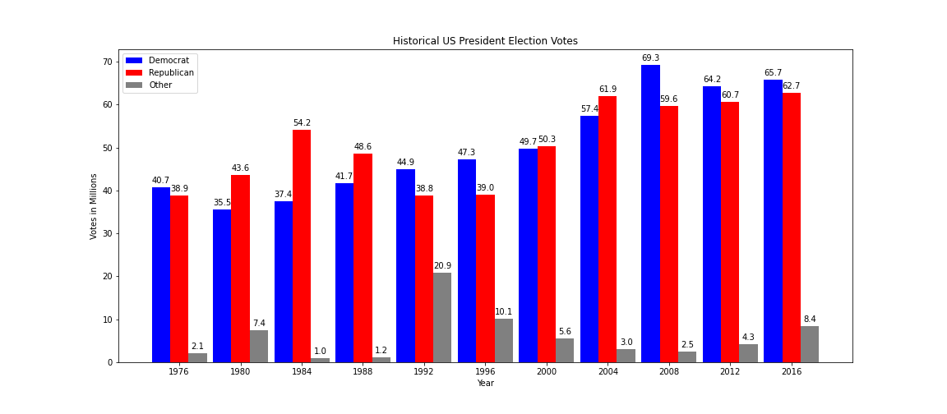
Voting Trends

Slide 11
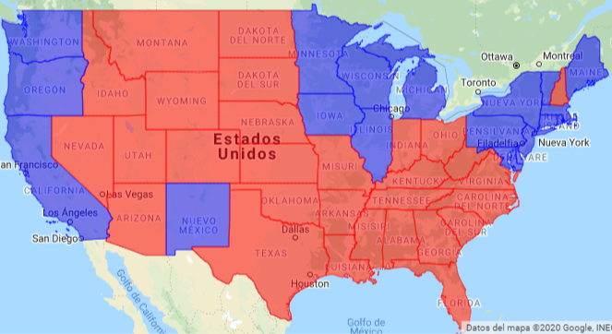


Historical Data

Slide 12
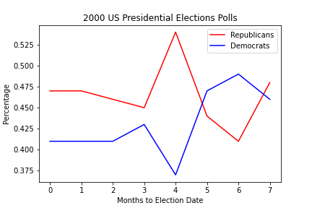
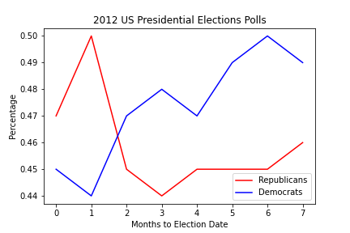
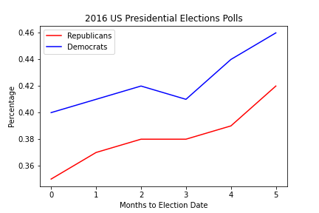
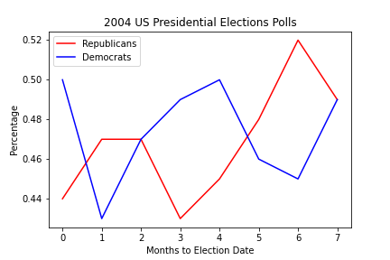
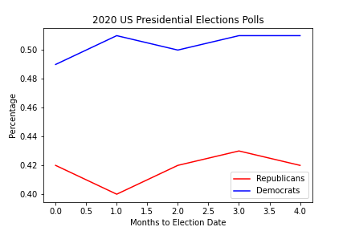
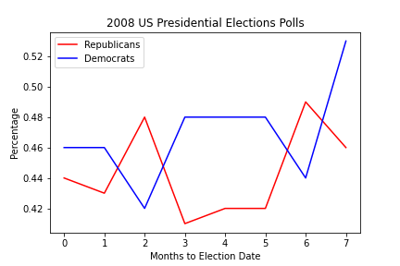
Polls

Slide 13

Our Code

Slide 14
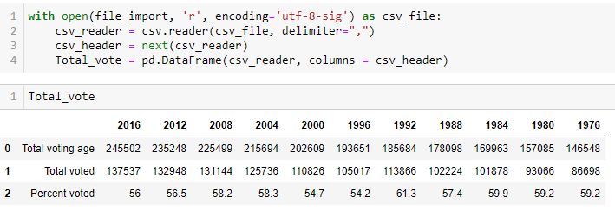

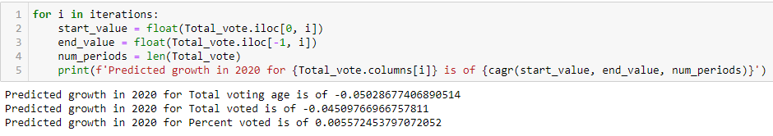
Demographics

Slide 15
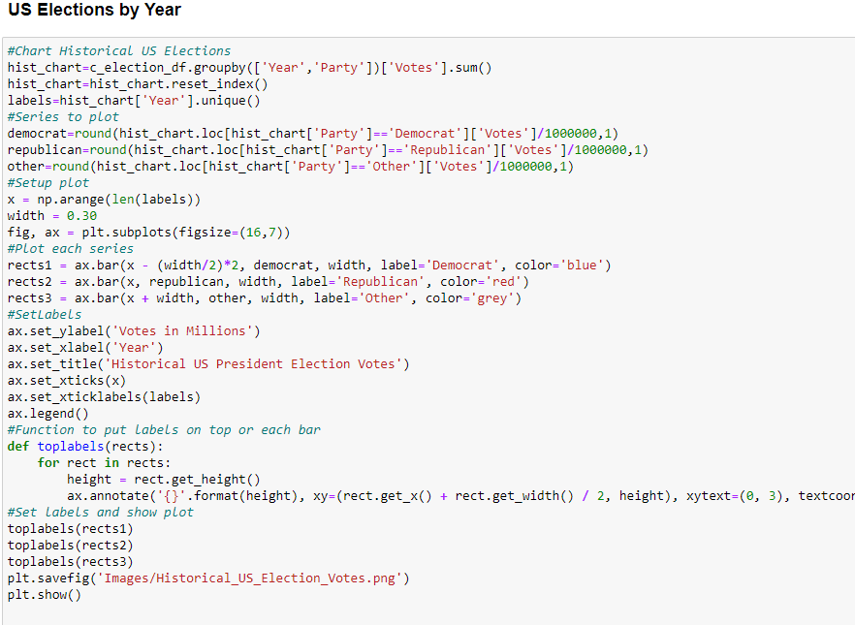
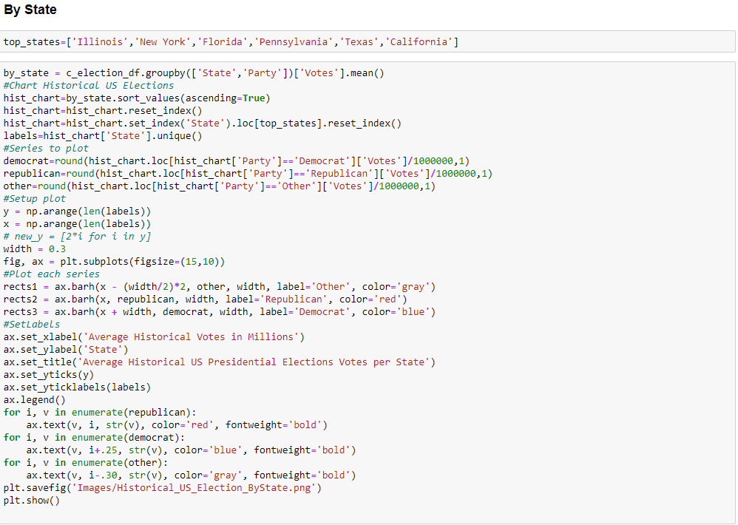
Voting Trends

Slide 16
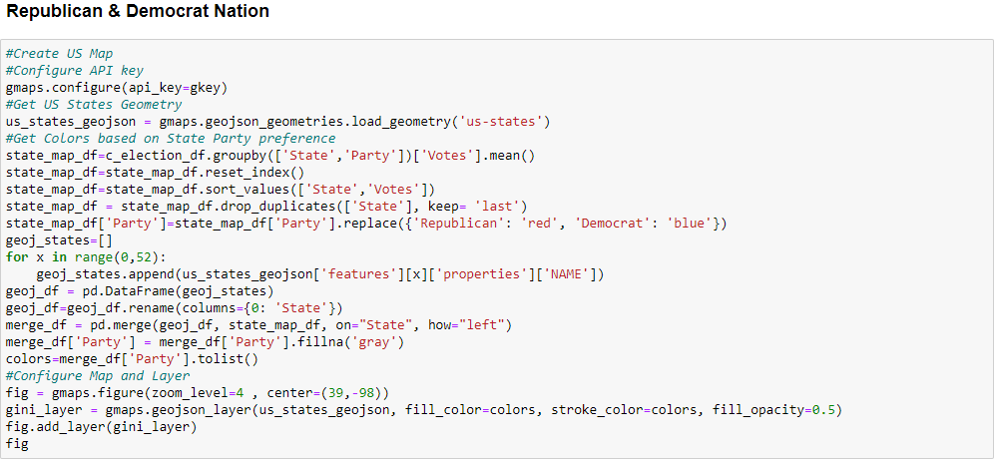
Historical Data

Slide 17
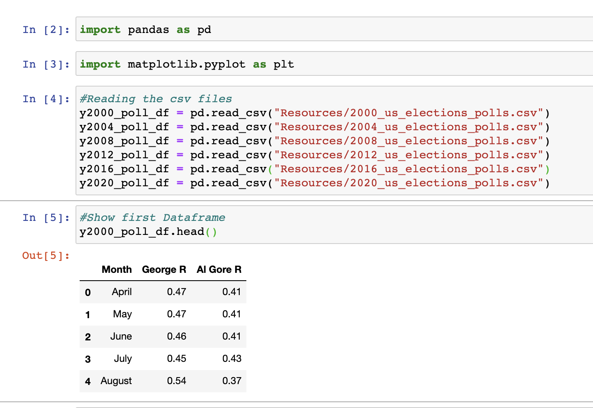
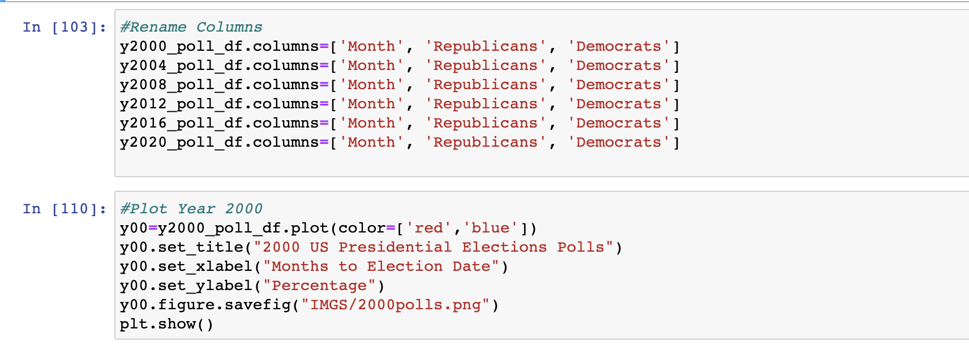
Polls

Slide 18
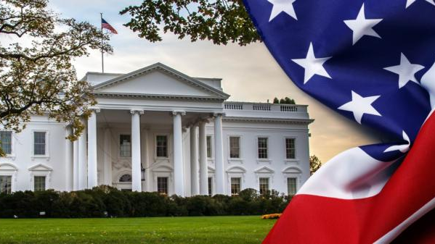
Thank you for your attention
Anonymous. (2020). [The White House] [Photograph]. America CGTN. https://america.cgtn.com/2020/09/19/the-heat-race-for-the-white-house-4

