Slide 1
E-Cart: Full Stack E-Commerce Application
Developed using Angular, Spring Boot, and MySQL
College Project Presentation

Slide 2
Abstract
E-Cart is a full-stack e-commerce application developed using Angular for frontend, Spring Boot for backend, and MySQL for database management. The system aims to provide a smooth shopping experience with efficient product handling, user authentication, and secure order processing.

Slide 3
Existing System
• Existing systems lack modular architecture and real-time synchronization.
• Manual systems are inefficient and time-consuming.
• Traditional systems have limited scalability and poor UI.
• Integration between frontend and backend is often weak.

Slide 4
Proposed System
• The proposed system ensures a fully integrated e-commerce platform.
• Angular manages UI while Spring Boot handles business logic and API integration.
• MySQL is used for storing users, products, and order data securely.
• Provides real-time updates, responsive design, and easy product management.

Slide 5
Advantages
• Easy to use and responsive user interface
• Modular and scalable design
• Efficient data management
• High performance backend APIs
• Secure login and data handling
• Smooth communication between client and server

Slide 6
Disadvantages
• Internet connection is mandatory
• Slightly complex setup for beginners
• Limited admin features in current version
• No integrated payment gateway yet

Slide 7
Hardware Requirements
• Processor: Intel i3 or higher
• RAM: Minimum 4GB
• Hard Disk: 500GB or more
• Display: 1024x768 or higher
• Internet: Required for data communication

Slide 8
Software Requirements
• OS: Windows / Linux / macOS
• Frontend: Angular
• Backend: Spring Boot
• Database: MySQL
• IDE: VS Code, IntelliJ IDEA or Eclipse
• Tools: Maven, Node.js, npm
• Browser: Chrome / Edge

Slide 9
Modules
1. User Authentication
2. Product Management
3. Cart Management
4. Order Processing
5. Checkout
6. Admin Panel

Slide 10
Module Description
1.User Authentication: Manages login and signup functionalities.
2. Product Management: Displays and maintains product details.
3. Cart Management: Handles adding/removing products from cart.
4. Order Processing: Confirms and processes orders.
5. Checkout: Calculates total and confirms user orders.
6. Admin Panel: Manages inventory, users, and transactions.

Slide 11
Sample Output
• Homepage with products list
• Product detail view
• Cart view
• Checkout confirmation page

Slide 12
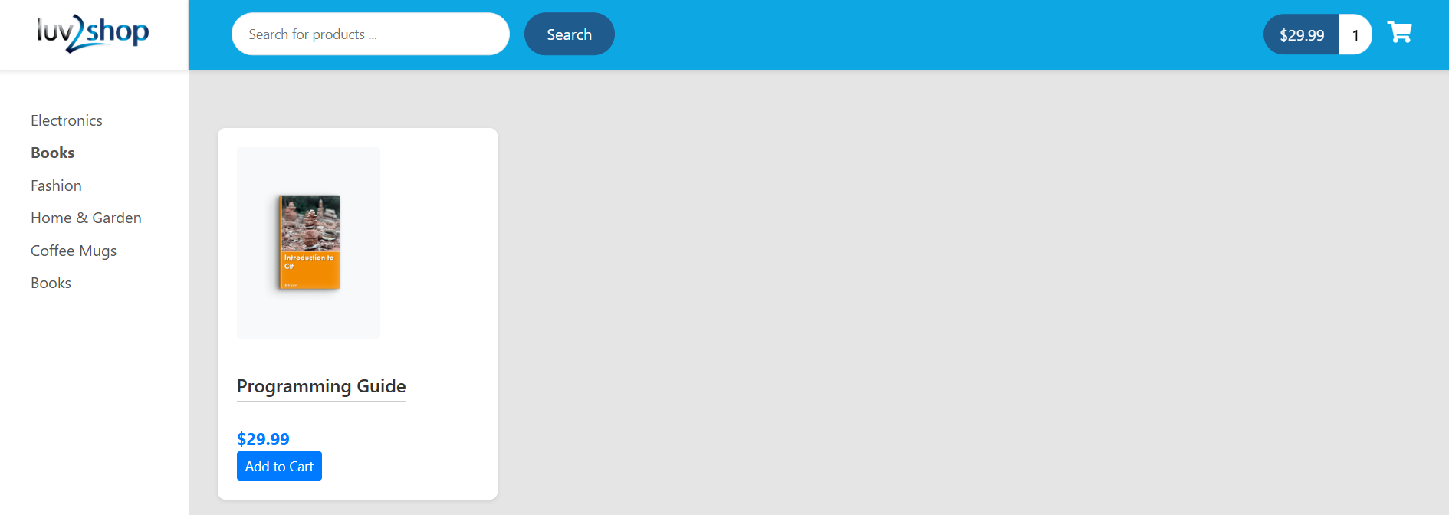
Sample Output (Screenshot)

Slide 13
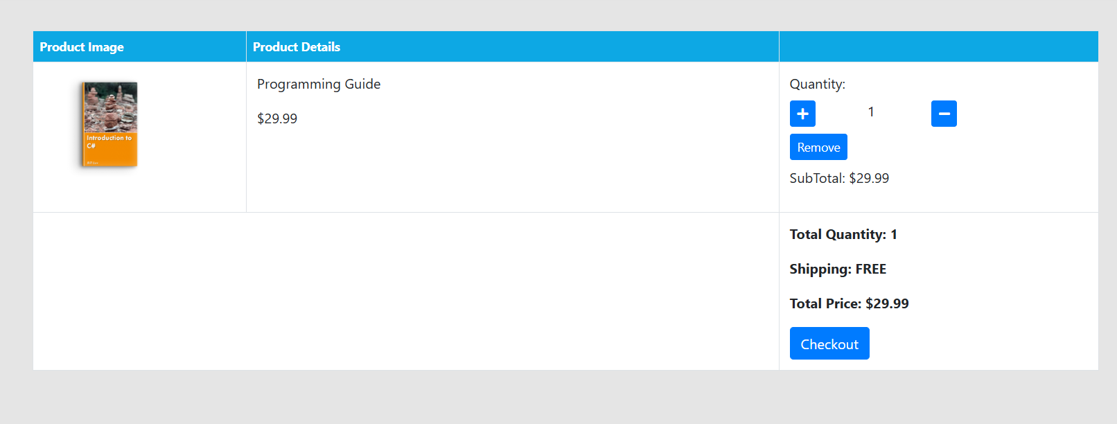
Sample Output (Screenshot)

Slide 14
Conclusion
E-Cart integrates modern technologies to deliver a reliable and responsive e-commerce experience. The project successfully demonstrates the collaboration of Angular and Spring Boot for full-stack development. With further enhancements like payment integration and admin analytics, it can be extended to a production-level system.

