Slide 1
E-Cart: Full Stack E-Commerce Application
Developed using Angular, Spring Boot, and MySQL
College Project Presentation

Slide 2
Introduction
E-Cart is a full-stack e-commerce web application designed to provide a seamless online shopping experience. It integrates Angular for the frontend, Spring Boot for the backend, and MySQL as the database to handle user data, products, and orders efficiently.

Slide 3
Objectives
- Build a scalable and maintainable full-stack e-commerce platform
- Implement secure user authentication and product management
- Enable smooth interaction between frontend and backend
- Provide an intuitive and responsive user interface

Slide 4
System Architecture
The architecture follows a client-server model:
• Frontend (Angular) – Manages user interface and API communication
• Backend (Spring Boot) – Handles business logic and data processing
• Database (MySQL) – Stores user, product, and order details

Slide 5
Technology Stack
Frontend: Angular
Backend: Spring Boot
Database: MySQL
Languages: TypeScript, Java, SQL
Tools: VS Code, IntelliJ IDEA, Postman, MySQL Workbench

Slide 6
Frontend Modules
- Product Listing
- Product Details
- Cart Management
- Checkout
- User Authentication (Login/Signup)
- Order Tracking

Slide 7
Backend Modules
- User Authentication & Authorization (Spring Security)
- Product Management (CRUD APIs)
- Order Processing
- Cart API
- Database Integration with JPA & Hibernate
- RESTful API Development

Slide 8
Database Overview
The MySQL database includes key tables:
• USERS – stores user login details
• PRODUCTS – stores product catalog
• ORDERS – records customer orders
• CART – temporary shopping cart data
SQL scripts for creating these tables are stored in /sql-resources

Slide 9
Integration Workflow
1. Angular frontend sends HTTP requests to Spring Boot APIs
2. Spring Boot processes business logic and communicates with MySQL
3. Data is returned in JSON format
4. Angular displays data dynamically using components and services
This enables real-time data flow between client and server.

Slide 10
Output Screenshots
• Homepage Display
• Product Details Page
• Cart Summary
• Checkout Page
• Order Confirmation

Slide 11
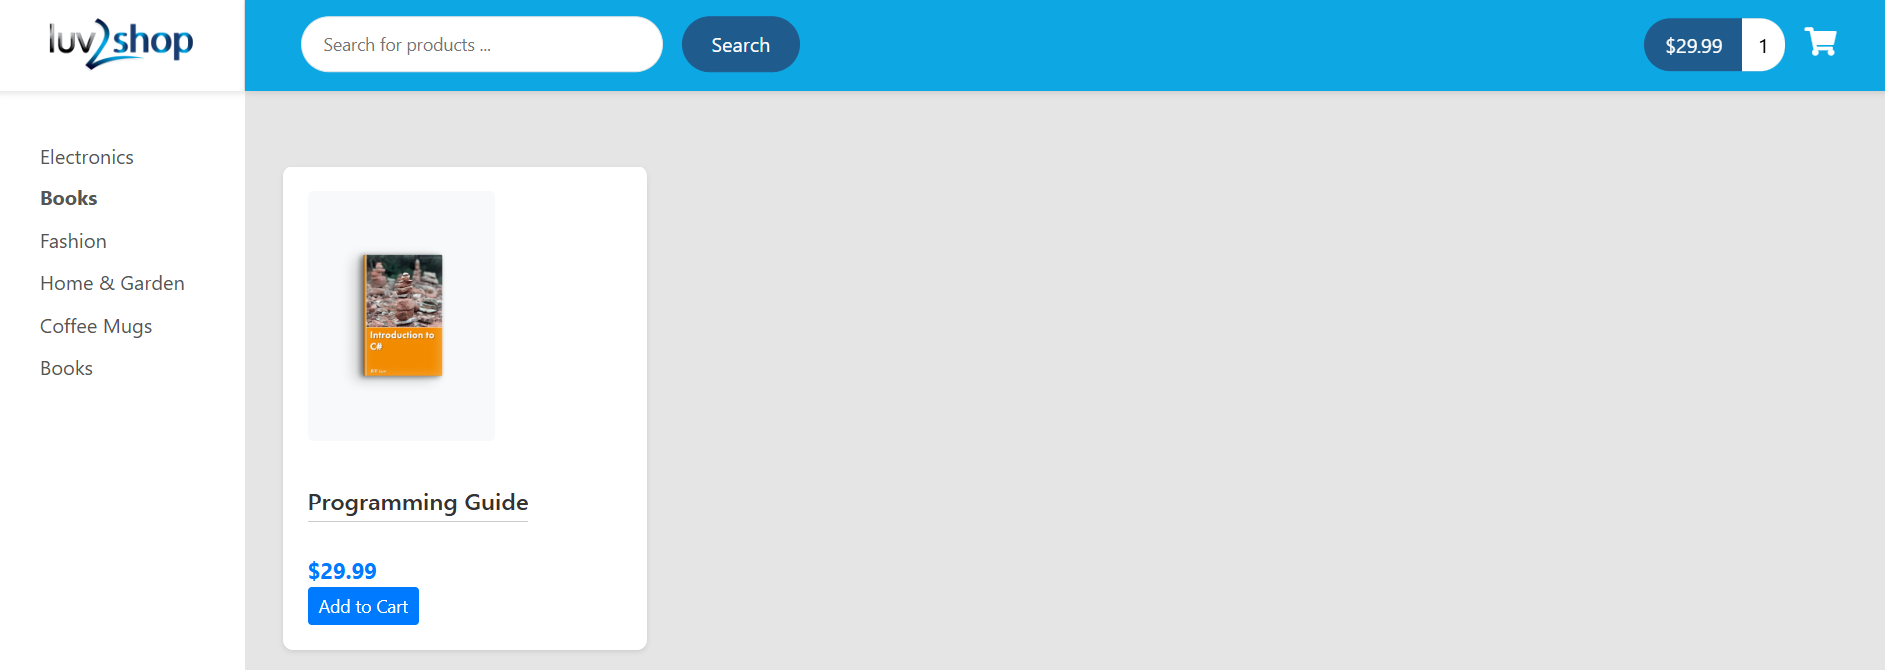
Output Screenshots

Slide 12
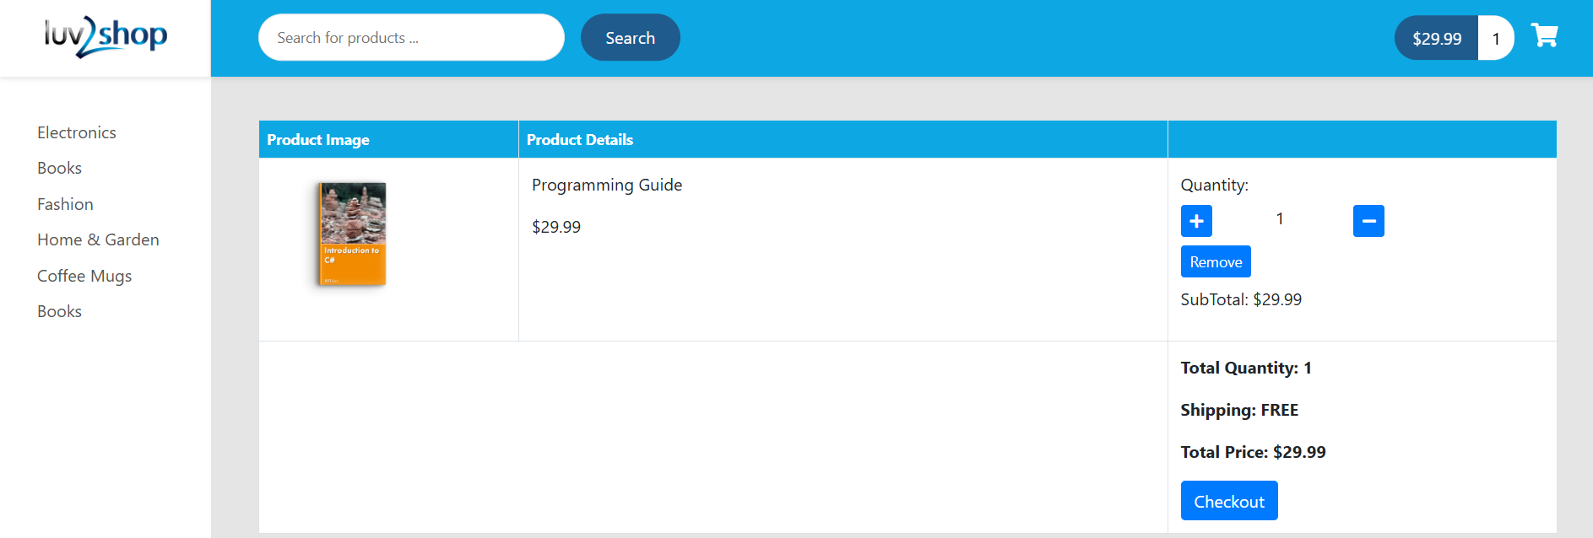
Output Screenshots

Slide 13
Future Scope
- Integration of Payment Gateway (Razorpay / Stripe)
- Admin Dashboard for Analytics
- Product Recommendation System using AI
- Mobile App Integration
- Multi-language Support

Slide 14
Conclusion
E-Cart provides a comprehensive e-commerce experience combining modern technologies. It demonstrates the integration of Angular and Spring Boot for building scalable, full-stack applications. Future improvements can further enhance user experience and business scalability.

