Slide 1

Phedito
Image Editor
BY :-
Ritesh Kumar (2015UCP1727)
Shubham Chourey (2015UCP1481)
Mohammad Aamir (2015UCP1541)
Batch : A(3,4)

Slide 2
Introduction
The project aims at developing a image editor using java image API.
Image editor is a small application which lets the user to manipulate digital images using tools such as brightness, zoom, rotation, lasso etc.
Efficient GUI has been provided which let the user to access this tools. Editor manipulates the image in arrays of pixels. These pixels contain the image colour and brightness information.
The pixels can be changed as a group, or individually, by the algorithms within the image editors and image filters.

Slide 3
Features
Features contained in the Image Editor :
Undo
Redo
Pencil
Eraser
Brightness
Rotate
Flip
Crop
Blur
Free Hand Lasso
Add Text
Resize

Slide 4
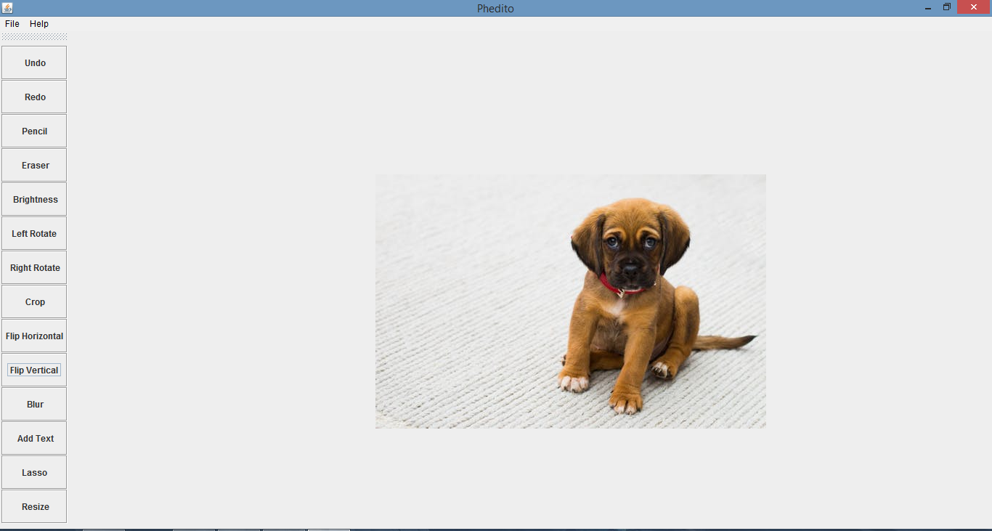

Slide 5
Detailed Description

Slide 6
UNDO & REDO
These are implemented using an array of BufferedImage.
Whenever a change is made to image, a copy of the transformed image is saved in the next index of array.
When Undo is clicked the image at the previous index is loaded.
When Redo is clicked the image at the next index is loaded.

Slide 7
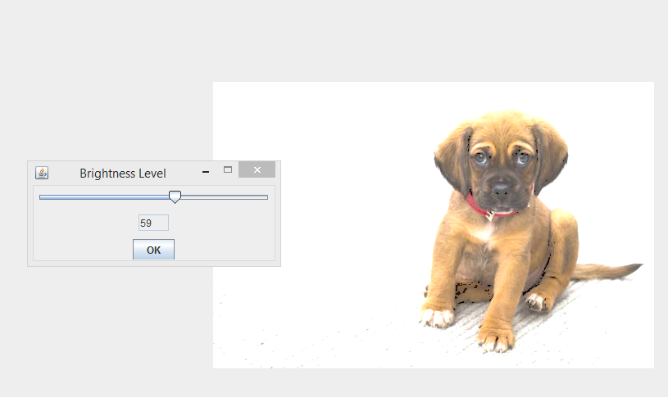
BRIGHTNESS
By altering the RGB values of each pixel of the image, its brightness is altered.
User can select the level of brightness using slider.

Slide 8
PENCIL & ERASER
It allows free hand drawing on the image and eraser is used to erase any part of the image.
As the mouse is dragged on the image, MouseMotionListener is used to get coordinates of successive points and a line is drawn between every two points.
User can select pencil size and the colour of drawing.
For eraser the colour of drawing is fixed to white.

Slide 9
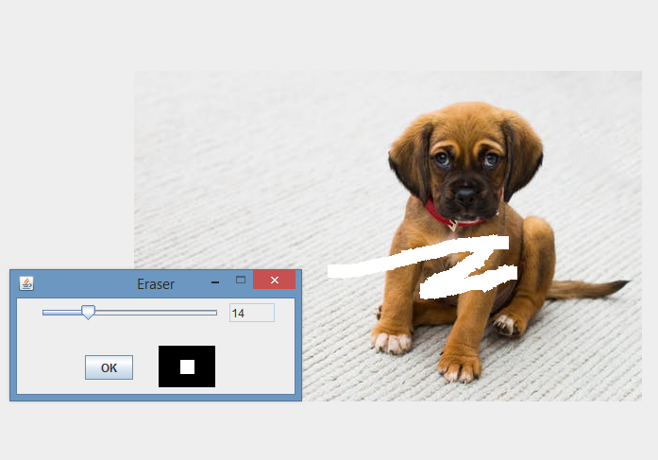
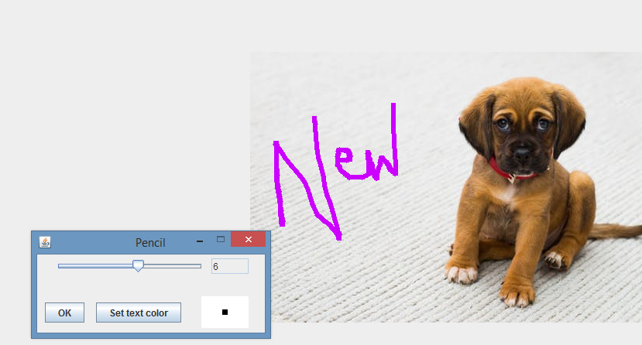

Slide 10
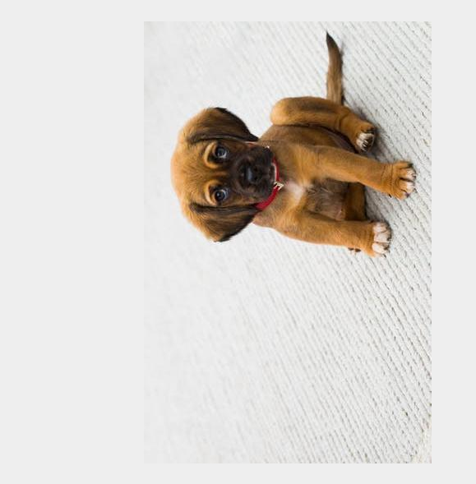
ROTATE
First the pixel matrix of image is computed.
For left rotation transpose of the matrix is taken followed by inversing the columns.
For right rotation just transpose of the pixel matrix is needed.

Slide 11
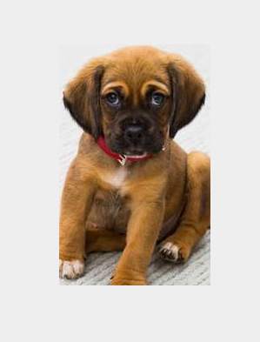
CROP
User draws the rectangular area which is needed to be cropped from image.
MouseMotionListener is used to get the coordinates of the upper left and bottom right corners of the rectangle.
These coordinates are passed to the method getsubimage() to get the desired part of the image.

Slide 12
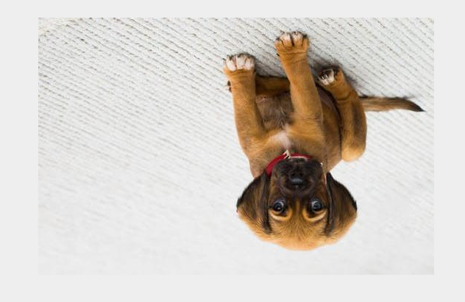
FLIP
The pixel matrix is computed.
For horizontal flip the first half pixels of each row are swapped with the respective pixels of the other half.
Similarly for vertical flip the first half pixels of each column are swapped with the respective pixels of the other half.

Slide 13
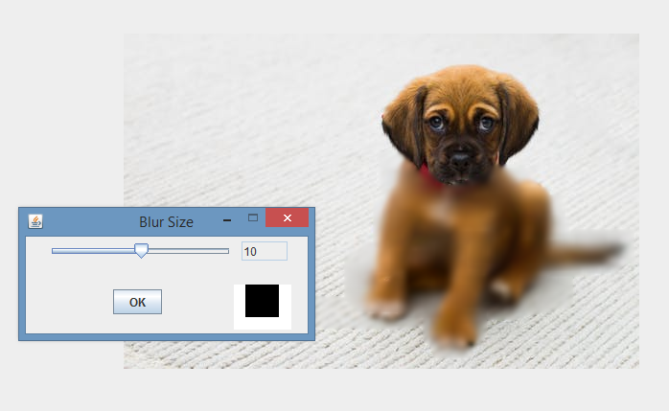
BLUR
Blurring need a rectangular array of numbers called, the convolution kernel.
For every pixel in the image, we take the corresponding numbers from the kernel and the pixels they are over, multiply them together and add all the results together to make the new pixel.

Slide 14
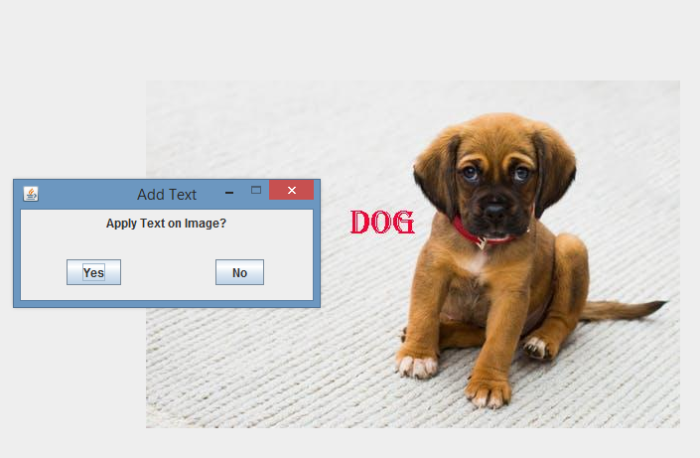
ADD TEXT
User can choose font style, size of text and colour and can add the text on any point of the image
The coordinates are obtained using MouseMotionListener.
The text is drawn using the method drawstring().

Slide 15
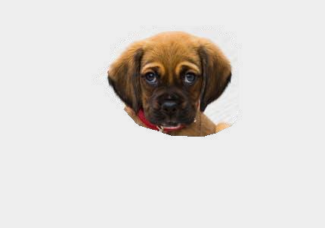
LASSO
The editor provides free hand lasso tool
As the mouse is dragged the boundary points are stored in an array.
Then the scanline polygon filling algorithm is used to draw the selected portion of the image.

Slide 16
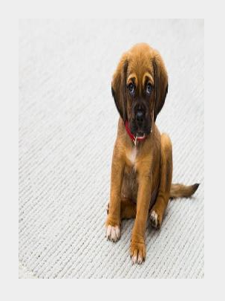
RESIZE
The user inputs the new height and width of the image
Then the original image is redrawn with entered height and width.
The image is compressed accordingly.

Slide 17


