Slide 1
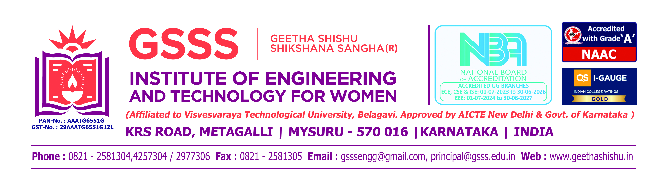


DEPARTMENT OF INFORMATION SCIENCE AND ENGINEERING
Project_Phase-1 (BIS685) Presentation
Title: AI-Based Early Alzheimer's Detection and Cognitive Assistance using Deep Learning
Presented by:
Bhavyashree R K [4GW23IS004]
Fouziya Safura [4GW23IS011]
Srinidhi S [4GW23IS052]
Ananya S [4GW24IS400]
Under the Guidance of
Dr. Anand M
Associate Professor
Department of Information Science and Engineering
GSSSIETW, Mysuru

Slide 2
CONTENTS
Title of the Project
2. Introduction
3. Aim & Objectives
4. Justification of the project
5. Related Work (Literature Review)
6. System Requirements:
a. Hardware Requirements
b. Software Requirements
7. Proposed Method
8. Expected outcomes of the project
9. References

Slide 3
INTRODUCTION
Alzheimer’s disease is a progressive neurological disorder that affects memory, thinking ability, and behavior.
It is one of the most common causes of dementia and mainly affects older adults.
In many cases, the disease is diagnosed only after symptoms become severe, making treatment less effective.
Apart from diagnosis, Alzheimer’s patients also require daily support because they may forget medicines, appointments, or even the identity of family members.
To solve these problems, this project proposes a system that combines:
1. Deep learning for early detection
2. GPS tracking for safety
3. Face recognition for identity support
4. Games for cognitive improvement
5. Doctor dashboard for monitoring

Slide 4
AIM AND OBJECTIVES
To design and develop an AI-based system for early detection of Alzheimer’s disease using deep learning and to provide cognitive assistance to patients through a smart application.
To develop a deep learning model to analyze MRI / CT scan images and detect
Alzheimer’s disease at early stages.
2. To build a mobile application that provides daily reminders for medicines, appointments, and tasks.
3. To design cognitive training exercises such as memory games, pattern recognition, and word recall to improve brain activity.
4. To implement face recognition so that patients can identify family members and friends.
5. To provide GPS-based location tracking to ensure patient safety and send alerts to caregivers.
6. To create a doctor dashboard that shows patient reports, scan results, and activity progress.

Slide 5
JUSTIFICATION OF THE PROJECT
Alzheimer’s disease is increasing rapidly due to aging population and lifestyle changes.
Many patients are diagnosed only after significant memory loss has occurred, which makes treatment difficult.
Traditional diagnosis methods require expert doctors and manual analysis of brain scans, which may take time and may not always detect early symptoms.
Deep learning techniques such as CNN have shown high accuracy in medical image classification, making them suitable for Alzheimer’s detection.
Mobile applications can provide reminders, exercises, and alerts, which help patients live more safely and independently.
Therefore, this project is justified because it combines Artificial Intelligence, Mobile Technology, and Healthcare Support to create a practical solution for Alzheimer’s patients.
This system can reduce risk, improve patient safety, and support doctors and caregivers in better decision making.

Slide 6
LITERATURE REVIEW

Slide 7
SYSTEM REQUIREMENTS
HARDWARE REQUIREMENTS
Processor: Intel i3 / Ryzen 5 or higher
Processor Speed: 1.2 GHz+
RAM: Minimum of 8GB or higher
Hard disk space: 500GB
SOFTWARE REQUIREMENTS
Operating System: Windows 10 or higher
IDE: Visual Studio Code, Android Studio(for mobile app)
Deep Learning Frameworks: scikit-learn, TensorFlow, Keras
Programming Language: Python
Libraries: OpenCV (image processing), NumPy, Pandas
Database: MySQL
Data Visualization Tool: matplotlib (for displaying dashboards)

Slide 8
PROPOSED METHOD

Slide 9
EXPECTED OUTCOMES
Accurate early detection of Alzheimer’s disease through deep learning-based MRI/CT scan analysis.
Enhanced cognitive engagement using structured memory, pattern recognition, and word-recall exercises.
Face recognition system that enables patients to identify family members and caregivers.
GPS-enabled location tracking for patient safety with alert notifications to caregivers.
Mobile application that supports patients with timely reminders for medicines, appointments, and daily tasks.
Comprehensive doctor dashboard for monitoring patient reports, scan results, and overall progress.

Slide 10
REFERENCES

