Slide 1


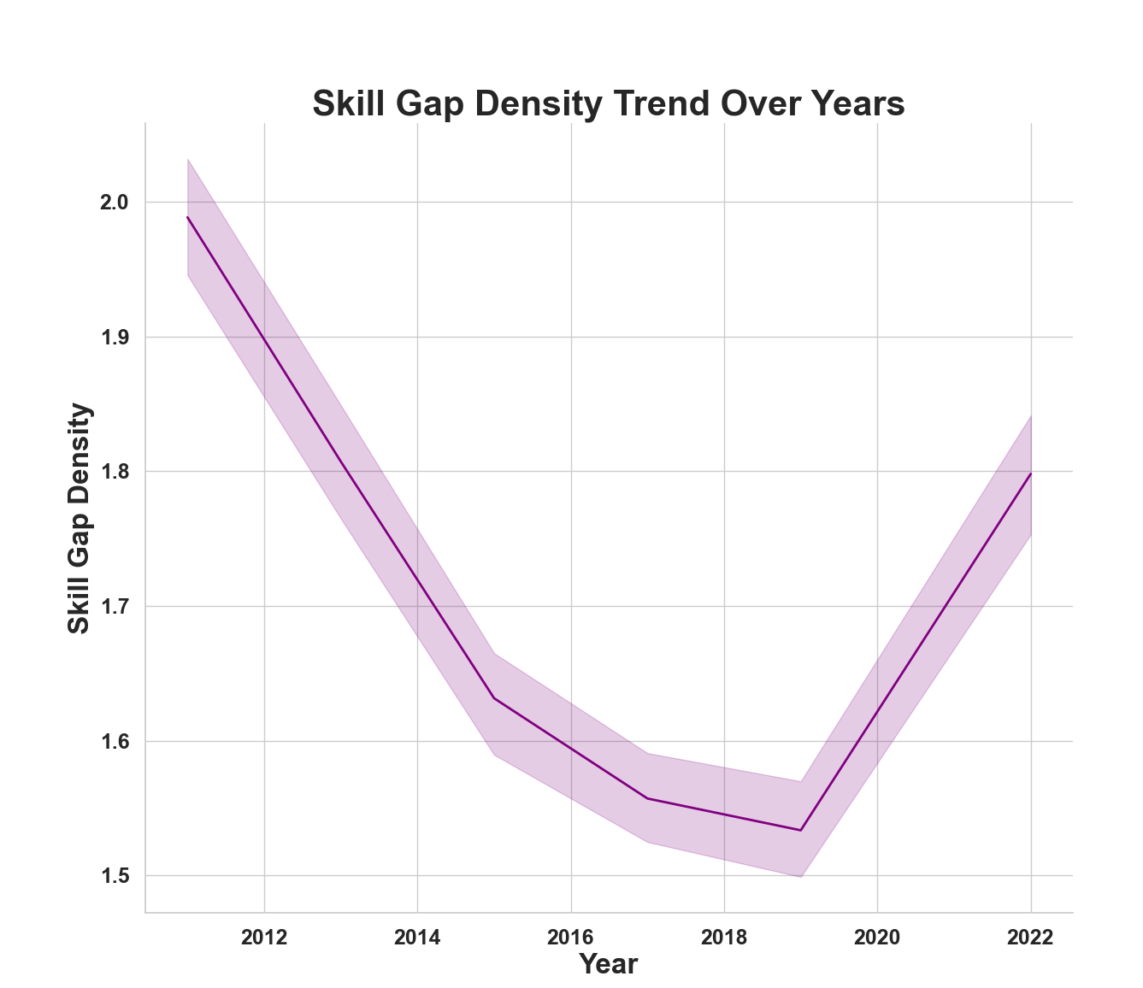
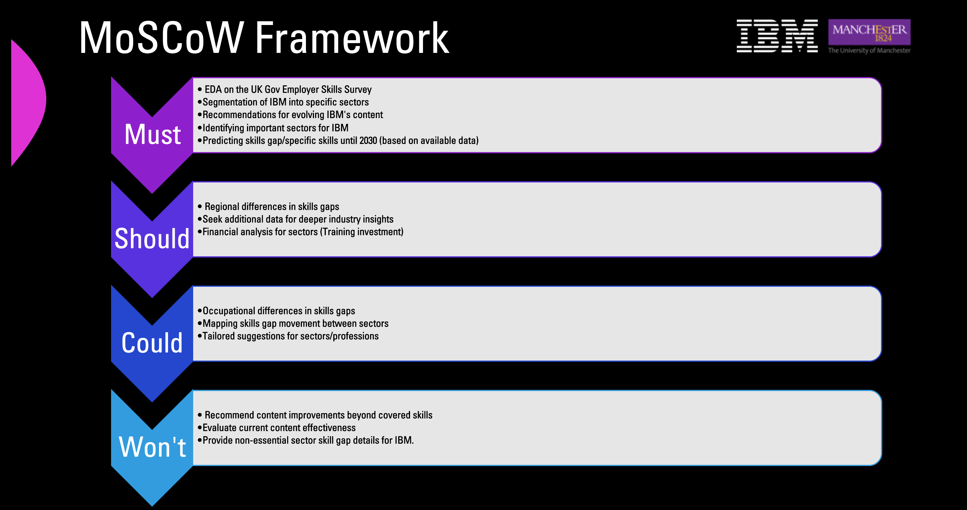
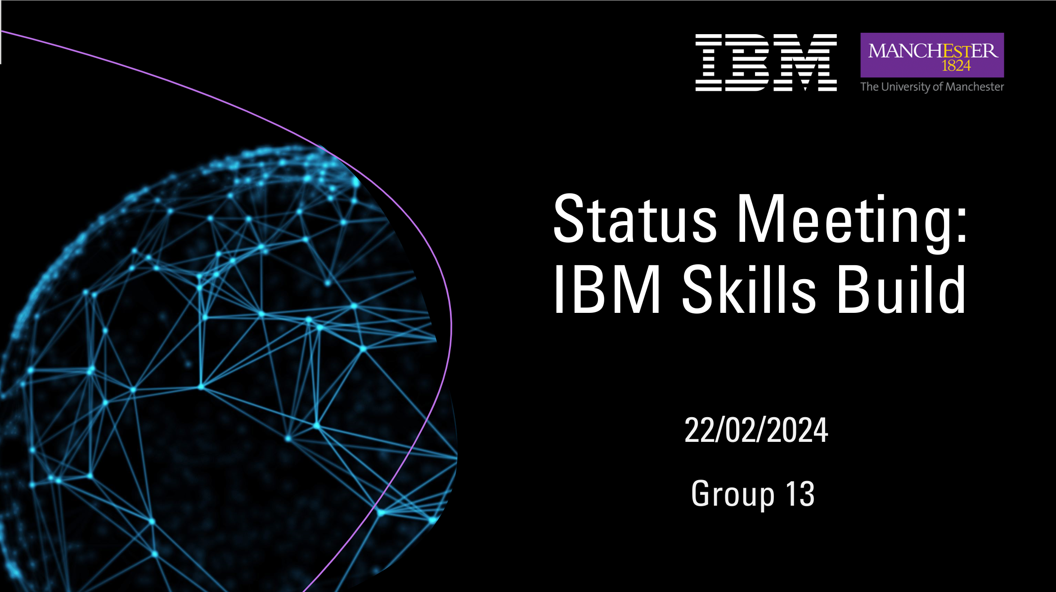
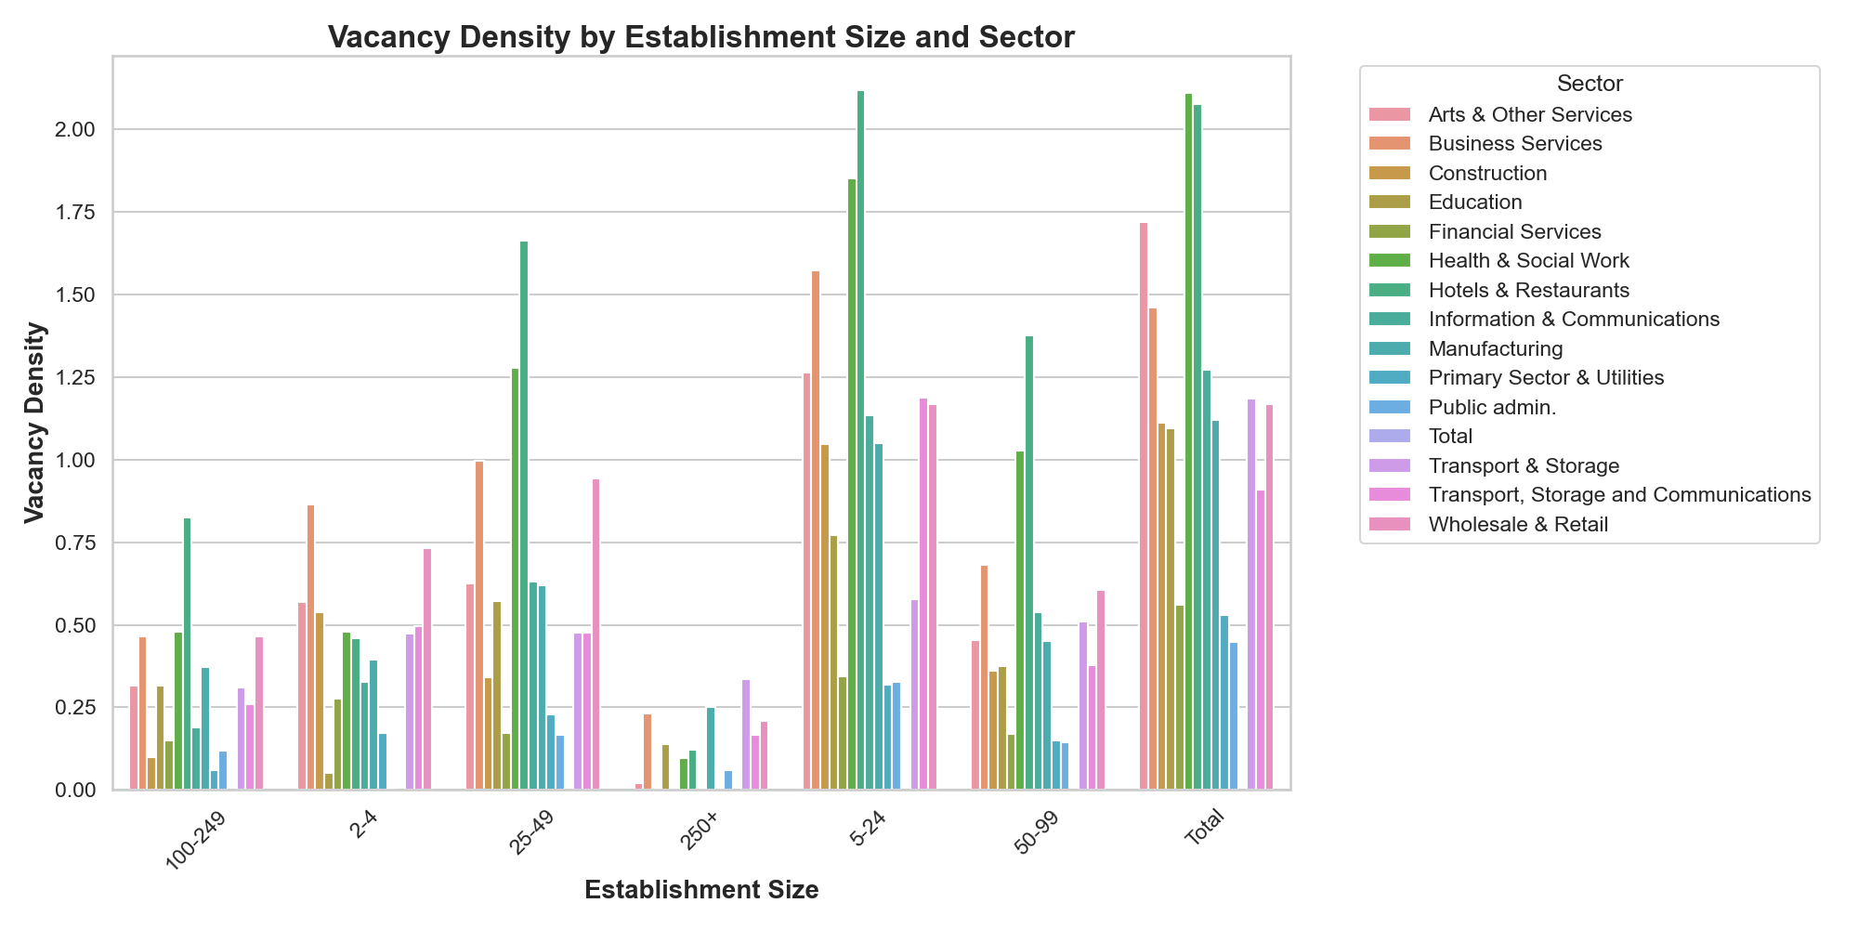

IBM Skills Build
Applying Data Science Project P13
Tomas Garcia, Iqra Ali, Maria Teneva, Zhihui Wang, Radoslaw Izak
Course Unit Leader: Dr Nuno Pinto
Industry Mentor: John McNamara
Academic Mentor: Dr Simon Rudkin
Aims and Objectives
First Analysis of Data
Engagement Client
Become familiar with the IBM Skills Build offering – and segment the content into specific skills.
Analyse the data contained in the Employer Skills Survey – UK Gov.
Identify current shortfalls in needed specific skills.
Predict the trend of increased skills gap (specific skills).
Total skills gap density decreasing from 2011-2019, increasing trend since 2019​.
Basic induction training is common, other forms like off-the-job are less prevalent​.
E-learning adoption is growing but remains relatively low.
Basic induction training helps reduce skill gaps, but e-learning impact is unclear​.
Skill-shortage vacancies correlate with dispersed skill gap density​.
Sectors with rapid growth or tech changes may have more vacancies.
Initial Kick-Off completed.
Scope of project agreed with partner.
Weekly meetings/chats.
Deliverables in the form of group presentations at end of project milestones .
MoSCoW Scoping – Agreed with Partner
MUST
SHOULD
Analysis of Employer Skills Survey.
Recommendations for IBM's content​.
Identification of important sectors for IBM​.
Prediction of skills gap/specific skills until 2030 (based on available data).
Find regional differences in skills gaps.
Seek additional data for deeper industry insights
Financial analysis of training investment per sector
Challenges/Limitations
Lack of data about gaps in specific skills​, only percentages of skill gaps (unfilled vacancies) available.
Vast amount of missing data​, missingness not properly specified in dataset.
Technical details about the dataset incomplete.
Change in the method of the survey over the years: not all regions available, new variables introduced at different points in time.
Aims and Objectives ​
COULD
WON'T
Occupational differences in skills gaps
Mapping skills gap movement between sectors
Tailored suggestions for specific sectors / professions
Recommend content improvements beyond covered skills
Evaluate current content effectiveness
Provide non-essential sector skill gap details for IBM.
Tasks Implementation and Project Timeline
Full Team, completed
Full Team, forthcoming
Tomas, Iqra, Zhihui
Maria, Radoslaw
TASKS | Feb: W2 | Feb: W3 | Feb: W4 | March: W1 | March: W2 | March: W3 | March: W4 | Apr: W1 | Apr: W2 | Apr: W3 | Apr: W4 | May: W1 | May: W2
Kick-Off with Partner, Project Plan
Scope and MoSCoW agreed with partner, EDA presentation to partner
Poster preparation and presentation
Literature Review, Additional Dataset Exploration
Model and evaluate skills gap percentage
Model and evaluate specific skills gaps
Models results and findings summary, report writing up, final presentation

