Slide 1

CYBER SECURITY
Presented By :
Rohit Kumar
Anurag Kumar Singh
Gaurav Singh
Kumar Rishabh

Slide 2
IT-ACT 2000
Why we need IT-ACT
IT-ACT 2000 details
Changes since formation

Slide 3
Why we need IT-ACT
To handle negative aspect of Internet and computer based services in India
Granting legal recognition to all electronic transactions
Give legal recognition to digital signatures, Fund transfer & Bankers
Facilitate the electronic storage of data

Slide 4
IT-ACT 2000 details
The laws apply to whole India or any computer or internet related crime
provides a legal framework for electronic governance by giving recognition to electronic records and digital signatures.
A procedure for the appointment of adjudicating officers for holding inquiries under the Act is finalized
The Act also amended various sections of the Indian Penal Code, 1860, Indian Evidence Act, 1872, Banker's Book Evidence Act, 1891.

Slide 5
Continues …
All electronic contracts made through secure electronic channels are legally valid.
Security measures for electronic records and also digital signatures are in place

Slide 6
Changes since formation
A major amendment was made in 2008. It introduced Section 66A and introduced section 69.
On 13 April 2015, it announced that the Ministry of Home Affairs will form a committee with Intelligence Bureau, Central Bureau of Investigation, National Investigation Agency, Delhi Police and ministry itself to produce a new and advance legal framework for IT ACT.

Slide 7
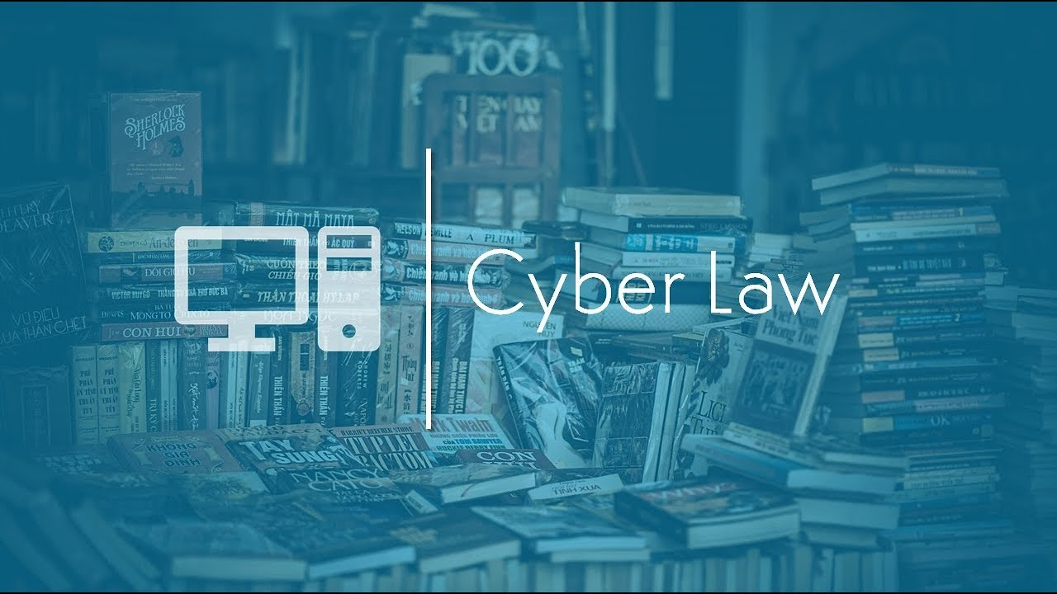

Slide 8
q. What is a cyber crime?
we can say that cyber crime is unlawful acts wherein the computer is either a tool or a target or both. Cyber crimes can involve criminal activities that are traditional in nature, such as theft, fraud, forgery, defamation and mischief, all of which are subject to the Indian Penal Code. The abuse of computers has also given birth to a gamut of new age crimes that are addressed by the Information Technology Act, 2000.

Slide 9
Indian Penal Code (IPC) 1980 Amendments with IT-ACT 2000
Forgery (Section 464)
Forgery pre-planned for cheating (Section 468)
False documentation (Section 465)
Presenting a forged document as genuine (Section 471)
Reputation damage (Section 469)

Slide 10
Sections applied for separate Cyber crimes
Section 65 – Tampering with computer Source Documents
Section 66 - Using password of another person
Section 66D - Cheating Using computer resource
Section 66E - Publishing private Images of Others
Section 66F - Acts of cyber Terrorism
Section 67 - Publishing Child Porn or predating children online
Section 69 - Govt.'s Power to block websites
Section 43A - Data protection at Corporate level

Slide 11
Refrences
https://www.infosecawareness.in/cyber-laws-of-india
https://www.meity.gov.in/content/cyber-laws
http://www.legalserviceindia.com/legal/article-1019-importance-of-cyber-law-in-india.html

Slide 12


