Slide 1
Software developer career
Vladimirs Kotovs, 2015 Nov

Slide 2





Slide 3
Programmer
Teacher
System administrator
System analyst
Linux, Solaris
Java, bash, C, C#
MySQL, Oracle

Slide 4
Dynamic organization
Professional team

Slide 5
Manifesto for Agile Software Development
Individuals and interactions over processes
and tools
Working software over comprehensive
documentation
Customer collaboration over contract negotiation
Responding to change over following a plan

Slide 6

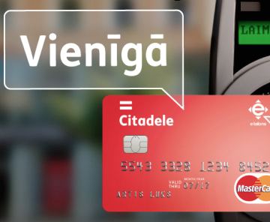
Innovative solutions

Slide 7

http://en.paperblog.com/all-in-the-same-boat-547043/

Slide 8
What makes IT tick?

Slide 9
Money?
Software?
Hardware?

Slide 10
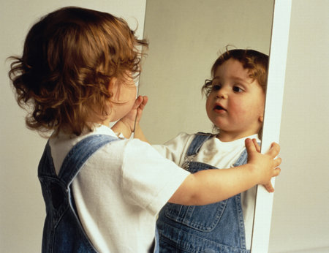
http://www.replicatedtypo.com/

Slide 11
Challenges of IT field.
What makes you a star IT professional?
IT education: successful experiences and opportunities.

Slide 12
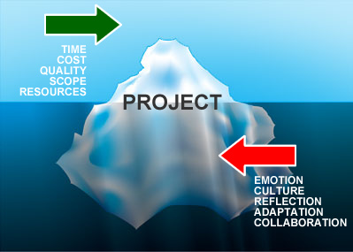
We don't know the future.
By Simon Baker, http://www.energizedwork.com/weblog/2007/11/xpday7-why-do-agile-projects-fail

Slide 13

Our perception changes...
http://community.humanityhealing.net/group/toolsforshiftingperspective/forum/topics/is-what-you-see-real-change-your-perception-change-your-life

Slide 14
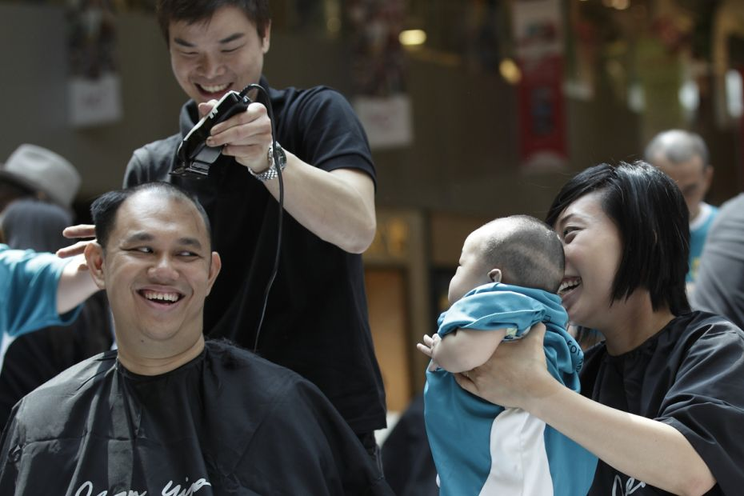
People change...
http://www.tnp.sg/picture/big-picture-week-12-finalist-5

Slide 15

So does the environment.
http://vxside.deviantart.com/art/4-seasons-81436429

Slide 16
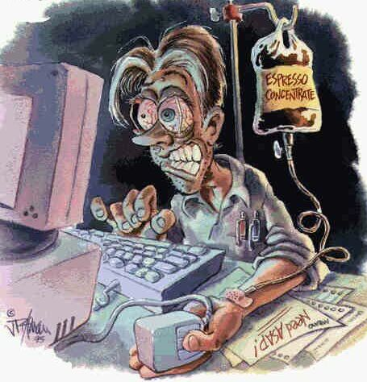
We work hard...
http://writerunboxed.com/2006/10/09/driving-the-deadline/

Slide 17
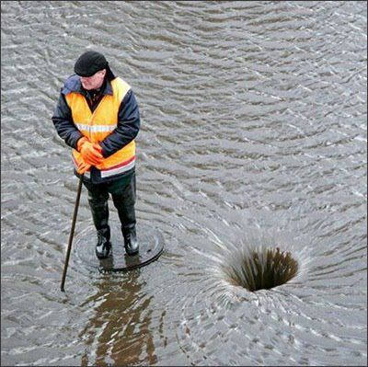
Some of our work goes down the drain
http://brucesmideastsoundbites.blogspot.com/2009/03/down-drain-pouring-money-down.html

Slide 18

http://www.flickr.com/photos/opensourceway

Slide 19
“real life” as opposed to learning enviroment
Budget, deadline and scope
Software development != programming
All this and more in Russian: https://www.youtube.com/watch?v=ewdxrcPz-IY

Slide 20
Persistence, knowledge, experience,
10,000 hour rule...

Slide 21


Slide 22



Java 1 – Java and OOP fundamentals
Java 2 – Web development practice
Java 3 – Enterprise technologies
http://www.javaguru.lv

Slide 23



http://www.javaguru.lv

Slide 24
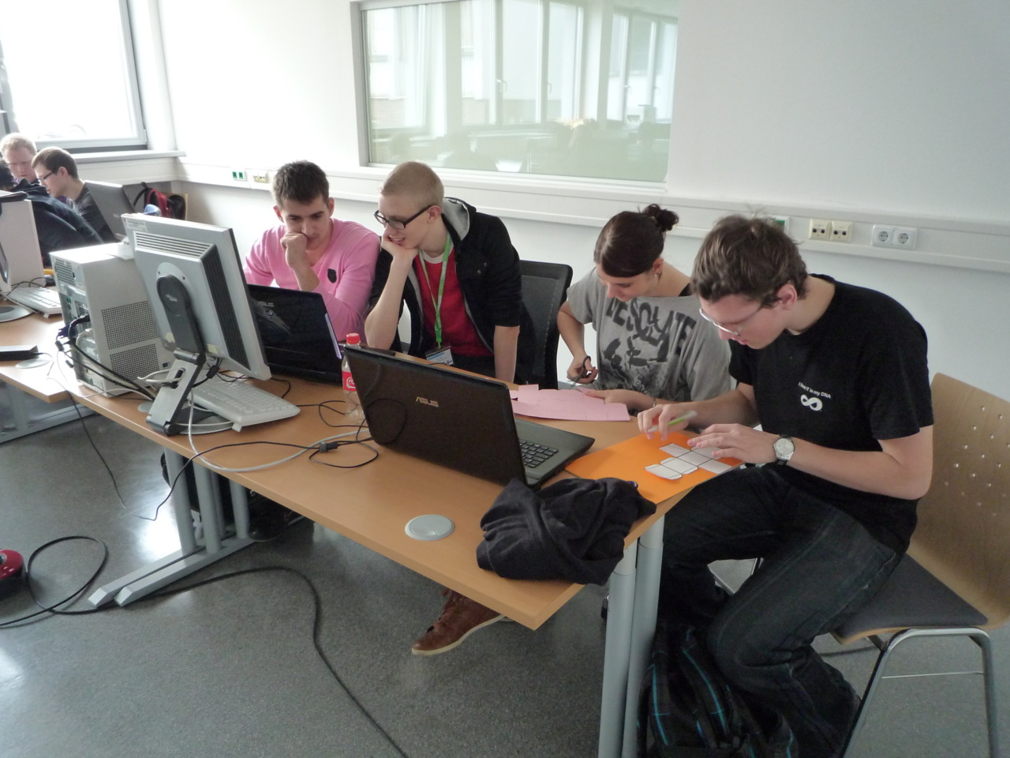

Slide 25
Practice
http://projects.apache.org/
Google summer of code
https://code.google.com/codejam/
https://github.com/trending

Slide 26


Practice
https://education.github.com/pack

Slide 27

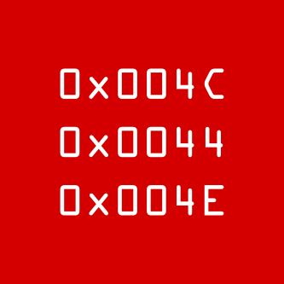



www.ldn.lv
gdgriga.lv

Slide 28
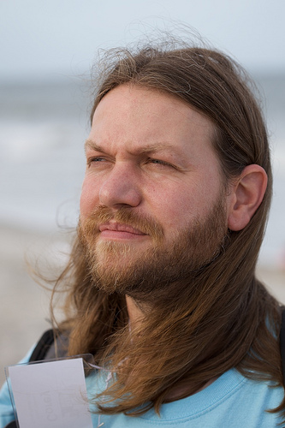
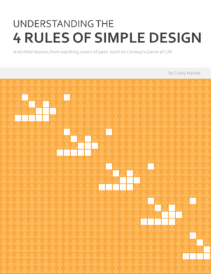
Coderetreat
An intensive practice event, focusing on the fundamentals of software development and design
http://coderetreat.org/
Great intro (Corey Haines)
http://vimeo.com/18955165

Slide 29

Codekata
Greatness comes from
practicing
Applying the theory over and over again, using feedback to get better every time
http://codekata.com/
http://butunclebob.com/ArticleS.UncleBob.TheBowlingGameKata

Slide 30


International community
NDC Oslo conference videos
http://vimeo.com/channels/ndc2014

Slide 31
Traits of a successful
IT specialist

Slide 32
We learn,
analyze,
invent,
communicate,
collaborate,
make decisions...

Slide 33
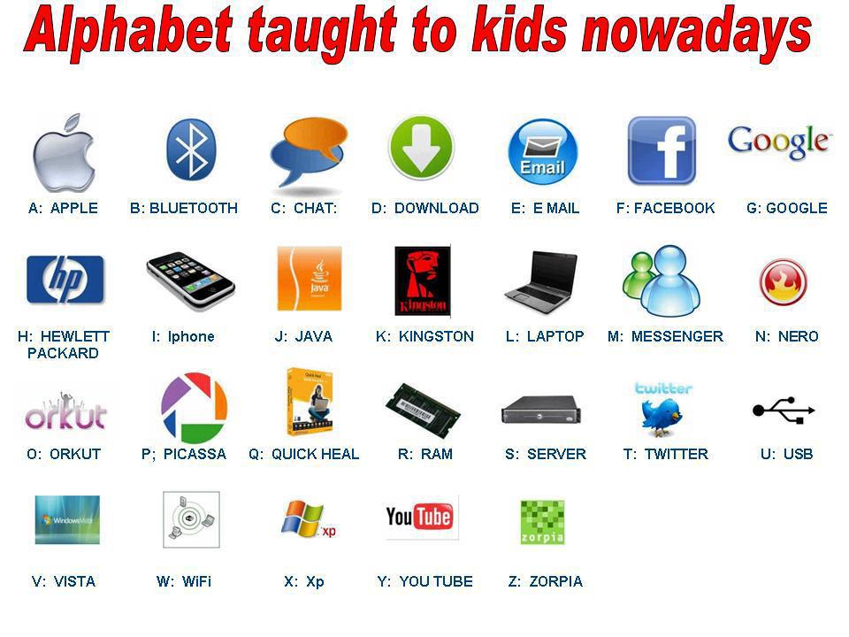
http://cristianaziraldo.altervista.org/english/

Slide 34

http://www.flickr.com/photos/tribesports/8434409743/

Slide 35
Some useful productivity articles
http://articles.jbrains.ca/GettingStartedWithGettingThingsDone.pdf
http://www.stevepavlina.com/blog/2005/06/self-discipline/
http://www.stevepavlina.com/blog/2007/05/33-rules-to-boost-your-productivity/

Slide 36


Slide 37

Pride of workmanship
http://praguestepchild.blogspot.com/2011/02/pride-of-workmanship.html

Slide 38
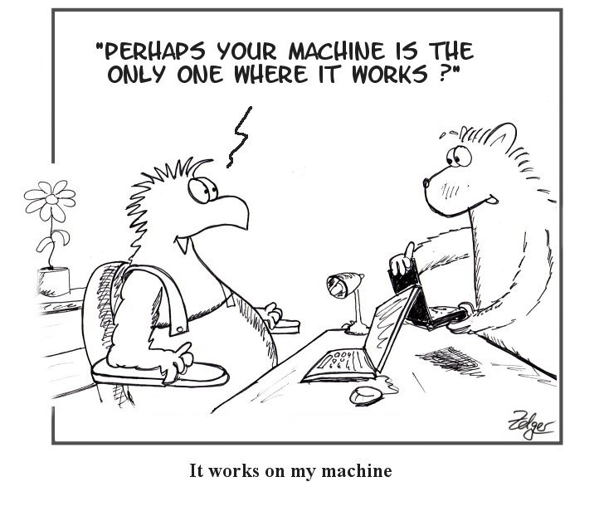
Responsibility...
http://simply-the-test.blogspot.com/2010/05/it-works-on-my-machine.html

Slide 39
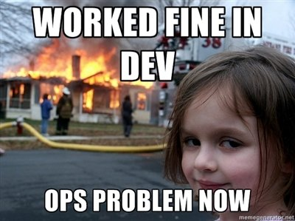
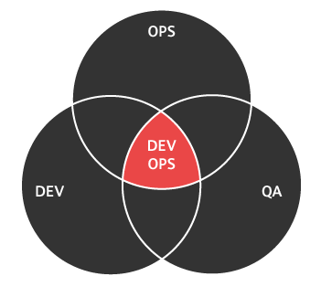
DevOps
http://www.zpesystems.com/wp-content/uploads/2014/09/

Slide 40
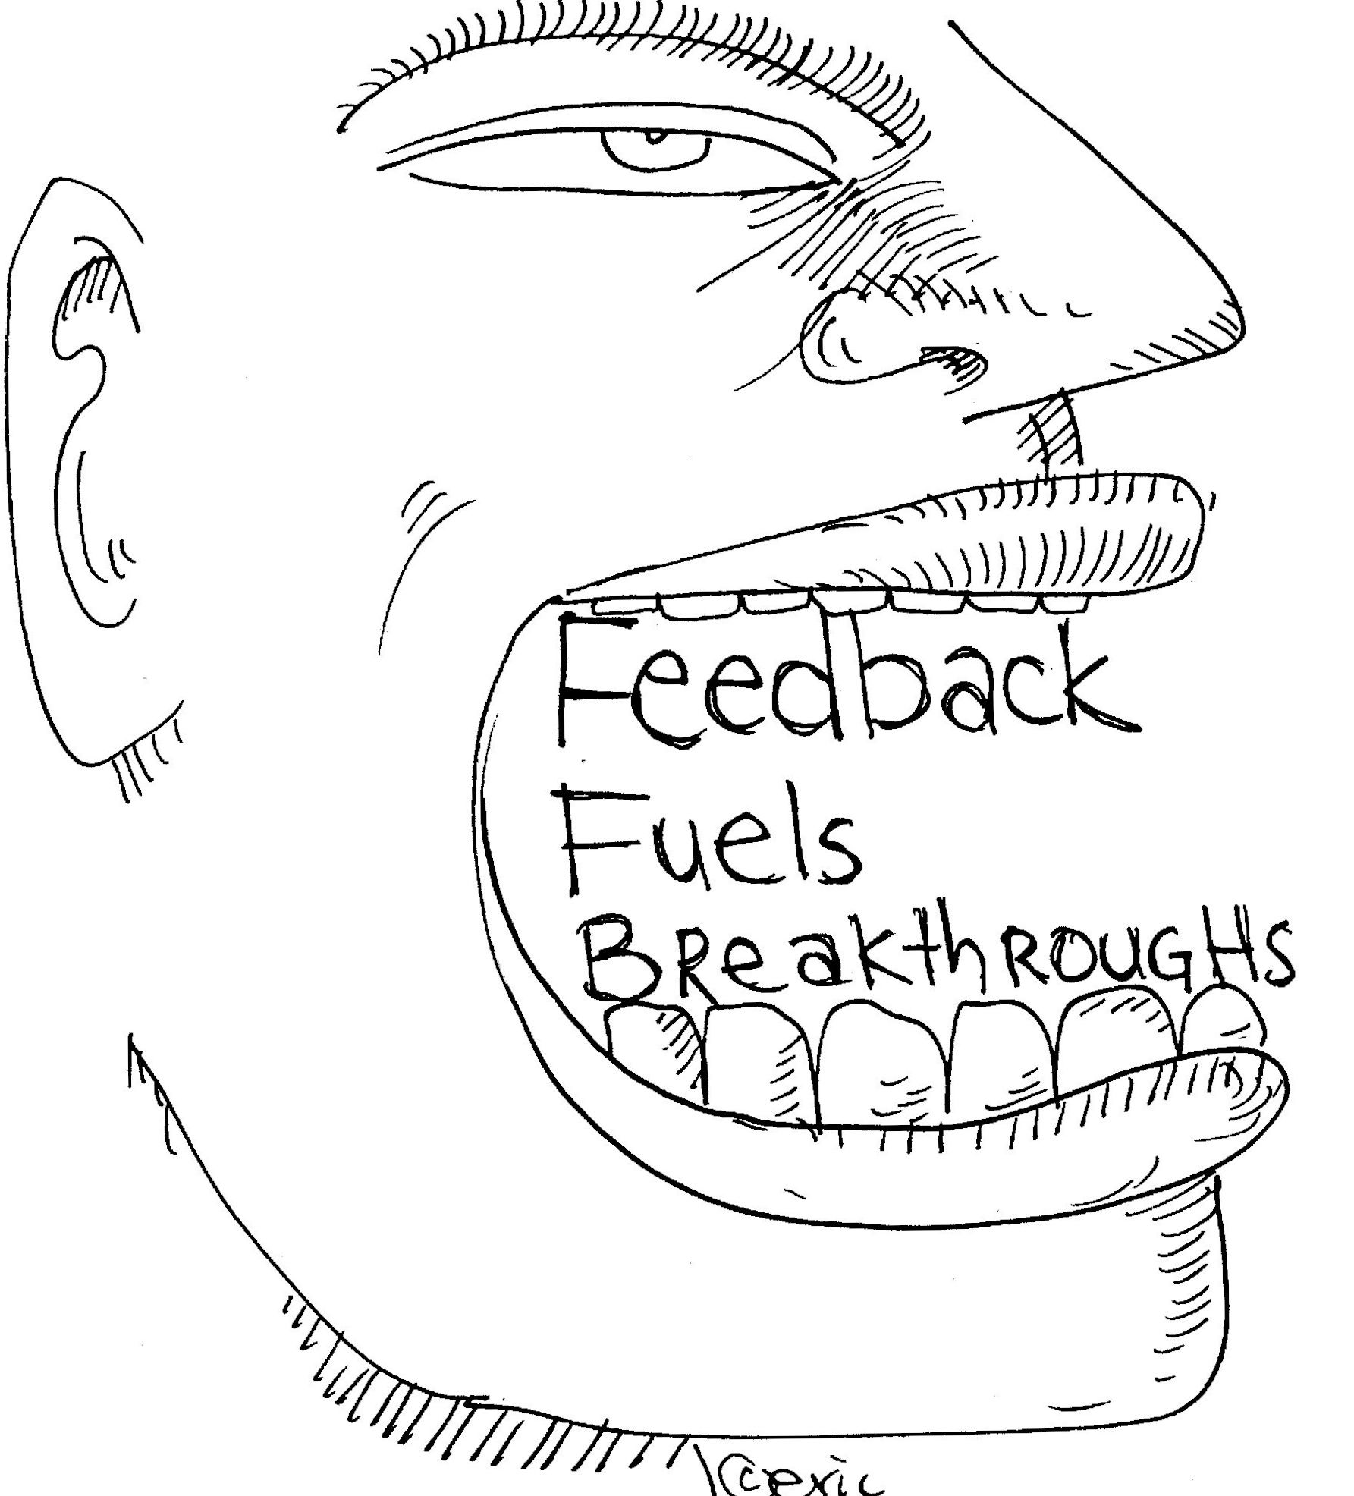
http://dharmaconsulting.com/2010/feedback-allergies-2/

Slide 41
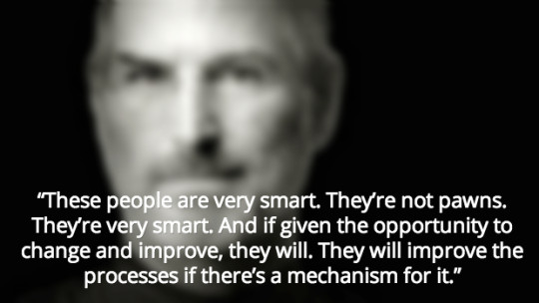
http://www.leanblog.org/2014/04/great-steve-jobs-video-transcript-from-1990-on-continuous-improvement/

Slide 42


Slide 43


Slide 44
Architecture & Design
“Hexagonal Architecture”
http://alistair.cockburn.us/Hexagonal+architecture
Microservices
http://martinfowler.com/articles/microservices.html
“Domain driven design” by Eric Evans
OO design patterns http://sourcemaking.com/design_patterns
Evolutionary architecture by Neal Ford
http://www.ibm.com/developerworks/java/library/j-eaed1/index.html

Slide 45


Slide 46
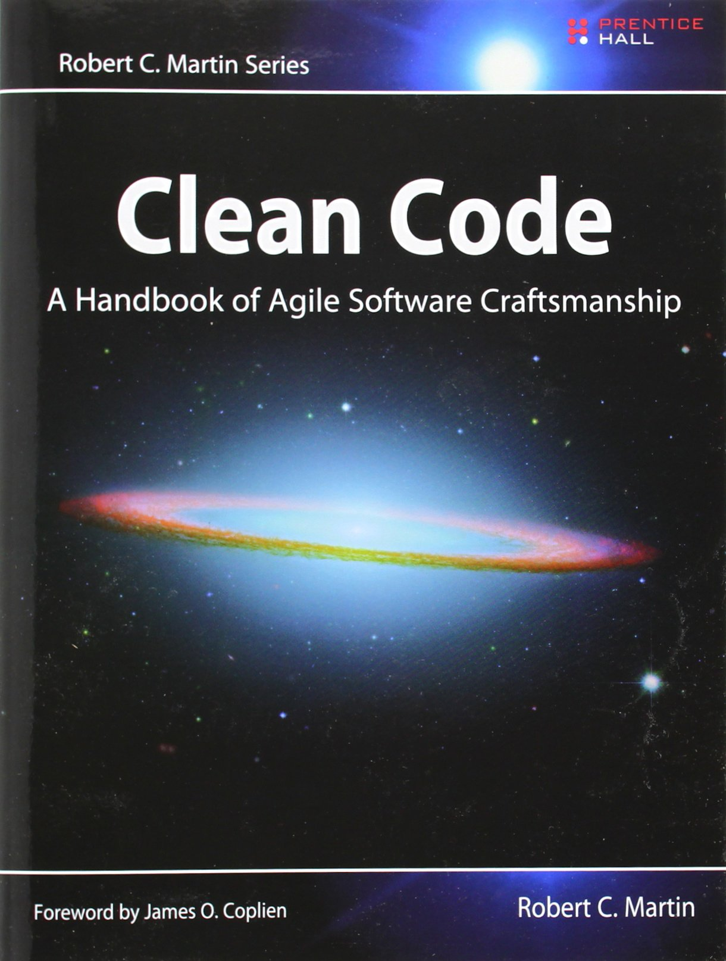

Slide 47
Tools and Process
Refactoring
http://sourcemaking.com/refactoring
Version control - git
Issue tracking
Automated testing
Continuous delivery
http://martinfowler.com/books/continuousDelivery.html
DevOps
http://www-01.ibm.com/software/rational/dummiesbooks/devops/
Continuous integration
http://martinfowler.com/books/duvall.html

Slide 48


Slide 49


Slide 50
Cloud / Highload / Virtualization
Distributed storage and execution
Amazon Dynamo
Google BigQuery
Docker

Slide 51
Machine Learning
Spam filtering
Pattern recognition
Computer vision

Slide 52
Artificial Intelligence
Learning
Perception
Reasoning
Problem-solving

Slide 53



see.stanford.edu

Slide 54
Google recommendations
Intro to Computer Science
https://www.udacity.com/course/cs101
Google's Python class
https://developers.google.com/edu/python/
Design of computer programs
https://www.udacity.com/course/cs212
Software testing and debugging
https://www.udacity.com/course/cs258
https://www.udacity.com/course/cs259
Math for Computer Science
http://ocw.mit.edu/courses/electrical-engineering-and-computer-science/6-042j-mathematics-for-computer-science-fall-2010/index.htm
https://www.google.com/edu/tools-and-solutions/guide-for-technical-development/

Slide 55
More recommendations
Cryptography
https://www.coursera.org/course/crypto
https://www.udacity.com/course/cs387
Algorithms and data structures
http://ocw.mit.edu/courses/electrical-engineering-and-computer-science/6-046j-introduction-to-algorithms-sma-5503-fall-2005/video-lectures/
Concepts, Techniques, and Models of Computer Programming
http://mitpress.mit.edu/books/concepts-techniques-and-models-computer-programming

Slide 56
More recommendations
Operating systems
https://www.youtube.com/watch?v=XgQo4JkN4Bw&list=PL3289DD0D0F0CD4A3
CS162 Berkley
Compilers
https://www.coursera.org/course/compilers

Slide 57
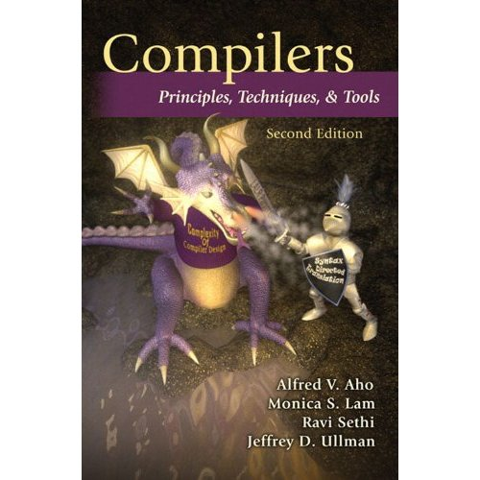

Slide 58
Projects and teams

Slide 59


Slide 60


Slide 61


Slide 62


Slide 63


Slide 64
Thank you!

Slide 65
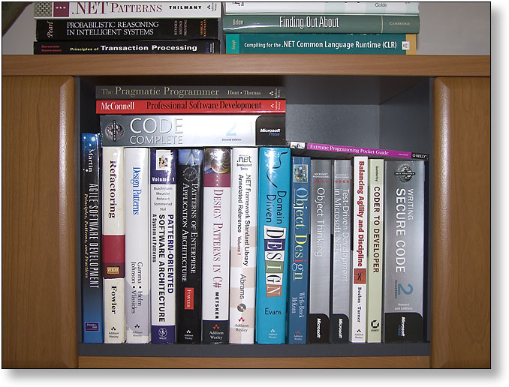
gdgriga.lv
www.ldn.lv

