Slide 1
Java Script

Slide 2

Java Script
Brenden Eich

Slide 3
INTRODUCTION
https://tinyurl.com/he4mm53

Slide 4
Introduction
What JavaScript Is and what it is not
Use Cases of JavaScript
JavaScript in a Web Page
<SCRIPT> and <NOSCRIPT>

Slide 5
Java Script
A scripting language Created by Brendan Eich at Netscape
Developed under the name Mocha, and officially called LiveScript
Renamed to JavaScript
  When Netscape added support for Java technology in its Netscape Navigator web browser.
Its official name is ECMAScript,
It’s interpreted by the browser engine while the page is loaded.
  HTML, gives structure to the web pages
  CSS, controls the appearance of web pages
  JavaScript gives the behavior for the page.

Slide 6
Scripts vs. programs
A scripting language is a simple, interpreted programming language
  scripts are embedded as plain text, interpreted by application
  simpler execution model: don't need compiler or development environment
  saves bandwidth: source code is downloaded, not compiled executable
  platform-independence: code interpreted by any script-enabled browser

Slide 7
Interpreted Language
Older implementations are purely interpreted language.
  The user's browser interprets the script analyzes and immediately executes it.
  interpreter in the browser reads over the JavaScript code, interprets each line, and runs it
In modern implementations have Just In Time Compilers
  Modern browsers now compile on the fly.
  JIT compilers use their own strategies for optimization.
  compiler are dedicated to optimizing a single task;
  may optimize common operations such as loops or functions.
  May employ some strategy to improve the performance of your code.

Slide 8
Common scripting tasks
adding dynamic features to Web pages
  validation of form data
  image rollovers
  time-sensitive or random page elements
  handling cookies
defining programs with Web interfaces
  utilize buttons, text boxes, clickable images, prompts, frames
limitations of client-side scripting
  since script code is embedded in the page, viewable to the world
  for security reasons, scripts are limited in what they can do
  since designed to run on any machine platform, scripts do not contain platform specific commands
  user can always disable JavaScript

Slide 9


JavaScript Execution
Other files
Server side code
HTML files
HTML file
JavaScript
Request
Web Server
Response
Client
Script executes locally and interacts with the browser
Server side code executes on the server and sends the response
So JavaScripts on client side executes faster than server-side code.

Slide 10
Adding Java Script
Added By Using Script Tag
  <script></script>
  <script type=“text/javascript”></script>
<noscript>
  An alternate content for users that have disabled scripts in their browser or have a browser that doesn't support script.

Slide 11
Placeholders for scripts within HTML
Inside head
  only declarations. Declarations could for variables or functions.
  No standalone executable statements must appear
Inside the body
  any statements can appear
  standalone executable statements inside the body are interpreted in place where it appears.
Along with the event handler
  Script expression can be written as a value when an event like button click happens.

Slide 12
Script Execution – Head Section
Scripts, placed in the head section will be executed
  When they are called or
  When an event is triggered.
  <html>
  <head>
  <script type=“text/javascript">
  some statements
  </script>
  </head>
  </html>
Advantage →
The script will be loaded before anyone uses it.

Slide 13
Scripts Execution - Body Section
A script to be executed while the page is being loaded is placed in the body section.
  <html>
  <head> </head>
  <body>
    <script type=“javascript">
    some statements
    </script>
  </body>
  </html>
Advantage →  The script generates the content of the page.

Slide 14
Name spacing in JavaScript
Global variables should be reserved for objects that have system-wide relevance
Should avoid creating global objects unless they are absolutely necessary.
The strategy is to create a small number of global objects
  which will serve as de facto namespaces for underlying modules and subsystems.

Slide 15
Script Execution
  <head>
  <script>
  var app={};
  app.show=function(){
  document.writeln("<h1> Hello From Java Script</h1>");
  }
  </script>
  </head>
  <body>
  <script>
  app.show();
  </script>
  </body>

Slide 16
In lining of JavaScript
  <html>
  <head>
  <title>Example</title>
  </head>
  <body>
  <input type="button" value="Click"
  onclick="javascript:alert('Wrong Button Clicked')"/>
  </body>
  </html>

Slide 17
Calling Java Script From .js Files
  var app={};
  app.showMessage= function() {
  console.log("Hello World");
  };
  app.init=function(){
  app.element = document.getElementById("btn1");
  app.element.onclick = app.showMessage;
  };

Slide 18
HTML Page
  <body>
  <button id="btn1">Click</button>
  <script src="scripts/Sample.js"></script>
  <script>
  app.init();
  </script>
  </body>

Slide 19
Java Script Object
Everything in JavaScript is an object
Document object
  Print JavaScript messages on the web page;
  Access HTML Elements
Objects have properties and methods.
Properties are values associated with an object.
Methods represent what an object can do, its behavior

Slide 20
getElementById
HTML Elements tags are associated with an id.
document.getElementById(‘id’)
  Method to get the reference of the HTML Element
innerHTML
  Property to set Contents into a section of the HTML Tags

Slide 21
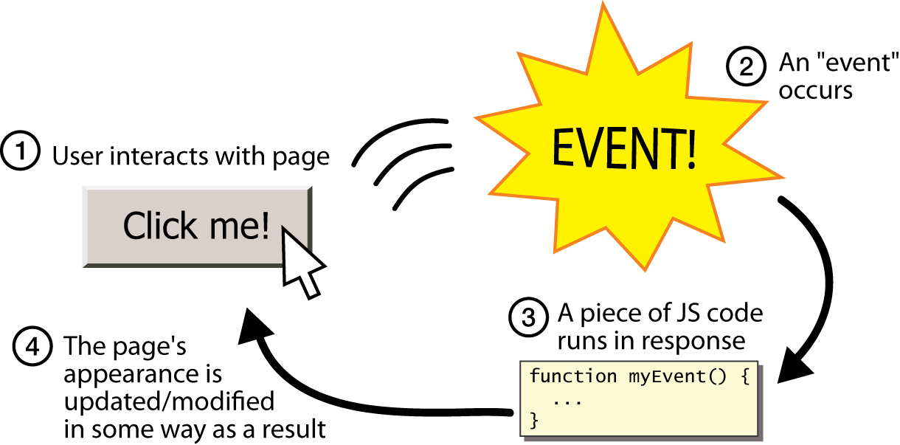
Java Script Events
Occurrences in the context of the interactions between web server, web browser, and web user.
Every element on a web page has certain events which can trigger invocation of event handlers

Slide 22
addEventListener
Method is used to separate JavaScript is from the HTML markup
Method to attach an event handler to the specified element.
Can add many event handlers to one element.
Events are attached without overwriting existing handlers.
Easier to control how the event reacts to bubbling.
  <button id='btn2'>Click</button>
  var clickButton= document.getElementById("btn2");
  clickButton.addEventListener('click', function(){
  console.log("I am added");
  });

Slide 23
Demo/Hands-on Exercise

Slide 24
Lexical Structure
Character Set
Case Sensitivity
Optional Semicolons
Valid Identifiers
Reserved Word

Slide 25
Lexical Structure
Character Set
  Scripts are written using the Unicode character set.
  Unicode supports virtually every written language currently used on the planet.
Case Sensitivity
    The Following should typed with a consistent capitalization of letters.
    keywords,
    variables,
    function names
    Identifiers

Slide 26


Case sensitivity
  app.attach = function(){
  var element = document.getElementById("clickButton");
  element.onclick = function (){
  alert("camel case");
  }
  element.onclick = function (){
  alert("camel case");
  }
  }

Slide 27
Optional Semi Colons
Required When two statement are on the Same Line
  var i = 0; i++
Can be omitted if the statement is followed by a line break
  var i;
  i = 5;
  i = i + 1;
  var x = 9;
Shouldn’t put a semicolon after a closing curly bracket }.
The only exceptions are assignment statements,
var obj = {};

Slide 28
Valid Identifiers
A JavaScript identifier can start
  with a letter,
  underscore (_),
  dollar sign ($);
Subsequent characters can also be digits (0-9).
  logo
  number_hits
  $credit
  temp99

Slide 29
Reserved Word
Abstract, super , export ,interface
synchronized , extends , let , this
catch , final , native , throws
finally , transient , class , const
Package, import, try , continue ,
Private, protected default public
void implements volatile static

Slide 30
Data Types
Data Types
  Primitive Data Types
  Composite Data Types
Variables
  Valid Names
  Declaring and Initializing Variables
  Dynamically or Loosely Typed Language
  Scope of Variables
  Concatenation and Variables
Constants

Slide 31
Data Types
Primitive data types are the simplest building blocks of a program.
JavaScript supports three core or basic data types:
  numeric
  string
  Boolean
Two other special types that consist of a single value:
  null
  Undefined
Composite Data Types
  A data type that can consist of many types grouped in some way.
  Object & Array is the Composite data types.

Slide 32
Strongly Typed
A strongly typed language has variable which will always behave as a certain type until it is reassigned.
  Java and C#
They are More likely to generate an error or refuse to compile if the argument passed to the function does not closely match the expected type.

Slide 33
Loosely Typed Language
Can declare a variable, but it doesn't require to classify the type
Dynamic programming language are loosely typed
  Can add new code
  Can extend objects and definitions
  Can modify the type system during runtime
  Values are checked during execution
  A poorly typed operation might cause the program to halt or otherwise signal an error at run time.
var answer = 42;
answer = 'Thanks all';

Slide 34
Variable
Information is stored in variables.
It’s value can be changed during the execution of script.
It can be referenced by its name to see its value or to change its value.
Data type supported – Variant.

Slide 35
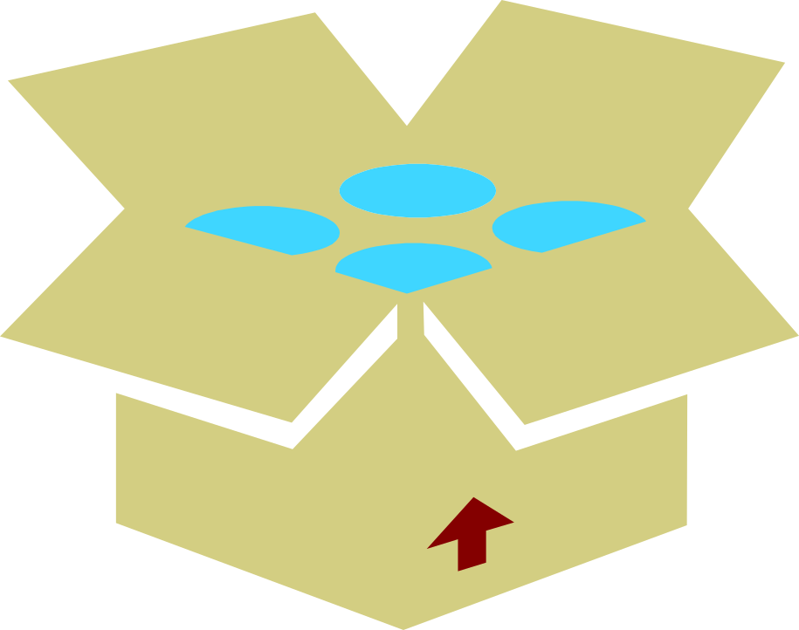
Variant Any Type of Data.
Integer
Float
Boolean
Char
Variant

Slide 36
Declaring Variables
There are two ways of declaring a variable.
Implicit Declaration
    Declared by using its name directly in the script.
    name=“Tom”
Explicit Declaration
  Declared with the keyword ‘var’ keyword
  var name = “Tom”
var a;
  console.log('The value of a is ' + a);
    // The value of a is undefined
  console.log('The value of c is ' + c);
    // Uncaught ReferenceError: c is not defined

Slide 37
Variable Declaration
variable declaration
  var state;
variable definition (assignment)
  state = "ready";
declaration plus definition (Initialization)
  var state = "ready";
Best Practice is to declare all variables at the beginning of every scope.

Slide 38
undefined
  var input;
  if (input == undefined) {
  doThis();
  } else {
  doThat();
  }
The undefined value behaves as false when used in a Boolean context

Slide 39
Nan and Null
  var a;
  a + 2; // Evaluates to NaN
null value
  Behaves as 0 in numeric contexts
  Behaves as false in boolean contexts.
  var n = null;
  console.log(n * 32); // Will log 0 to the console

Slide 40
Scope of variables
Can be local or global scope
Local Scope:
  Created using var inside the function
  visible, or accessible, only within the function in which it lives.
    function three() {
    var a = 3;
    alert(a); //prints 3
    }
    three();

Slide 41
Scope of Variables
Global scope means that it's accessible, anywhere in script..
    Created with or without “var” outside the function
    Created without “var” inside the function
    var a = 1;
    function one() {
    alert(a); //prints 1
    }

Slide 42
Local and Global Variables
  (function () {
  glbl_total = 0;
  var glbl_z = 50;
  function sum() {
  glbl_y = 20;
  var local_x = 10;
  glbl_total = local_x + glbl_y;
  alert(glbl_z); // print 50
  }
  sum();
  alert("Total"+glbl_total); // prints 30
  alert("Value of y" + glbl_y); // prints 20
  alert(glbl_z); //prints 50
  alert("Reference Error -x" + local_x); // error
  })();

Slide 43
Variable Scope
JavaScript's doesn't have a block scope.
  As in C or Java, blocks ({...})
Variables in JavaScript are scoped to their nearest parent function or globally if there is no function present.
The JavaScript interpreter make two passes on a section of JavaScript code.
  The first pass processes variables and function declarations and lifts them to the top (the ‘hoisting’).
  The second pass processes the function expressions and undeclared variables.

Slide 44
Hoisting
Hoisting is moving all declarations to the top of the current scope
  To the top of the current script or the current function
Only variable declarations are hoisted to the top,
Initialization and assignments are NOT hoisted to the top.
variable can be declared after it has been used.
  console.log(x === undefined); // true
  var x = 3;
The above code is Interpreted as
  var x;
  console.log(x === undefined); // true
  x = 3;

Slide 45
Hoisting
  var foo = 1;
  function bar() {
  if (!foo) {
  var foo = 10;
  }
  alert(foo);
  }
bar();
Will display 10
  var foo = 1;
  function bar() {
  if (!foo) {
  foo = 10;
  }
  alert(foo);
  }
bar();
Will Display 1
Foo is hoisted up to the nearest parent function.
The undefined value behaves as false when used in a Boolean context

Slide 46
Window Object –Dialog boxes
Alert Box:
  A small window that pops up with a yellow warning sign used important message.
Confirm box
  User will have to click either "OK" or "Cancel" to proceed
Prompt box
  User will have to click either "OK" or "Cancel" to proceed after entering an input value

Slide 47
Example
  app.promptBox = function(){
  var user = prompt("Enter Your Name", "Guest");
  if(user.toUpperCase()==="RAMESH") {
  app.update("info","welcome:="+user);
  }
  else {
  app.update("info","Dear:="+user);
  }
  }
  app.update = function(elementId,message){
  var showMsgElement = document.getElementById(elementId);
  showMsgElement.innerHTML= message;
  }

Slide 48
Example
  app.confirmBox = function(){
  var result = confirm("Are You sure to submit");
  if(!result)
  {
  app.update("info","Try Again");
  }
  else
  {
  window.location.assign("FormExample.html");
  }
  }

Slide 49
Example
  app.init = function(){
  var promptElement = document.getElementById("promptButton");
  promptElement.addEventListener('click',app.promptBox);
  var confirmElement = document.getElementById("cfrmButton");
  confirmElement.addEventListener('click',app.confirmBox);
  }

Slide 50
Example
  <button id="promptButton">Prompt Box</button>
  <button id="cfrmButton">Confirm Box</button>
  <div id="info"></div>
  <script type="text/javascript" src="scripts/DialogBoxes.js"></script>
  <script type="text/javascript">
  app.init();
  </script>

Slide 51
Operators
JavaScript Operators and Expressions
  Assignment
  Precedence and Associativity
Types of Operators
  Arithmetic Operators
  Shortcut Assignment Operators
  Autoincrement and Autodecrement Operators
  Comparison Operators
  Logical Operators
  The Conditional Operator
Data Type Conversion
  The parseInt() Function
  The parseFloat() Function
  The eval() Function

Slide 52
Operators
Arithmetic:
+ - * / % += -= *= /= %= ++ --
Logical:
& | ! && ||
Relational:
> >= < <= == != === !==
String concatenation: +
Bit wise:
>> << >>> >>= <<= >>>=
Ternary: ?:

Slide 53
=== and !==
alert("34"==34); Returns true
alert("34"===34); Returns false
  alert(true===1); returns false
  The ( = ) operator is used to assign or give a value to a variable. It is not a sign for equality.
( == ) compares only values, ( === ) compares both values and data type.

Slide 54
Shift Operator
Left Shift Operator
var bar = 5; // (00000000000000000000000000000101)
bar <<= 2; // 20 (00000000000000000000000000010100)
Right Shift Operator
var bar = 5; // (00000000000000000000000000000101)
bar >>= 2; // 1 (00000000000000000000000000000001)

Slide 55
Ternary Operator
Operator that takes three operands.
  used as a shortcut for the if statement
condition ? expr1 : expr2
If condition is true, returns the value of expr1; otherwise, value of expr2.
console.log(mark>20 ? 'pass':'fail');

Slide 56
parseInt
Function parses a string argument and returns an integer of the specified radix
parseInt(string, radix);
  console.log(parseInt('15.99', 10));
  console.log(parseInt(' 0xF', 16));
  console.log(parseInt(' F', 16));
  console.log(parseInt('17', 8));

Slide 57
parseFloat
Parses a string argument and returns a floating point number.
parseFloat(string)
If the first character cannot be converted to a number, NaN is returned.
  console.log(parseFloat('3.14'));
  console.log(parseFloat('FF2'));

Slide 58
eval
Evaluates JavaScript code represented as a string.
If the completion value is empty, undefined is returned.
The argument of the eval() function is a string.
If the string represents an expression, evaluates the expression.
Should not be used to evaluate an arithmetic expression
console.log(eval(200+'400'));
If the Argument is not String it returns the Object itself
  console.log(eval(new String('2 + 2'))); // returns String Object
console.log(eval('2 + 2')); // returns 4

Slide 59
Control Structures
Conditionals
  if/else
  if/else if
  switch
Loops
  The while Loop
  The do/while Loop
  The for Loop
  The for/in Loop
  Loop Control with break and continue
  Nested Loops and Labels

Slide 60
If-else
The if statement executes a statement if a specified condition is true.
If the condition is false, another statement can be executed.
if (condition)
statement1
[else statement2]
conditionAn expression that evaluates to true or false.

Slide 61
Switch Statement
  switch (expression) {
  case value1:
  [break;]
  case value2:
  [break;]
  case valueN:
  [break;]
  default:
  }

Slide 62
For Loop
All three expressions in the head of the for loop are optional.
for (var i = 0; i < 9; i++) { console.log(i); // more statements }
initialization block it is not required to initialize variables:
  var i = 0;
  for (; i < 9; i++) {
  console.log(i);
  // more statements
  }

Slide 63
For Loop
Like the initialization block, the condition block is also optional.
Loop is broken condition infinite loop.
  for (var i = 0;; i++) {
  console.log(i);
  if (i > 3)
  break;
  // more statements
  }

Slide 64
For Loop
Can omit all three blocks.
A break statement to end the loop and also modify (increase) a variable,
  var i = 0;
  for (;;) {
  if (i > 3)
  break;
  console.log(i);
  i++;
  }

Slide 65
Do-while
he do...while statement creates a loop that executes a specified statement until the test condition evaluates to false.
The condition is evaluated after executing the statement, resulting in the specified statement executing at least once.
  var i = 0;
  do {
  i += 1;
  console.log(i);
  }
  while (i < 5);

Slide 66
While Statement
The while statement creates a loop that executes a specified statement as long as the test condition evaluates to true.
The condition is evaluated before executing the statement.
  var n = 0;
  var x = 0;
  while (n < 3) {
  n++; x += n;
  }

Slide 67
Break
The break statement terminates the current loop, switch, or label statement and transfers program control to the statement following the terminated statement.
  var i = 0;
  var x =2;
  while (i < 6) {
  if (i == 3) {
  break;
  }
  i += 1;
  }
  console.log(i * x);
Returns value 6

Slide 68
Continue
Terminates execution of the statements
Continues execution of the loop with the next iteration.
  var i = 0;
  var n = 0;
  while (i < 5) {
  i++;
  if (i === 3) {
  continue;
  }
  n += i;
  console.log(n);
  }
  ➔ 1, 3, 7, and 12

