Slide 1
Legacy DOM
Model which was introduced in early versions of JavaScript.
It offers access to a few HTML elements, most importantly forms and (later) images.
It is well supported by all browsers
  allows access only to certain key portions
  documents, such as forms, form elements, and images.
This model provides several properties, such as title, URL, and lastModified
Provided methods to set and get document property values.

Slide 2
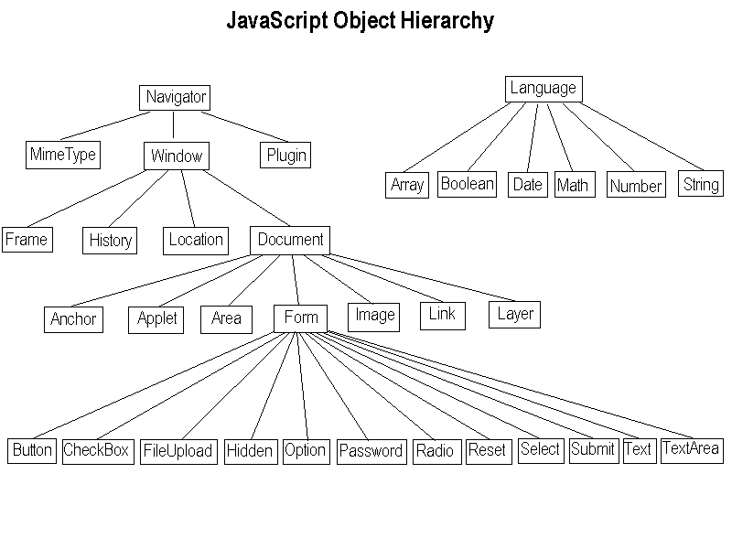

Slide 3
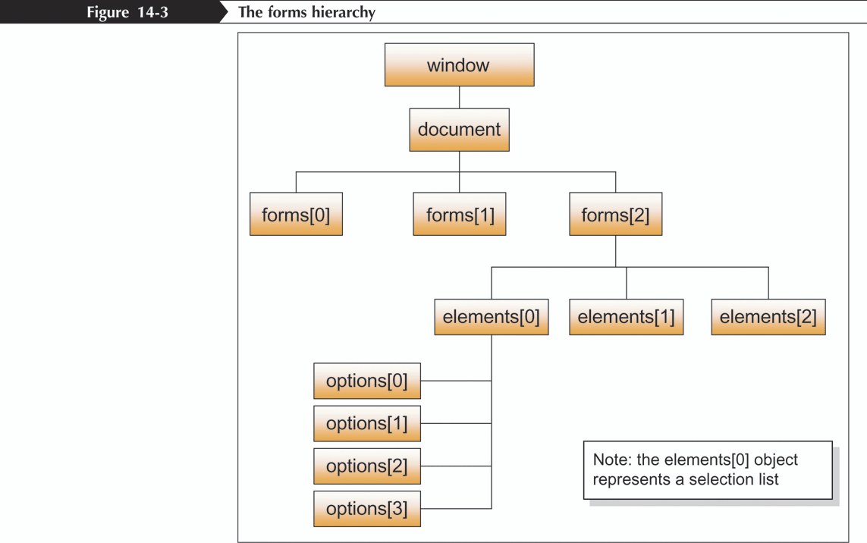
Working with Forms and Fields

Slide 4
Legacy DOM
close( )
  Closes a document stream opened with the open( ) method and returns nothing.
  document.close( )
Title
  The text contents of the <title> tag.
  document.title
elements[],
  which grants access to all form fields in one form, whatever their tag name.
  document.forms['contactform'].elements['address']
  document.forms['contactform'].elements[0]
  document.forms[0].elements['address']
  document.forms[0].elements[0]

Slide 5
Legacy DOM
forms[ ]
  An array of Form objects, one for each HTML form that appears in the document.
  document.forms[0], document.forms[1]
images[ ]
  An array of Image objects, one for each image that is embedded in the document with the HTML <img> tag.
  document.images[0], document.images[1]
anchors[ ]
  An array of Anchor objects, one for each anchor that appears in the document
  document.anchors[0], document.anchors[1]
  which grants access to all anchors (<a name>) on the page.
  document.anchors[pos].text

Slide 6
Submit and Reset Method
Restores a form element's default values.
  Same as clicking the form's reset button.
  document.getElementById("myform").reset();
Submit
  Method submits the form.
  Similar to activating a submit button of the form.
  The form's onsubmit event handler will not be triggered when invoking this method
  document.forms["myform"].submit()

Slide 7
Attributes of Form Elements
Form
  represents a document section that contains interactive controls to submit information to a web server.
  Can apply Pseudo Classes like :valid and :invalid
Name
  The name of the form.
  In HTML 4, its use is deprecated (id should be used instead).
  It must be unique among the forms in a document and not just an empty string in HTML 5.

Slide 8
Validate Form Fields
  function validate()
  {
  var firstname =document.regForm.firstName ;
  var surName = document.regForm.surName;
  if (firstName.value=="") {
  console.log("User Name should not be blank");
  return false;
  }
  if(surName.value=="") {
  console.log ("Password should not be blank");
  return false;
  }

Slide 9
Validation
  if(email.value!="") {
  var emailID = document.regForm.email.value;
  atCount = emailID.indexOf("@");
  if (atCount < 1 ) {
  alert("Please enter correct email ID");
  document.myForm.email.focus() ;
  return false;
  }
  return( true );
  }
  }

Slide 10
Validation With CSS and HTML5
  <form>
  <label for="mail_id">Email</label>
  <input type="email" name="mail_id" placeholder="email" id="mail_id" required>
  <label for="mobile_number">Phone Number</label>
  <input type="tel" name="mobile_num" placeholder="Mobile Number" id="mobile_number" pattern="\d{10}" required>
  <label for="pan_number">Pan Number</label>
  <input type="text" name="pane_num" placeholder="Pan Number" id="pan_number" pattern="[A-Za-z]{3}\d{2}[A-Za-z]{1}" required>
  <input type="submit" id="submit" value="Submit"/>
  <input type="reset" id="reset" value="Reset"/>
  </form>

Slide 11
Validation With CSS and HTML5
  input:invalid {
  background-color: #ffdddd;
  }
  form:invalid {
  border: 5px solid #ffdddd;
  }
  input:valid {
  background-color: #ddffdd;
  }
  form:valid {
  border: 5px solid #ddffdd;
  }

Slide 12
USEFUL TASKS-PRINTING

Slide 13
Window.print() Method
<form> <input type="button" value="Print this page" onClick="window.print()">
</form
:
Can print by Using "return false" in an image link:
<a href="whatever.htm"
onClick="window.print();return false">
<img src="print.gif">
</a>
Return false cancels the default action
the image becomes exclusively a button that prints a document,

Slide 14
Javascript Url
Printing can be done using a "JavaScript url".
A JavaScript url is a special kind of url that executes a command, instead of loading the specified url.
<a href="javascript:window.print()“><img src="print.gif"></a>
<a href="javascript:alert('hi there!')">Click here</a>

Slide 15
Javascript Url
Printing can be done using a "JavaScript url".
A JavaScript url is a special kind of url that executes a command, instead of loading the specified url.
<a href="javascript:window.print()“><img src="print.gif"></a>
<a href="javascript:alert('hi there!')">Click here</a>

Slide 16
Coding Guidelines
Always Use Declarations with var or let
Always use Semicolons
Do not declare function in blocks
  if (x) { function foo() {} }
Do not Use Wrapper objects for primitive types
  Var result = new Boolean(‘true’);
Use “This” with Cautioon
  this is so easy to get wrong,
  limit its use to constructors in methods of objects ,event handler
Use Array and Object literals

Slide 17
Browser Compatibility
The cause of this is typically due to "unsupported" tags that are "deprecated" and are not recommended for use or you have
Bad HTML, CSS or JavaScript code that was incorrectly written.
The first step in fixing a browser compatibility problem is to check the code to see if it passes "validation".
HTML Validator
CSS Validator

Slide 18
Test Browser Compatibility
Can Use Public and Free Tools for testing cross browser compatibility.
Can install all the known browsers and then view in each browser
The downfall to this will not be able to see what the older versions of a browser looks like.
Can Use a universal browser compatibility checker
https://www.browseemall.com

Slide 19
Performance
Avoid Excessive DOM changes that force the page to re-render
Minimize Events that get fired all the time (for example, resizing/scrolling)
Avoid Lots of HTTP requests (and even this is becoming less important).
Save bytes by using Minification
Avoid unwanted loops Don’t use nested loops if not required
Index directly to NodeLists
Try not to use global variables
Use script caching when a script is extremely large, or embedded across multiple pages
Cache Object rather than accessing every time not having document.images.length in loop construct

