Slide 1
Introduction to AJAX
Notes:
Welcoem to AJAX Basics Training , My Name is Srivatsan , I am a Freelance Corporate Trainer .

Slide 2
Issues of Conventional Web Application
Interruption of user operation
  Users cannot perform any operation while waiting for a response
Loss of operational context during refresh
  Loss of information on the screen
  Loss of scrolled position
No instant feedback's to user activities
  A user has to wait for the next page
  Constrained by HTML
  Lack of useful widgets
Rich Internet Application (RIA) technologies are a solution for the above issues
Notes:
The conventional behavior of web application we talked in the
previous slide has several limitations. First of all, it is slow
both in terms of actual and especially in perceived
responsiveness because the user simply cannot do anything
until a response is received.
The second issue is loss of operational context during refresh.
Because the total page has to be refreshed, in a sense your
brain has to start from scratch in understanding each page.
Another example is loss of scrolled position. If you have a
page in which you have scrolled down, the next time the
same page get refreshed, you have to scroll it down again.
There is no instant feedback to user activities since the user
has to wait for the response from the server.
Now there have been several so called Rich Internet Application
technologies that addressed some of these problems.

Slide 3
Asynchronous JavaScript and XML.
Intuitive and natural user interaction
  No clicking required
  Mouse movement is a sufficient event trigger
"Partial screen update" replaces the "click, wait, and refresh" user interaction model
  Only user interface elements that contain new information are updated (fast response)
  The rest of the user interface remains displayed without interruption (no loss of operational context)
  Data-driven (as opposed to page-driven)
  UI is handled in the client while the server provides data
Notes:
As you have seen, AJAX based web applications allow more
intuitive and natural user interaction. For example, unlike
conventional web application, you don't need to do a click a link
or button to trigger an event. A mouse movement or typing a
character into a input form field could be a sufficient event
trigger.
Under AJAX-based application, partial screen update replaces
the old “click, wait a refresh the whole page” model. Partial
screen update means only the element that contain new
information is updated while the rest of the page remains the
same so that you do not lose the operational context.
Another aspect of AJAX is AJAX enables the interaction between the
client and server to be data-driven rather than page-driven. In other
words, the UI is handled by the client while the data is provided by
the server. This generally results in higher performance,reduced
bandwidth, reduced work load on the server, and a better end user
experience

Slide 4
Real-Life Examples of AJAX Apps
Google maps
  http://maps.google.com/
Goolgle Suggest
  http://www.google.com/webhp?complete=1&hl=en
Gmail
  http://gmail.com/
Yahoo Maps (new)
  http://maps.yahoo.com/
Many more are popping everywhere
Notes:
Everybody knows Google maps now. And it is highly likely
everybody has used Google maps. Google maps is the one that
really triggered the AJAX phenomenon.
Other applications that use AJAX underneath include Google
Suggest which is basically auto-completion. And more
comprehensive use of AJAX is Gmail application.
Yahoo is revamping their sites using AJAX. And more and more
Web sites are beginning to use AJAX.

Slide 5
Usage cases for AJAX
Real-time server-side input form data validation
  User IDs, serial numbers, postal codes
  Removes the need to have validation logic at both client side for user responsiveness and at server side for security and other reasons
Auto-completion
  Email address, name, or city name may be auto-completed as the user types
Master detail operation
  Based on a user selection, more detailed information can be fetched and displayed
Notes:
Some usage cases for AJAX interactions are the following:
* Real-Time Server side input form Data Validation: Form
data such as user IDs, serial numbers, postal codes, or even
special coupon codes that require server-side validation can
be performed through AJAX. Now in general, applications
have to have both client side validation and server side
validation, the former for the purpose of user responsiveness
and the latter due to security and other reasons such as the
validation has to use backend data. Now having validation
logic in two different places causes the maintenance problem
of the application. Now using AJAX, you removes the need to
have validation logic in two different places.
* Auto-completion: A specific portion of form data such as an
email address, name, or city name may be autocompleted as
a user types.
* Master Details Operations: Based on what a user selects,
more detailed information can be retrieved and displayed. For
example, if a user selects a product on a online shopping
page, detailed information on that product can be retrieved
and displayed without refreshing the page.

Slide 6
Usage cases for AJAX
Advanced GUI widgets and controls
  Controls such as tree controls, menus, and progress bars may be provided that do not require page refreshes
Refreshing data
  HTML pages may poll data from a server for up-to-date data such as scores, stock quotes, weather, or application-specific data
Simulating server side notification
  An HTML page may simulate a server-side notification by polling the server in the background
Notes:
This is the more example usage cases of AJAX technology.
* Advanced User Interface Controls: Controls such as tree
controls, menus, and progress bars may be provided that do
not require page refreshes.
* Refreshing Data on the Page: HTML pages may poll data
from a server for up-to-date data such as scores, stock
quotes, weather, or application-specific data.
* Server-side Notifications: An HTML page may simulate a
server-side notification by polling the server for event
notifications that may notify the client with a message, refresh
page data, or redirect the client to another page.

Slide 7
Why AJAX?
Asynchronous communication replaces "synchronous request/response model."
  A user can continue to use the application while the client program requests information from the server in the background
  Separation of displaying from data fetching
  Most viable RIA technology so far
  Tremendous industry momentum
  Several toolkits and frameworks
  No need to download code & no plug-in required
Notes:
As its name implies, AJAX allows asynchronous communication
between the browser and the backend server. What this means to a
user experience is that a user can continue to function while the
browser performs HTTP request/response interaction
asynchronously in the background. In other words, the data fetching
operation is done independently from displaying the information
under AJAX-based interaction model.

Slide 8
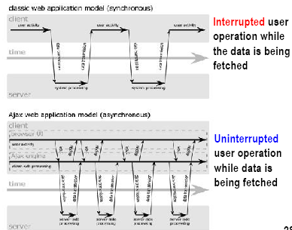
Notes:
I assume some of you have seen this picture before. This picture
compares the user interaction models of conventional web
application in the top half of the slide against AJAX-fied web
application in the bottom part of the slide.
On the top, it is how a user interaction occurs when conventional
web application is used. Here a user has to stop and wait until a
response is received. What this means is that data fetching activity
interrupts the user operation.
The bottom picture shows how a user interaction occurs for AJAX
application. In this model, a user keeps operating since the data
fetching occurs in the background.

Slide 9
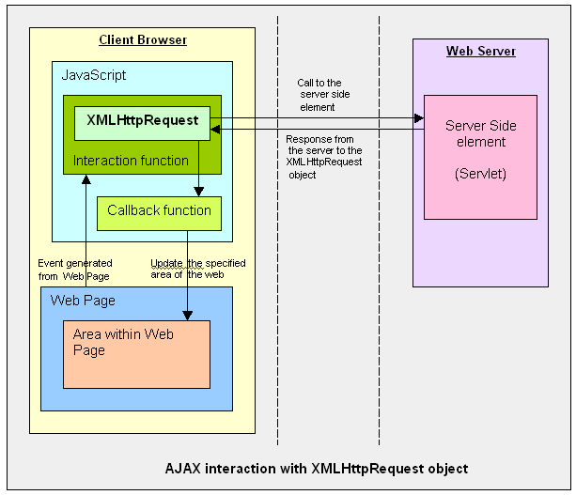
Ajax Interaction
Notes:
So how does AJAX application performs the asynchronous
communication with the server?
This slide also compares conventional web application and AJAX
application. In the left side, which shows the conventional web
application, HTTP request/response interaction occurs directly
between a browser and a backend web application.
In the right side, which shows AJAX based web application, within
a browser, there is AJAX engine, which is actually represented by a
JavaScript object called XMLHttpRequest which handles the HTTP
request/response interaction in an asynchronous fashion.

Slide 10
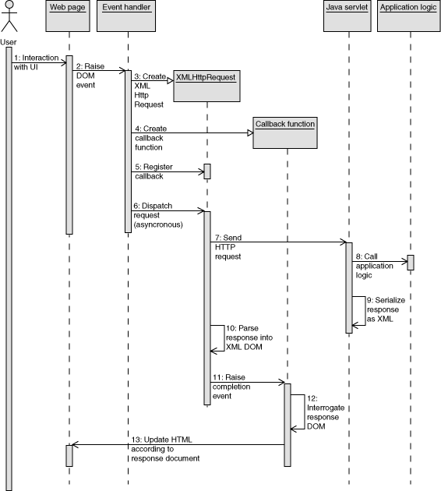
AJAX –SEQUENCE

Slide 11
Technologies Used In AJAX
Javascript
  Loosely typed scripting language
  JavaScript function is called when an event in a page occurs
  Glue for the whole AJAX operation
DOM
  API for accessing and manipulating structured documents
  Represents the structure of XML and HTML documents
CSS
  Allows for a clear separation of the presentation style from the content and may be changed programmatically by JavaScript
XMLHttpRequest
  JavaScript object that performs asynchronous interaction with the server
Notes:
This slide shows the technologies used in AJAX.
* JavaScript - JavaScript is a loosely typed object based scripting
language supported by all major browsers and essential for AJAX
interactions. JavaScript functions in a page are invoked as event
handlers when an event in a page occurs such as a page load, a
mouse click, or a key press in a form element.
* DOM - is API for accessing and manipulating structured
documents. In most cases DOM represent the structure of XML or
HTML documents.
* CSS - Allows you to define the presentation of a page such as
fonts, colors, sizes, and positioning. CSS allow for a clear separation
of the style from the content and may be changed programatically by
JavaScript.
* HTTP - Understanding the basic request/response interaction
model of HTTP is important for a developer using AJAX. You will be
exposed to the GET and PUT method when configuring an
XMLHttpRequest and HTTP response codes when processing
callback.

Slide 12
XMLHttpRequest
JavaScript object
Adopted by modern browsers
  Mozilla™, Firefox, Safari, and Opera
Communicates with a server via standard HTTP GET/POST
Object works in the background for performing asynchronous communication with the backend server
  Does not interrupt user operation
Notes:
Now let's talk about XMLHttpRequest a bit. It is a JavaScript object,
which means it gets created within a JavaScript code.
The XMLHttpRequest JavaScript object is supported in most modern
browsers.
It is the AJAX engine that performs the HTTP request/response
interaction with the backend web application in asynchronous
fashion.

Slide 13
Server-Side AJAX Request Processing
Server programming model remains the same
  It receives standard HTTP GETs/POSTs
  Can use Servlet, JSP, JSF, ...
With minor constraints
  More frequent and finer-grained requests from client
  Response content type can be
    text/xml
    text/plain
    text/json
    text/javascript
Notes:
Now, how does server side web application handle the AJAX
interaction with the browser? Well as far as Server side code is
concerned, it is just another HTTP request that comes in. The server
side does not even know the browser is sending the HTTP request
in asynchronous fashion and it should not.
What this means is that the server side web application can use any
server side technology of its choice such as servlet, JSP, JSF,
Struts, or whatever.
The server side application however has minor constraints. First, it is
possible the client might send more frequent and finer grained
requests. The response type can be text/xml, text/plain, text/json, or
text/javascript.

Slide 14
Client event
A JavaScript function is called as the result of an event
  <input type="text“ size="20"
  id="userid“ name="id“ onkeyup="validateUserId();">
When the use types a character into a input text form field, whose id is set to “userid”.
This user triggered event is captured as JavaScript event called “onkeyup” , validateUserId() is then called as a result.

Slide 15
An XMLHttpRequest object is created
  A XMLHttpRequest Object gets created for IE and Mozilla in different ways
  var req;
  function initRequest() {
  if (window.XMLHttpRequest) {
  req = new XMLHttpRequest();
  } else if (window.ActiveXObject) {
  isIE = true;
  req = new ActiveXObject("Microsoft.XMLHTTP");
  }
  }
Used For Mozilla type Browsers
Used for IE Browser

Slide 16
An XMLHttpRequest object is configured with a callback function
req = new XMLHttpRequest();
target = document.getElementById("myinputid");
var url = "CharacterCount?id=" + target.value;
req.onreadystatechange = processRequest;
req.open("GET", url, true);
req.send(null);
Callback Function Name
True to indicate Async Call.
Post Data ,Always “null” for GET

Slide 17
XMLHttpRequest object makes an async. request
URL is set to validate?id=ram
The “open” method of the XMLHttpRequest requires three parameters:
  HTTP method, which is GET or POST;
  URL of the server-side component to interact
  Boolean indicating – the call is asynchronous or not.
Most cases, it is set to “true”, which means the HTTP request/response interaction occurs in asynchronous fashion.

Slide 18
function and processes the result
  function processRequest() {
  if (req.readyState == 4) {
  if (req.status == 200) {
  var message = ...; }}
The combination of two things
  readyState value of the XMLHttpRequest is 4
  HTTP Status returned from server: 200 = OK
    indicates that the data from the server has been successfully received by the client.
Onreadystatechange
  Set with an JavaScript event handler that fires at each state change
  Event is fired, when the readyState property of the XMLHttpRequest changes.

Slide 19
readyState – current status of request
UNSENT
  The XMLHttpRequest client has been created,
  open() method hasn't been called yet.
OPENED
  open() method has been invoked.
  Request headers can be set using the setRequestHeader() method
  Send() method can be called to initiate the fetch.
HEADERS_RECEIVED
  send() has been called and the response headers have been received.
LOADING
  Response's body is being received.
  If responseType is "text" or empty string, responseText will have the partial text response as it loads.
DONE
  The fetch operation is complete.
  This could mean that either the data transfer has been completed successfully or failed.

Slide 20
readyState –Internet Explorer
READYSTATE_UNINITIALIZED (0),
READYSTATE_LOADING (1),
READYSTATE_LOADED (2),
READYSTATE_INTERACTIVE (3)
READYSTATE_COMPLETE (4)

Slide 21
responseType
responseType : String
  Determines the type returned by response.
  Must be set to one of the following:
    Text
    Arraybuffer
    'blob‘
    Document
    Json

Slide 22
Initialize XHR Object
  var xhr;
  function initRequest(){
  if(window.XMLHttpRequest)
  {
  xhr = new XMLHttpRequest();
  }
  else if(window.ActiveXObject)
  {
  xhr=new ActiveXObject("Microsoft.XMLHTTP");
  }
  console.log(xhr);
  }

Slide 23
Make Ajax Call
  function load(url){
  initRequest();
  xhr.open("GET",url,true);
  xhr.onreadystatechange=processResponse;
  xhr.send(null);
  }

Slide 24
Call Back Function
  function processResponse(){
  if(xhr.readyState == 4 && xhr.status == 200)
  {
  var element = document.getElementById("placeHolder");
  element.innerHTML= xhr.responseText;
  }
  }
  var anchors = document.getElementsByTagName("a");
  for(let i =0;i<anchors.length;i++)
  {
  anchors[i].addEventListener("click", function(event){
  event.preventDefault();
  var url = this.getAttribute("data-file");
  load(url);
  })
  }

Slide 25
Web Page
  <a href="#" data-file="HtmlContent.html #p2">HTML</a>
  <a href="#" data-file="CssContent.html">CSS</a>
  <a href="#" data-file="jQueryContent.html">JavaScript</a>
  <section id="placeHolder"> </section>

Slide 26
Events
  xhr.onloadstart=function(){
  console.log("Load Start"+xhr.readyState);
  }
  xhr.open('GET', '/api', true);
  console.log('OPENED‘,xhr.readyState);
  xhr.onprogress = function () {
  console.log('LOADING', xhr.readyState);
  }
  xhr.onload = function () {
  console.log('DONE', xhr.readyState);
  }
  xhr.send(null);

Slide 27
JSON
(JavaScript Object Notation)
https://tinyurl.com/jcwtayg

Slide 28
JSON (JavaScript Object Notation)
A lightweight data-interchange format
A subset of the object literal notation of JavaScript
Completely language independent
Easy to understand, manipulate and generate

Slide 29
JSON
JSON is NOT
  Overly Complex
  A “document” format
  A markup language
  A programming language

Slide 30
JSON Feature
Straightforward syntax
Easy to create and manipulate
Supported by all major JavaScript frameworks
Supported by most backend technologies

Slide 31
JSON Syntax
Unordered sets of name/value pairs
Begins with { (left brace)
Ends with } (right brace)
Each name is followed by : (colon)
Name/value pairs are separated by , (comma)

Slide 32
Sample JSON Data
  var employeeData = {
  "employee_id": 1234567,
  "name": “Ramesh",
  "hire_date": "1/1/2013",
  "location": “Chennai",
  "consultant": false
  };

Slide 33
Arrays in JSON
An ordered collection of values
Begins with [ (left bracket)
Ends with ] (right bracket)
Name/value pairs are separated by , (comma)

Slide 34
JSON Array
  var employeeData = {
  "employee_id": 1236937,
  "name": “Ramesh",
  "hire_date": "1/1/2013",
  "location": “Chennai",
  "consultant": false,
  "random_nums": [ 24,65,12,94 ]
  };

Slide 35
Data Types: Objects & Arrays
Objects: Unordered key/value pairs wrapped in { }
Arrays: Ordered key/value pairs wrapped in [ ]
Array Objects
data = [{ id: '101', name: "Samsung" }, { id: '102', name: "Lenovo" }]

Slide 36
JSON Data
  lanPlayerList = [
  {
  player: {
  firstName: 'Sangakara',
  lastName: 'Kumar'
  },
  runs: 3420,
  iplteam: "Chennai Super kings",
  }
  ]

Slide 37
JSON Parse
The JSON.parse() method parses a string as JSON
var city='{"location": "chennai"}';
loc =JSON.parse(city);
alert(loc.location);

Slide 38
JSON Stringify
Need a JSON parser or a function, stringify(), to convert between JavaScript objects and JSON encoded data.
var emp={1:"Ramesh"};
var strEmp= JSON.stringify(emp);
alert(strEmp.slice(6,9));

Slide 39
XML vs. JSON (in AJAX Application)
JSON produces slightly smaller documents
JSON is easier to use in JavaScript
Parsing JSON encoded data is much faster than parsing XML encoded data
Plain text formats
“Self-describing“ (human readable)
Hierarchical (Values can contain lists of objects or values)

Slide 40
<?xml version='1.0' encoding='UTF-8'?>
<card>
<fullname>Sean Kelly</fullname>
<org>SK Consulting</org>
<emailaddrs>
<address type='work'>kelly@seankelly.biz</address>
<address type='home' pref='1'>kelly@seankelly.tv</address>
</emailaddrs>
<telephones>
<tel type='work' pref='1'>+1 214 555 1212</tel>
<tel type='fax'>+1 214 555 1213</tel>
<tel type='mobile'>+1 214 555 1214</tel>
</telephones>
<addresses>
<address type='work' format='us'>1234 Main St
Springfield, TX 78080-1216</address>
<address type='home' format='us'>5678 Main St
Springfield, TX 78080-1316</address>
</addresses>
<urls>
<address type='work'>http://seankelly.biz/</address>
<address type='home'>http://seankelly.tv/</address>
</urls>
</card>

Slide 41
{
"fullname": "Sean Kelly",
"org": "SK Consulting",
"emailaddrs": [
{"type": "work", "value": "kelly@seankelly.biz"},
{"type": "home", "pref": 1, "value": "kelly@seankelly.tv"}
],
"telephones": [
{"type": "work", "pref": 1, "value": "+1 214 555 1212"},
{"type": "fax", "value": "+1 214 555 1213"},
{"type": "mobile", "value": "+1 214 555 1214"}
],
"addresses": [
{"type": "work", "format": "us",
"value": "1234 Main StnSpringfield, TX 78080-1216"},
{"type": "home", "format": "us",
"value": "5678 Main StnSpringfield, TX 78080-1316"}
],
"urls": [
{"type": "work", "value": "http://seankelly.biz/"},
{"type": "home", "value": "http://seankelly.tv/"}
]
}

Slide 42
JSON Request
  let url = "https://jsonplaceholder.typicode.com/posts/2";
  xhr.open("GET",url,true);
  xhr.onreadystatechange=processResponse;
  xhr.send(null);

Slide 43
Parsing JSON
  function processResponse(){
  if(xhr.readyState == 4 && xhr.status == 200)
  {
  var element = document.getElementById("placeHolder");
  var response= xhr.responseText;
  var text = JSON.parse(response);
  element.innerHTML=text.body;
  }
  }

Slide 44
Update DOM
  var element = document.getElementById("jsonData");
  element.addEventListener("click", function(){
  load();
  });

Slide 45
POST Request
  function postRequest() {
  var xmlHttp = new XMLHttpRequest();
  var usr=document.f1.username.value;
  data = "user=" +usr;
  var url="SayHello";
  xmlHttp.open('POST', url, true);
  xmlHttp.setRequestHeader('Content-Type',
  'application/x-www-form-urlencoded');
  xmlHttp.onreadystatechange = function() {
  if (xmlHttp.readyState == 4) {
  updatepage(xmlHttp.responseText);
  }
  }
  xmlHttp.send(data);
  }

Slide 46
Cross-Origin Resource Sharing
A W3C spec that allows cross-domain communication from the browser.
A site aaa.com has some data that the site bbb.com wants to access.
  These requests wouldn’t be allowed under the browser’s same origin policy.
Supporting CORS requests, aaa.com can add a few special response headers that allows bbb.com to access the data.
Requires coordination between both the server and client.
Client-side developers are shielded from most of these details.

Slide 47
Http Request
  GET
  /cors HTTP/1.1
  Origin: http://api.bob.com
  Host: api.alice.com
  Accept-Language: en-US
  Connection: keep-alive
  User-Agent: Mozilla/5.0...
A valid CORS request *always* contains an Origin header.
It is added by the browser, and can not be controlled by the user.
The presence of the Origin header does not necessarily mean that the request is a cross-origin request.
Its Implemented by Different Browser in different ways

Slide 48
Http Response
Access-Control-Allow-Origin: http://api.bob.com
All CORS related headers are prefixed with "Access-Control-".
Access-Control-Allow-Origin :
  Included in all valid CORS responses
  Omitting the header will cause the CORS request to fail.
  The value of the header can also use '*'
  “*” allows requests from any origin.

Slide 49
Cache
AJAX application frequently ask the server for the same URL
After The First Request –
  Browser may return the cached page and the AJAX application does not work as expected.
Clearing the browser cache or setting “no cache” parameters on the page does not always work.
The Cache-Control header field is used to specify directives for caching mechanisms in both, requests and responses.
They are unidirectional, a given directive in a request is not implying that the same directive is to be given in the response.
response.setHeader("Cache-Control”,”no-cache”);

Slide 50
Cache
Can add a pseudo-random parameter to the URL the AJAX application is requesting.
var url = “http://mydomain?myParameters=myValues&pseudoParam= “+new Date().getTime();
The Date().getTime(); returns a new value every millisecond the browser thinks this is a new page that has not been cached and requests the URL form the server.
no-cache
  Forces caches to submit the request to the origin server for validation before releasing a cached copy.
Cache-Control: no-cache

Slide 51
No-cache
The “no-cache” directive, tells the browser that it should revalidate with the server before serving the page from the cache.
Revalidation lets the application conserve band-width.
If the page the browser has cached has not changed, the server just signals that to the browser and the page is displayed from the cache.

Slide 52
Optimizing the Critical Rendering Path
A critical resource is a resource that could block initial rendering of the page.
The fewer of these resources, the less work for the browser, the CPU, and other resources.
Critical path length is a function of the dependency graph between the critical resources and their bytesize:
some resource downloads can only be initiated after a previous resource has been processed, and the larger the resource the more roundtrips it takes to download.
Can minimize the transfer size by compressing and optimizing each resource.

Slide 53
Critical Rendering
Sequence of steps to optimize the critical rendering path is:
  Analyze and characterize Critical path: number of resources, bytes, length.
  Minimize number of critical resources: eliminate them, defer their download, mark them as async, and so on.
  Optimize the number of critical bytes to reduce the download time
  Optimize the order in which the remaining critical resources are loaded: download all critical assets as early as possible to shorten the critical path length.

Slide 54
Resources
https://developer.chrome.com/devtools

