Slide 1

Independent Study
Financial Engineering

Slide 2
Strategies Used
Protective Put Strategy
Iron Butterfly Spread
Strangles

Slide 3
Financial Instruments
Stocks
Disney
Tesla
Equity & Index Options
Disney (DIS 19APR 24)
Tesla(TSLA 19APR 24)
S&P500 (SPXW 06MAR 24)
S&P500 (SPXW 19APR 24)

Slide 4
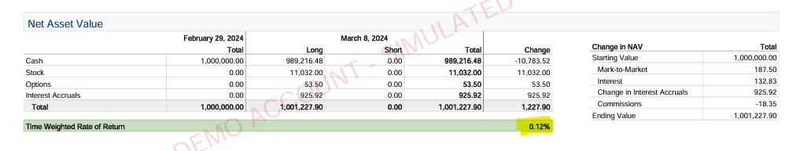
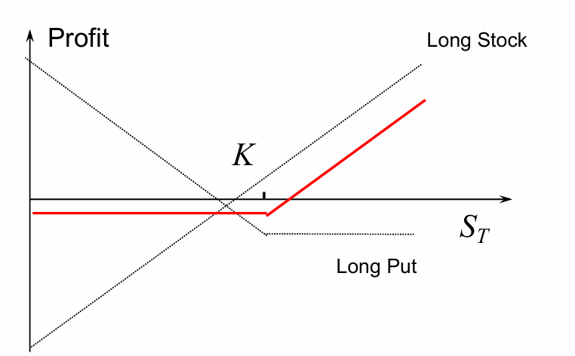
Week1
Strategy
Summary
Protective Put
A protective put strategy involves buying put options for stocks you already own, serving as a form of insurance against a drop in stock price. By purchasing put options, you acquire the right to sell your shares at a predetermined price, known as the strike price, before the option expires. This strategy limits potential losses if the stock price falls below the strike price, as you can sell your stocks at the strike price regardless of the lower market price. The cost of this protection is the premium paid for the put options, which is the only loss if the stock price does not decline.

Slide 5
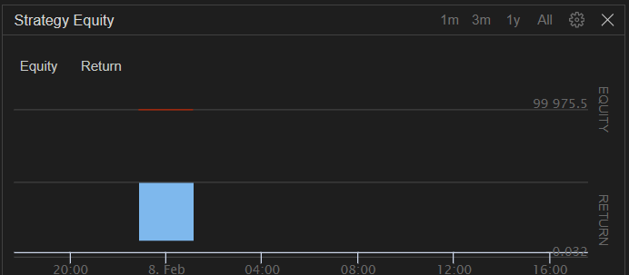
Algorithmic Trading
Protective Put S&P DISNEY

Slide 6
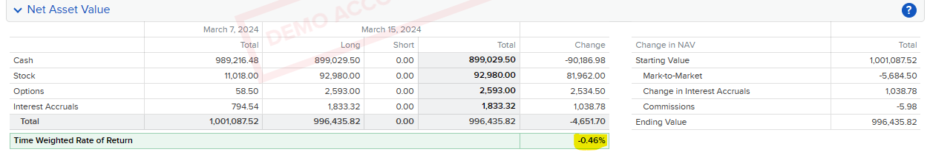
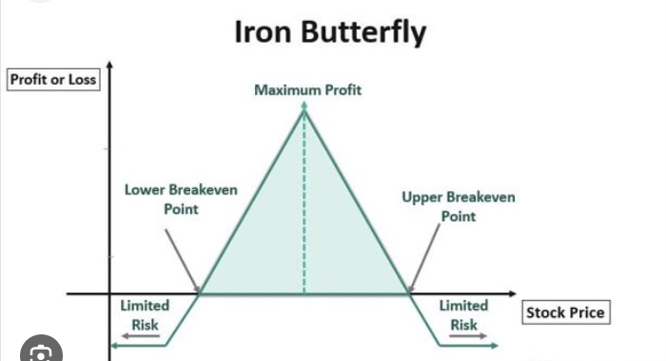
Week2
Strategy Used
We used Iron Butterfly strategy where we will be combining both a long and short position on calls and puts with the same expiration date but at different strike prices.
The strategy involves four options contracts:
Buy a Put at a lower strike price.
Sell a Put at the middle strike price, close to the current level of the underlying asset, which in this case you've specified as 5140.
Sell a Call at the same middle strike price as the put sold.
Buy a Call at a higher strike price.

Slide 7
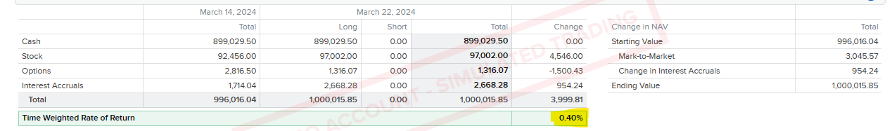
Week3

Slide 8
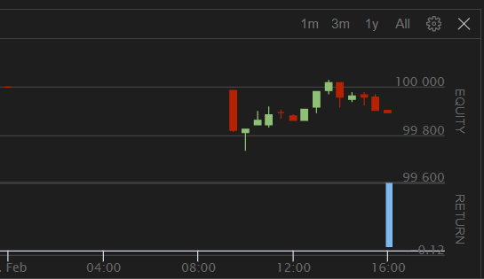
Algorithmic Trading
Protective Put S&P Tesla

Slide 9
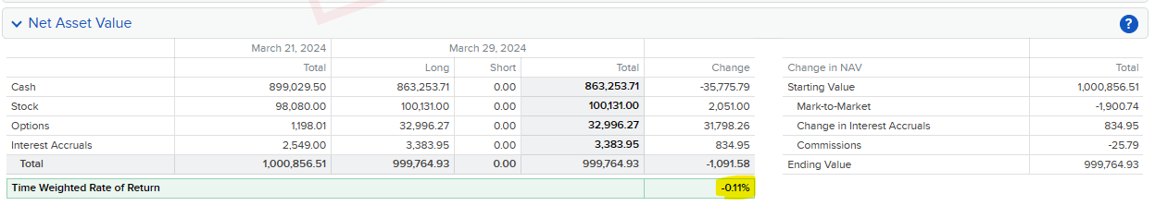
Week4

Slide 10
Strategy changes
In week-4 I have changed my strategies
Closed all my positions in Iron butterfly
Opened positions in Strangles expecting some movement in the S&P Index.

Slide 11
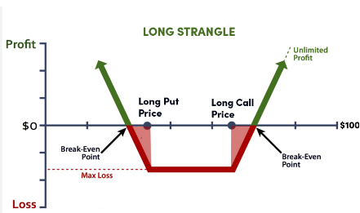
Strangle-Combination
Options strategy involving simultaneous purchase of out-of-the-money (OTM) call and put options on the same underlying asset with the same expiration date.
Call Option: Buy a call with a strike price above the current stock price.
Put Option: Buy a put with a strike price below the current stock price.
Possible Outcomes:
Price Rises: Profit if the stock price rises significantly above the call option's strike price, covering the total premiums paid.
Price Falls: Profit if the stock price falls significantly below the put option's strike price, covering the total premiums paid.
Limited Loss: Maximum loss is limited to the total premiums paid for both options if the price stays between the two strike prices.

Slide 12
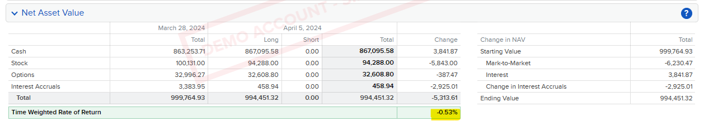
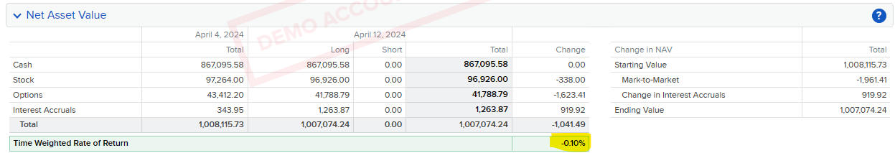
Week5&6

Slide 13
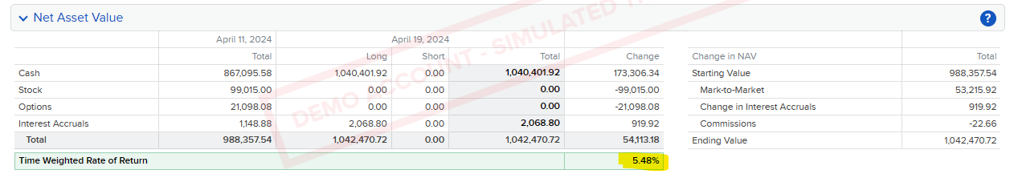
Week7

Slide 14
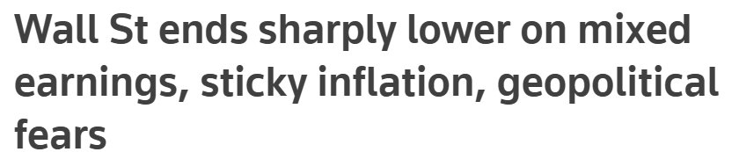
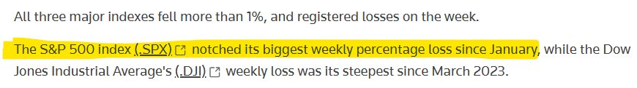
Week7(Cont...)
Possible reasons for change in P/L % of portfolio from –0.10% to +5.48%

Slide 15
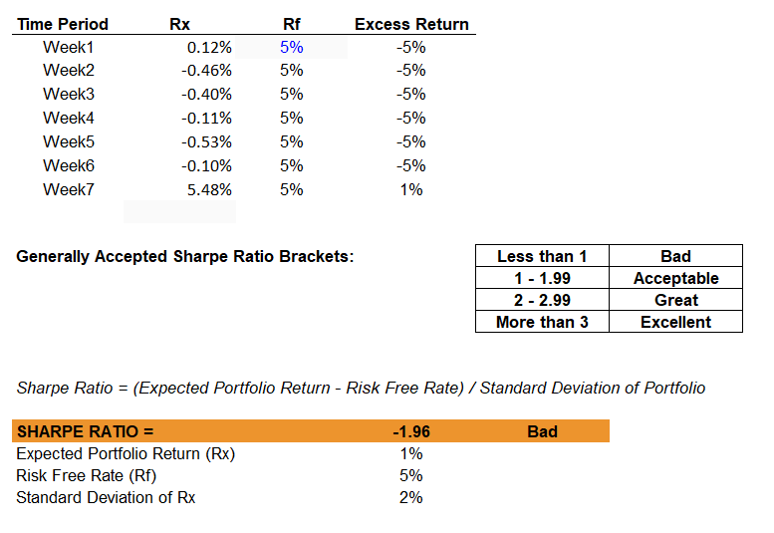
Result and Conclusion
When comparing algorithmic trading to manual trading, there’s a slight variation in the entry points of the
trades made by the algorithm, which resulted in profitability, even though I was experiencing losses in the
manual trades.

Slide 16

Thank You

