Slide 1
Exploring Socioeconomic and Housing Dynamics with Machine Learning to predict Household Income

Slide 2
AGENDA
Research Question
Dataset Overview
EDA
Data Preparation and Feature Selection
Models
Preferred Model
Ensemble Model
Conclusion

Slide 3

Research Question
Main Question:
Can we predict a household's income level based on demographic, housing, and employment characteristics?
Objective:
To explore and analyze the influence of various socioeconomic and housing factors on the income levels of households using machine learning techniques.
Importance:
Understanding the relationship between these factors and household income can help in policy formulation, targeted interventions, and improving economic research.

Slide 4
Data Set overview
Source:
Data derived from the American Community Survey (ACS) 2022.
Specifically, the Public Use Microdata Sample (PUMS) files.
Key Features:
Volume and Scope:
The dataset includes 819,228 records and 241 features.
For the scope of this study, data for 26 states was considered, focusing on the most significant variables.
Selected Features:
Demographics: Age, Sex, Race, Marital Status.
Economic: Household Income, Personal Income, Employment Status.
Housing: Property Value, Monthly Rent, Number of Bedrooms.

Slide 5
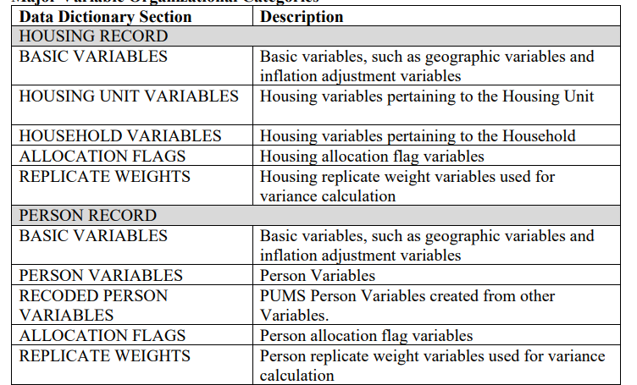
Data Handling:
Storage and Access:
Data is stored and managed using GitHub LFS, ensuring efficient handling of large-scale data.
Preprocessing Considerations:
Initial focus on filtering states with more than 50,000 records to ensure robust sample sizes for analysis.

Slide 6
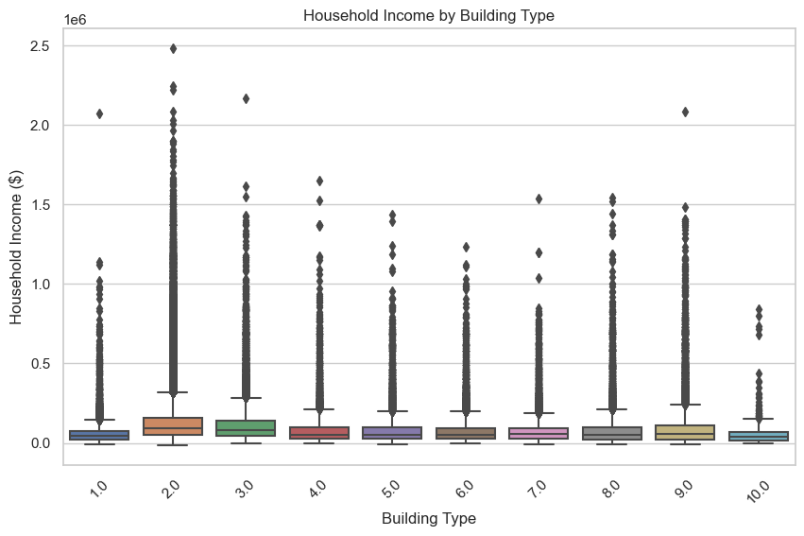
EDA
Key Insights from Data Visualizations:
Household Income by Building Type:
The boxplot indicates a wide variation in income across different building types, with some building types showing more outliers, suggesting higher income variability.
Most building types have a similar median income, but the range differs significantly, pointing to a disparity in income distribution within types.

Slide 7
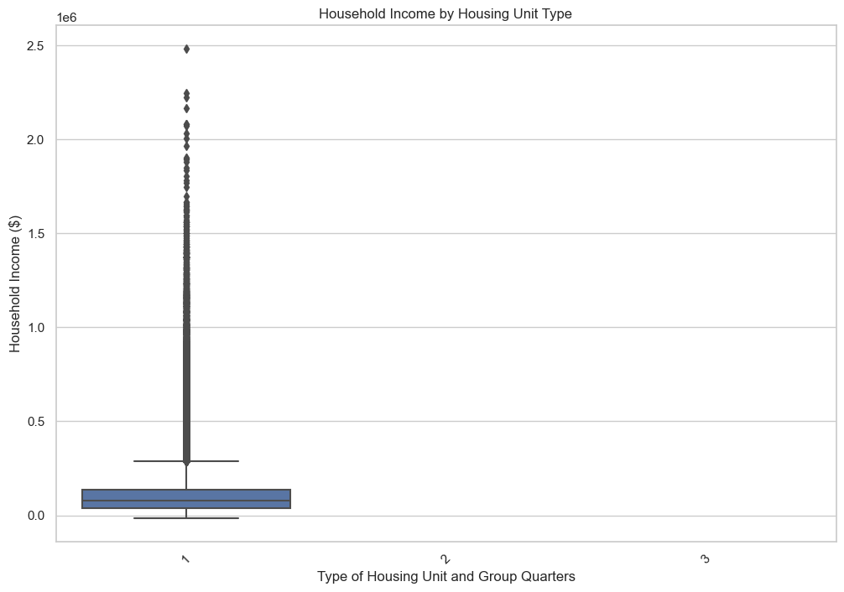
Household Income by Housing Unit Type:
The boxplot shows a concentrated distribution for most housing unit types, with a small number of high-income outliers.
This suggests a general homogeneity in income for the majority of housing types with few exceptions.

Slide 8
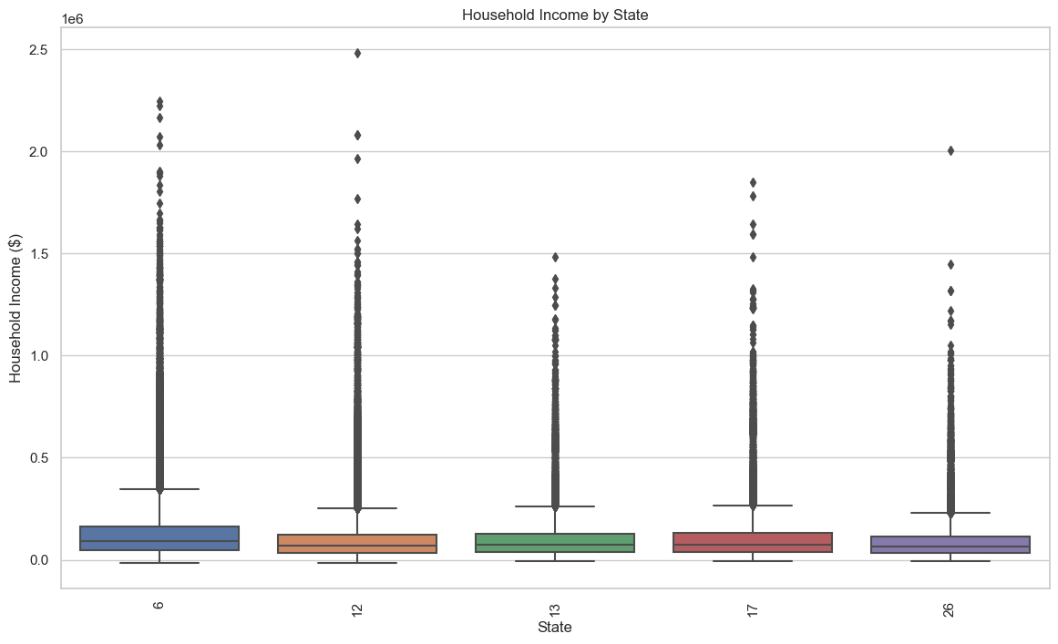
Income Distribution Across States:
The boxplot across different states reveals that some states have a higher median income and more upper-range outliers.
This geographic variation can indicate differing economic conditions or living costs across states.

Slide 9
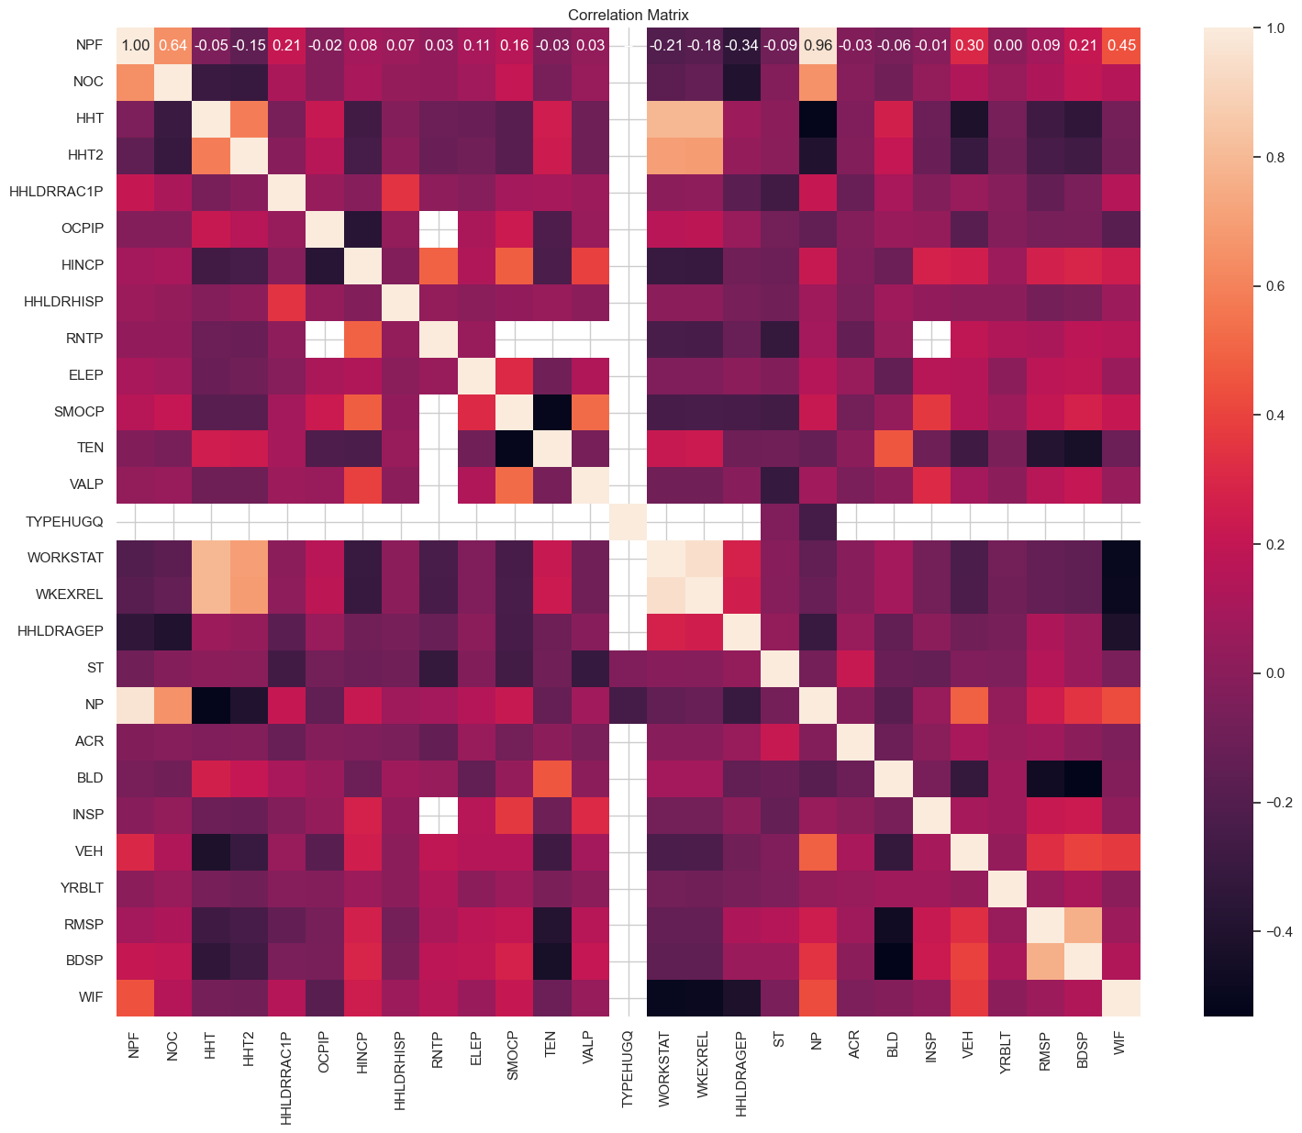
Correlation Analysis:
The heatmap of the correlation matrix highlights significant relationships between household income and variables like property value, rent price, and type of housing unit.
Strong positive correlations between income and property values suggest that as household incomes increase, so do property values.

Slide 10
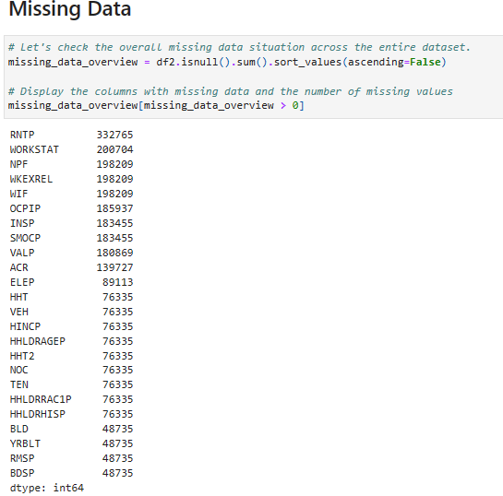
Data Preparation and Feature Selection
Objective:
To clean and prepare the dataset for modeling by handling missing data, imputing values, removing outliers, and encoding categorical variables.
Missing Data Handling:
Overview of Missing Data:
Significant missing values in columns like RNTP, WORKSTAT, and NPF.
Missing data proportions range from minor (e.g., ELEP 20.2%) to major (e.g., RNTP 75.7%).
Actions Taken:
Columns with very high missing rates like RNTP have been handled specifically.
HINCP (Household Income) column missing values were dropped to ensure data integrity for income predictions.

Slide 11
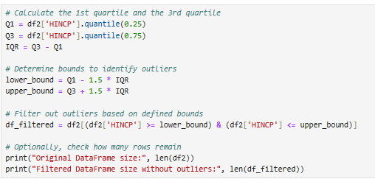
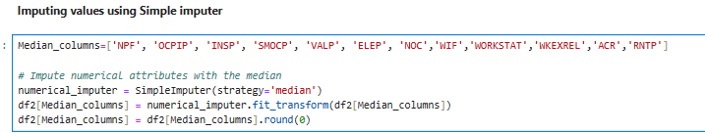
Imputation:
Method:
Used the median for imputing missing numerical values in columns such as NPF, OCPIP, etc.
This method helps retain the central tendency without being affected by outliers.
Outlier Removal:
Process:
Calculated the interquartile range (IQR) and removed outliers beyond 1.5 times the IQR for HINCP and other variables.
This step helps in normalizing the data distribution and improving model accuracy.

Slide 12
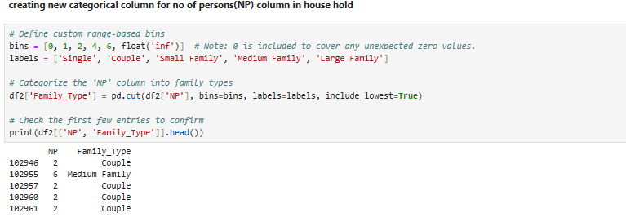
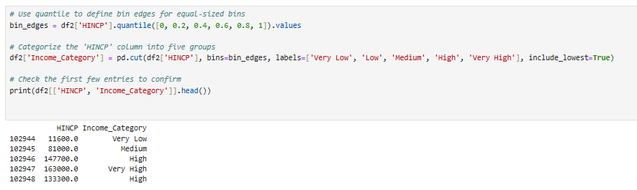
Feature Engineering:
Income Category:
Transformed HINCP into categorical bins (Very Low, Low, Medium, High, Very High) based on quantiles to simplify income analysis.
Household Type and Tenure:
Created new categorical features like Family_Type based on the number of persons and TEN based on the type of tenure.
Standardization and Encoding:
Standardized numerical features to bring them to a common scale.
Applied encoding to transform categorical variables for model compatibility.
Visualization:
Income Distribution:
Visualized the log-transformed household income to analyze the distribution after outlier removal and log transformation

Slide 13
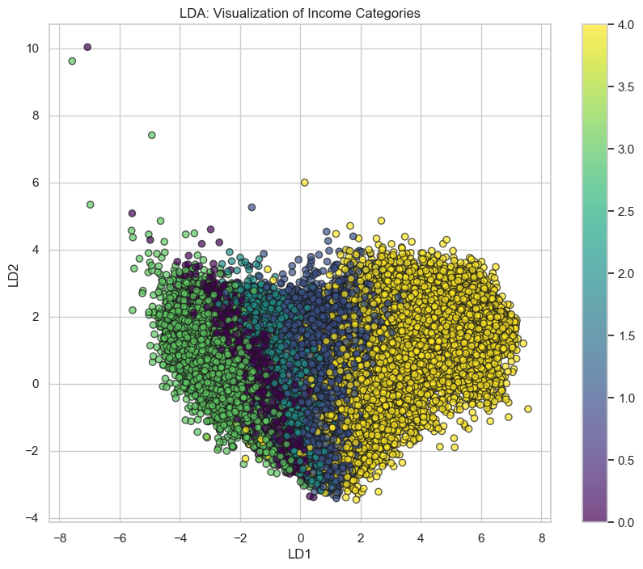
Feature selection
Feature selection is a crucial step to identify the most relevant predictors for our model. In this section, we explore two methods: Linear Discriminant Analysis (LDA) and Random Forest Feature Selection.
Linear Discriminant Analysis (LDA):
LDA is a dimensionality reduction technique used for feature extraction.
We applied LDA to the dataset with the goal of visualizing the separation of income categories.
The number of samples in our dataset is 200,428, with 26 features considered.

Slide 14
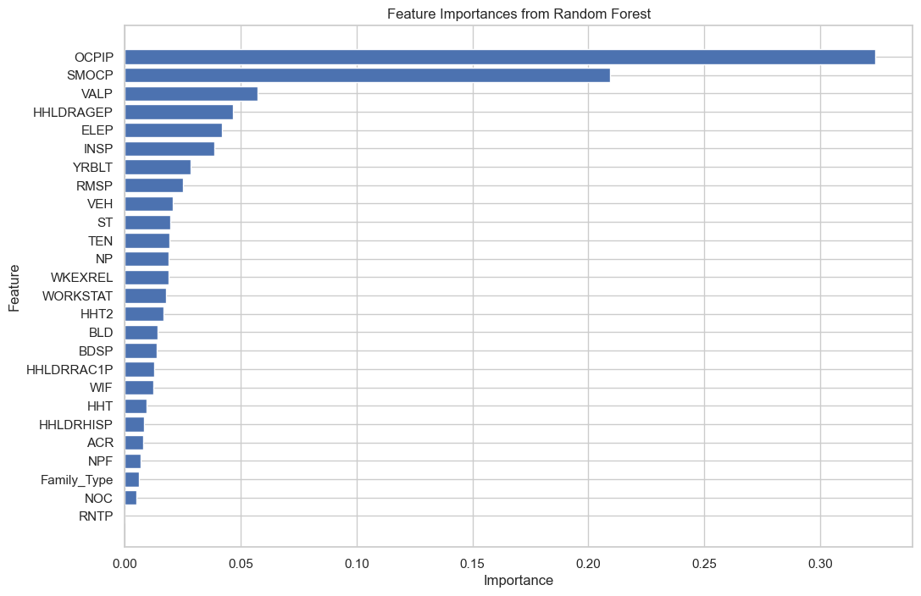
RandomForest feature Selection
Random Forest Feature Selection:
Random Forest is a popular ensemble learning method that provides a feature importance ranking.
We trained a Random Forest classifier to determine the importance of each feature in predicting income categories.
The top features identified by Random Forest include OCPIP, SMOCP, VALP, and others, indicating their significance in our model.

Slide 15
Models
we explore various machine learning models for predicting income categories. We assess the performance of each model and provide insights into their strengths and weaknesses.
We have used:
RandomForest Model
XGBoost Model
Neural Network Model

Slide 16
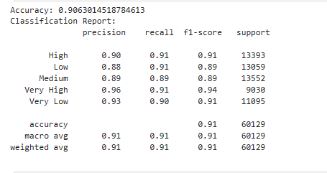
Random Forest Model
We utilized a RandomForestClassifier with 100 estimators to predict income categories.
The model achieved an accuracy of approximately 91% on the test set.
Precision, recall, and F1-score metrics were computed for each income category, showing consistent performance across classes.
The confusion matrix visually represents the model's performance in classifying true and predicted labels.

Slide 17
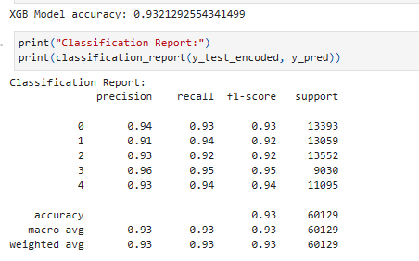
XG Boost Model
An XG Boost classifier was trained using encoded target variables.
The XG Boost model demonstrated higher accuracy compared to RandomForest, reaching approximately 93% on the test set.
Like the RandomForest model, precision, recall, and F1-score metrics were computed for each income category.
The confusion matrix provides a detailed overview of the model's classification performance.

Slide 18
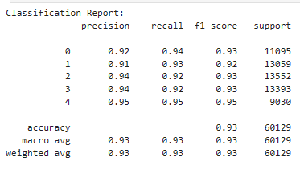
Neural Network Model
A neural network model was constructed using TensorFlow and Keras.
The model consists of multiple layers with ReLU activation functions and softmax activation in the output layer.
Training history indicates the model's progression in accuracy and loss over epochs.
The model achieved an accuracy of around 93% on the test set, demonstrating competitive performance.

Slide 19
Preferred Model
Accuracy Comparison:
Random Forest: Achieved an accuracy of approximately 91%.
XG Boost: Outperformed Random Forest with an accuracy of around 93%.
Neural Network: Demonstrated competitive performance with an accuracy of about 93%.
Precision, Recall, and F1-score:
All models exhibited consistent precision, recall, and F1-score across different income categories.
Precision measures the model's ability to avoid false positives, recall measures its ability to find all relevant cases, and F1-score provides a balance between precision and recall.
Computational Complexity:
Random Forest and XG Boost are ensemble methods and generally faster to train compared to neural networks.
Neural networks, especially deep architectures, may require more computational resources and longer training times.

Slide 20
5. Interpretability:
Random Forest and XG Boost offer feature importances, which provide insights into the importance of each feature for prediction.
Neural networks, particularly deep architectures, are often considered black-box models, making interpretation challenging.
6. Deployment and Scalability:
Random Forest and XG Boost models are easier to deploy and scale due to their simplicity and efficiency.
Neural networks may require specialized hardware for deployment and might not scale well with large datasets.
Based on these considerations, the XG Boost model emerges as the preferred choice due to its superior accuracy, efficient training, and interpretability. However, the final decision should also consider factors such as deployment environment, computational resources, and the need for model interpretability.

Slide 21
Ensemble Model
The implementation of an ensemble model combining Random Forest, XG Boost, and Neural Network classifiers, along with the evaluation of its performance.
Ensemble Model Construction:
We combine predictions from Random Forest, XG Boost, and Neural Network classifiers to create an ensemble model.
Each model provides probability estimates for each class, which are averaged to generate ensemble predictions.
Model Configuration and Training:
Random Forest and XG Boost models are trained using their respective classifiers with suitable hyperparameters.
The Neural Network architecture consists of multiple dense layers with ReLU activation, trained using the Adam optimizer.

Slide 22

3. Performance Evaluation:
Ensemble accuracy: 93.19%
We achieve a high accuracy by combining the predictions of individual models.
Ensemble methods often lead to improved generalization and robustness compared to individual models.

Slide 23
Conclusion
Our analysis included the implementation of various algorithms such as XGBoost, Random Forest, and Neural Networks. Each model underwent preprocessing steps, including one-hot encoding for categorical variables and scaling for numerical features, ensuring consistent data handling across the pipeline.
Upon evaluation, our models demonstrated promising performance, with XGBoost achieving an accuracy of approximately 93.21%, Random Forest achieving 90.63%, and the Neural Network reaching 93.17%. Additionally, our ensemble model, combining XGBoost and Random Forest, achieved an accuracy of 93.19%. These results indicate the effectiveness of our approach in accurately predicting the target variable.

Slide 24
THANK YOU
Minjae lee
Rahul kanth Panganamamula
Mahanth Dasari

