Slide 1
CAR PRICE PREDICTION
PRESENTED BY:- RAJ KUMAR
BATCH-81

Slide 2
INTRODUCTION
ABC Auto LTD.is new in indian market they wants to understand the factors affecting the pricing of used cars for reselling in the Indian market.
The company wants to know:
Which variables are significant in predicting the price of a car
How well those variables describe the price of a car
Based on various market surveys, the firm has gathered a large data set of different types of cars across the market.

Slide 3
OBJECTIVE
Company wants a model for the price of cars with the available independent variables.
Management wants a model to understand how exactly the prices vary with the Features. They can accordingly set the price of the cars, the business strategy etc.
We need to train a model for better price predictions from survey record.

Slide 4
DATA DESCRIPTION
carID:- ID of car.
Brand :- Brand of Car
Model:- Model of Car.
Year:- Year of Manufacturing
Transmission:- Transmission type of Car
Mileage:- Mileage of Car means how much this vehicle already run
fuel Type:- Fuel required to operate
Tax:- Tax
Mpg:- How much it run in 1 Gallon of fuel.
Engine Size:- Size of engine
Price:- Selling Price

Slide 5
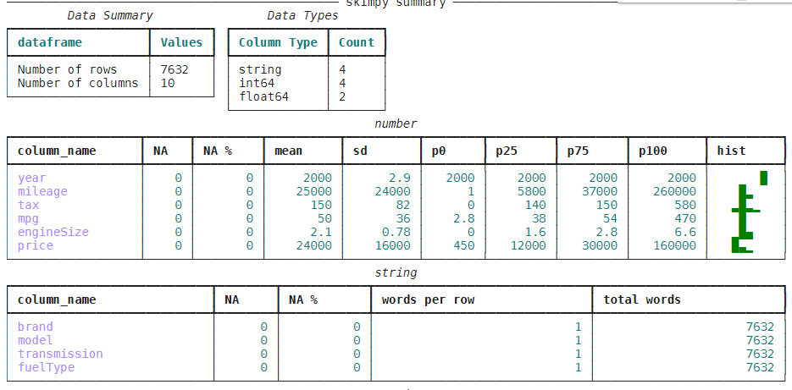
DATA DESCRIPTION

Slide 6
DATA DESCRIPTION
Total 7632 rows and 10 columns.
Datatypes of 4 columns is int
Datatypes of 4 columns is string
Datatypes of 2 columns is float
No null values in any columns

Slide 7
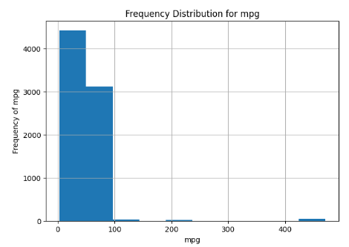
EXPLORATORY DATA ANALYSIS
Most of the cars can runs upto 100 mile per gallon while some car can run upon 200 and 450 mpg.

Slide 8
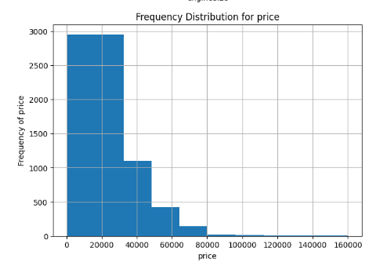
EXPLORATORY DATA ANALYSIS
Most of the cars price is between 20k to 35k USD.
Price of some cars is also gone high till 1.6Lakh USD.

Slide 9
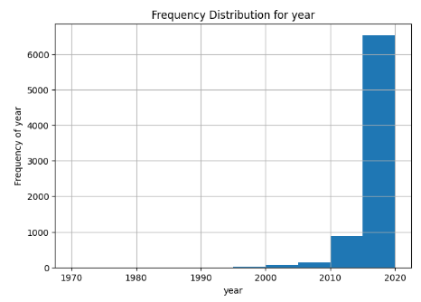
EXPLORATORY DATA ANALYSIS
Most of the cars are between 2015 to 2020.There are some outliers as some cars manufactured before 2012.

Slide 10
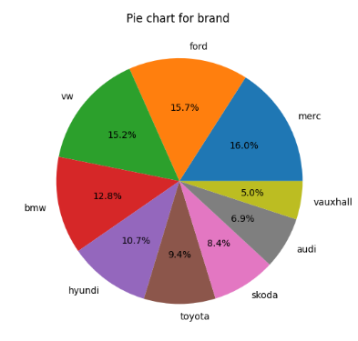
EXPLORATORY DATA ANALYSIS
Brands distribution in reselling cars.

Slide 11
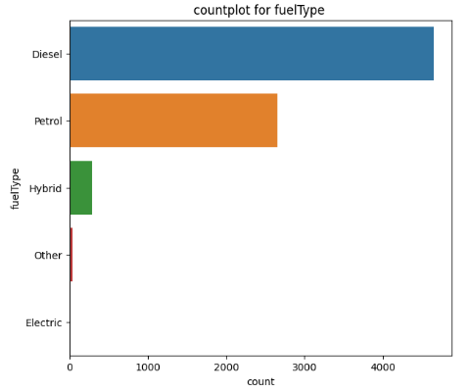
EXPLORATORY DATA ANALYSIS
60% of the total cars are operated by Diesel.

Slide 12
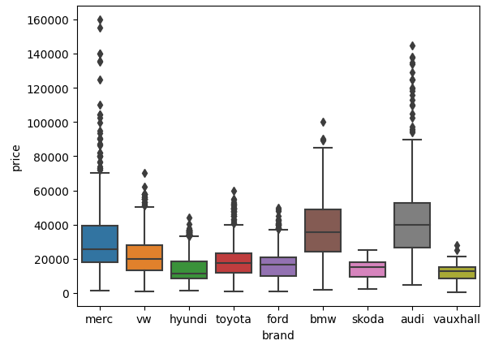
EXPLORATORY DATA ANALYSIS
Audi and Merc are most expensive with some outliers while, vauxhall/skoda are most affordable brand.

Slide 13
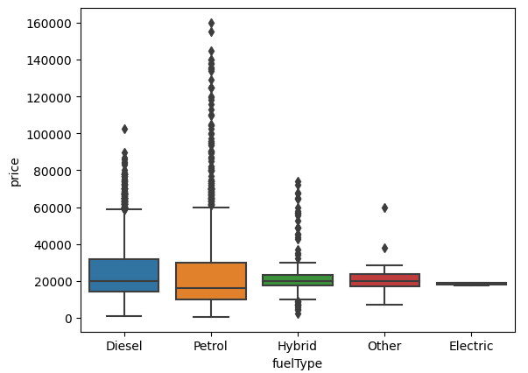
EXPLORATORY DATA ANALYSIS
Price of Electric vehicle is much less as compared to others.
Price of diesel and petrol car is much higher than others,outliers are also detecting.

Slide 14
TRAINING AND TEST DATA
We will use 80% of data for training and 20% data for model testing.
Further we will use train data into 80-20 ratio for train and validation data.
from sklearn.model_selection import train_test_split #importing train test split
x=data.drop(["price"],axis=1) # Except for price all the other data is my features.
y=data["price"] # price is the target
#test size defining that 80% is training data and 20% is test data
x_train,x_test,y_train,y_test=train_test_split(x,y,test_size=.2)
#train data is splitted into train and validation
x_train,x_val,y_train,y_val=train_test_split(x_train,y_train,test_size=0.2)

Slide 15
LINEAR MODELS
We will build some models and analyse the performance of each model on performance metrics.
Model Initialization
from sklearn.linear_model import LinearRegression #importing Linear Regression model
from sklearn.linear_model import Ridge #importing Ridge
from sklearn.linear_model import Lasso #importing Lasso
from sklearn.linear_model import ElasticNet #importing Elasticnet
from sklearn.svm import SVR #importing svr
from sklearn.ensemble import RandomForestRegressor #importing Random_forest
from sklearn.tree import DecisionTreeRegressor #importing Decision tree
from catboost import CatBoostRegressor #importing catboost

Slide 16
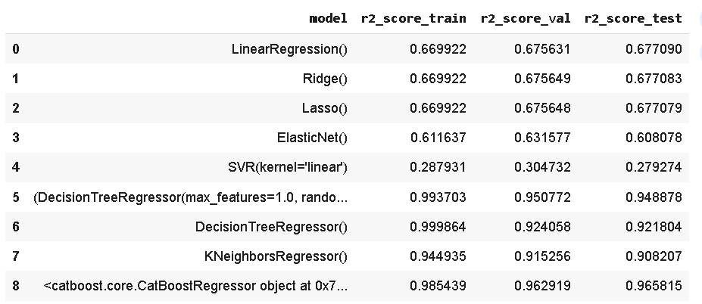
ANALYSIS OF MODELS
R2 score
R-squared values ​​range from 0 to 1, usually expressed as a percentage from 0% to 100%. And this value of R square tells us how well the data fits the line model drawn. The higher the model's R-Squared value, the better the regression line fits the data.

Slide 17
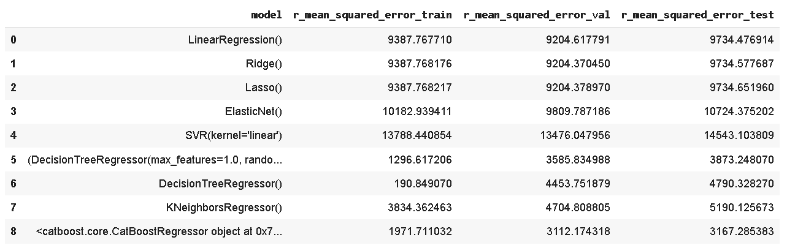
ANALYSIS OF MODELS
Root Mean Squared Error
RMSE is the measure of the root of the mean of the squared errors between the predicted and observed/actual values.

Slide 18
CONCLUSION
Based on the RMSE values on the test dataset, the "CatBoost Regressor" appears to perform the best, followed by Random Forest Regressor and "Decision Tree Regressor.
Based on the R2 scores on the test dataset, the "CatBoost Regressor" seems to perform the best, with an R2 score of 0.965815, followed by the "Random Forest Regressor" and "Decision Tree Regressor" with very similar R2 scores.

Slide 19


