Slide 1

AIRLINE SATISFACTION ANALYSIS
PRESENTED BY:- RAJ KUMAR
BATCH-81

Slide 2
PROBLEM
This data set contains a survey on air passenger satisfaction of Ratra Airlines.
Airline wants to know whether there customers are satisfied with their services or not.
For analysis of the services they conduct survey on customers.

Slide 3
DATA DESCRIPTION
Gender: male or female
Customer type: regular or non-regular airline customer
Age: the actual age of the passenger
Type of travel: the purpose of the passenger's flight (personal or business travel)
Class: business, economy, economy plus
Flight distance
Inflight wifi service: satisfaction level with Wi-Fi service on board (0: not rated; 1-5)
Departure/Arrival time convenient: departure/arrival time satisfaction level (0: not rated; 1-5)
Ease of Online booking: online booking satisfaction rate (0: not rated; 1-5)
Gate location: level of satisfaction with the gate location (0: not rated; 1-5)
Food and drink: food and drink satisfaction level (0: not rated; 1-5)

Slide 4
DATA DESCRIPTION
Online boarding: satisfaction level with online boarding (0: not rated; 1-5)
Seat comfort: seat satisfaction level (0: not rated; 1-5)
Inflight entertainment: satisfaction with inflight entertainment (0: not rated; 1-5)
On-board service: level of satisfaction with on-board service (0: not rated; 1-5)
Leg room service: level of satisfaction with leg room service (0: not rated; 1-5)
Baggage handling: level of satisfaction with baggage handling (0: not rated; 1-5)
Checkin service: level of satisfaction with checkin service (0: not rated; 1-5)
Inflight service: level of satisfaction with inflight service (0: not rated; 1-5)
Cleanliness: level of satisfaction with cleanliness (0: not rated; 1-5)
Departure delay in minutes
Arrival delay in minutes

Slide 5
DATA DESCRIPTION
Dataset contains 50000 Rows and 24 Columns.
Dataset contains 18 int type column.
Dataset contains 1 float type columns.
Dataset contains 5 object type column.

Slide 6
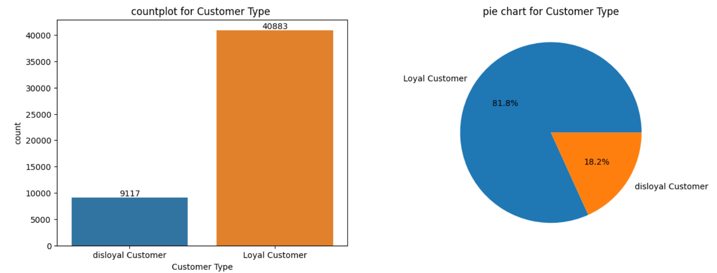
EDA
Dataset contains 81.8% samples of Loyal customer and 18.2% samples of Disloyal customers.

Slide 7
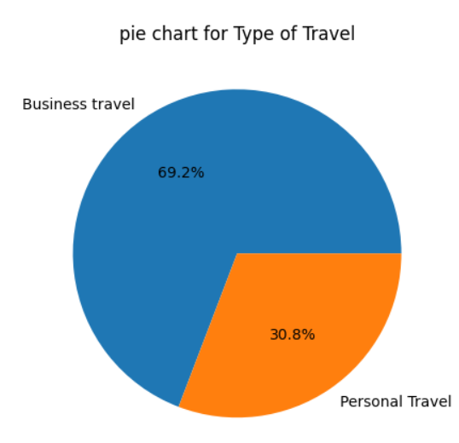
EDA
70% customers uses our services for Business travel while 30% used for Personal Travel.

Slide 8
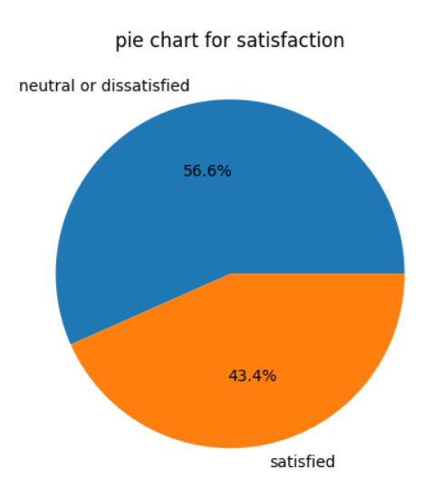
EDA
57 % customers are not fully satisfied with services. It is very disappointing.

Slide 9
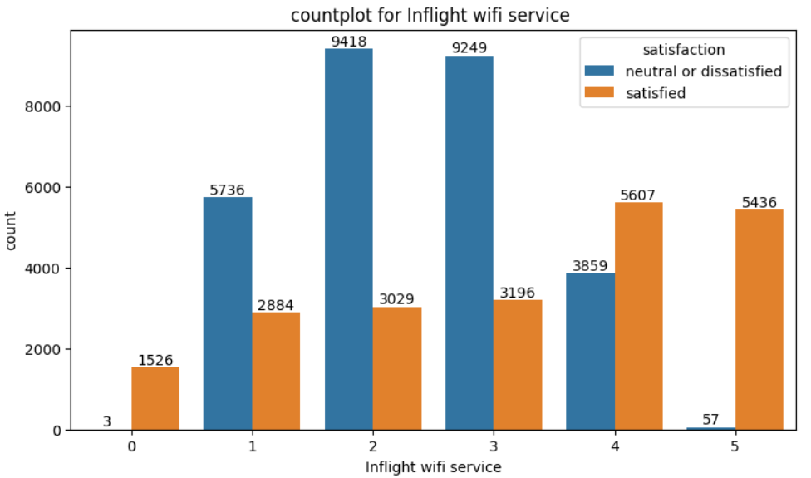
EDA
Wifi service is playing major role in Passengers overall satisfaction score.
Passenger who rate 5 for wifi are most satisfied with overall services among all.

Slide 10
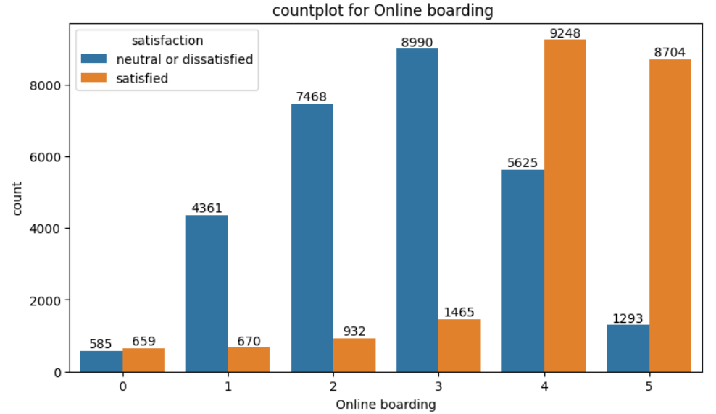
EDA
Online boarding service impact is seen in Passengers overall satisfaction score.
Passenger who rate 4-5 for online boarding are satisfied with overall services amongst all.

Slide 11
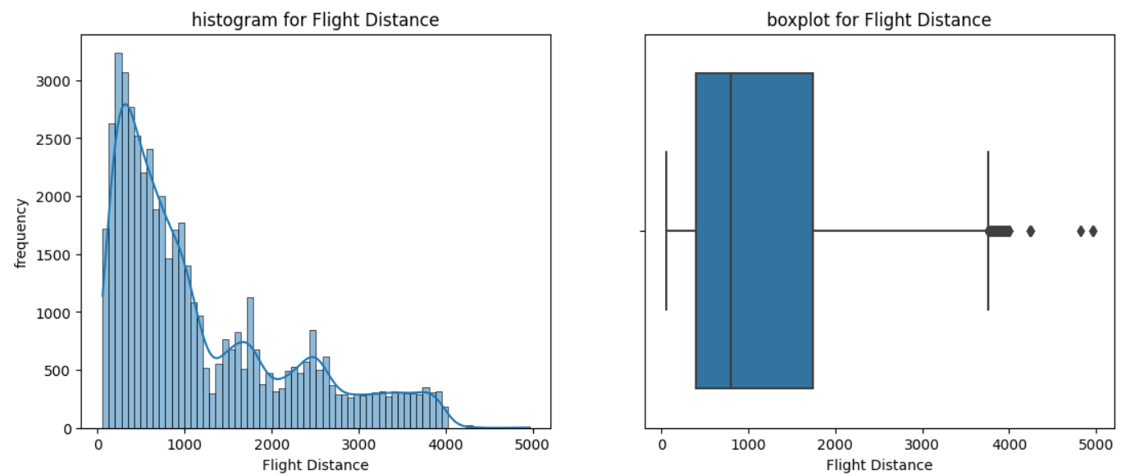
EDA
Most of the customers travel between 400 km to 1800 km.
Only a few passengers travel beyond 4000 km.

Slide 12
TRAINING AND TESTING DATA
We will use 20% data for testing and 80% data for training. While train data will further split into train and validation data.
Satisfaction is dependent feature and rest all are Independent features.
Model will predict for Satisfaction by using all other features.
CODE
#importing train test split from sklearn.model_selection
from sklearn.model_selection import train_test_split
x=data.drop(["satisfaction"],axis=1) #input data to model except result"satisfaction"
y=data["satisfaction"] #satisfaction is prediction
#defining training and test data, test size=0.2 means test data will be 20%.
x_train,x_test,y_train,y_test=train_test_split(x,y,test_size=0.20)
#defining training and validation data,validation data will be 20%.
x_train,x_val,y_train,y_val=train_test_split(x_train,y_train,test_size=0.20)

Slide 13
KNN CLASSIFIER MODEL
Observations based on KNN model :-
Accuracy_score of train data is: 0.9446875
Accuracy_score of val data is: 0.923125
Accuracy_score for test data is: 0.9207
Model is performing good with Validation and test data.

Slide 14
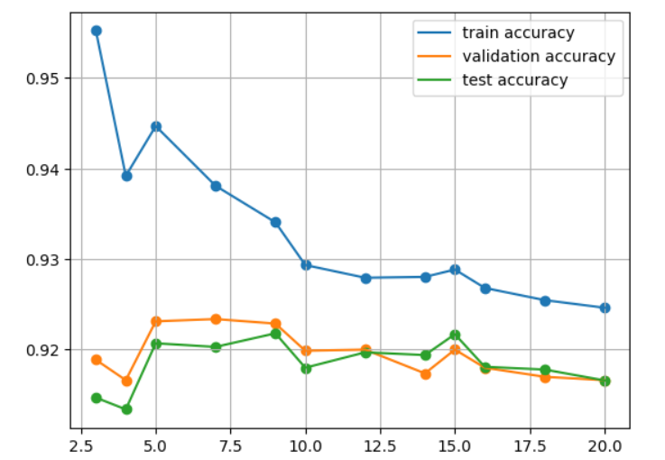
KNN CLASSIFIER MODEL
Accuracy score analysis with different value of K.
From the graph it can be seen that with the value of k=12 model trying to fit best.

Slide 15
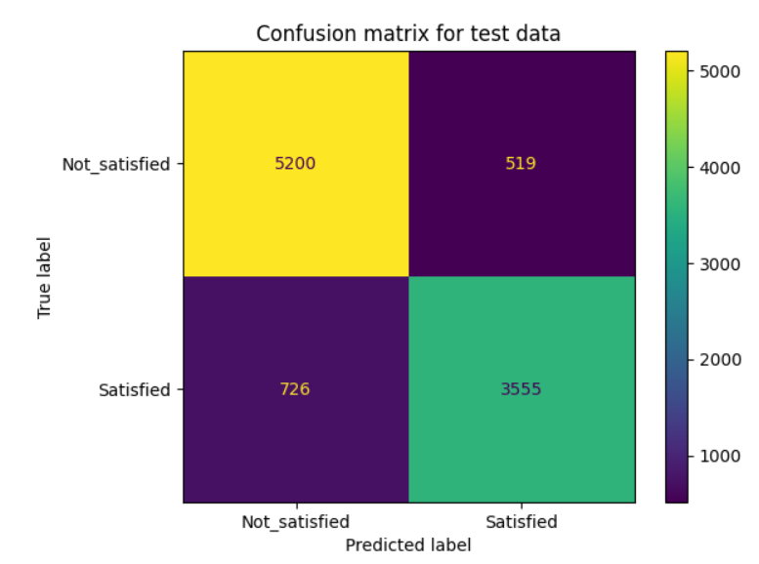
LOGISTIC REGRESSION MODEL
Observations based on Logistic regression model :-
Accuracy score for train data is 87.56875%
Accuracy score for val data is 87.1875%
Accuracy score for test data is 87.55%
From confusion matrix:- Model is performing good for both the classes.

Slide 16
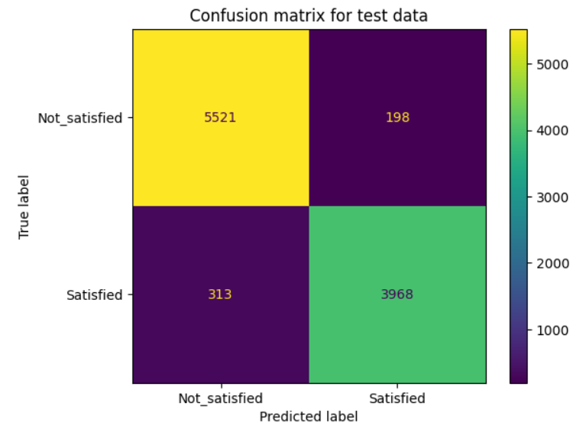
SUPPORT VECTOR CLASSIFIER MODEL
Observations based on SVC model :-
Accuracy score for train data is 0.9576875%
Accuracy score for val data is 0.95175%
Accuracy score for test data is 0.9489%
Model is performing well with all the datasets and for both classes.

Slide 17
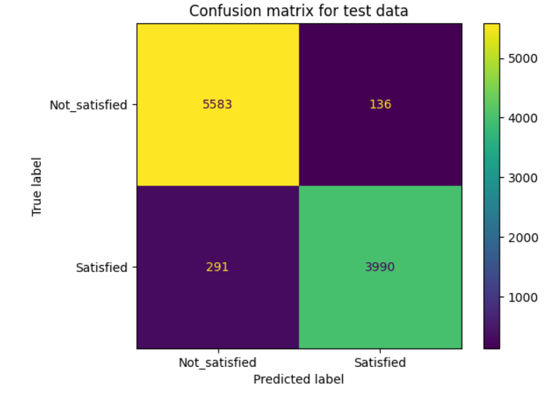
RANDOM FOREST CLASSIFIER MODEL
Observations based on DT classifier model :-
accuracy score for train data is 1.0%
accuracy score for val data is 0.962%
accuracy score for test data is 0.9573%
Model’s accuracy is almost same for validation and test data.

Slide 18
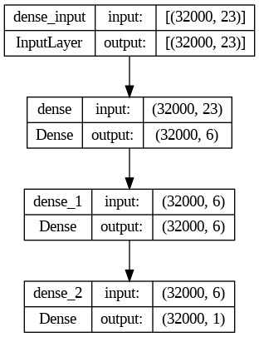
DEEP LEARNING CLASSIFIER MODEL
Architecture of model.
Model has 1 input Layer 1 hidden Layer and 1 output Layer.

Slide 19
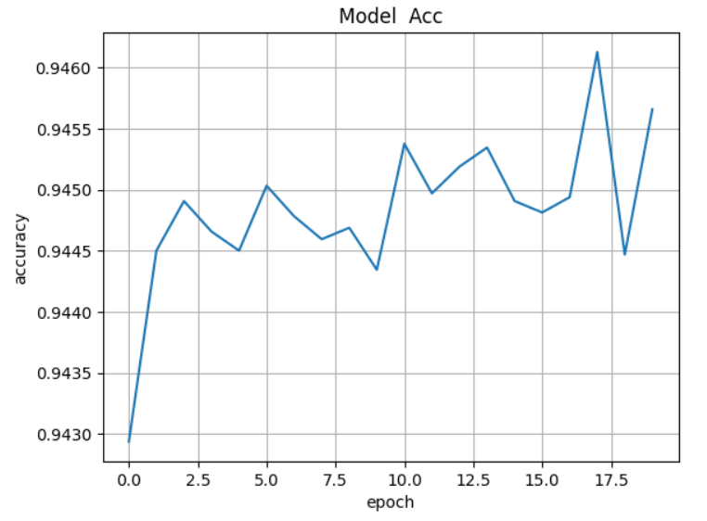
DEEP LEARNING CLASSIFIER MODEL
Epoch:- epoch in machine learning means one complete pass of the training dataset through the algorithm. This epoch’s number is an important hyperparameter for the algorithm.
Here we are using epoch as 20 and Batch size is 20 means train data will be iterate 20 times in each epoch.
Accuracy vs epoch

Slide 20
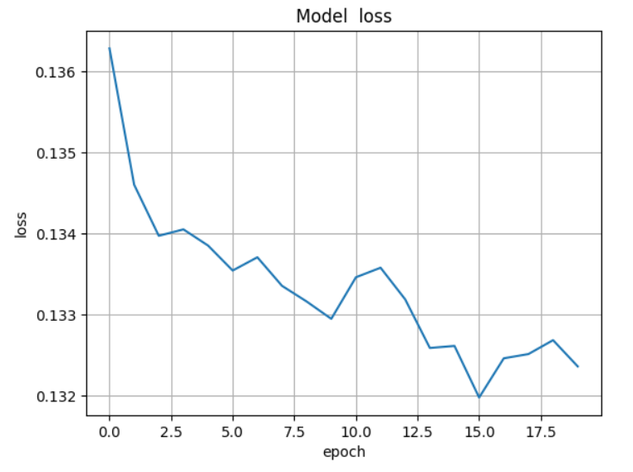
DEEP LEARNING CLASSIFIER MODEL
Loss vs epoch
The accuracy score on test data is : 94.42 %

Slide 21
EVALUATION OF MODELS
We have predictions for all the models.
Based on accuracy score we can see that all model are working good.
Performance of Random forest is good amongst all model.
We can see we achieved same result with deep learning model as well, DL model takes less time as compared to ML models to train and predict on data.
Further we can improve DL accuracy by select appropriate epoch and batch sizes.

Slide 22
THANK YOU

