Slide 1
PIZZA SALES POWER-BI REPORT
Presented By- RAJ KUMAR

Slide 2
Objective
To analyse the Revenue and other Performance results based on data.
Plan for future, Based on outcomes from dashboard analysis.

Slide 3
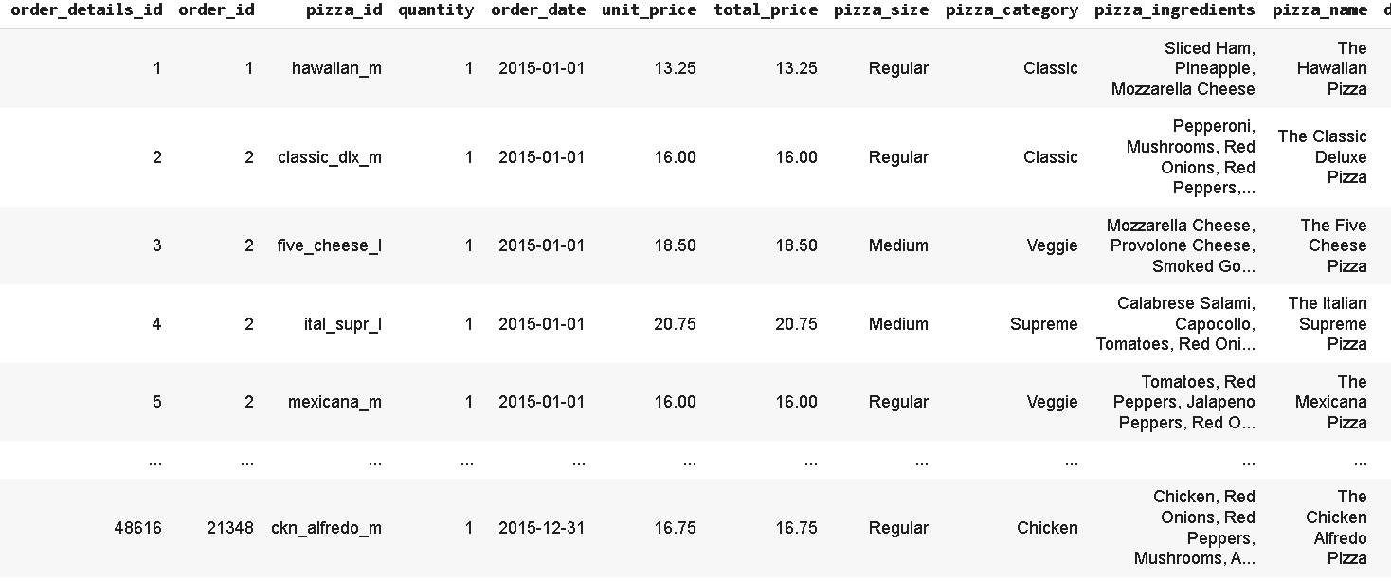
Overview of Dataset
Here is overview of dataset based on this we will do some operations by pandas.

Slide 4
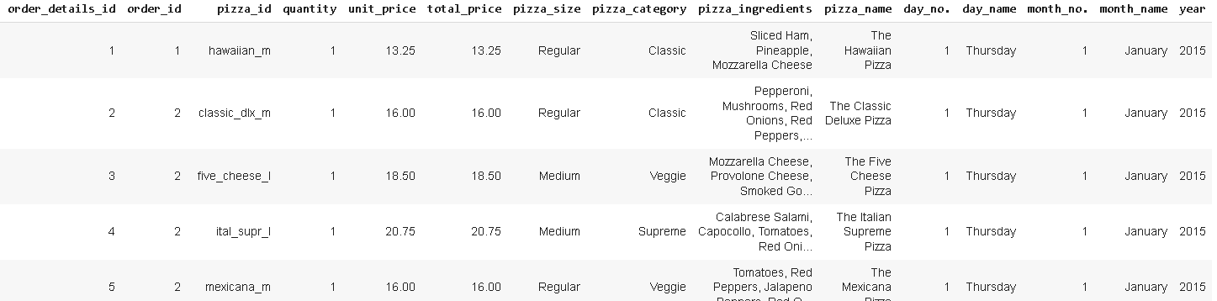
Modified Dataset
overview of final dataset.
We extract day_name,month_name,year etc. from order_date to make ways easy for analysation using PowerBi.

Slide 5
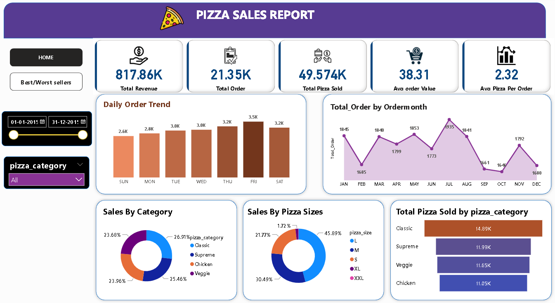
DASHBOARD (page-1)

Slide 6
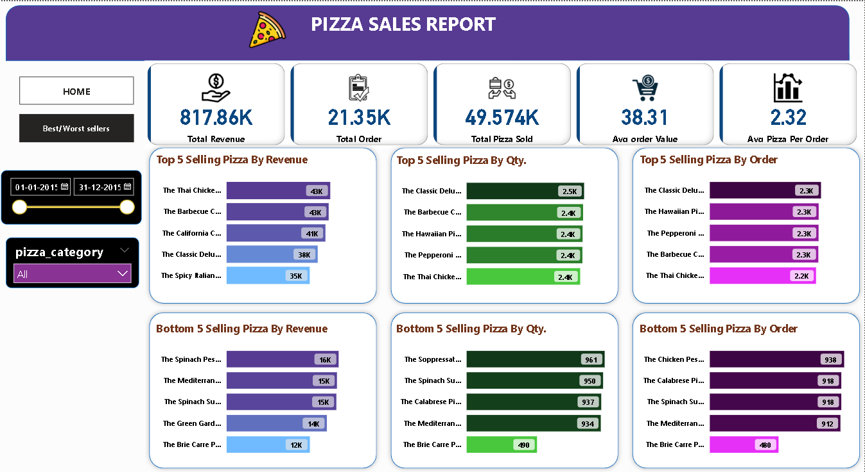
DASHBOARD (page-2)

Slide 7
Outcomes
Total revenue earned for time period is $ 817.86K.
Total Pizza order for the Period is 21.35K with total Qty. sold is 49.574K.
From daily order trend it is observed that maximum order comes on Friday.
From monthly order trend - Maximum orders come from July and August month while it dropped in Dec, Feb, Sep and Oct months.
From sales By category distributions it observed that classic pizza contributes slightly more than other categories.
Large size pizzas have 45% contributions in total revenue.
Based on outcomes from best/worst dashboard management can decide future operation strategy of pizzas.

Slide 8
THANK YOU

