Slide 1

ADIDAS SALES REPORT
PRESENTED BY:- RAJ KUMAR
BATCH-81

Slide 2
Objective
To analyse the Revenue and other Performance results based on data.
Plan for future expansion of stores, Based on outcomes from dashboard analysis.

Slide 3
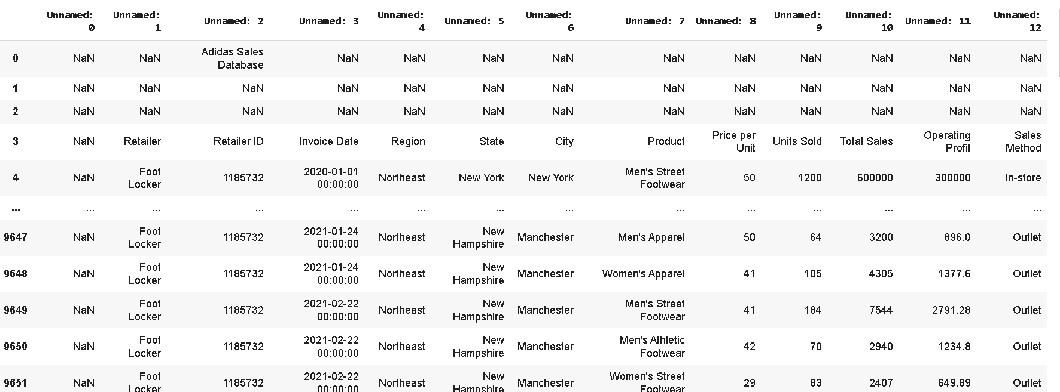
Overview of Dataset
Here is overview of dataset, based on this we will do some cleaning and filtration operations by using pandas.

Slide 4
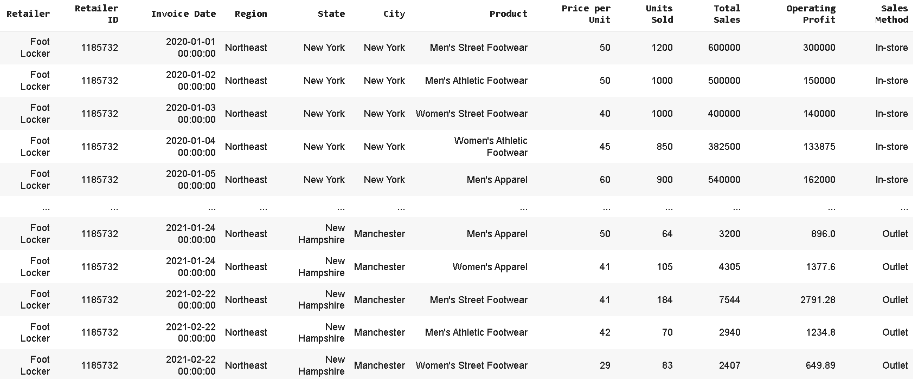
Modified Dataset
overview of final dataset.
We do some cleaning in dataset to make ways easy for analysation using PowerBi.

Slide 5
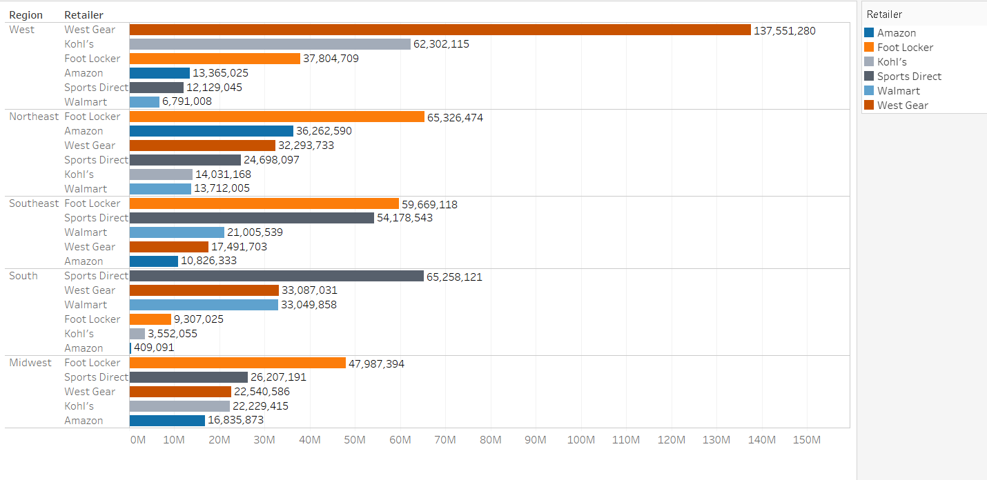
REGION WISE RETAILER SALES

Slide 6
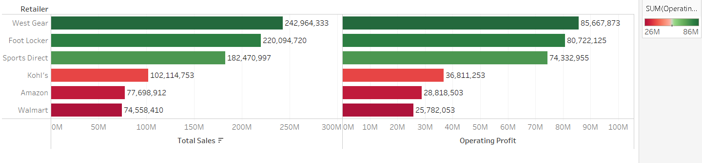
RETAILER WISE SALES AND OPERATING PROFIT

Slide 7
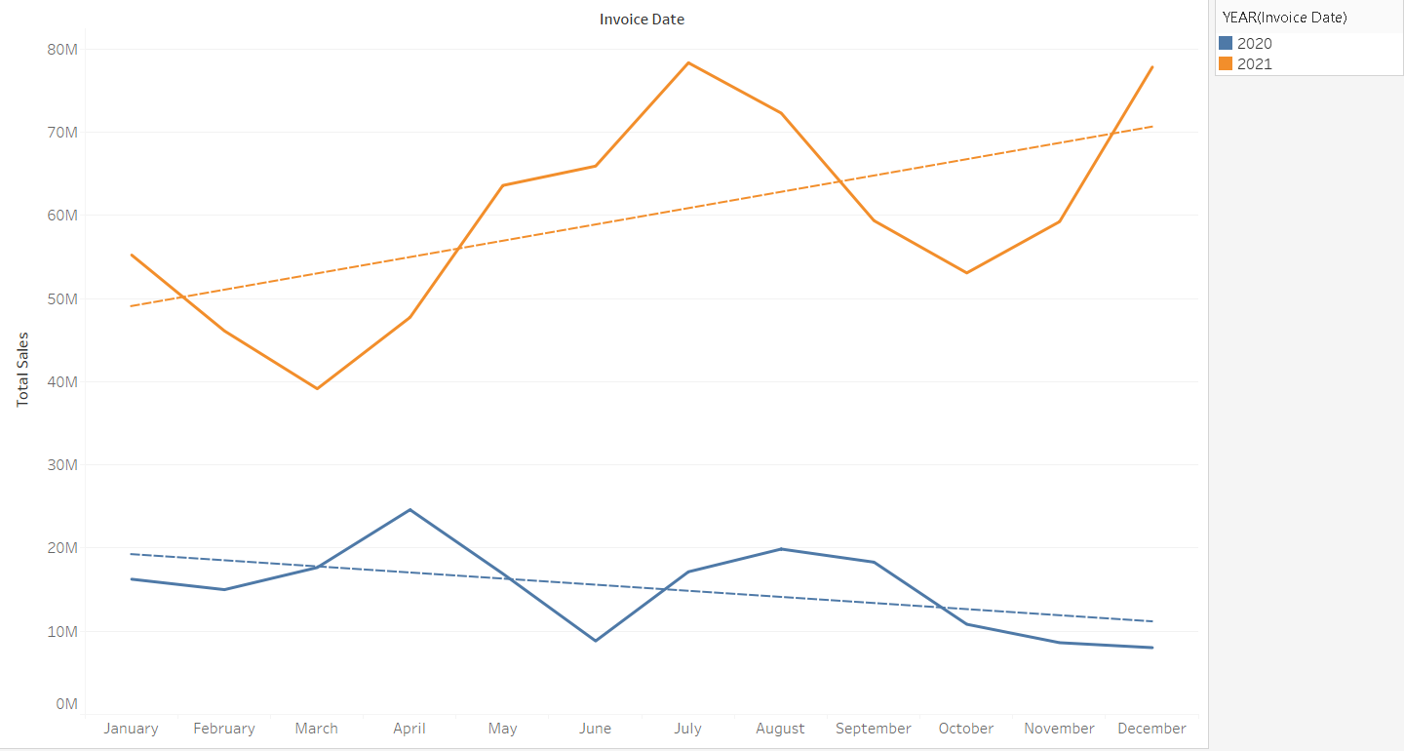
SALE TREND FOR YEARS

Slide 8
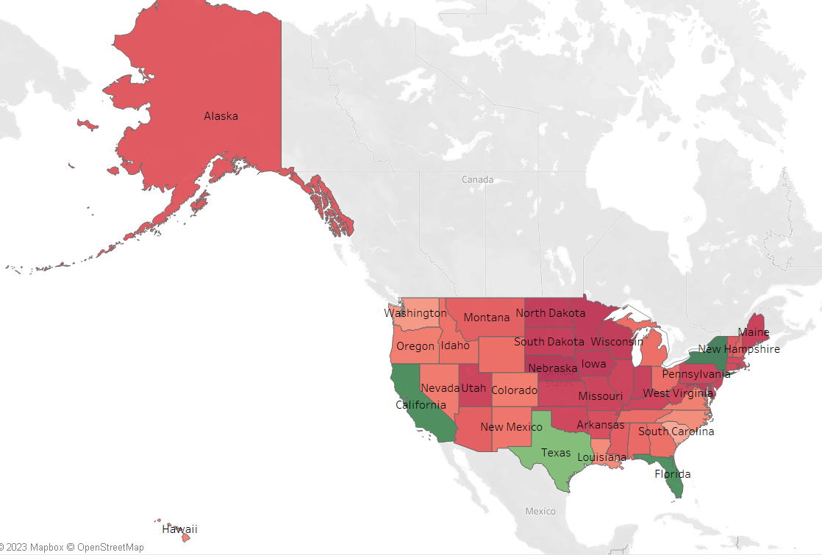
STATE WISE SALES CONTRIBUTION

Slide 9
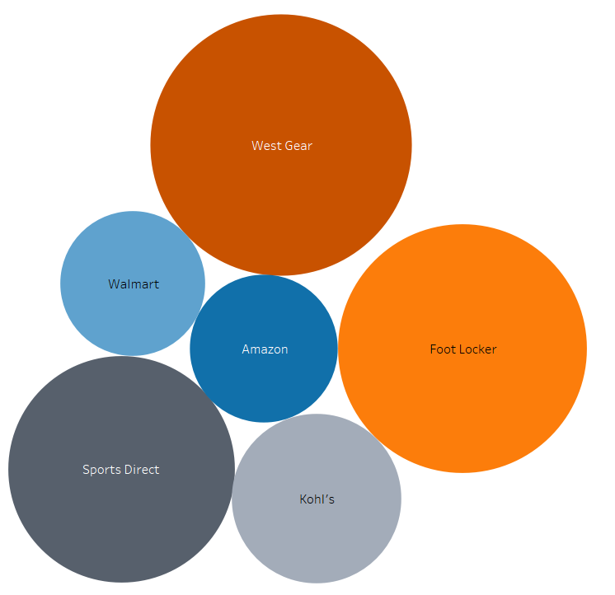
RETAIL STORES CONTRIBUTION IN SALES

Slide 10
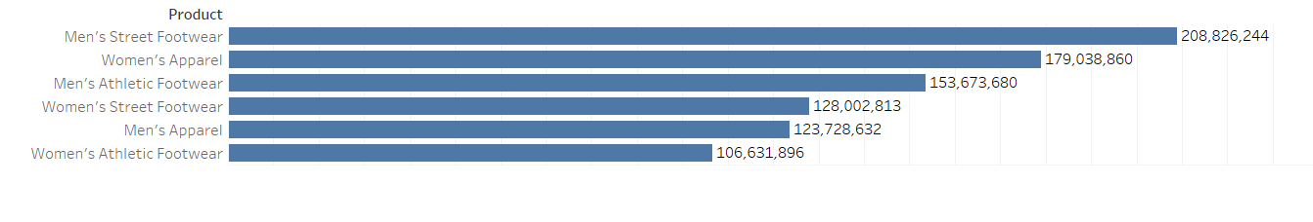
PRODUCT CONTRIBUTION IN SALES

Slide 11
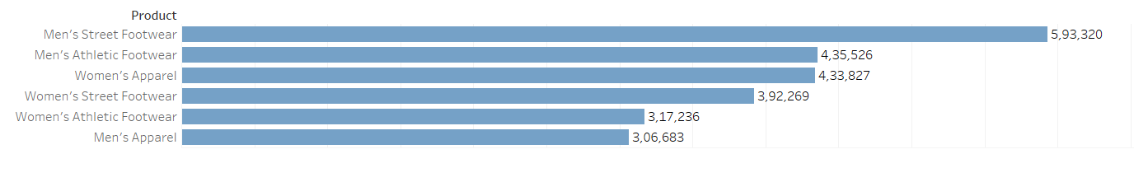
QTY. SOLD (PRODUCT)

Slide 12
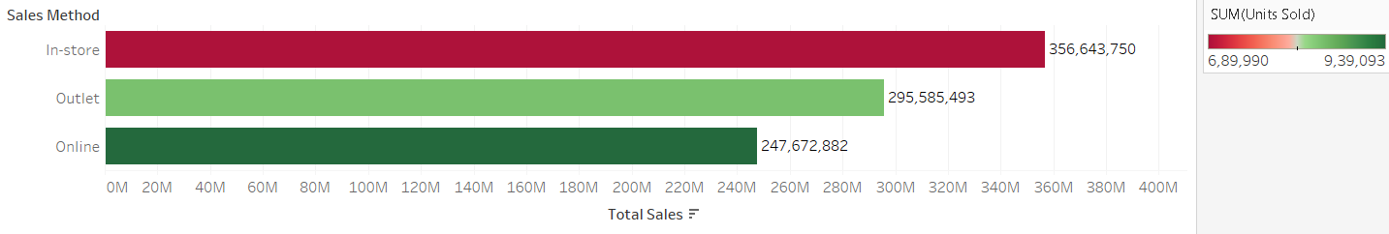
SALES VS SOLD QTY. BASED ON SALES METHOD

Slide 13
OUTCOMES
Highest revenue comes from west region ,west gear is top performer retailer store in region.
Sales trend is negative in 2020 but it reversed in 2021.
High revenue is coming from california,Texas,Florida and New Hampshire.
In products "Men's Street Footwear" is contributing most in sense of revenue while,"Women's Athletic Footwear" contributing lesser.
On analysing QTY sold, it is observed that "Men's Street Footwear" sold with most qty. while "Men's Apparel" lesser.
One of the very interesting outcome is most product sold in online marketplaces but highest revenue comes from In-store sales.

Slide 14
THANK YOU

