Slide 1



SDN App Development Tutorial November, 2013
Srini Seetharaman Dhananjay Sampath Anirudh Ramachandran
Deutsche Telekom Innovation center
Notes:
Before the talk starts, I would like to check with audience about the environment setup.

Slide 2
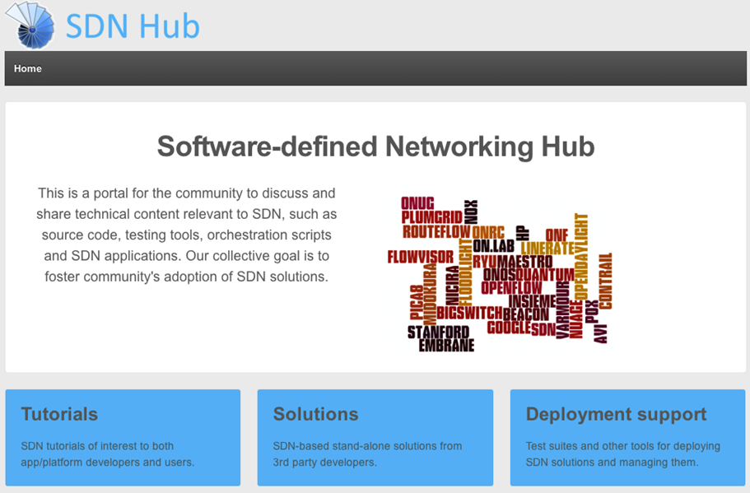
Contact us if you're interested to contribute hands-on materials to sdnhub.org

Slide 3

Hands-on Tutorial Background Info

Slide 4
Bootstrap
sdnhub.org/
Install VirtualBox or Vmware player or Vmware Fusion
Import the tutorial VM appliances available at:
64-bit: (Login: ubuntu, Passwd: ubuntu) http://yuba.stanford.edu/~srini/OpenFlow_tutorial_64bit.ova
32-bit: (Login: ubuntu, Passwd: ubuntu) http://yuba.stanford.edu/~srini/OpenFlow_tutorial_32bit.ova
Install X-Windows if you do not already have it
Mac user: Install xquartz
Windows user: Install xming
Start the VM, and “ssh -X” to its host-only IP address
VirtualBox: Ensure the vboxnet0 interface is configured for “host-only”
File->Preferences->Network and “Add host-only network” button with default settings.

Slide 5
Inside the Virtual Machine
openvswitch: Virtual switch programmable using OpenFlow
mininet: Network emulation platform
$sudo mn --topo single,3 --mac --switch ovsk --controller remote
wireshark: Graphical tool for viewing packets with OF protocol plug-in
Start wireshark: $sudo wireshark
Start capture packets going through interface “lo” and Decode as OFP
ovs-ofctl: Command-line utility for checking switch status and manually inserting flow entries.
Check supported commands in manual: $ man ovs-ofctl
Multiple OpenFlow controllers with sample apps prepackaged
NOX, POX, Ryu, and OpenDayLight
Notes:
Bootstrap and setup VM should be done offline.
Hands-on tutorial will includes:
-- introduction to the tools
-- start mininet OF network
-- ovs-ofctl: checkout switch status, flow status, add flow, delete flow, etc. (ping test)
--start OF ryu (do nothing): use wireshark to observe OF messages
-- Ryu controller and applications.

Slide 6



A quick primer on OpenFlow
Match | L1: Tunnel ID, Switchport
 | L2: MAC addr, VLAN ID, Ether type
 | L3: IPv4/IPv6 fields, ARP
 | L4: TCP, UDP
Action | Output to zero or more ports Encapsulate Header rewriting Send to controller
Controller
Alice's Rule
Alice's code
OpenFlow Switch
PC
Decision?
OpenFlow
Protocol
Alice's Rule
Alice's Rule
OpenFlow Switch
OpenFlow Switch
OpenFlow offloads control intelligence to a remote software

Slide 7
Setup 1: Mininet-based Single Switch
Controller
port6633
OpenFlow Tutorial
3hosts-1switch
Topology
c0
loopback
(127.0.0.1:6633)
OpenFlow Switch
loopback
(127.0.0.1:6634)
ovs-ofctl
(user space process)
s1
s1-eth0
s1-eth1
s1-eth2
h1-eth0
h2-eth0
h3-eth0
h1
10.0.0.1
h2
10.0.0.2
h3
10.0.0.3
virtual hosts
$ sudo mn --topo single,3 --mac --switch ovsk --controller remote

Slide 8
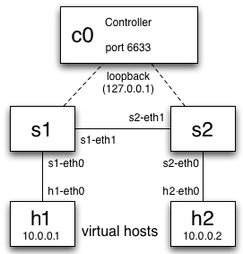
Setup 2: Linear topology with 2 switches
OpenFlow Tutorial
2hosts-2switch
Topology
$ sudo mn --topo linear --switch ovsk --controller remote

Slide 9
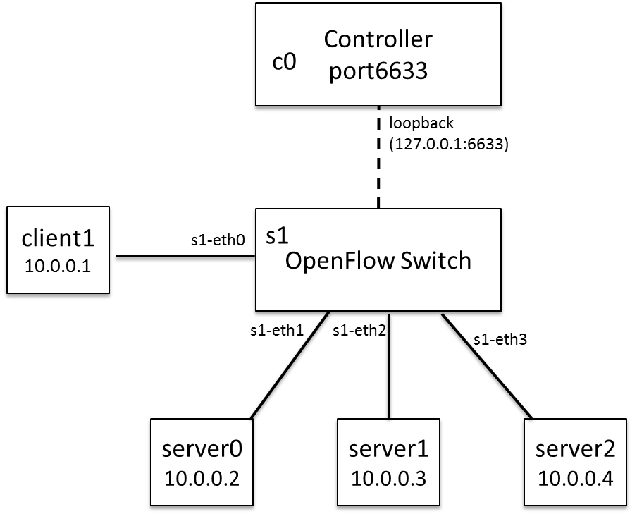
Setup 3: Web Server Farm in Mininet
$ sudo mn --topo single,4 --mac --switch ovsk --controller remote
SERVER SETUP:
h2 python -m CGIHTTPServer &
h3 python -m CGIHTTPServer &
h4 python -m CGIHTTPServer &
ARP INIT FOR REACHABILITY:
h1 arp -s 10.0.0.5 00:00:00:00:00:05
h2 arp -s 10.0.0.5 00:00:00:00:00:05
h3 arp -s 10.0.0.5 00:00:00:00:00:05
h4 arp -s 10.0.0.5 00:00:00:00:00:05
PREP (AFTER STARTING CONTROLLER):
h1 ping h2
h3 ping h4
CLIENT REQUEST:
h1 curl http://10.0.0.5:8000/cgi-bin/serverip.cgi

Slide 10
ovs-ofctl and wireshark workflow
Before controller is started, execute the following
$ ovs-ofctl show tcp:127.0.0.1:6634
$ ovs-ofctl dump-flows tcp:127.0.0.1:6634
mininet> h1 ping h2
$ ovs-ofctl add-flow tcp:127.0.0.1:6634 in_port=1,actions=output:2
$ ovs-ofctl add-flow tcp:127.0.0.1:6634 in_port=2,actions=output:1
mininet> h1 ping h2
Start controller and check OF messages on wireshark (enabling OFP decode)
Openflow messages exchanged between switch and controller: openflow/include/openflow/openflow.h
/* Header on all OpenFlow packets. */
struct ofp_header {
uint8_t version; /* OFP_VERSION. */
uint8_t type; /* one of the OFPT_ constants.*/
uint 16_t length; /*Length including this ofp_header. */
uint32_t xid; /*Transaction id associated with this packet..*/
};
All ports of switch shown, but no flows installed. Ping fails because ARP cannot go through
Ping works now!
Notes:
Bootstrap and setup VM should be done offline.
Hands-on tutorial will includes:
-- introduction to the tools
-- start mininet OF network
-- ovs-ofctl: checkout switch status, flow status, add flow, delete flow, etc. (ping test)
-- start OF ryu (do nothing): use wireshark to observe OF messages
-- Ryu controller and applications.
Summays

Slide 11
Top 3 features in most controllers
Event-driven model
Each module registers listeners or call-back functions
Example async events include PACKET_IN, PORT_STATUS, FEATURE_REPLY, STATS_REPLY
Packet parsing capabilities
When switch sends an OpenFlow message, module extracts relevant information using standard procedures
switch.send(msg), where msg can be
PACKET_OUT with buffer_id or fabricated packet
FLOW_MOD with match rules and action taken
FEATURE_REQUEST, STATS_REQUEST, BARRIER_REQUEST

Slide 12
Sample App 1: Hub
App logic:
On init, register the appropriate packet_in handlers or interfaces
On packet_in,
Extract full packet or its buffer id
Generate packet_out msg with data or buffer id of the received packet
Set action = FLOOD
Send packet_out msg to the switch that generated the packet_in
Hub
(3)
(4)
POX
(2)
(5)
OF Switch
(1)

Slide 13
Sample App 2: MAC-learning switch
App logic:
On init, create a dict to store MAC to switch port mapping
self.mac_to_port = {}
On packet_in,
Parse packet to reveal src and dst MAC addr
Map src_mac to the incoming port
self.mac_to_port[dpid] = {}
self.mac_to_port[dpid][src_mac] = in_port
Lookup dst_mac in mac_to_port dict to find next hop
If found, create flow_mod and send
Else, flood like hub.

Slide 14
Sample App 3: Stateless Load-balancer
Mininet setup:
$ sudo mn --topo single,4 --mac --switch ovsk --controller remote
mininet> h1 curl http://10.0.0.5:8000/cgi-bin/serverip.cgi
Application logic:
Set virtual_ip (10.0.0.5), virtual_mac (00…:05)
Initialize list of servers and their MAC
On packet_in for virtual_ip from “Y”,
Pick server “X” in round-robin fashion
Insert flow
Match: Same as the incoming packet
Action (DST_ip -> 10.0.0.2):
Rewrite dst_mac, dst_ip of packet to that of “X”
Forward to port towards “X”
Proactively Insert reverse flow
Match: Src (IP, MAC, TCP_Port) = X, Dst = Y,
Action:
Rewrite src_mac, src_ip to that of virtual_ip
Forward to port towards “Y”

Slide 15
OpenDayLight controller

Slide 16
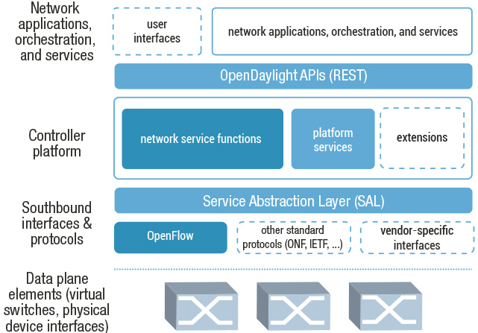
Controller Architecture

Slide 17

Hydrogen Release
Management
GUI/CLI
VTN Coordinator
DDoS Protection
OpenStack Neutron
Network Applications Orchestration & Services
OpenDaylight APIs (REST)
Base Network Service Functions
Affinity Service
OpenStack Service
Topology Mgr
Stats Mgr
Switch Mgr
Host Tracker
Shortest Path Forwarding
Network
Config
Controller Platform
LISP Service
VTN Manager
DOVE Mgr
Service Abstraction Layer (SAL) (plug-in mgr., capability abstractions, flow programming, inventory, …)
OpenFlow
NETCONF
OVSDB
SNMP
BGP-LS
PCEP
LISP
Southbound Interfaces & Protocol Plugins
1.0
1.3
OpenFlow Enabled Devices
Open vSwitches
Additional Virtual & Physical Devices
Data Plane Elements (Virtual Switches, Physical Device Interfaces)
VTN: Virtual Tenant Network
DOVE: Distributed Overlay Virtual Ethernet
DDoS: Distributed Denial Of Service
LISP: Locator/Identifier Separation Protocol
OVSDB: Open vSwitch DataBase Protocol
BGP: Border Gateway Protocol
PCEP: Path Computation Element Communication Protocol
SNMP: Simple Network Management Protocol

Slide 18
Java, Maven, OSGi, Interface
Java allows cross-platform execution
Maven allows easier building
OSGi:
Allows dynamically loading bundles
Allows registering dependencies and services exported
For exchanging information across bundles
Java Interfaces are used for event listening, specifications and forming patterns

Slide 19
Setup (See Brent Salisbury’s tutorial on youtube.com)
INSTALL OPENDAYLIGHT (Dependency Maven, JDK1.7)
git clone https://git.opendaylight.org/gerrit/p/controller.git
mv controller opendaylight; cd opendaylight
cd opendaylight/distribution/opendaylight/
mvn clean install
cd target/distribution.opendaylight-0.1.0-SNAPSHOT-osgipackage/opendaylight/
./run.sh
IMPORT OPENDAYLIGHT TO ECLIPSE
Install Eclipse with Maven Integration Version 1.2.0
File => Import => Maven => Existing Maven Projects
Browse ~/opendaylight/opendaylight/distribution/opendaylight
In distribution.opendaylight, right click on opendaylight-assembleit.launch and select “Run”. Then “Run” opendaylight-application.launch

Slide 20
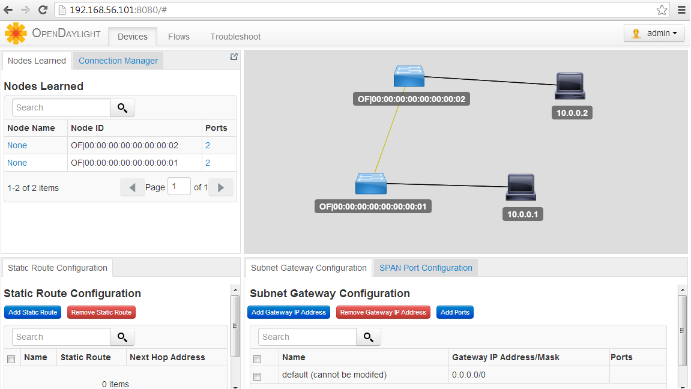
OpenDayLight web interface

Slide 21
Writing a new application
Clone an existing module (e.g., arphandler) in Eclipse project explorer
Include the new app in opendaylight/distribution/opendaylight/pom.xml and in the Eclipse“Run Configurations”
Update set/unset bindings in the module’s class so as to access other bundle objects
List dependencies imported and interfaces implemented in the module’s Activator.java
Update dependencies and services exported in the new bundle’s pom.xml
Implement the interface functions to handle the async events or use other bundle objects to edit state
Add needed northbound REST API and associate with the web bundle
Done

Slide 22
Useful Interfaces and Bundles
Bundle | Exported interface | Description
arphandler | IHostFinder | Component responsible for learning about host location by handling ARP.
hosttracker | IfIptoHost | Track the location of the host relatively to the SDN network.
switchmanager | ISwitchManager | Component holding the inventory information for all the known nodes (i.e., switches) in the controller.
topologymanager | ITopologyManager | Component holding the whole network graph.
usermanager | IUserManager | Component taking care of user management.
statisticsmanager | IStatisticsManager | Component in charge of using the SAL ReadService to collect several statistics from the SDN network.

Slide 23
Useful Interfaces and Bundles
Bundle | Exported interface | Description
sal | IReadService | Interface for retrieving the network node's flow/port/queue hardware view
sal | ITopologyService | Topology methods provided by SAL toward the applications
sal | IFlowProgrammerService | Interface for installing/modifying/removing flows on a network node
sal | IDataPacketService | Data Packet Services SAL provides to the applications
web | IDaylightWeb | Component tracking the several pieces of the UI depending on bundles installed on the system.

Slide 24
Life of a Packet
A packet arriving at Switch1 will be sent to the appropriate plugin managing the switch
The plugin will parse the packet, generate an event for SAL
SAL will dispatch the packet to the modules listening for DataPacket
Module handles packet and sends packet_out through IDataPacketService
SAL dispatches the packet to the modules listening for DataPacket
OpenFlow message sent to appropriate switch
ARP Handler
Tutorial_L2_ forwarding
(3)
IListenDataPacket
IListenDataPacket
(3)
(4)
IDataPacketService
Service Abstraction Layer (SAL)
IPluginOutDataPacketService
(2)
IPluginInDataPacketService
(5)
OpenFlow protocol plugin
OpenFlowJ
OpenFlow
(1)
(6)
Switch1
Switch3
Switch2

Slide 25
Coding Time! (See tutorial_L2_forwarding app)
Packet in event handling:
public class TutorialL2Forwarding implements IListenDataPacket
Indicates that the class will handle any packet_in events
public PacketResult receiveDataPacket(RawPacket inPkt) { ... }
Call-back function to implement in the class for receiving packets
Packet parsing
Packet formattedPak = this.dataPacketService.decodeDataPacket(inPkt);
byte[] srcMAC = ((Ethernet)formattedPak).getSourceMACAddress();
long srcMAC_val = BitBufferHelper.toNumber(srcMAC);
Send message (packet_out or flow_mod) to switch
RawPacket destPkt = new RawPacket(inPkt);
destPkt.setOutgoingNodeConnector(p);
this.dataPacketService.transmitDataPacket(destPkt);

Slide 26

POX controller

Slide 27
Intro to POX controller General execution: $ ~/pox/pox.py <dir>.<name> Example: $ ~/pox/pox.py forwarding.hub
Parses messages from switch and throws following events
FlowRemoved
FeaturesReceived
ConnectionUp
FeaturesReceived
RawStatsReply
PortStatus
PacketIn
BarrierIn
SwitchDescReceived
FlowStatsReceived
AggregateFlowStatsReceived
TableStatsReceived
PortStatsReceived
QueueStatsReceived
Packets parsed by pox/lib
arp
dhcp
dns
eapol
eap
ethernet
icmp
igmp
ipv4
llc
lldp
mpls
rip
tcp
udp
vlan
Example msg sent from controller to switch
ofp_packet_out
header:
version: 1
type: 13
length: 24
xid: 13
buffer_id: 272
in_port: 65535
actions_len: 1
actions:
type: 0
len: 8
port: 65531
max_len: 65535

Slide 28
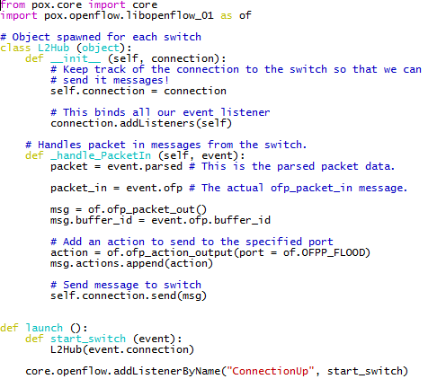
Application 1: Hub (inspect file pox/pox/misc/of_tutorial.py)
Hub
(3)
(4)
POX
(2)
(5)
OF Switch
(B)
(1)
(6)
(C)
(A)

Slide 29
Application 2: MAC-learning switch (convert pox/pox/misc/of_tutorial.py to L2 switch)
Build on your own with this logic:
On init, create a dict to store MAC to switch port mapping
self.mac_to_port = {}
On packet_in,
Parse packet to reveal src and dst MAC addr
Map src_mac to the incoming port
self.mac_to_port[dpid] = {}
self.mac_to_port[dpid][src_mac] = in_port
Lookup dst_mac in mac_to_port dict to find next hop
If found, create flow_mod and send
Else, flood like hub.
Execute: pox/pox.py misc.of_tutorial
msg = of.ofp_flow_mod()
msg.match = of.ofp_match.from_packet(packet)
msg.buffer_id = event.ofp.buffer_id
action = of.ofp_action_output(port = out_port)
msg.actions.append(action)
self.connection.send(msg)

Slide 30
App 3: Stateless Load-balancer
Set virtual_ip (10.0.0.5), virtual_mac (00…:05)
Initialize list of servers and their MAC
On packet_in for virtual_ip from “Y”,
Pick server “X” in round-robin fashion
Insert flow
Match: Same as the incoming packet
Action (DST_ip -> 10.0.0.2):
Rewrite dst_mac, dst_ip of packet to that of “X”
Forward to port towards “X”
Proactively Insert reverse flow
Match: Src (IP, MAC, TCP_Port) = X, Dst = Y,
Action:
Rewrite src_mac, src_ip to that of virtual_ip
Forward to port towards “Y”

Slide 31

Ryu controller

Slide 32

Intro to RYU: OpenFlow Controller
Firewall
Topology
Viewer
Statistics
app
lib
simple_ switch
ofctl_ rest
quantum plugin
app_manager
base
RYU Controller
handler
dpset
event
controller
ofp_event
ofp_handler
1.0
1.3
1.2
controller
OF Switch
OF Switch
of_parser
of_header
lib
OF Switch
ofproto
Components:
Provides interface for control and state and generates events
Communicates using message passing
Libraries:
Functions called by components
Ex: OF-Config, Netflow, sFlow, Netconf, OVSDB

Slide 33
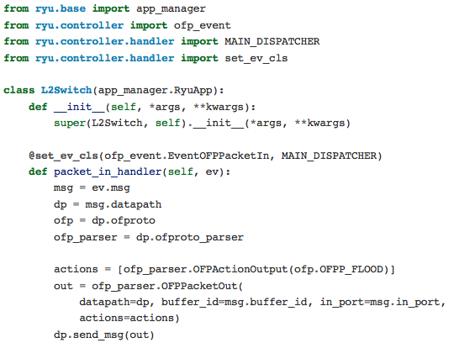
Application 1: Hub ryu-manager --verbose ryu/ryu/app/tutorial_l2_hub.py
Hub
(3)
(4)
RYU
(2)
(5)
OF Switch
(A)
(1)
(6)
(B)
(C)

Slide 34
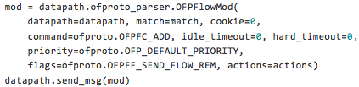
Application 2: MAC-learning switch
Build on your own with this logic:
On init, create a dict to store MAC to switch port mapping
self.mac_to_port = {}
On packet_in,
Parse packet to reveal src and dst MAC addr
Map src_mac to the incoming port
self.mac_to_port[dpid] = {}
self.mac_to_port[dpid][src_mac] = in_port
Lookup dst_mac in mac_to_port dict to find next hop
If found, create flow_mod and send
Else, flood like hub.
Pssst… solution in tutorial_l2_switch.py

Slide 35
The End

