Slide 1
📊 Mobile Sales Dashboard – Power BI
Rahul Kushwaha
Data Analyst Internship – Elevate Labs
MSME, Govt. of India
Email: rk653821@gmail.com

Slide 2
Objective & Tools
🎯 Objective:
- Design an interactive dashboard for business stakeholders.
- Provide sales & financial insights for decision making.
🛠 Tools Used:
- Power BI
- MS Excel (Kaggle Dataset)

Slide 3
KPIs & Dashboard Features
📌 KPIs:
- Total Sales: 769.20M
- Transactions: 4K
- Units Sold: 19K
- Average Sales: 40.11K
✨ Features:
- Time-series Analysis (Year, Quarter, Month, Day)
- Sales by City, Brand, Payment Method
- Customer Age & Ratings
- Interactive Slicers & Navigation Menu

Slide 4
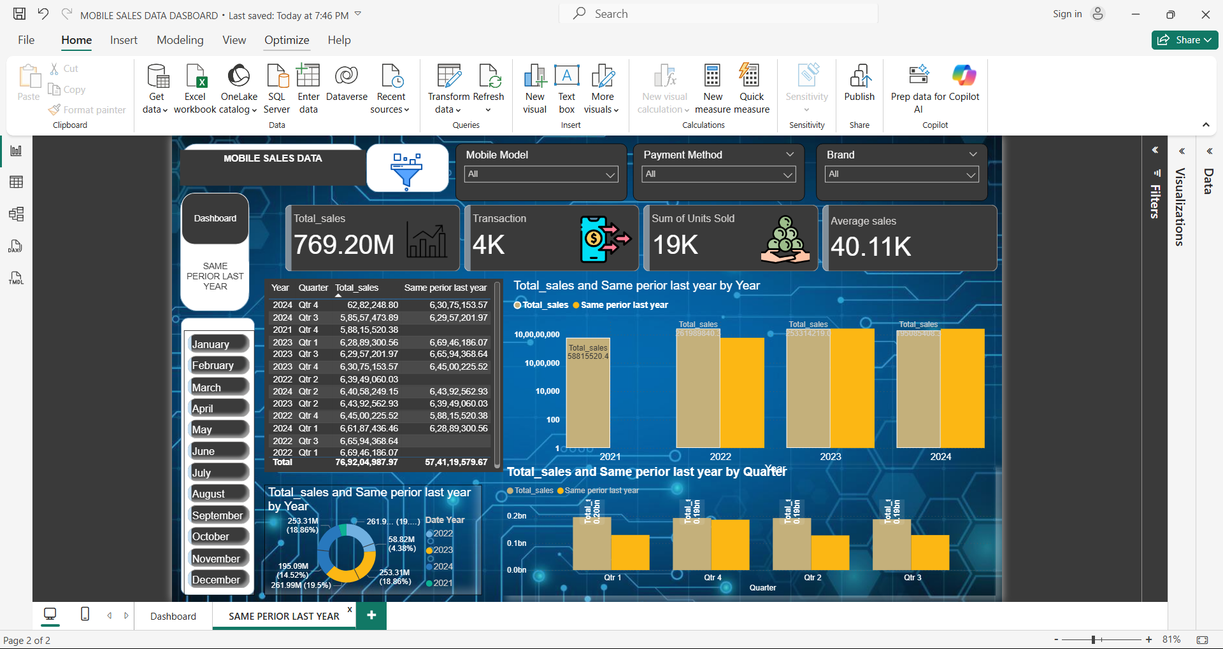
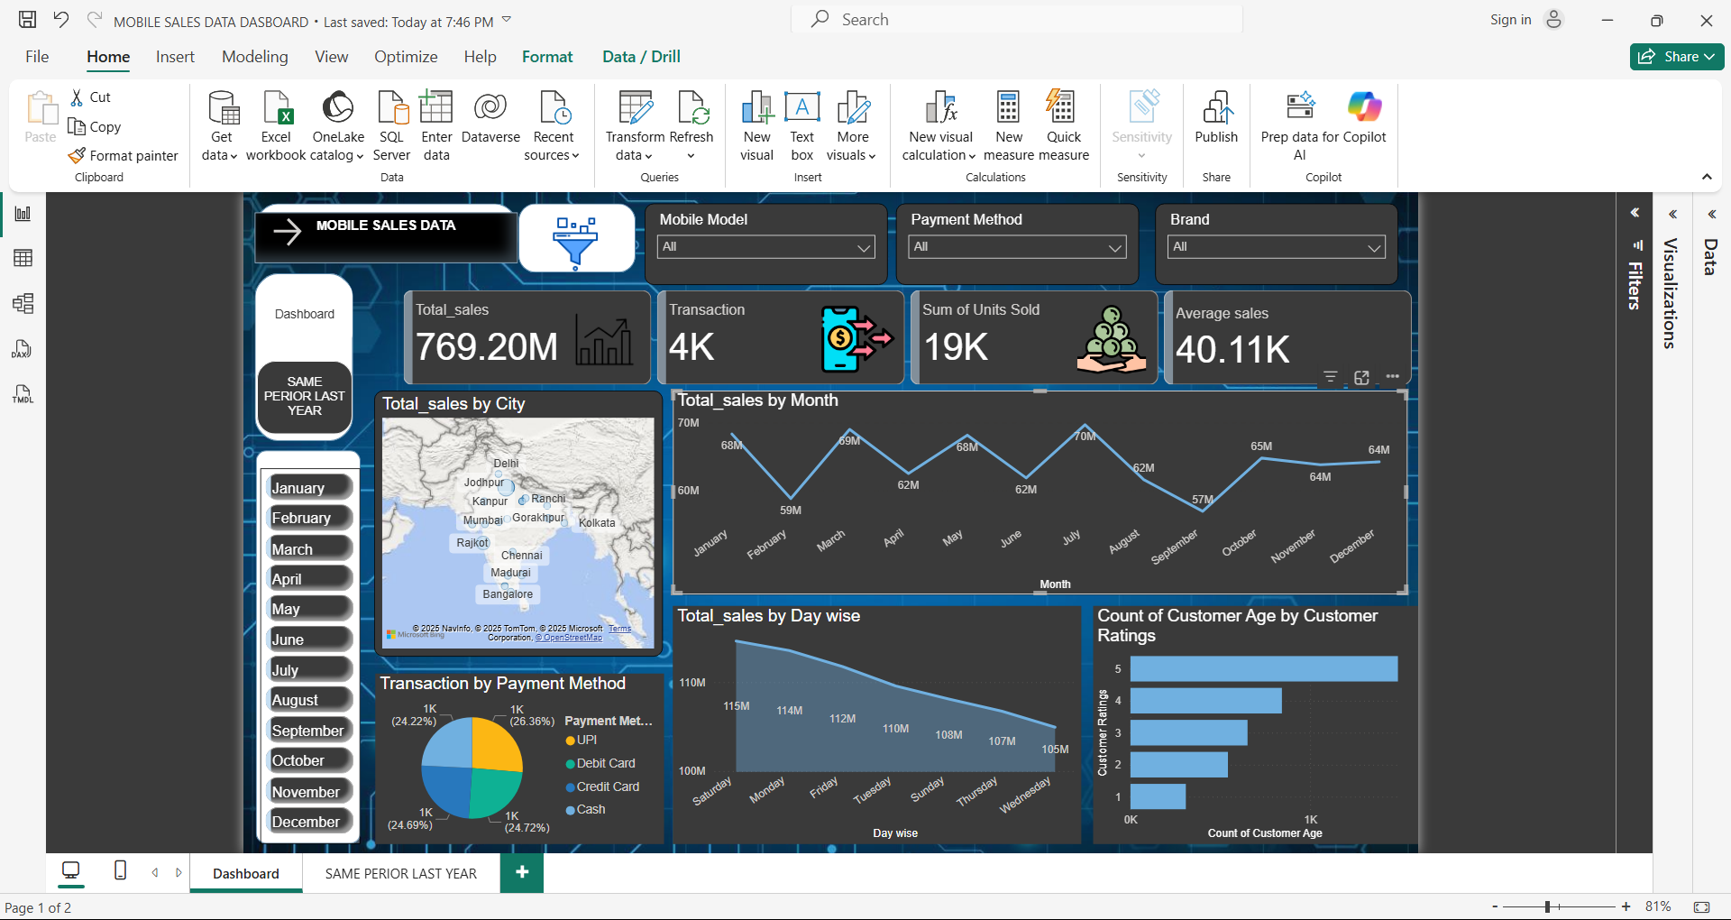
Dashboard Screenshots

Slide 5
Key Insights
- Sales show consistent growth across years.
- UPI is the most preferred payment method (~26%).
- Peak sales months: July & October.
- Customer segment 25–35 years shows highest ratings.
- Total Sales achieved: 769.20M.

