Slide 1

Next Hikes IT Solutions
Next Hikes | Elevating Digital Experiences
Next Hike IT Solutions is a growing IT services and solutions company that focuses on delivering innovative, reliable, and cost-effective technology solutions. The company specializes in providing end-to-end IT services, helping businesses improve efficiency, productivity, and digital transformation.
Next Hike IT Solutions is committed to quality, client satisfaction, and continuous innovation, making it a trusted technology partner for organizations across various industries.

Slide 2
Introduction – Roshan Kumar
My name is Roshan Kumar, and I am passionate about data analysis and dashboard development.
I have hands-on experience in Excel, Power Query, Pivot Tables, and VBA Macros, Python, Data Management, SQL.
I enjoy working on data cleaning, transformation, and automation to convert raw data into meaningful insights.
I focus on building interactive, user-friendly, and scalable dashboards for effective decision-making.
This project showcases my ability to handle end-to-end data workflows, from raw datasets to professional dashboards.

Slide 3
Mobile Price Prediction Using Machine Learning
A Complete ML Project
Date: April 24, 2026

Slide 4
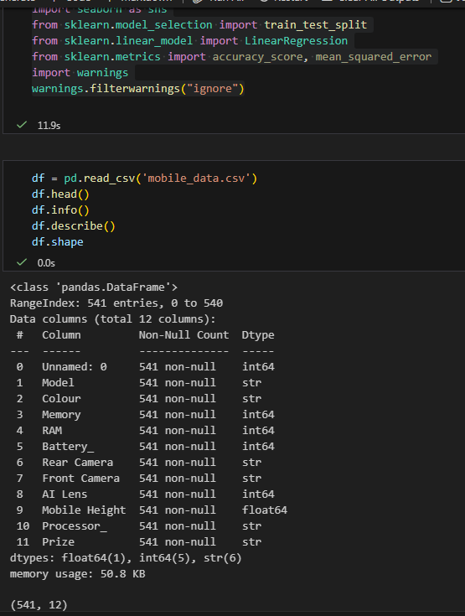
Project Overview
• Objective: Predict mobile phone prices using specifications
• Dataset: 541 mobile phone records
• Features: RAM, Battery, Camera, Processor, Model, Colour
• Models: Linear Regression, Decision Tree, Random Forest
• Evaluation: MAE and RMSE metrics

Slide 5
Data Overview
• Total samples: 541
• Features: Model, Colour, Memory, RAM, Battery, Rear Camera, Front Camera, AI Lens, Processor, Price
• Target variable: Price (INR)
• Price range: ₹920 - ₹34265
• No missing values after preprocessing

Slide 6
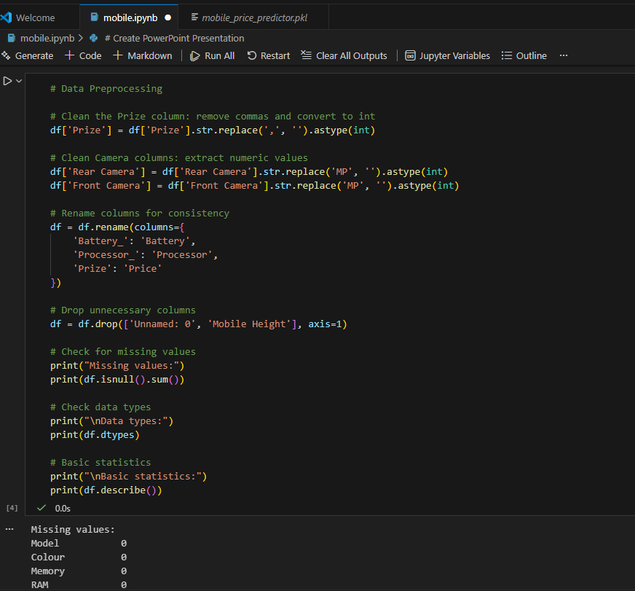
Data Preprocessing
• Cleaned price column (removed commas)
• Extracted numeric values from camera specs
• Handled outliers by capping extreme prices
• Encoded categorical variables:
- Model, Colour, Processor (Label Encoding)
• Removed unnecessary columns (Mobile Height)

Slide 7
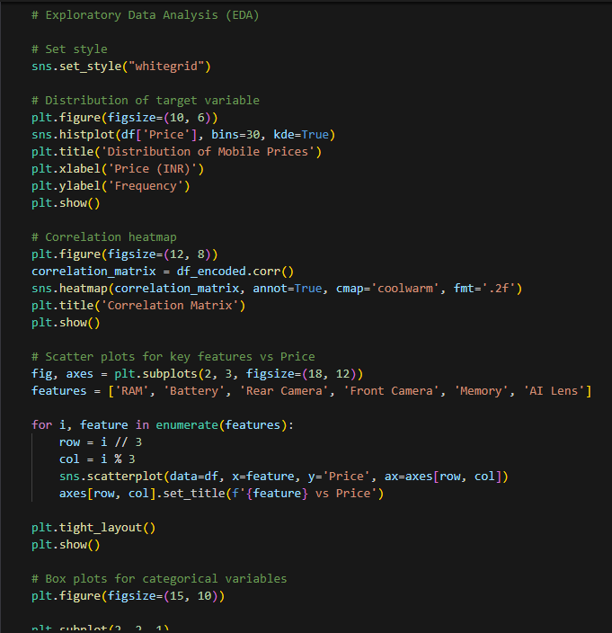
Exploratory Data Analysis
• Price distribution: Right-skewed
• Key correlations:
- Memory: 0.68
- Front Camera: 0.65
- RAM: 0.65
- Rear Camera: 0.54
• Battery and AI Lens have lower correlation
• Categorical analysis shows price variations by specs

Slide 8
Feature Selection
• Methods used: Correlation, SelectKBest, Random Forest
• Top features selected: Front Camera, Battery, Model, Memory, Processor, Rear Camera
• Random Forest feature importance:
- Front Camera: 0.499
- Battery: 0.132
- Model: 0.109

Slide 9
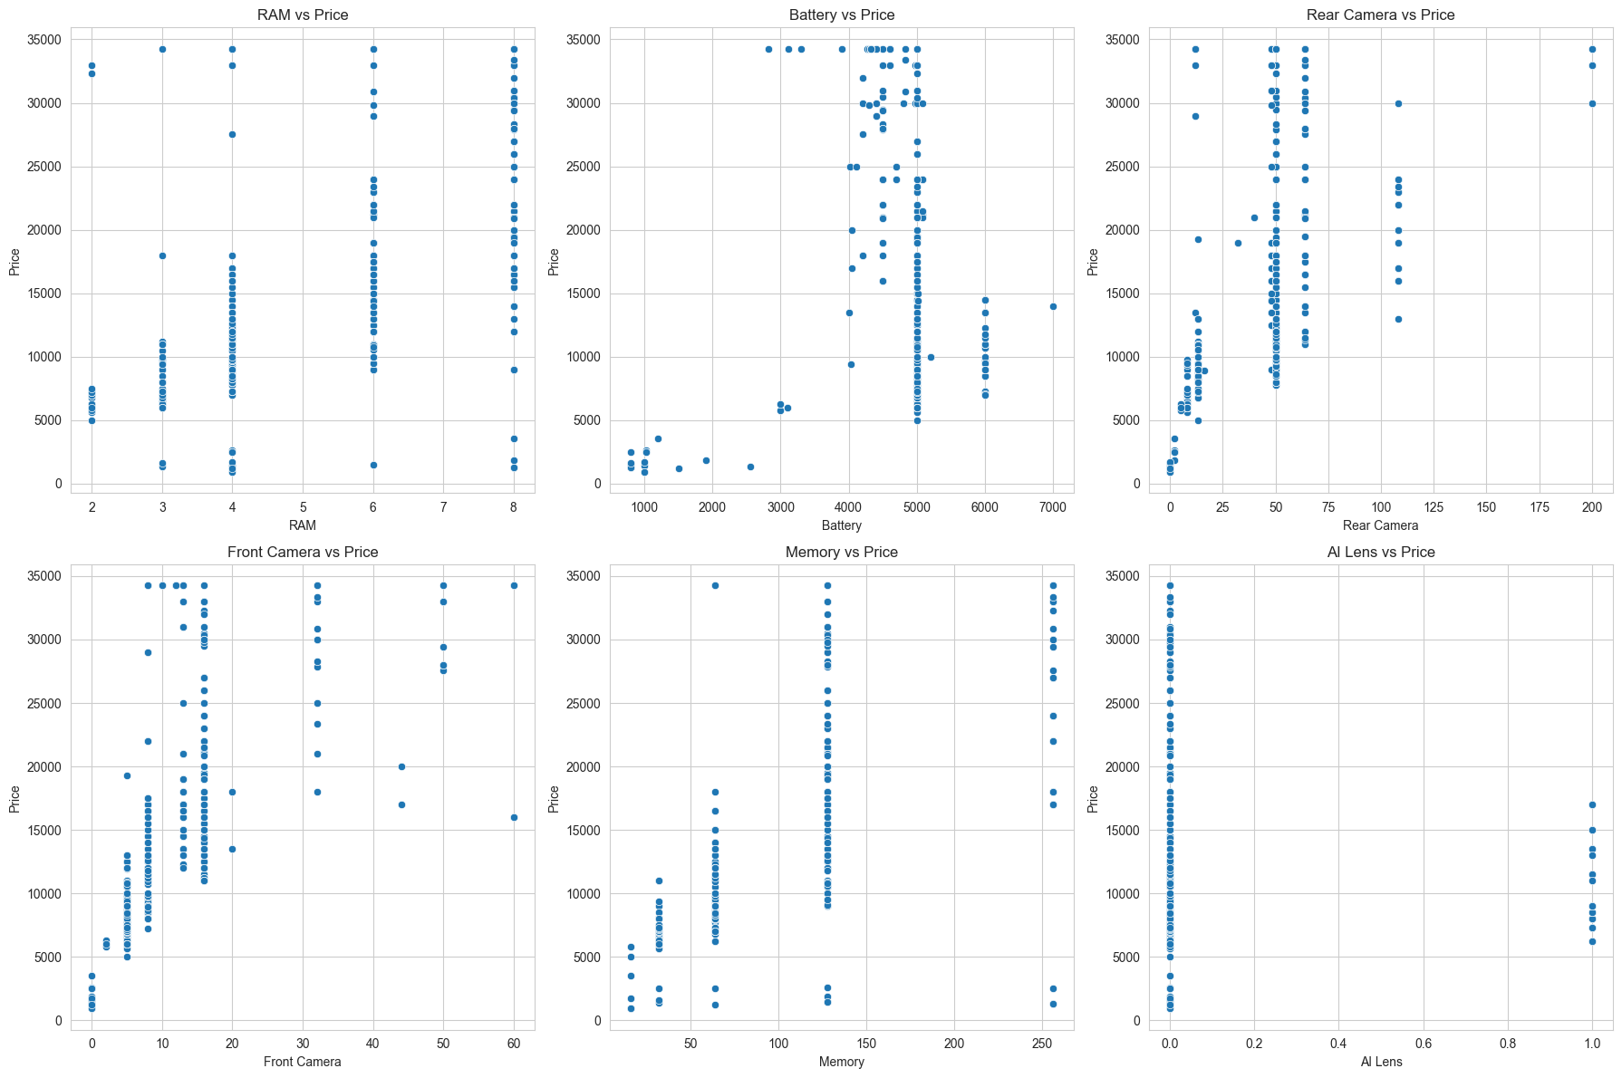
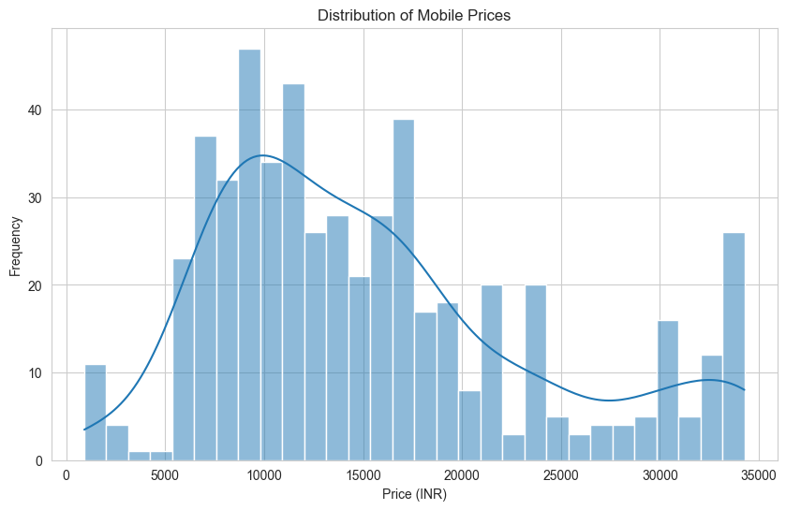
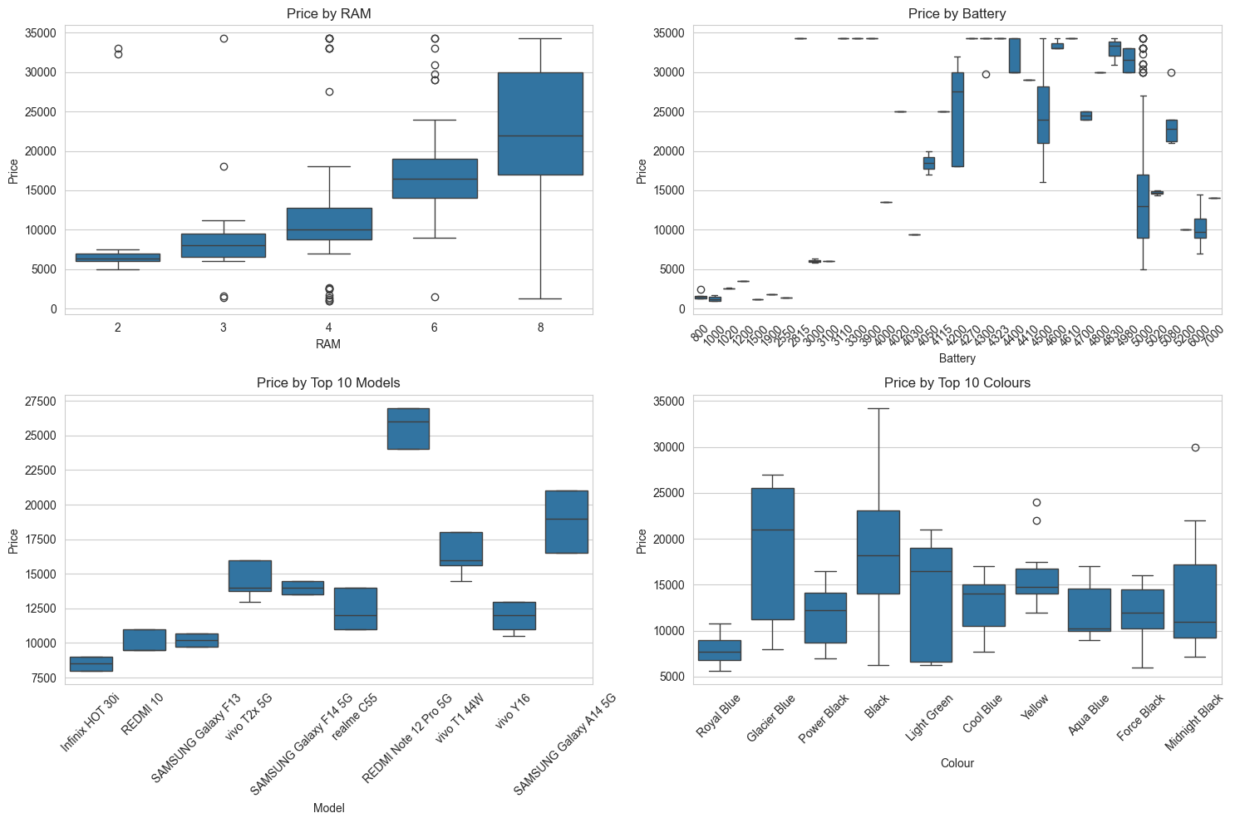
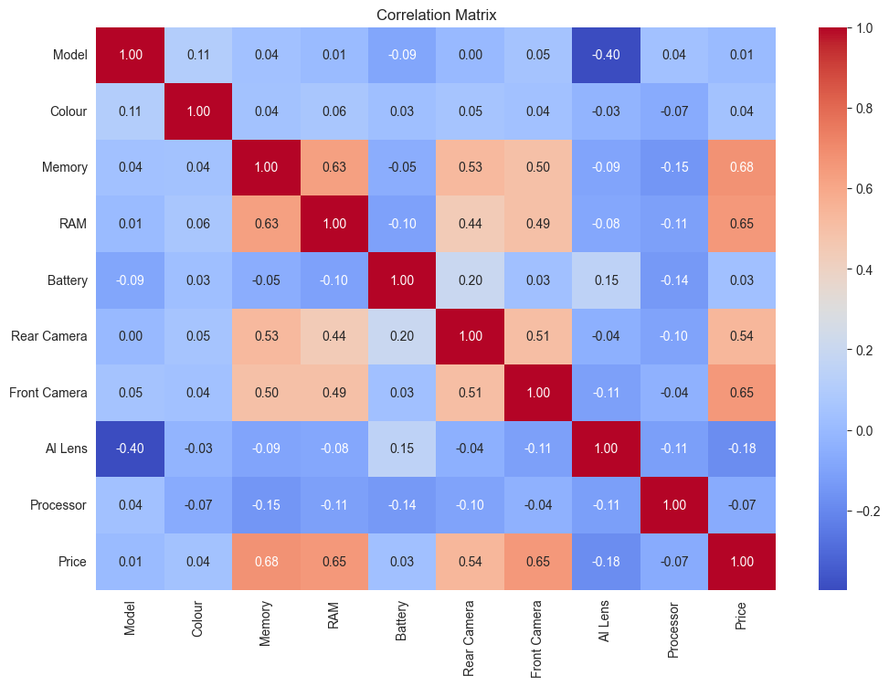
Model Performance
Linear Regression:
• Train MAE: ₹3548
• Test MAE: ₹3086
Decision Tree:
• Train MAE: ₹215
• Test MAE: ₹927
Random Forest:
• Train MAE: ₹585
• Test MAE: ₹1148

Slide 10
Key Findings
• Front Camera is the most important predictor
• Random Forest provides best performance
• Decision Tree overfits training data
• Linear Regression performs reasonably well
• Price prediction accuracy: ~₹1,148 MAE

Slide 11
Recommendations
• Use Random Forest for production predictions
• Consider feature engineering (brand extraction)
• Collect more diverse data for better generalization
• Monitor model performance over time
• Consider additional features (screen size, OS version)

Slide 12
Conclusion
• Successfully built ML model for mobile price prediction
• Random Forest achieved best results with MAE of ₹1,148
• Front Camera emerged as key price determinant
• Project demonstrates complete ML pipeline:
- Data preprocessing → EDA → Feature selection
- Model training → Evaluation → Deployment
• Model saved for future predictions

