Slide 1

DESIGN OF OBSTACLE DETECTION AND COLLISION AVOIDANCE MODEL USING RASPBERRY PI
RAJAT KUMAR AGARWAL(111308038)
VIVEK KUMAR(111308051)
ADITYA BOSE(111308021)

Slide 2
CONTENTS
1
INTRODUCTION
APPROACH
RASBERRY PI
-INTRODUCTION
-INSTALLTION
INFRARED SENSOR
-INTRODUCTION
WORKING
MOTOR DRIVER MODULE

Slide 3
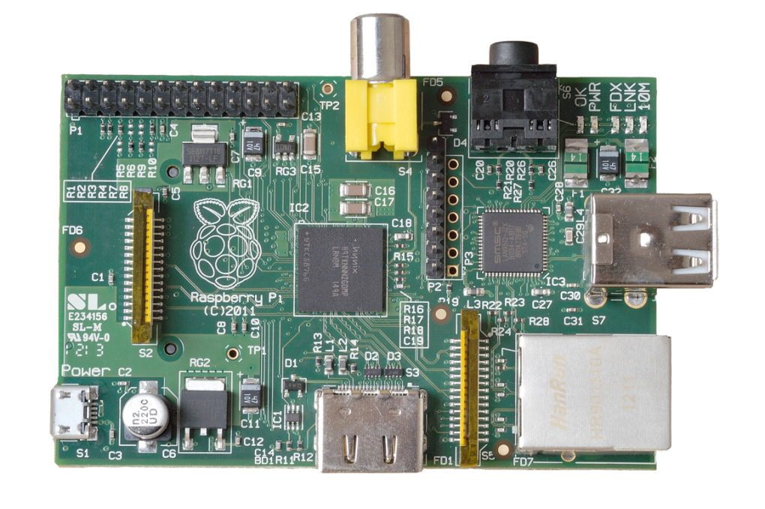
WORK OVERVIEW
4
University of Cambridge’s Computer Laboratory
  Decline in skill level
  Designed for education
A credit card sized PC
Plugs into a TV or monitor
Inexpensive
Capability:
  Programming
  Electronic Projects
  Office
  Play HD Videos

Slide 4
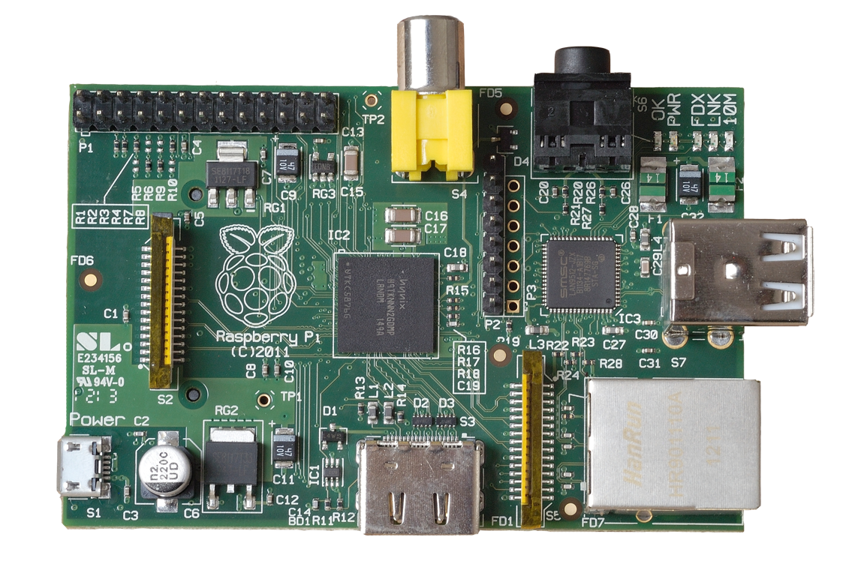
Internals
LAN Controller
2 x USB 2.0
ports
GPIO
DSI
CSI
(camera interface)
SOC (System On a Chip)
Broadcom BCM2835 700Mhz
10/100Mb
Ethernet

Slide 5
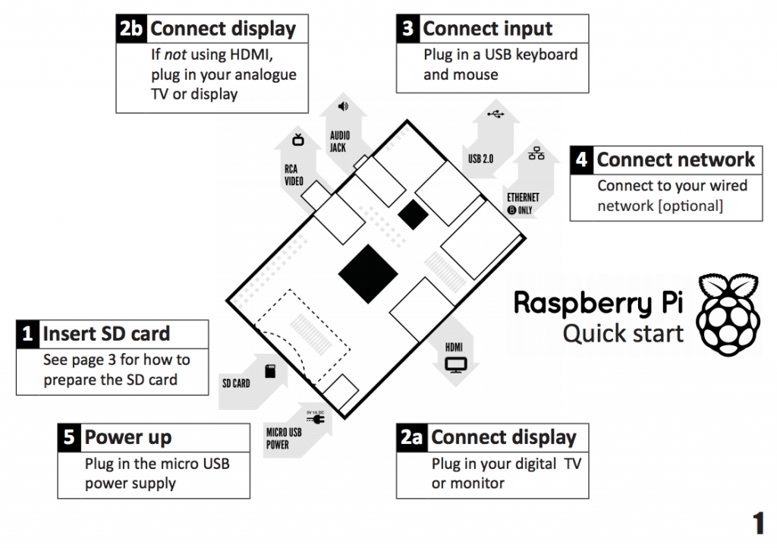

Slide 6
Kit Components
Essential:
  Raspberry Pi board
  Prepared Operating System SD Card
  USB keyboard
  Display (with HDMI, DVI, or Composite input)
  Power Supply
Highly suggested extras include:
  USB mouse
  Internet connectivity - LAN cable
  Powered USB Hub
  Case

Slide 7
CONCLUSION
21
This project is just one type of contrast mining. Now with this concept,
we can proceed to many different analyses. We can compare the slide
This work is to be communicated soon to the ACM KDD ODD 4.0 conference.

Slide 8
REFERENCE
22
https://www.raspberrypi.org/downloads/raspbian/
https://en.wikipedia.org/wiki/Raspberry_Pi
http://kodi.wiki/view/HOW-TO:Install_Kodi_on_Raspberry_Pi
https://www.elprocus.com/infrared-ir-sensor-circuit-and-working/
http://www.rakeshmondal.info/L293D-Motor-Driver
https://www.packtpub.com/books/content/avoiding-obstacles-using-sensors

Slide 9
23
THANK YOU

