Slide 1
DO WE SPEAK THE SAME WHAT WE COMPOSE?
A STATISTICAL PERSPECTIVE.
Rajat Kumar Agarwal (111308038)
Chandrima Bhattacharya (111308009)
Goutam Debnath (111308041)

Slide 2
CONTENTS
Introduction
Motivation
Work Overview
Dataset Collection
Brief Description
Proposed Approach
1. Frequency Analysis
-> TagCrowd
2. Similarity Analysis
-> Cosine Similarity
Experimental Results
Analysis of the Results
Assumptions
Conclusion

Slide 3
INTRODUCTION
The world has seen a growing trend of people publishing new ideas and inventions in the form of research.
Research is the systematic investigation and study of materials and sources in order to establish facts and reach to new conclusions.
Research can be published as literature, presented in conference or protected as patent.
Due to the emerging trend of publishing research, we can work on the trend and find correlations and similarities and differences of many aspects related to research.

Slide 4
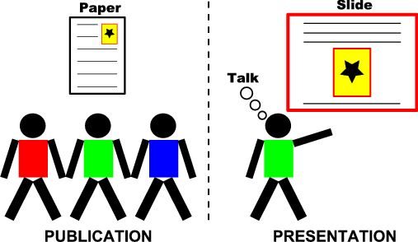
MOTIVATION
Motivation for the project.

Slide 5
WORK OVERVIEW
Data analytics is an emerging field at present.
Contrast mining is a new field of learning similarities and differences between related groups with the help of reverse engineering techniques.
We have used the concepts of contrast mining and tried to find out the relationship between the three kinds of data – the literature published, a conference power point presentation and what is spoken during the conference.

Slide 6
DATASET COLLECTION
The International Conference on Intelligent System for Molecular Biology (ISMB) maintains a database of the slides and presentation videos for the corresponding published papers. We took ten papers to make our dataset.
Hence our dataset consists of three materials: the paper i.e., the published literature, the conference talk and the slide presented during the conference. We have thirty total files for comparing.
We have excluded diagrams, graphs, chart, bar graphs, tables, etc. while dataset collection, but have kept the description and captions along with it.

Slide 7
BRIEF DESCRIPTION
Representation of contrasts is important.
Quality of contrasts is also important. Needs Statistical significance, which can be measured in multiple ways.
Ability to rank contrasts is desirable, especially for classification.

Slide 8
APPROACH
Our objective
A paper is generally published in three different forms
i) Document ii) Slide iii) Video
Our objective is to find similarity between two different forms of the same paper :
i) Paper and slide,
ii) Slide and video and
iii) Paper and video
Analyse the result from statistical point of view.

Slide 9
APPROACH 1
Frequency Analysis
We have selected TagCrowd and have created the tag crowd for each dataset to visualize the crowd and the frequency of each.
We have chosen the parameter values as follows:
Options | Settings
Language of text | English
Maximum number of words to show | 50
Minimum frequency | 2
Show frequency | Yes
Group similar words | Yes
Convert to lowercase | Yes

Slide 10
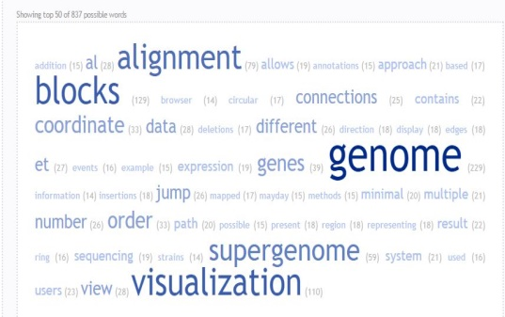
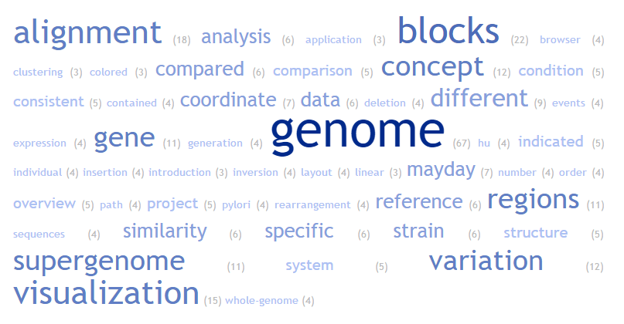
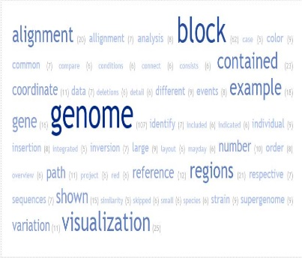
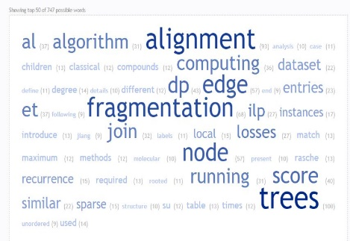
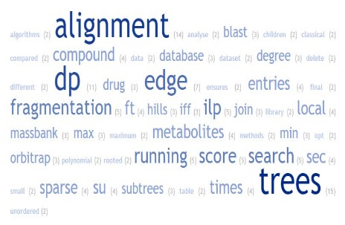
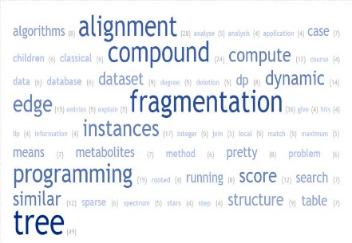
TAGCROWD
(a) (b) (c)
Figure 1: Visualization of frequent words appearing in the paper [1] in the forms of
(a) published paper, (b) presented slides, and (c) verbal presentation.
(a) (b) (c)
Figure 2: Visualization of frequent words appearing in the paper [2] in the forms of
(a) published paper, (b) presented slides, and (c) verbal presentation

Slide 11
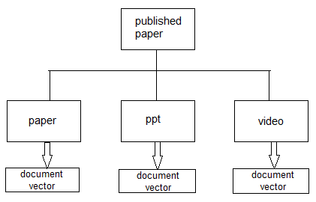
APPROACH 2.
  Similarity Analysis
  We prepare organized dataset as a collection of document triplets :
  < paper, ppt, video > for each of the papers.

Slide 12
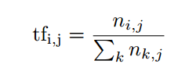
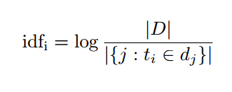
ANALYSIS
  Similarity Analysis
  Text documents are transformed into document vector-
  N- dimensional vector in Euclidean vector space
  Each vector component value is represented by the tf-idf value associated with each distinct word of the document
. where n_{i,j} is the number of occurrences of the considered term (t_{i}) in . document d_{j} , and the denominator is the sum of number of occurrences of all . terms in document d_{j} , that is, the size of the document |d_{j} |

Slide 13
COSINE SIMILARITY
  Similarity Analysis
The tf-idf weight of a term is the product of its tf weight and its idf weight. So, the tf-idf weight of a term t_{i} in document d_{j} is given by
tf-idf_{i},_{j} = tf_{i} * idf_{j}
We compute cosine similarity between two different document forms of the same paper (i.e. between paper and ppt, between ppt and video and between paper and video). Thus, we get three cosine similarity values for each of the papers and thirty values for all the ten papers in total

Slide 14
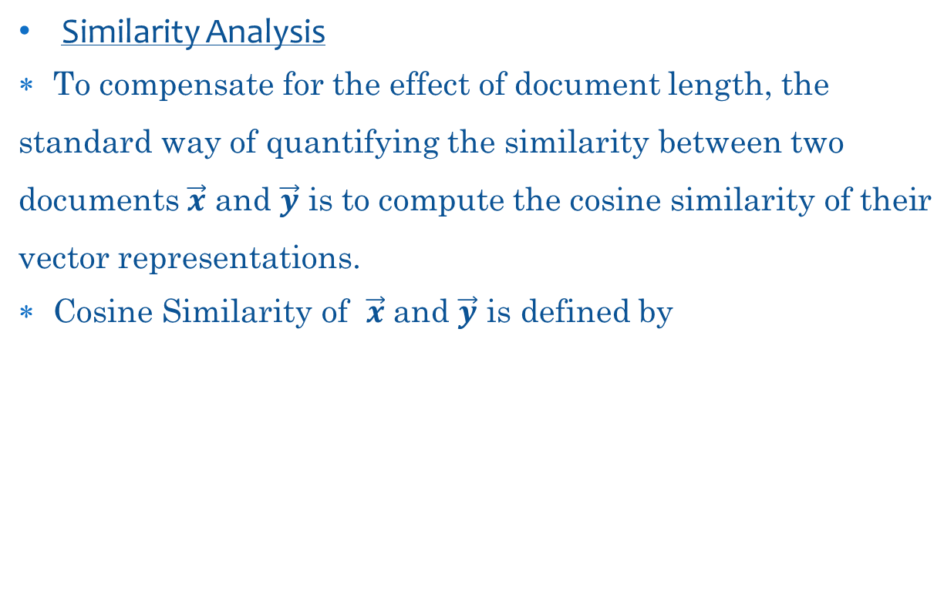
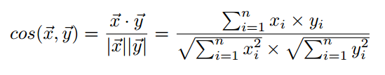


CORRELATION

Slide 15
EXPERIMENTAL RESULTS
We have found thirty cosine similarity values in total for all the ten papers following the above procedure. Those values are put in tabular form.
We have later found the correlation between the paper and the slide, the slide and the video, and the video and the paper.

Slide 16
EXPERIMENTAL RESULTS
Cosine Similarities
Serial no. | Paper_PPT | PPT_Video | Video_Paper
1 | 0.718234364 | 0.662978071 | 0.869688232
2 | 0.704973578 | 0.564727738 | 0.880399794
3 | 0.650960929 | 0.564006724 | 0.875257705
4 | 0.687027481 | 0.661625297 | 0.87205514
5 | 0.679212537 | 0.784126295 | 0.737409231
6 | 0.615406506 | 0.40350298 | 0.822265915
7 | 0.055057098 | 0.059717816 | 0.6883728
8 | 0.579854262 | 0.500770032 | 0.701926416
9 | 0.367124616 | 0.31492547 | 0.737477821

Slide 17
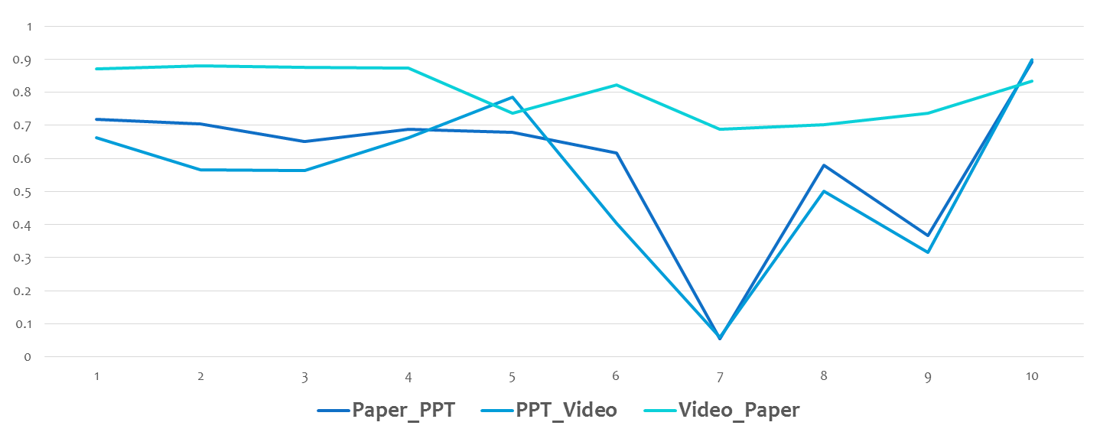
EXPERIMENTAL RESULTS
Graphical representation of Cosine Similarities

Slide 18

ANALYSIS OF THE RESULT
We calculate correlation between cosine similarities of different pairs of forms to show whether and how strongly they are related.
Correlation coefficient ρ_{X,Y} between two variables X and Y is given by
Where cov is the covariance, σ_{X} is the standard deviation of X.

Slide 19
ANALYSIS OF THE RESULT
Pairs of document forms | Correlation
Paper_PPT and PPT_Video | 0.933432618
PPT_Video and Video_Paper | 0.518246914
Paper_PPT and Video_Paper | 0.684532761
Correlation between the three types of documents taken in pair

Slide 20
ANALYSIS OF THE RESULT
TagCrowd and the Cosine Similarities can be explained as follows:
The difference in frequency in TagCrowd may be due to the fact that we have selected only multi authored papers. As different authors contribute to different areas, maybe the speaker spoke about the area where he/she is more comfortable about.
The trend in cosine similarity clearly shows a strong correlation between paper and video while a loose correlation between slide and video and slide and paper. This can be explained by the fact that many times the person preparing the slide is not one of the author. Hence such a relationship.

Slide 21
ASSUMPTIONS
As conversion from video to text file for analysis was done manually, there remains a high probability of error. The error can be ascribed to the fact that accent difference, unclear video recording etc. This error was not taken into account during calculation.
Only multi-authored papers had been considered. As single authored papers can be expected to show a different in trend, we have not considered those.

Slide 22
CONCLUSION
This project is just one type of contrast mining. Now with this concept,
we can proceed to many different analyses. We can compare the slide
and videos for all the authors in a multi-authored paper and find their
differences.
Moreover, we can also find the trend for single authored papers.
Moreover, we can use concepts of Crowd Sourcing to collect a larger dataset
for a more detailed analysis of trend.
This work is to be communicated soon to the ACM KDD ODD 4.0 conference.

Slide 23
REFERENCE
Proceedings of lectures from https://www.iscb.org/ismb-mm/media-ismb2012
[ISCB 2012 multimedia folder]
Graham L. Giller (2012). "The Statistical Properties of Random Bitstreams and the Sampling Distribution of Cosine Similarity". Giller Investments Research Notes (20121024/1).
Rodgers, J. L.; Nicewander, W. A. (1988). "Thirteen ways to look at the correlation coefficient". The American Statistician 42 (1): 59–66.
Template , http://www.iiests.ac.in/ , 2016.

Slide 24
THANK YOU

