Slide 1
Team
Raw
Hndcp
Adjusted

Slide 2



Slide 3
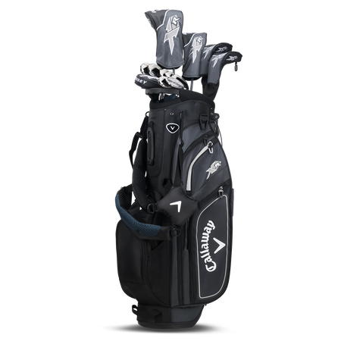
COME AND TAKE IT

Slide 4
Team | Hole | Player 1 Name | Player 2 Name | Player 3 Name
01A | 1 | Jon Bartsch | Chris Fohn | Gary Klaus
01B | 1 | Patrick Murphy | Braden Murphy | Bryson Murphy
12A | 12 | Greg Friske | Nicholas Friske | Bill Kadura
12B | 12 | Bradley Nutt | Kaycee Nutt | Carter Nutt
13A | 13 | Stephen Klaus | Adam Goertz | Kevin Wolf
13B | 13 | Steve Meuth | Chris Meuth | Marcus Meuth
14A | 14 | Gregg Muehr | Andrew Vinklarek | Jordan Muehr
14B | 14 | Damian Muehr | Ty Muehr | Wyatt Smith
15A | 15 | Bobby Goertz | Cliff Goertz | Steve Darilek
15B | 15 | John Allen Goertz | Amy Menely | Carson Kovar
16A | 16 | Elmer Goertz | Darren Goertz | Christopher Goertz
16B | 16 | Richie Fiebrich | Steve Fiebrich | Kevin Klaus
17A | 17 | Colton Tucker | Samuel Tucker | Ronnie Tucker
17B | 17 | Gary Tucker | Scott Tucker | Jeremy Tucker
17C | 17 | John Kadura | Kris Klaus | Brian Klaus
17D | 17 | Scott Rascke | Justin Fohn | Clint Osborne
18A | 18 | Kenny Hoffman | Joe Hoffman | Toby Hoffman
18B | 18 | John Altum | Shawn Altum | Rodney Kadura

