Slide 1

Presentation Title
Your company My name
My position, contact information
or project description

Slide 3
Processes (Technical)
Data Collection
  HTLM Forms
  Navigation
  Flask App
  MongoDB

Slide 4
Traffic Data
Segments (SegmentID)
  Bus Route
  Geo-Coordinates
Traffic Data (Segment_ID)
  Traffic Info

Slide 5
Database
MongoDB
  Traffic Info (Consolidated with Meta Data and Traffic Info)
SQLite
  Air Quality Info

Slide 6
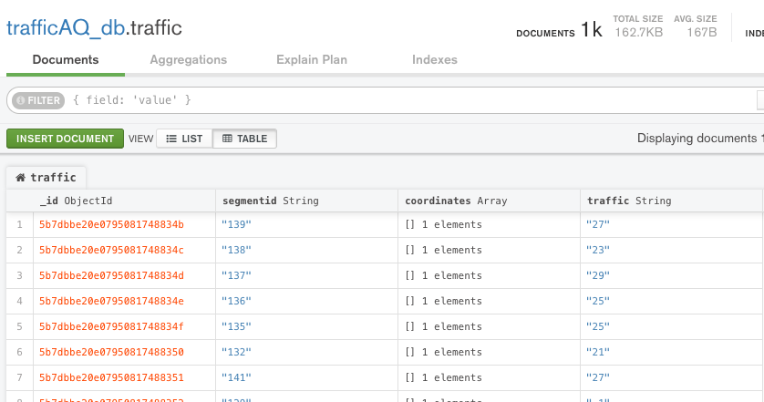
Mongo DB Snapshot

