Slide 1
Tableau Escape Room #SonsofHierarchies
File created on: 7/19/2022 10:18:32 PM

Slide 2
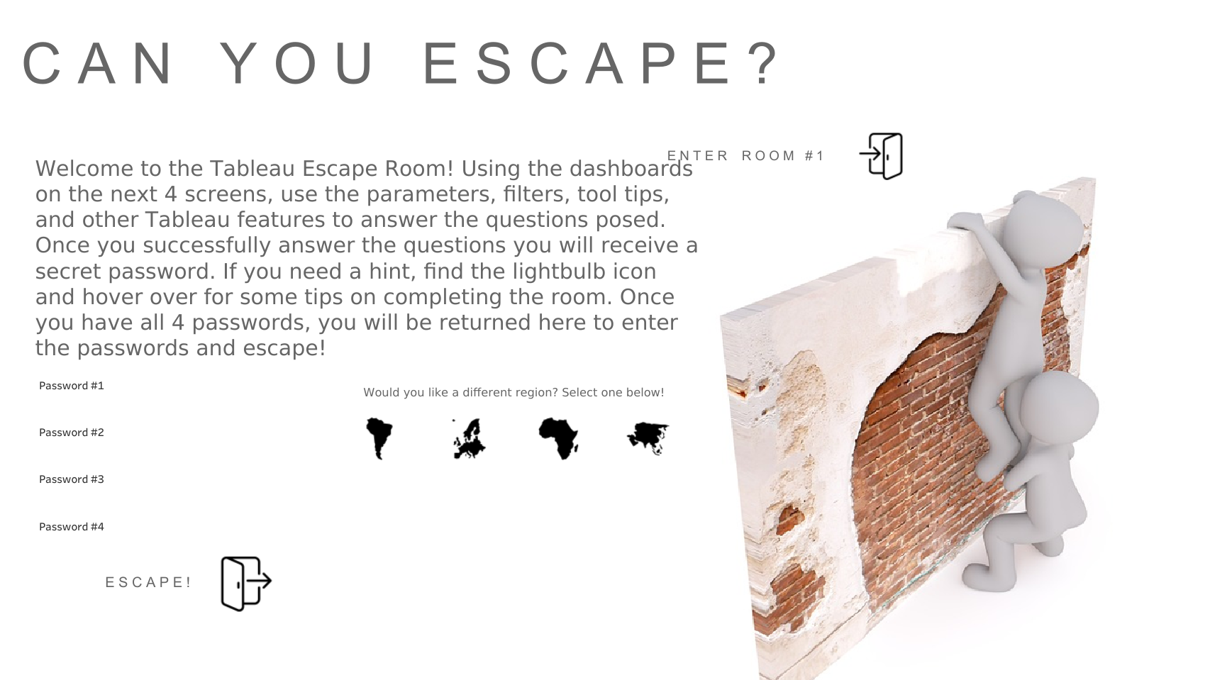

Slide 3
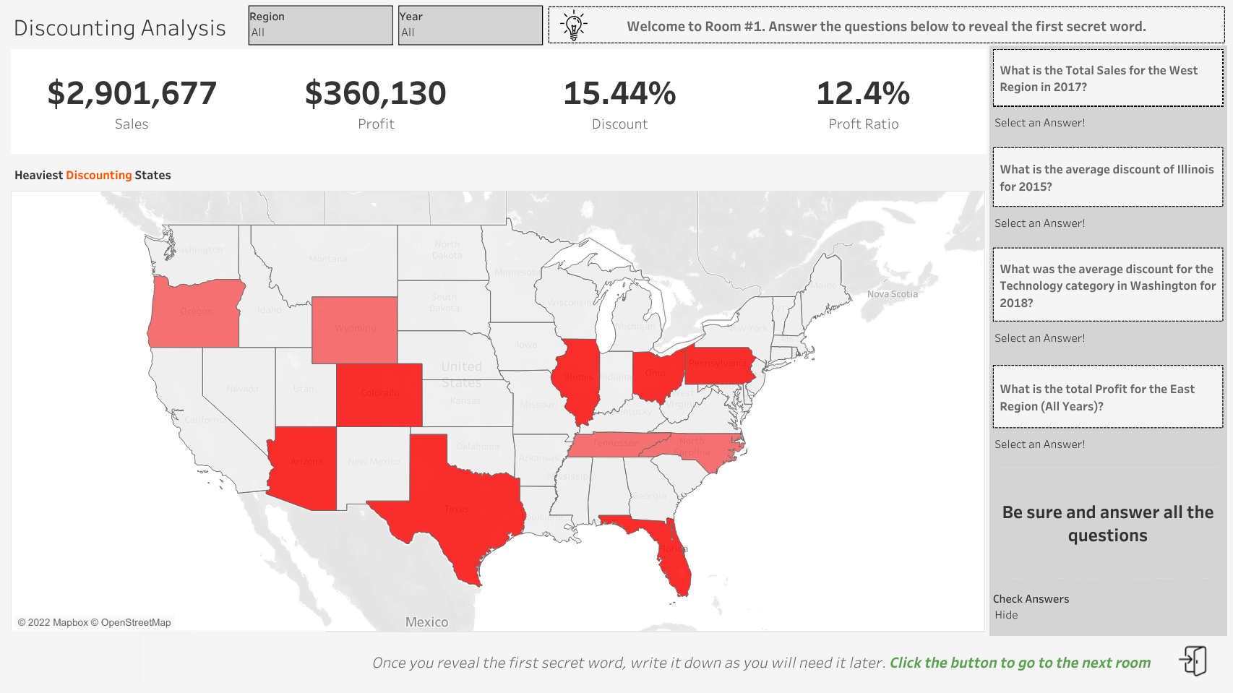

Slide 4
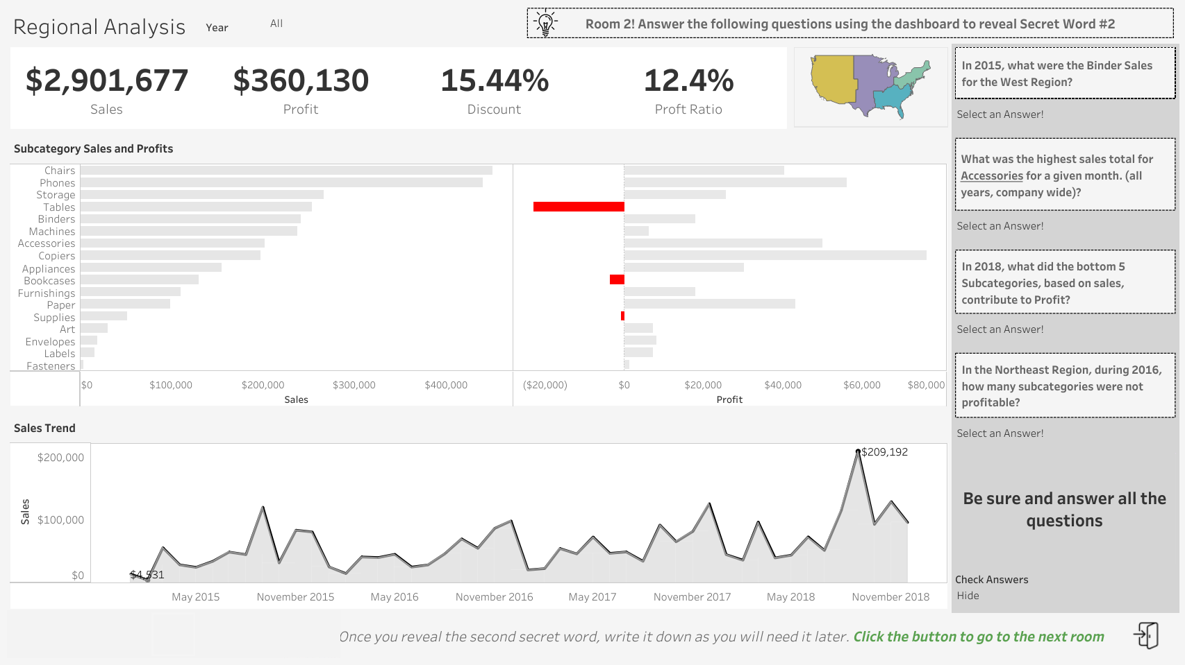

Slide 5
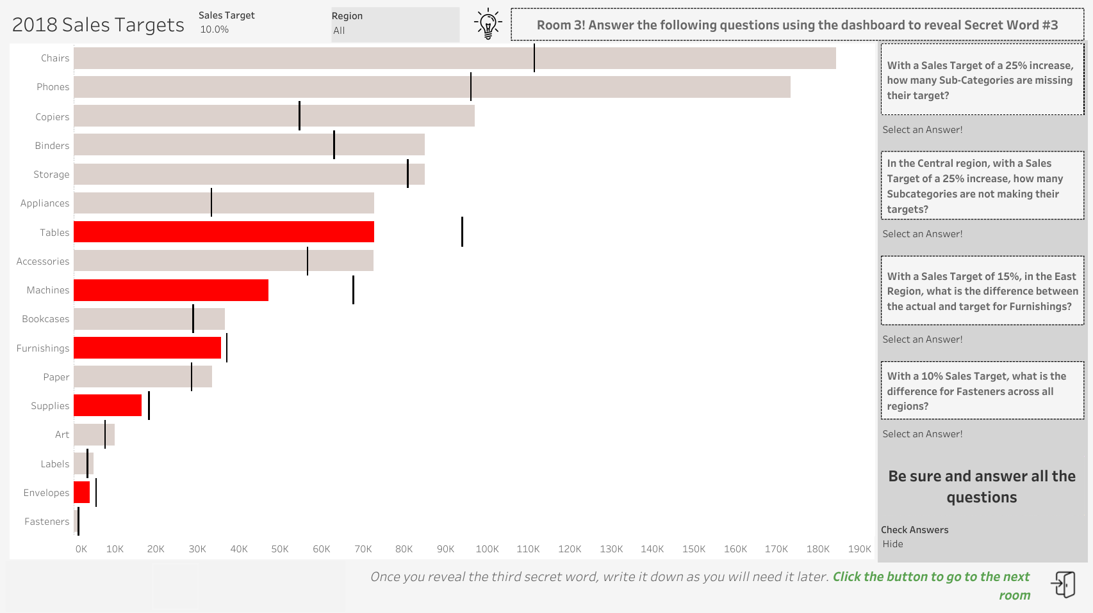

Slide 6
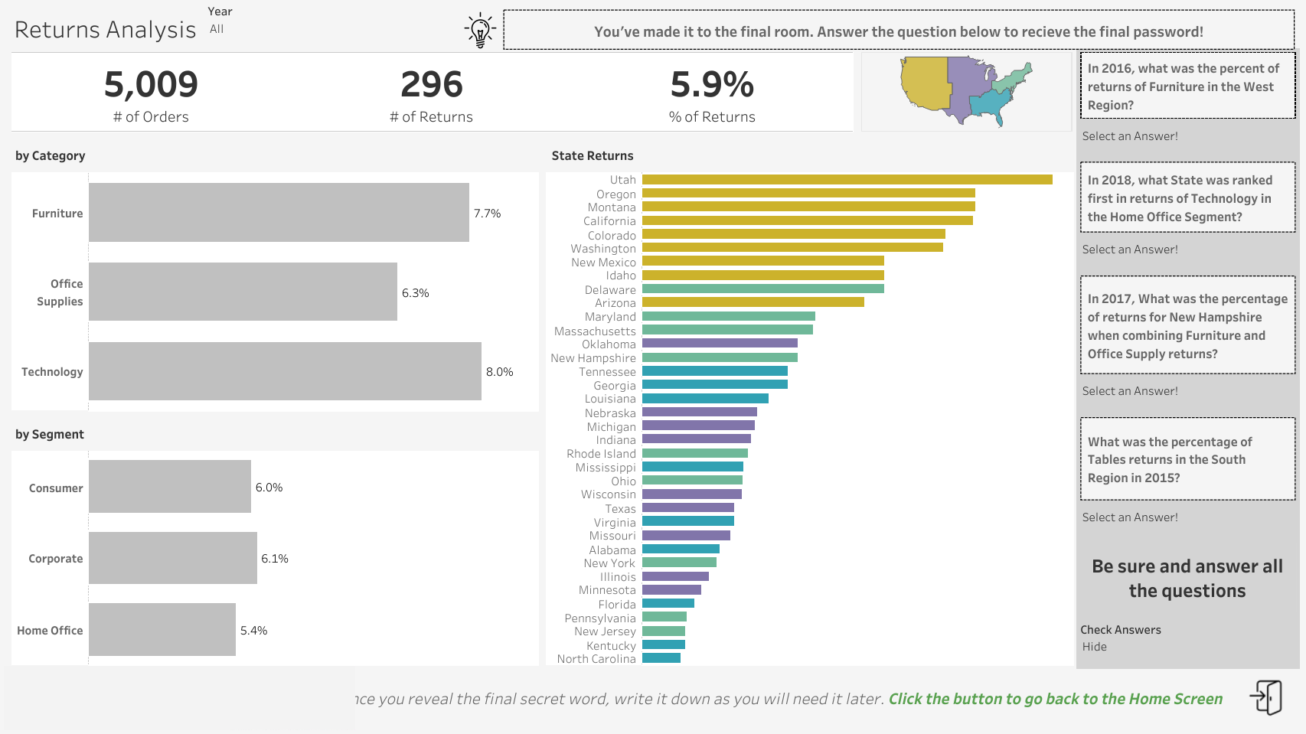

Slide 7


