Slide 1
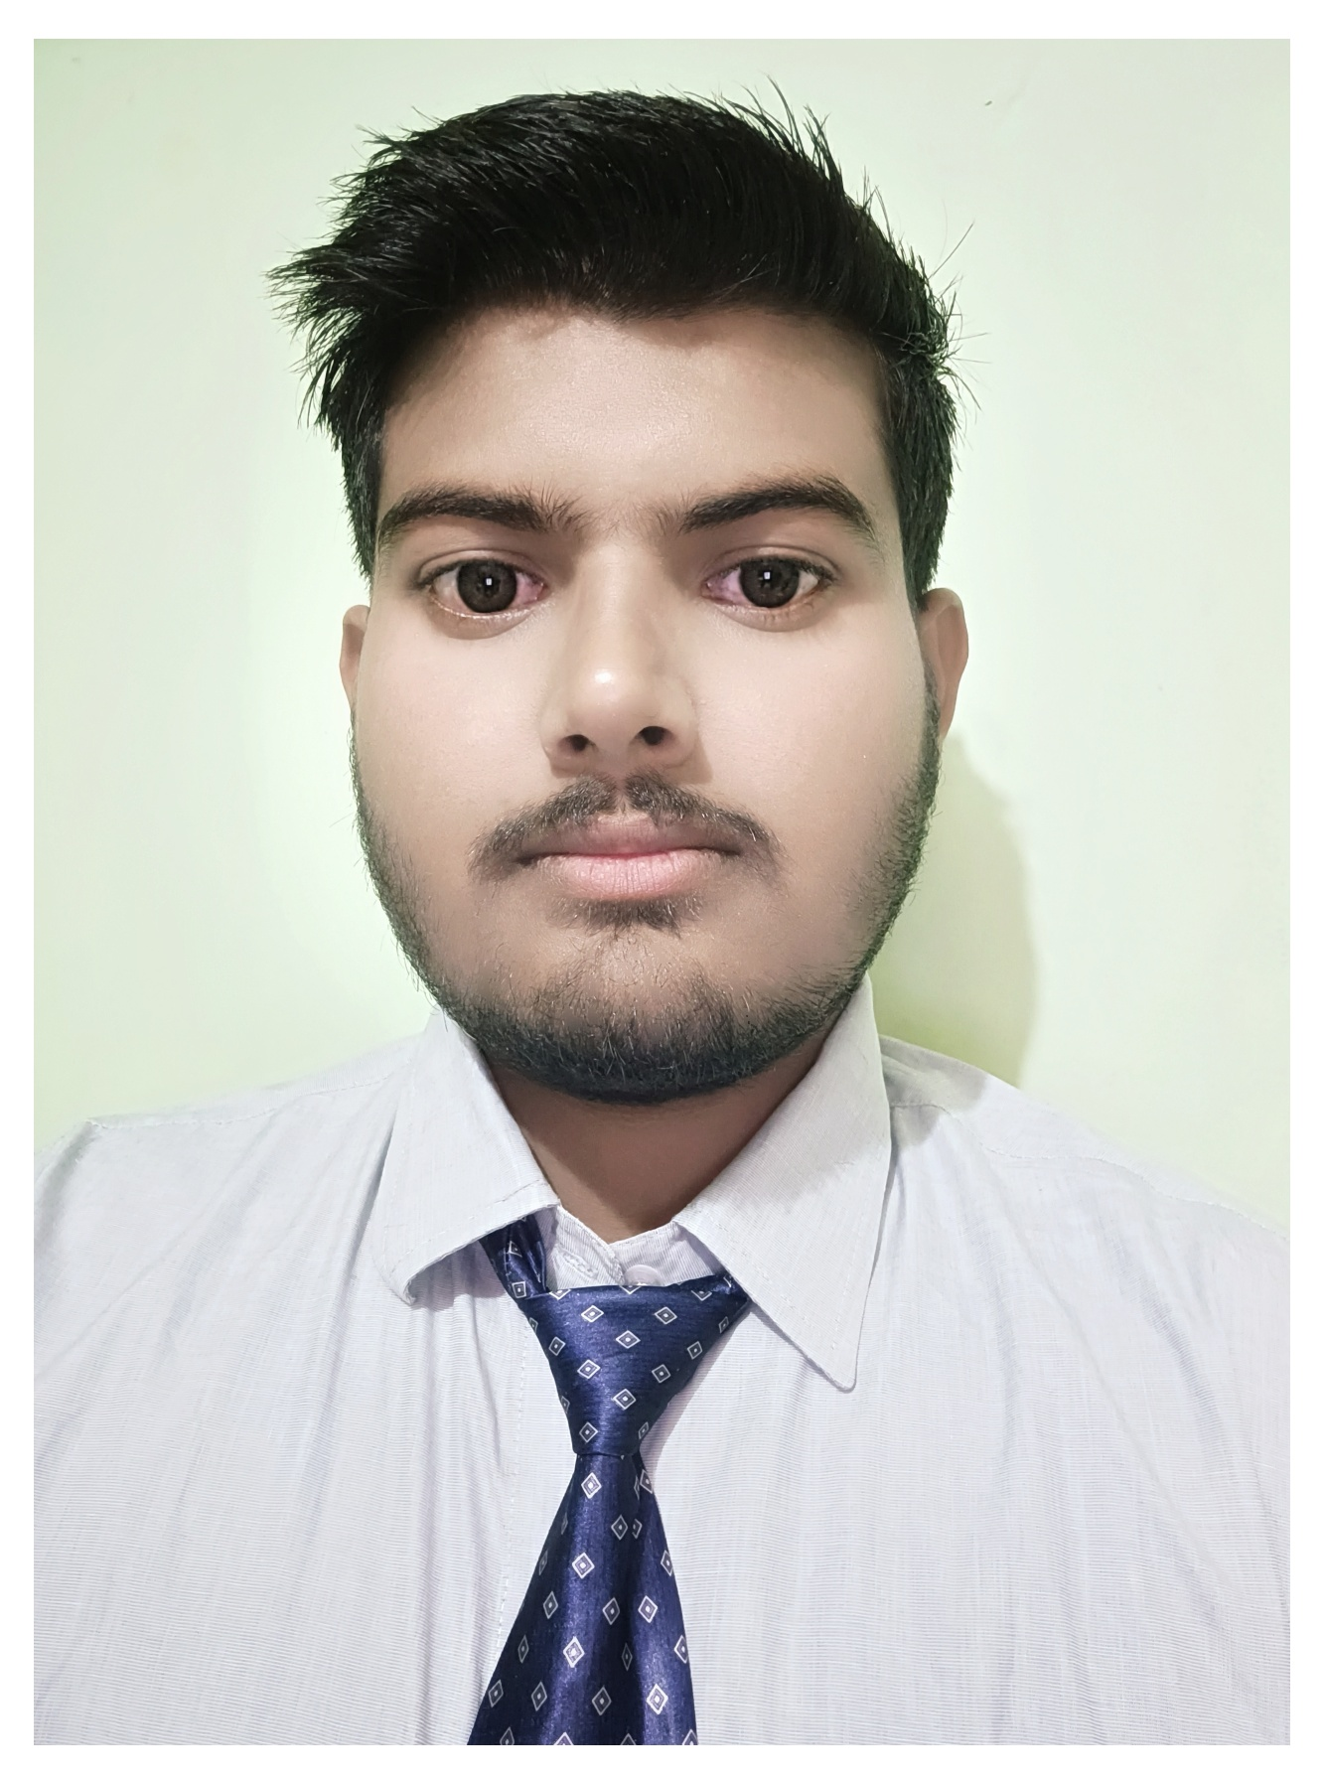



Akshay Kaushik
Analyst/Software Engineer
Bachelor of Technology (2018 – 2022)
Computer Science and Engineering
Skills Java 11
Spring Boot, MVC
Spring Security
Spring Cloud
MEAN Stack
Angular
NodeJS
MongoDB
Database
SQL database – MySQL
No SQL database – MongoDB
Web Technologies
HTML5 & CSS3
Javascript
Typescript
AddOns
Github
Maven
Postman
VS Code
Additional Details
Communication Skills
Team management
Navi Mumbai
akshay.kaushik@capgemini.com
+91 9027290253
A4
Full Stack Developer
Hands on experience in creating microservices with Spring boot, Spring Security, Spring Cloud API Gateway, Eureka server
Hands on experience in creating single page web application
Java Microservice Development knowledge using Spring boot and spring cloud framework on an intermediate level.
Team player who communicates effectively and works well with others to improve work output.
Eager to improve myself by learning new technologies and increasing my overall skills.
Coupons and Deals Finder Application
Completed end to end Coupons and Deal case study using Java Full Stack with Angular.
Implemented Multiple Micro services using Spring Boot and Spring Cloud and connecting them via a Discovery Server i.e. Eureka. Including routing using Netflix ZULL as a API Gateway and used SWAGGER Documentation.
Frontend with Angular 12, using Angular CLI for creating a user-friendly UI.
Backend with Mongo Compass.
Completed the Capgemini ADAPT Java Full Stack Angular training.
Check out my work on GitHub & Video Profile

