Slide 1
COVID-19 and Democratic Development: Data Cleaning
Rachel Kalusniak
MIS 5460
December 11, 2022​

Slide 2
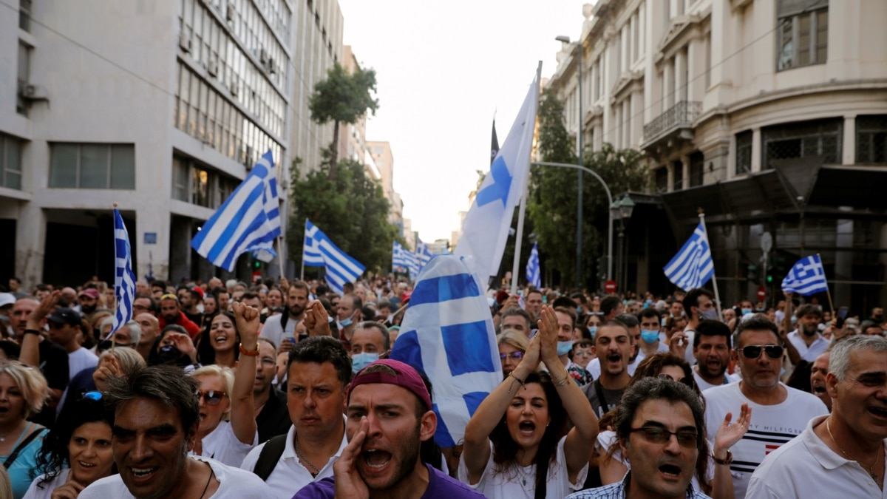
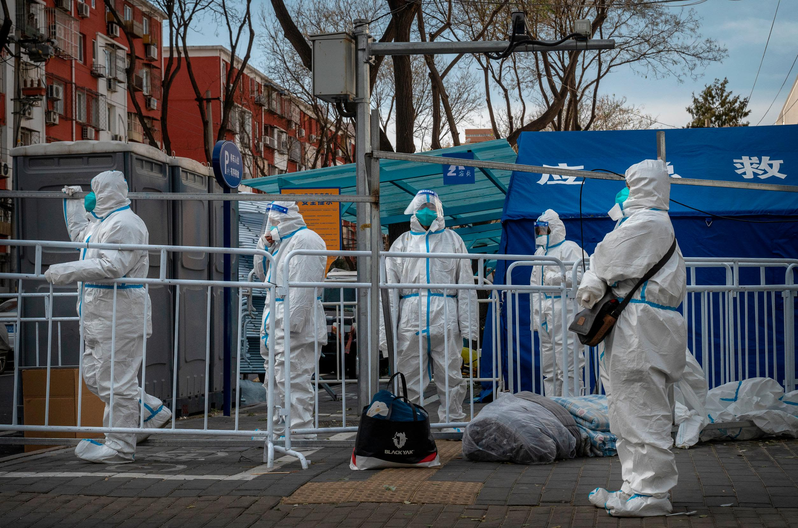
Background
Greece
States Restrictions → Stability → Prosperity (Tilly, 1985)
Response to COVID-19 pandemic varied greatly by country
China (authoritarian)
Strict COVID lockdown & Low case rate
Europe and North America
COVID lockdowns with backlash & Higher case rate
Research Hypothesis: Authoritarians countries with high levels of development were the best at reducing COVID cases and deaths
China

Slide 3
The Current Problems
Different country names
Lack of tidy data
Each data source has a different way to name certain countries
ISO 3166 (country codes)
Special characters
Remove extra rows and column
Unpivot COVID data
Constant updating Different File Types and Locations
Missing or Extra data
Lack of data for small or isolated countries
COVID accumulators include cruise ship and all US Citizens
New COVID daily
5 sources and 2 file types
Large and slow files

Slide 4
FLOW CHART
Show User the Update Form
Select Cancel
Exit
Select Update
Error Handler
Exit
Select No Options
Show User the Select Data Form
New Link from User
Select Cases/
Deaths
Select Democracy
Select Population
Select HDI
Import CSV
Show Instructions
Import CSV
Import Excel
Filter
Unpivot
File Picker
Import CSV

Slide 5
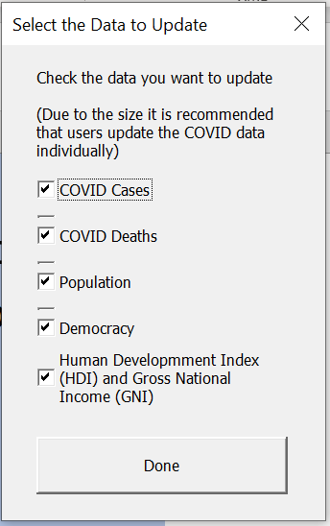
Capabilities
Simple user interface with clear instructions
Easy updating for multiple files types across locations
Aggregates all non-COVID data onto a single sheet with quartiles and regions
Friendly to new links

Slide 6
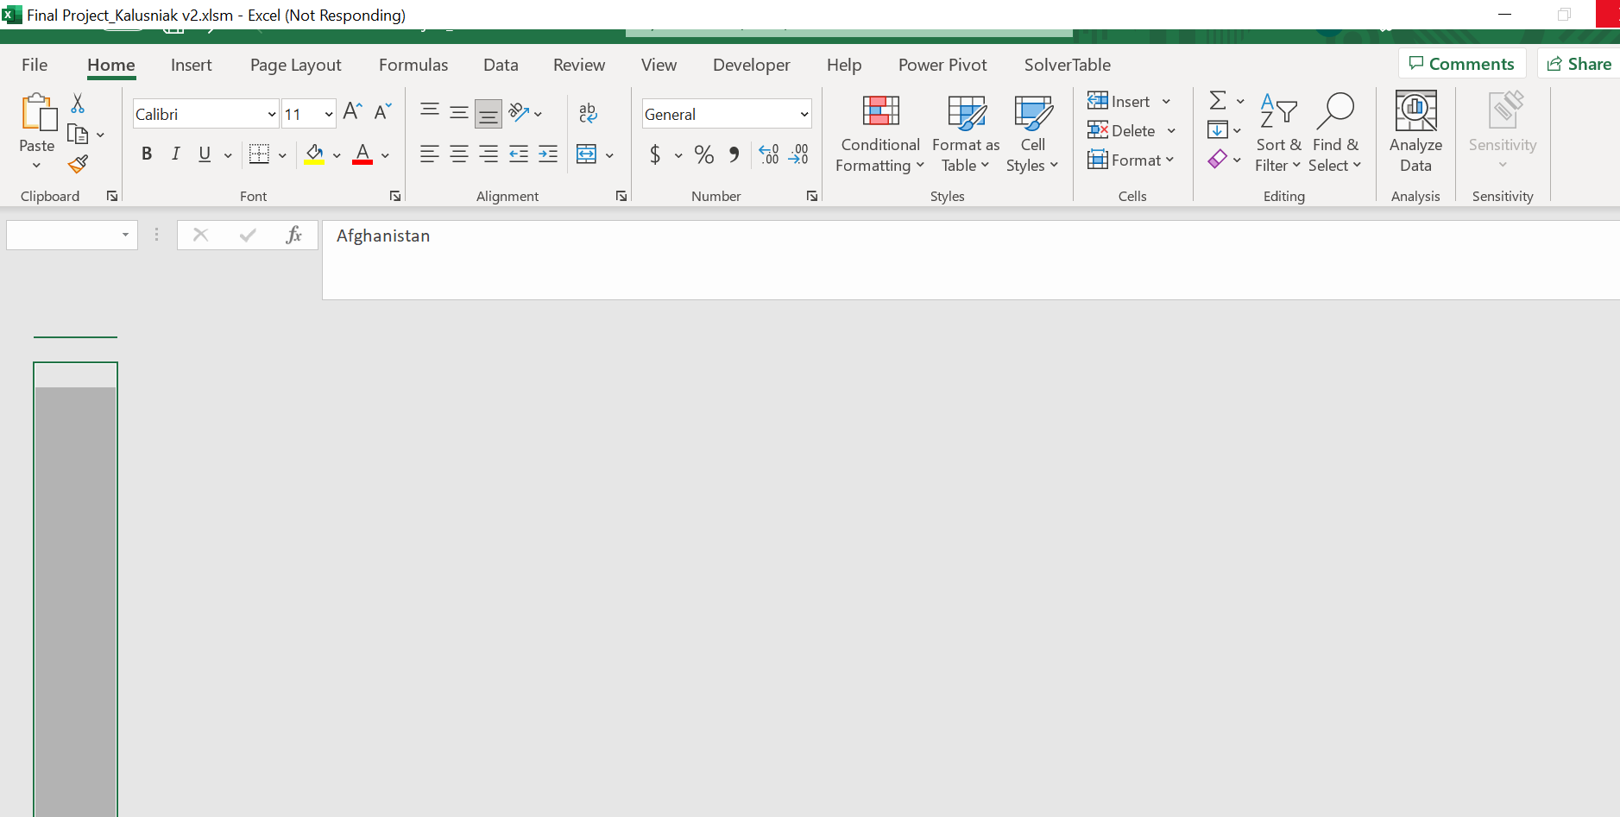
Limitations
Large data files
Runs slowly
Can only handle link moved errors
Doesn’t work if the data structure changes

Slide 7
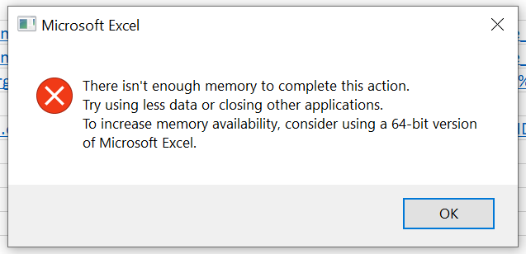
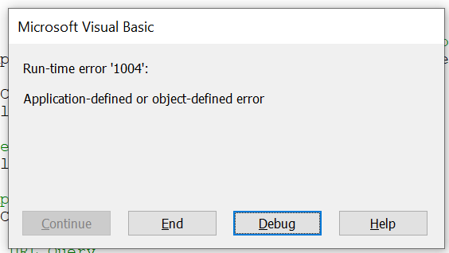



Challenges
Large Data Sets
Several Sources
Too many Options
Efficiency, looping, simplification
User warnings
Not enough memory
Design time development (formulas over code)
Modularization
Data sources key
Build up
Flexible code
Abandoned ideas

Slide 8
Demo

Slide 9
THANK YOU!

