Slide 1

DATA 5100 | 25FQ
Classification of Fruits and Vegetables as Fresh or Rotten
Rashmi Kamath

Slide 2
Agenda
Introduction
Description of data
Description of analysis method
Description of results supported by statistics
Conclusion

Slide 3
Introduction
Image classification is a key area in computer vision.
Used in many industries: object detection, face recognition, medical imaging.
In the food industry, freshness of produce is vital for quality and safety.
Manual inspection is labor-intensive and inconsistent.
Deep learning offers an automated and reliable alternative.

Slide 4
Data
Source: Fresh and Rotten classification.
Includes apples, bananas, oranges, cucumbers, okra, potatoes and tomatoes.
Images show both fresh and rotten states.
Thousands of high-resolution images with varied lighting and backgrounds.

Slide 5
Potential applications
Food Quality Inspection
Smart Refrigeration
Retail & E-commerce
Agriculture & Farming

Slide 6
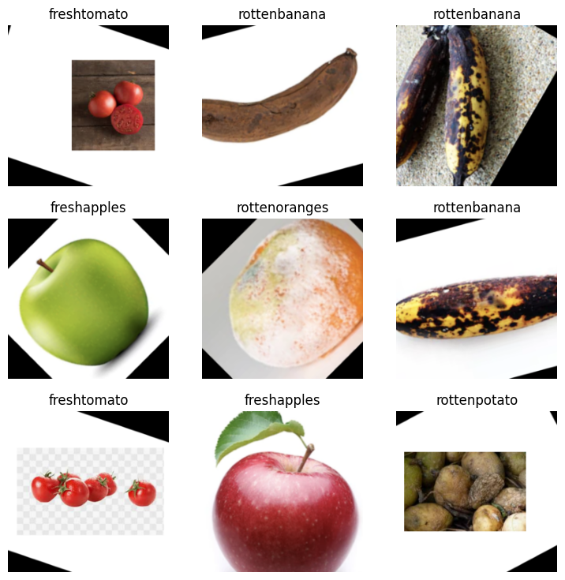
Analysis method
Understanding the Data

Slide 7
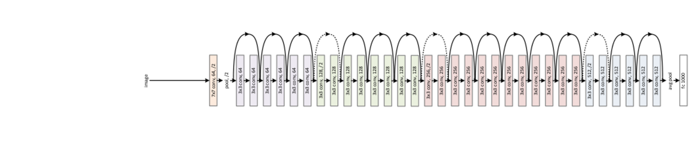
Modeling
The model is based on the ResNet-34 deep neural network, originally trained on the ImageNet dataset.
Retrained it to identify whether fruits and vegetables are fresh or rotten.
The model keeps learning until the error rate i.e. the number of wrong predictions is minimized.
In this case , I have retrained for 2 epochs(training rounds).

Slide 8
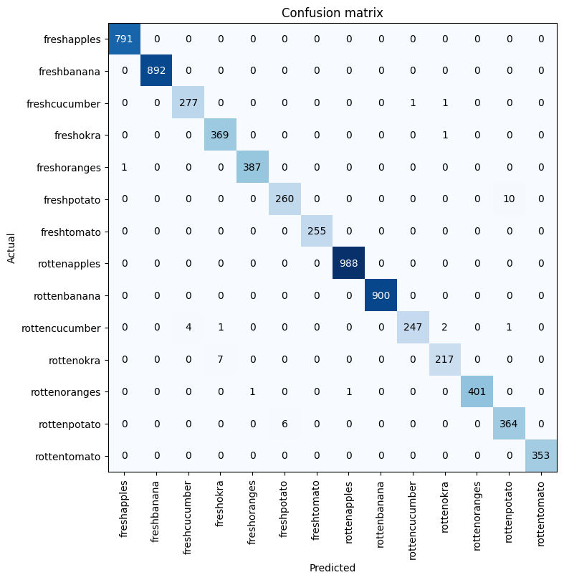
Results

Slide 9
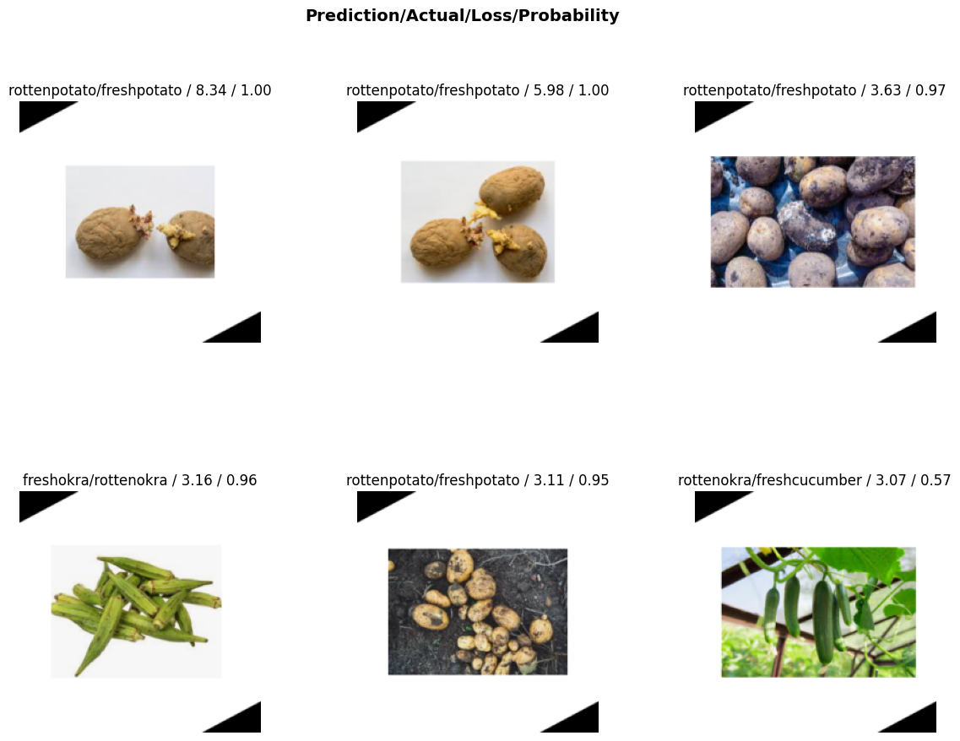
Results

Slide 10
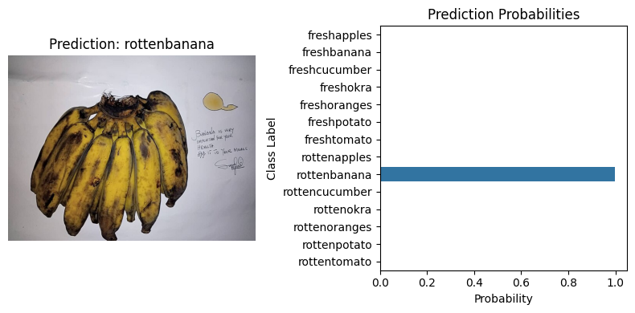
Deployment

Slide 11
Conclusion
Automate freshness detection for fruits and vegetables.
ResNet-34 architecture.
Achieved about 99% accuracy, showing strong generalization across lighting, texture, and background variations.
Reduces manual inspection effort and improves consistency in food-quality assessment.

Slide 12
Conclusion
References:
Tuğçe Göksu,Zeliha Kaya,Shaaban Sahmood-Classification of Fruit Images as Fresh and Rotten.Using Convolutional Neural Networks, 2023 3rd International Conference on Computing and Information Technology (ICCIT),
FCIT, University of Tabuk, KSA. 13 and 14/Sep/2023.
Kaggle: Fresh and Rotten classification.
Tutorials : Dr Brian Fischer

Slide 13
Thank you!

