Slide 1

Home project
A simple maven project with test-ng tests
running in multiple docker containers
Automated docker runs with scaling
Jenkins job that runs github project
REPO URL: https://github.com/rkamiset/W2O

Slide 2

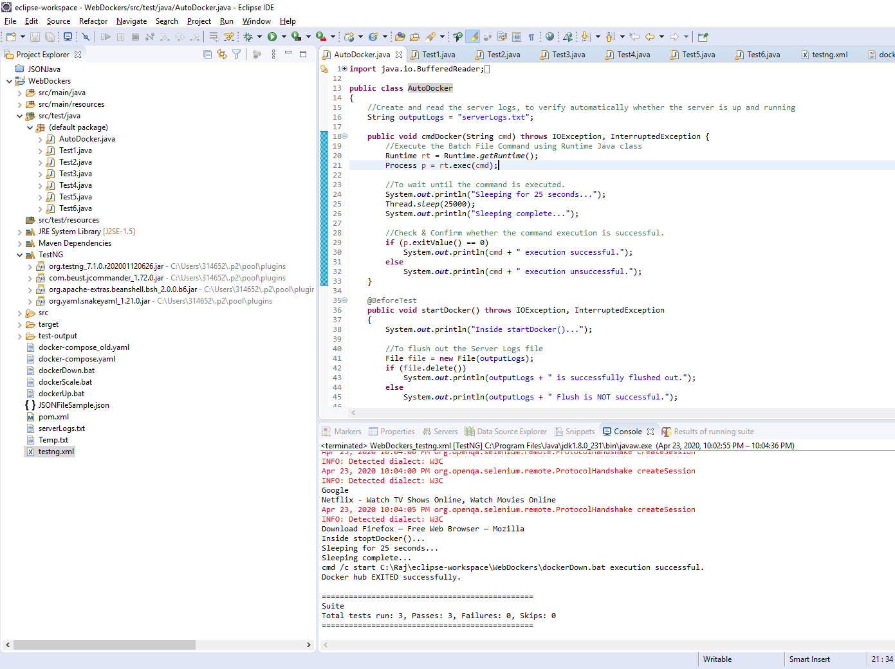
Maven project with testng

Slide 3
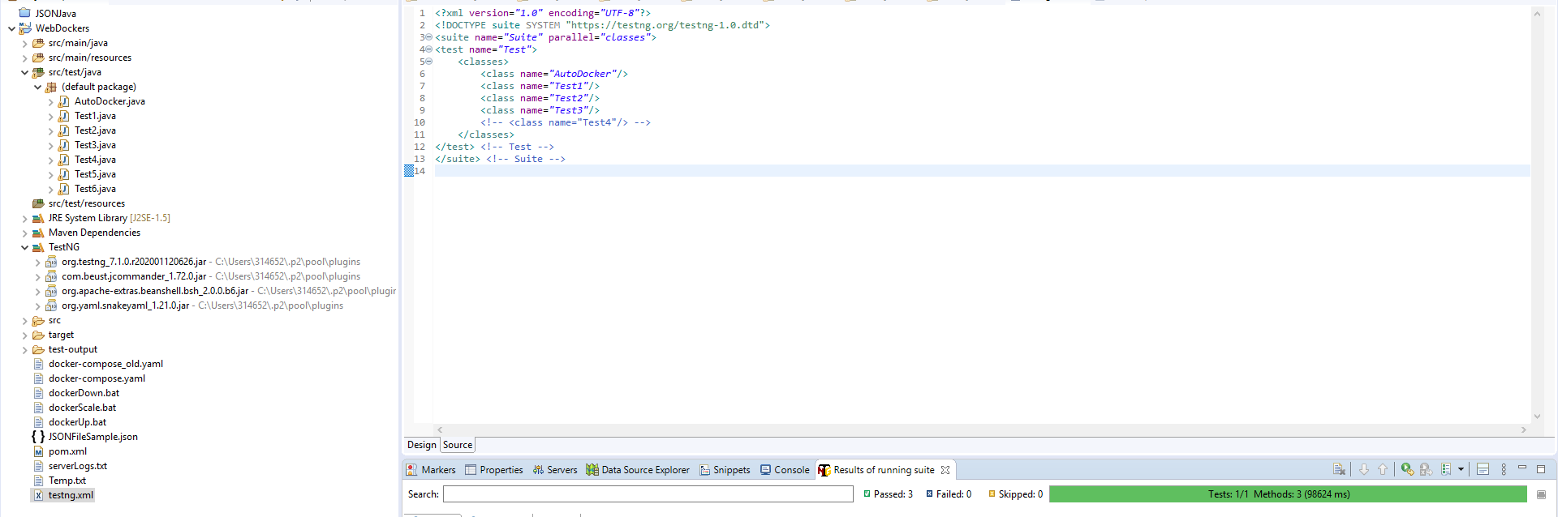
Testng configuraton

Slide 4
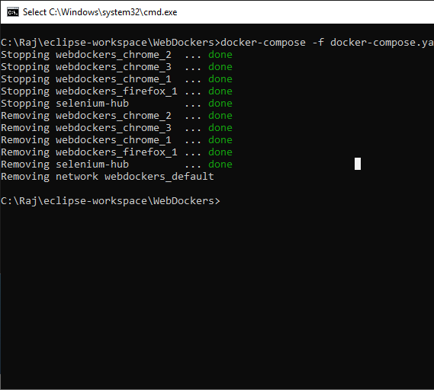
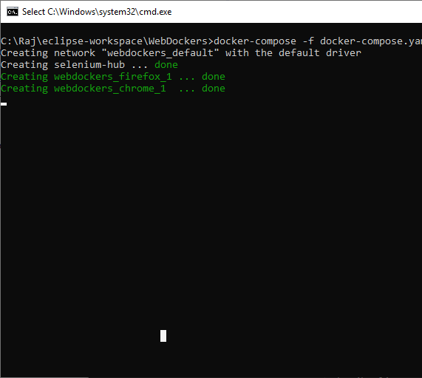
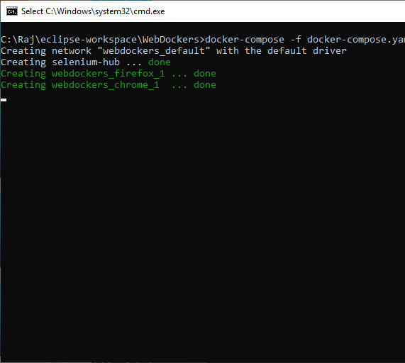
Docker automated

Slide 5
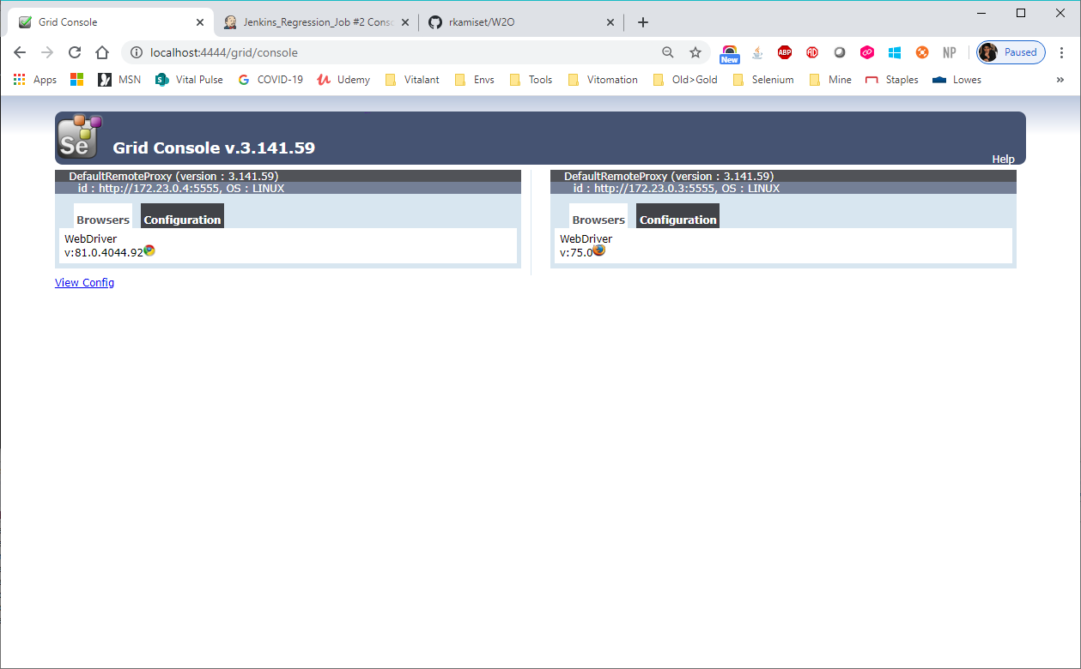
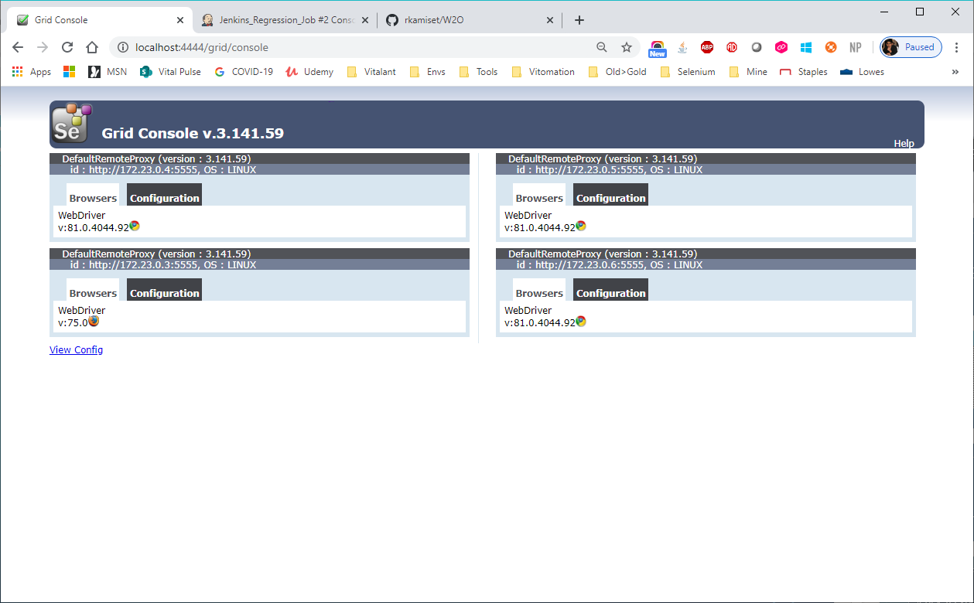
Container scaling

Slide 6
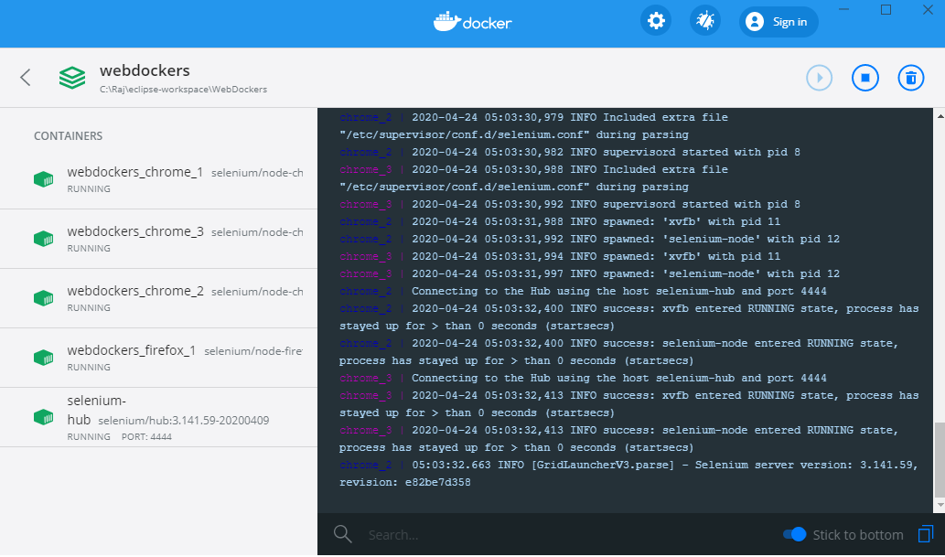
Docker dashboard

Slide 7
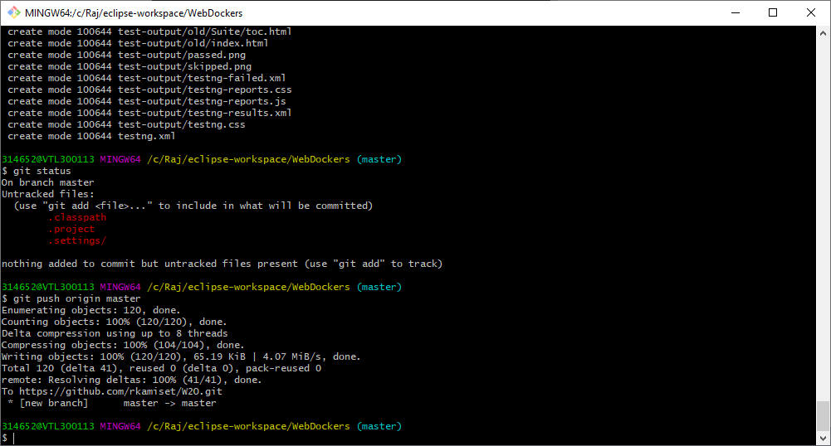
Git client

Slide 8
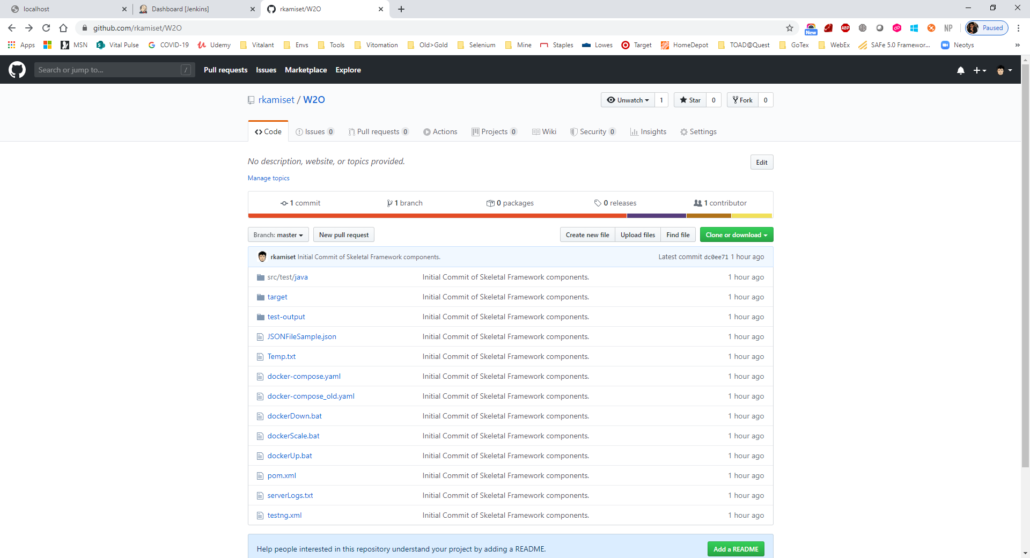
Github repo

Slide 9
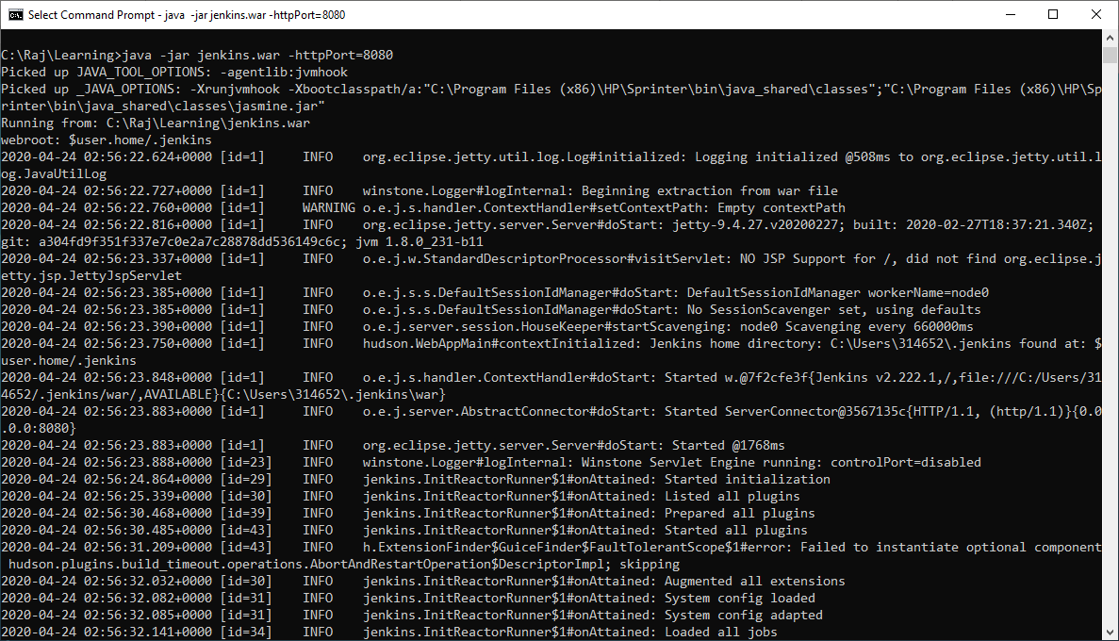
Jenkins server – running locally

Slide 10
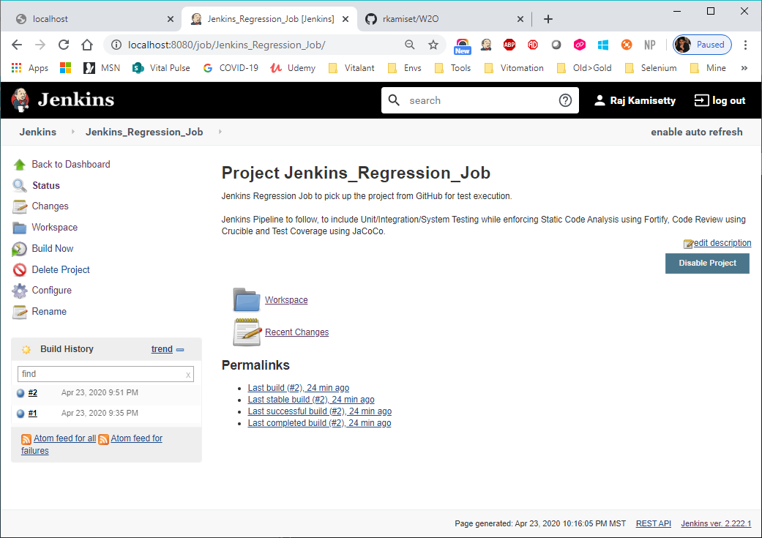
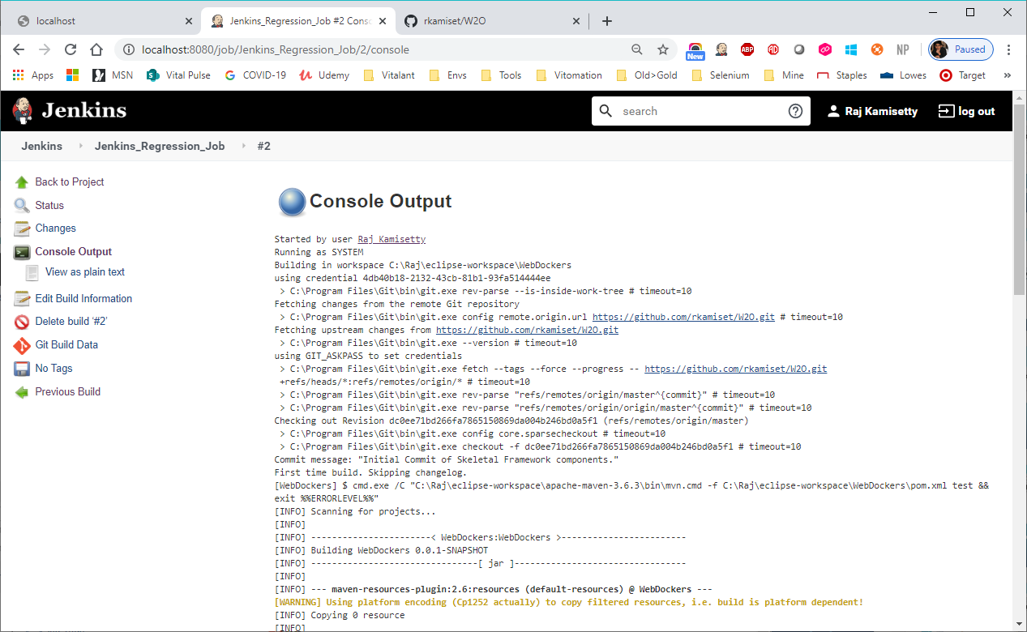
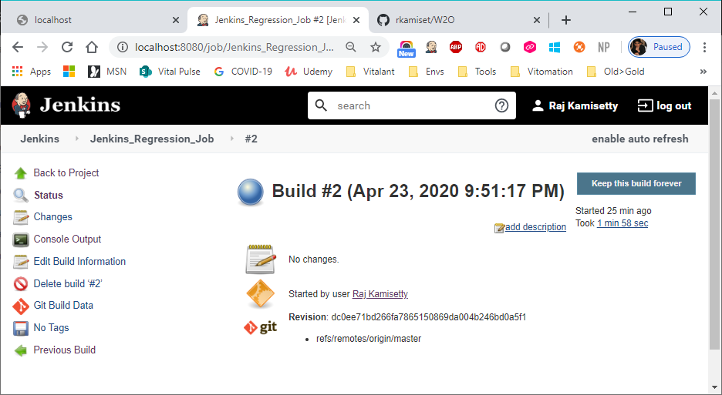
Jenkins job – basic (no CI/cd yet)

