Slide 1
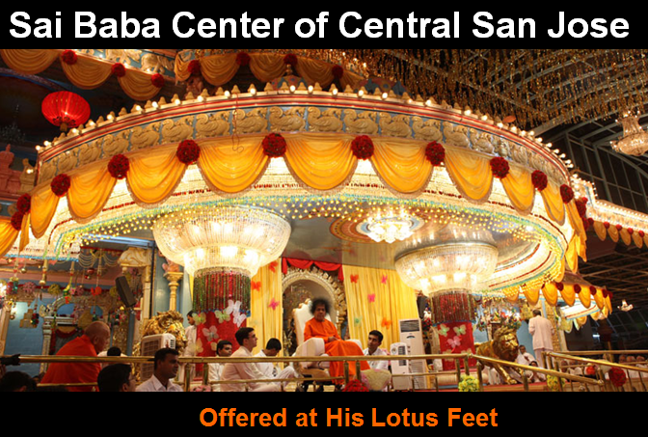

Slide 2

Upcoming Activities - Center and Region:
CENTER: April 5th, Sunday – Text
REGION: April 26^{th,} Sunday:Text
Center Announcements

Slide 3
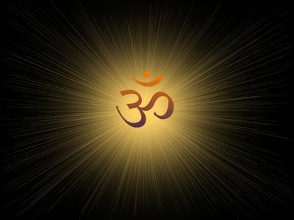

OM (3x)
Gayathri (3x)

Slide 4
Om
Bhoorbhuvah Ssuwaha Thath Savithur Varenyam Bhargo Devasya Dheemahi Dhiyo Yonah Prachodayaath
(x3)
Om Shanthi Shanthi Shanthihi
We contemplate the glory of Light illuminating the three worlds: gross, subtle, and causal.
I am that vivifying power, love, radiant illumination, and divine grace of universal intelligence.
We pray for the divine light to illumine our minds.

