Slide 1
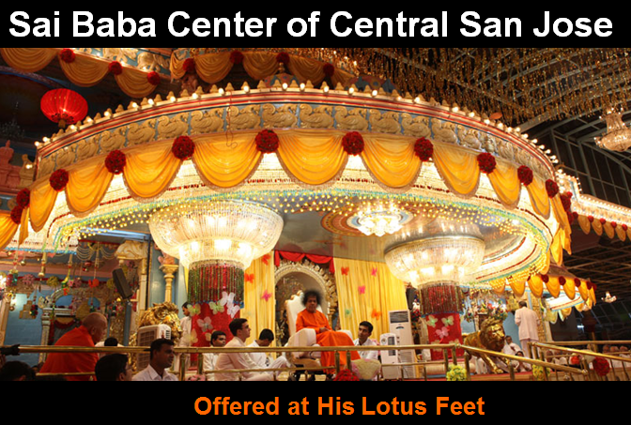

Slide 2

Upcoming Activities - Center and Region:
CENTER: April 5th, Sunday – Text
REGION: April 26^{th,} Sunday:Text
Center Announcements

Slide 3
UNISON
All praise to You Lord of the Worlds
Swami Sathya Sai Our Lord
You protect devotees who cling to You
Show Your Mercy to us who sing to You
Knowing You are God in human form
All praise to You Lord of the Worlds
With captivating…..
Notes:
3

Slide 4
UNISON
With captivating grace and loveliness
You do everything to bring us happiness
You're aware of all through infinite consciousness
You are Master of every living thing
For devotees You're wish-fulfilling
Helping us when we are in distress
All praise to You Lord of the Worlds
Mother Father …..
Notes:
4

Slide 5
UNISON
Mother Father Teacher and Lord
You remind us there is only one not two
Swami there is truly no one else but You
Master of creation You are adored
People of all nations are striving toward
Realization of our true reward
Our unity with You Lord of the Worlds
You are the word…..
Notes:
5

Slide 6
UNISON
You are the Word of God pure and bright
The Embodiment of all that’s true and right
Sathya Sai fill our hearts with pure delight
Do accept our prayer and heed us
From darkness we can't bear please lead us
With your might You make our burdens light
All praise to You Lord of the Worlds
Om Jaya Jagadeesa …..
Notes:
6

Slide 7
UNISON
Om Jaya Jagadeesa Harey
Swami Sathya Sai Harey
Bhaktha Jana Samrakshaka (2x)
Parthi Maheshwara
Om Jaya Jagadeesa Harey
Victory to Lord of the Universe, Lord Sathya Sai, Who destroys grief, evil and miseries of life and Who guards and protects devotees. Victory to Lord of Lords - Lord of Parthi!
Sashi Vadana…..
Notes:
7

Slide 8
UNISON
Sashi Vadana Sree Karaa
Sarva Praana Pathey, Swami Sarva Prana Pathe
Aasritha Kalpalatheeka (2x)
Aapadh Baandhavaa
Om Jaya Jagadeesa Harey
O Graceful and Charming as a Full Moon ! O Auspicious One ! O Lord Sai! Thou art: the Indweller and Life-force of all Beings; the wish- fulfilling Divine creeper to those who have surrendered to Thee; and kinsman, protector and friend in times of distress and calamities. Victory to the Lord of the Universe.
Matha Pitha…..
Notes:
8

Slide 9
UNISON
Maatha Pitha Guru Daivamu
Mari Anthayu Neevey , Swami Mari Anthayu Neevey
Naadabrahma Jagannaatha (2x)
Naagendra Shayanaa
Om Jaya Jagadeesa Harey
Victory to Lord of the Universe, Lord Sathya Sai, Who destroys grief, evil and miseries of life and Who guards and protects devotees. Victory to Lord of Lords - Lord of Parthi!
Omkaara Roopa…..
Notes:
9

Slide 10
UNISON
Omkaara Roopa Ojaswi O Saayi Mahadeva
Sathya Saayi Mahadeva
Mangala (H)Aarathi Anduko (2x)
Mandhara Giridhari
Om Jaya Jagadeesa Harey
O Splendorous One ! O Lord of Lords - Lord Sai Thou Form is Pranava. We pray Thee to accept the auspicious waving of flame of light (signifying the removal of ignorance). Victory to Thee, O Lord of the Universe, O Lord Giridhari who lifted the Mandhar mountain.
Narayana Narayana..
Notes:
10

Slide 11
UNISON
Narayana Narayana Om
Sathya Narayana Narayana Narayana Om
Narayana Narayana Om
Sathya Narayana Narayana Om
Sathya Narayana Narayana Om
Om Jaya Sathguru Devaa (x3)
Om Shanthi Shanthi Shantihi!
Chant the name of Lord Sathya Sai Narayana, Whose Form is Pranava (Om). Victory to Noble Teacher and Supreme Lord Sai, Sathya Sai.
Sacred Holy and Supreme..
Notes:
11

Slide 12
UNISON
Sacred, holy and Supreme is Baba’s vibhuti
Pouring forth in brilliant stream – this play of vibhuti
So auspicious is its might, it grants liberation
Baba’s vibhuti – its power protects me.
Paramam Pavithram Baba Vibhuthim
Paramam Vichithram Leela Vibhuthim
Paramaartha Ishtaartha Moksha Pradhaatham
Baba Vibhuthim Idhamasrayami
I take refuge in the supremely sacred Vibhuthi of Lord Baba, the wonderful Vibhuti, which bestows salvation, the sacred state which I desire to attain.
Divine Code of Conduct....
Notes:
12

Slide 13
Divine Code of Conduct
Daily meditation and prayer
Thought for the week

Slide 14
Thought for the week
Take Hanuman as your example in sevā (selfless service). He served Rama, the Prince of Righteousness, regardless of obstacles of all types. Though he was strong, learned and virtuous, he
had no trace of pride. When asked who he was by the Rākshasas (demons) in Lanka, into which he had entered so daringly, he described himself in all humility as the servant of Rama. That is a fine example of uprooting of the ego that sevā must bring about in us. No one can serve another while the ego is rampant. The attitudes of mutual help and selfless service develop humanness and help the unfoldment of the Divinity latent in the human.
Selfless Service - A Study Guide, Sri Sathya Sai, November 19, 1981
From Untruth…

Slide 15
UNISON
From untruth, lead us to Truth
From the darkness, lead us to the Light
From death, to immortality
Asatoma Sadgamaya
Tamasoma Jyotirgamaya
Mrityorma Amritangamaya
Om Shanti Shanti Shantihi
May all the beings

Slide 16
UNISON
May All The Beings In All The Worlds Have Happiness And Peace.
Samastha Lokah
Sukhino Bhavantu (3X)
Om Shanti Shanti Shantihi!
Meditation…

Slide 17
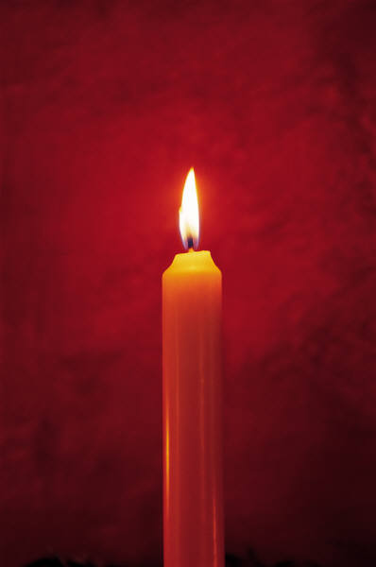
Meditation
Silent Departure……

Slide 18
