Slide 1
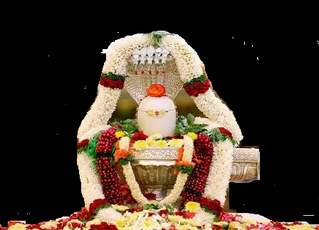


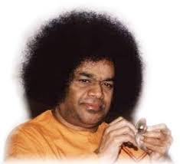
Scale
:
Bhajan
Meaning
Next:
NextBhajan
NextScale

