Slide 1

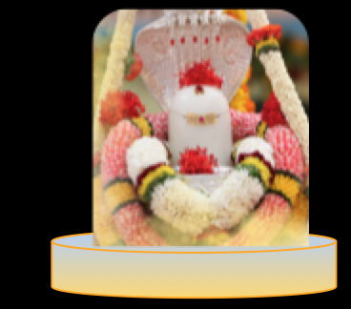
Maha Shivaratri
Bhajan
Meaning
Next Bhajan : Next Bhajan Scale

