Slide 1
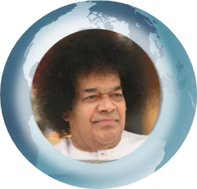

LIVING HIS MESSAGE - Prayers for Global Peace
Bhajan
Meaning
Scale
NextBhajan
NextScale

