Slide 1
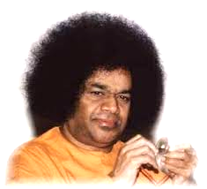

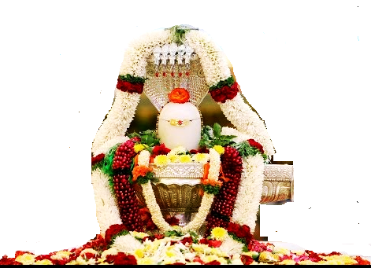
Maha Shivaratri Celebrations
Scale
Bhajan
Meaning
NextBhajan
NextScale

