Slide 1
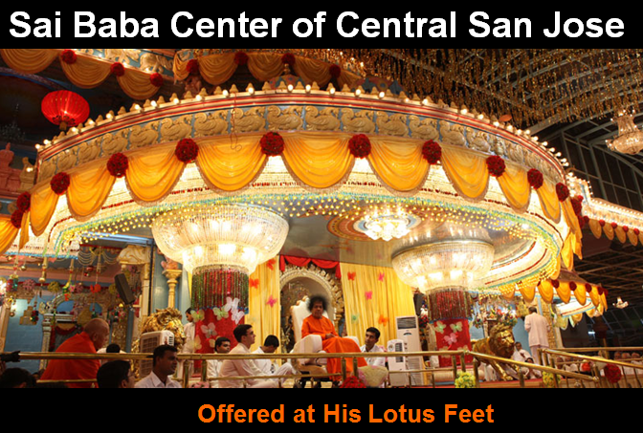
Sathya Sai Baba Center of Central San Jose

Slide 2


OM (3x)
Center Announcements
Bhajan
Next: Announcements

Slide 3
Center Announcements
Next: Gayatri

Slide 4
Om Bhur Bhuvaḥ Swaḥ
Tat-savitur Vareñyaṃ
Bhargo Devasya Dhīmahi
Dhiyo Yonaḥ Prachodayāt
(3x)
We meditate on that most adored Supreme Lord, the creator, whose effulgence (divine light) illumines all realms (physical, mental and spiritual). May this divine light illumine our intellect.
Next: Bhajans

