Slide 1
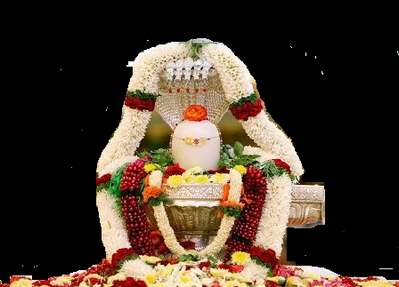

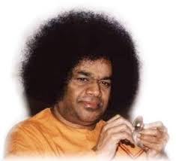
Maha Shivaratri Celebrations
Scale
:
Bhajan
Meaning
Next:
NextBhajan
NextScale

