Slide 1
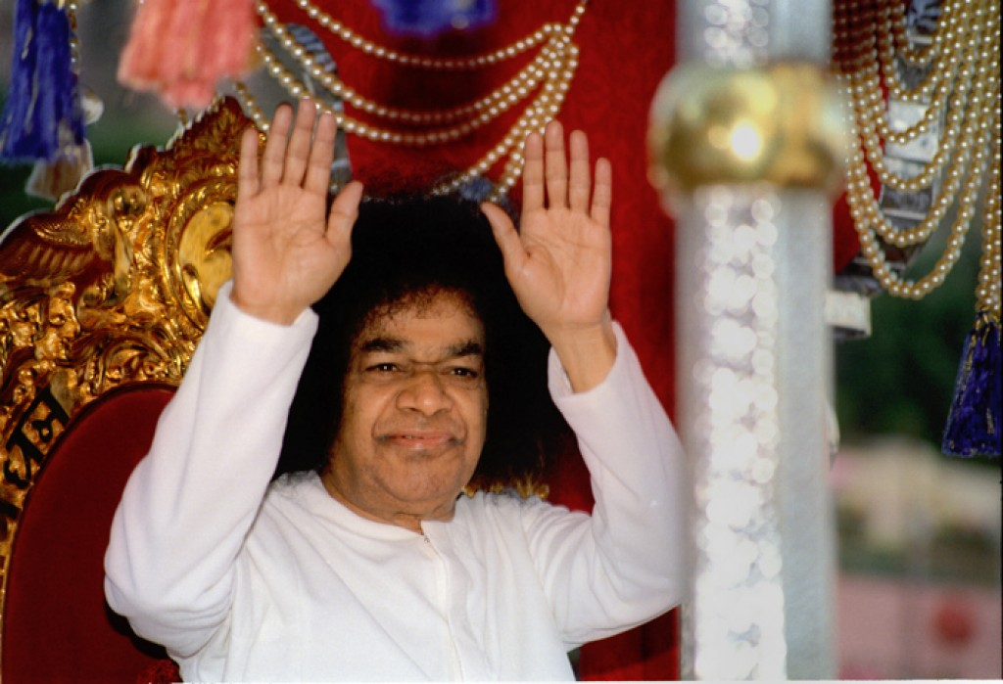

Help Ever Hurt Never - Prayers for Global Peace
Bhajan
Meaning
Scale
NextBhajan
NextScale

