Slide 1
UNISON
From untruth, lead us to Truth
From the darkness, lead us to the Light
From death, to immortality
Asatoma Sadgamaya
Tamasoma Jyotirgamaya
Mrityorma Amritangamaya
Om Shanti Shanti Shantihi
May all the beings

Slide 2
UNISON
May All The Beings In All The Worlds Have Happiness And Peace.
Samastha Lokah
Sukhino Bhavantu (3X)
Om Shanti Shanti Shantihi!
Meditation……

Slide 3
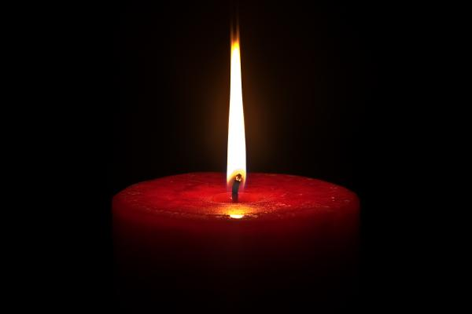
Meditation
ૐ
Silent Departure
Silent Departure……

Slide 4
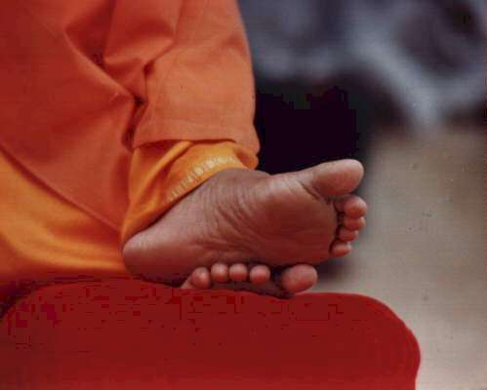
Love All & Serve All

