Slide 1
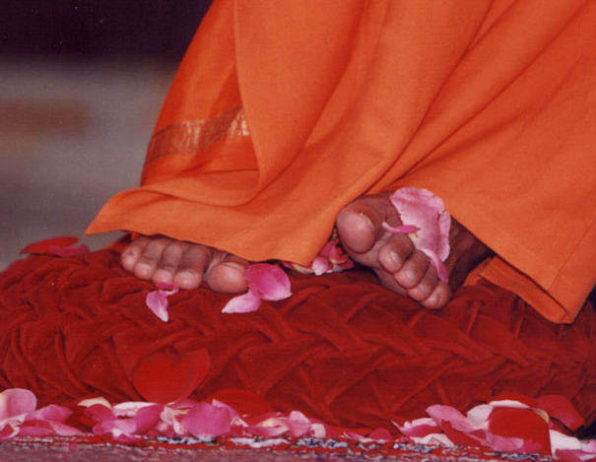
Sathya Sai Baba Center of Peninsula
Next: Multi faith chants
Notes:
1

Slide 2
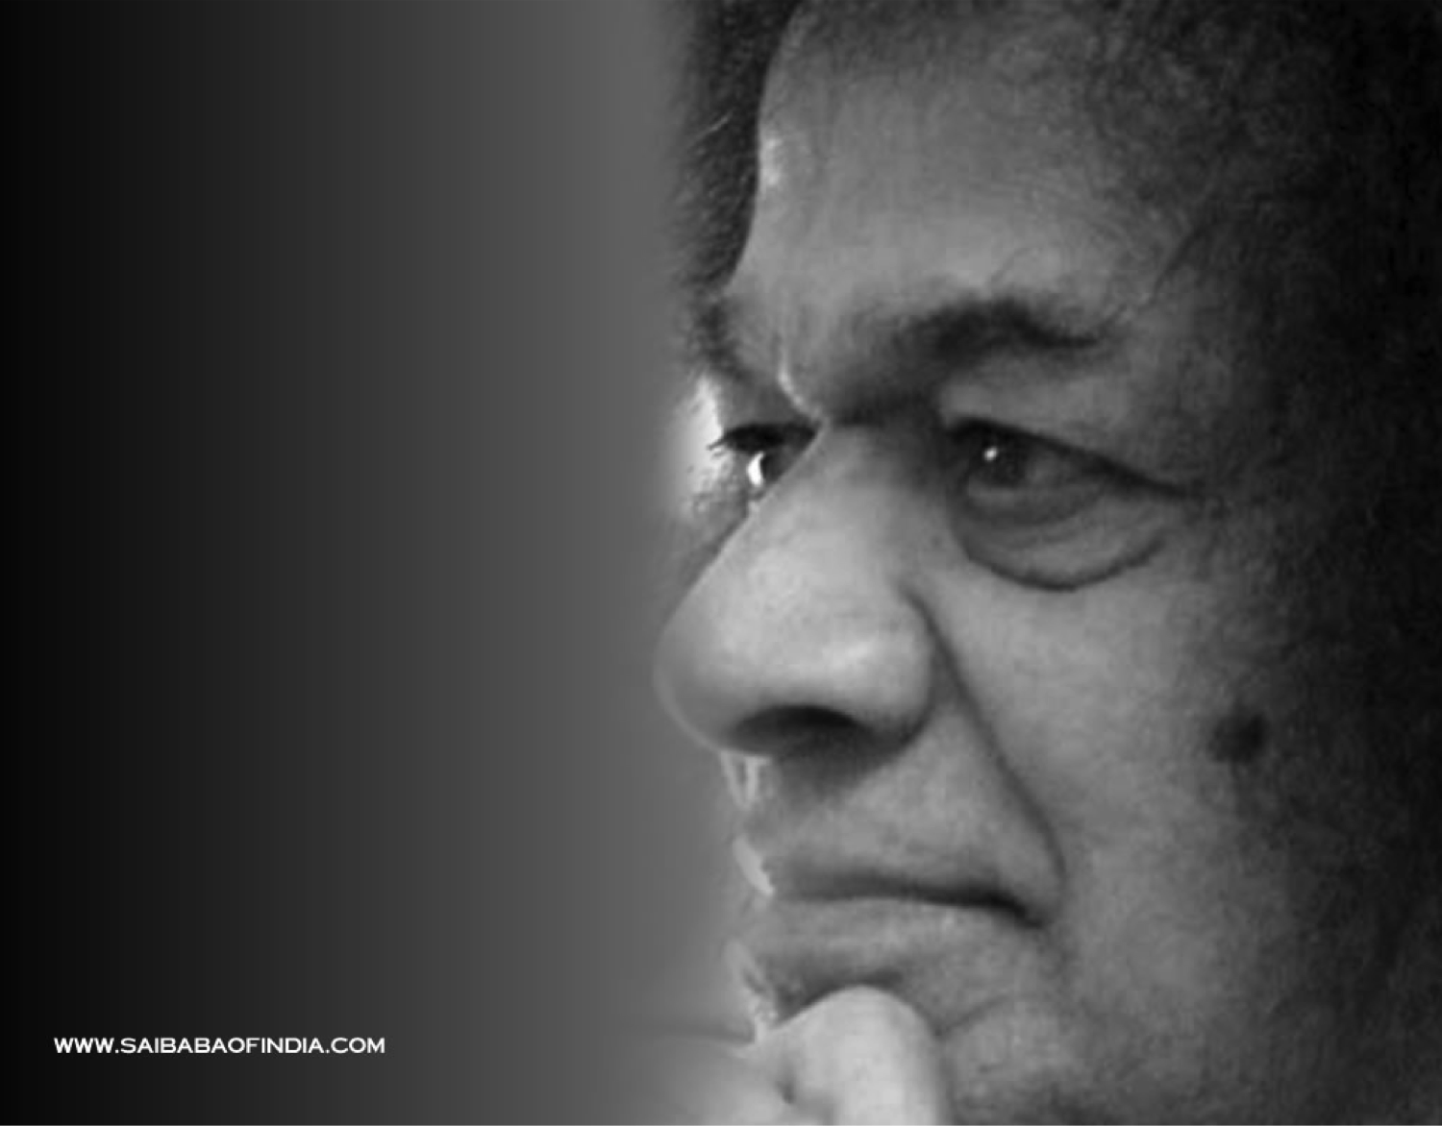
Let the different faiths exist, let them flourish, let the glory of God be sung in all the languages, in a variety of tunes that should be the ideal. Respect the differences between the faiths and recognize them as valid as far as they do not extinguish the flame of Unity. - Baba

Slide 3
Multi-Faith Chants
Hinduism
Om Bhur Buvah Suvaha
Thath Savithur Varenyam
Bhargo Devasya Dheemahi
Dhiyo Yonaha Prachodayath
We contemplate the glory of Light illuminating the three worlds: gross, subtle, and causal. I am that vivifying power, love, radiant illumination, and divine grace of universal intelligence. We pray for the divine light to illumine our minds.
Christianity
Our Father, who art in heaven, hallowed be Thy name.
Thy kingdom come, Thy will be done on earth as it is in heaven.
Give us this day our daily bread, and forgive us our trespasses,
as we forgive those who trespass against us.
And lead us not into temptation, but deliver us from evil.
For Thine is the kingdom, and the power, and the glory, forever and ever.
Amen.

Slide 4
Multi-Faith Chants
Judaism
Shma Yisra-el Adonai Elohaynu,
Adonai Echad
Hear Oh Israel, The Lord is our God. The Lord is One.
Zoroastrianism
Ashem Vohu Vahisthem Asthi
Ushtho Asthi Ushtho Ahamoi
Hyath Ashoi Vahisthoi Ashem
Righteousness is the highest virtue; that alone is happiness.

Slide 5
Multi-Faith Chants
Buddhism
Namo Tassa Bhagavato Arahato Samma Sambuddhassa
Salutations to the Blessed One, the holy One, and the Fully Enlightened One.
Buddham Sharanam Gachchami
Dhammam Sharanam Gachchami
Sangham Sharanam Gachchami
I take refuge in the Buddha, I take refuge in the teaching (righteousness), I take refuge in the community of followers

Slide 6
Multi-Faith Chants
Islam
Bismillah Ar-Rahman Ar-Rahim (3x)
I begin with the name of God, most gracious, most merciful.
La ilaha illallah, Allah Allah (4x)
There is no God, but God.
Sai Gayatri
Saayeeshvaraaya Vidhmahe
Sathya-Devaaya Dheemahi
Thannah-Sarvah Prachodayaath
We know this Sai as supreme divinity incarnate. We meditate on this God of Truth. May this Almighty All-in-all Personality lead us
on the path of total liberation.

Slide 7
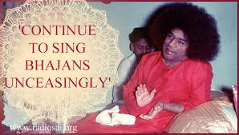
Devotional Songs

