Slide 1
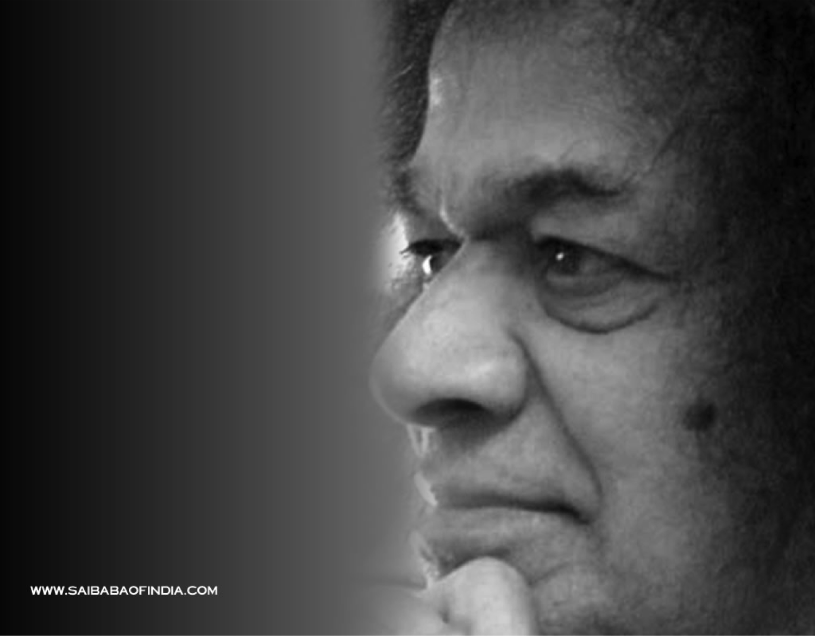
Sarva Dharma Prayer
Om Tat Sat Sri Narayan Tu,
Purushottama Guru Tu,
Siddha Buddha Tu, Skanda Vinayaka,
Savita Pavaka Tu,
Brahma Mazda Tu, Yehovan Shakti Tu,
Ishu Pita Prabhu Tu,
Rudra Vishnu Tu, Ramakrishna Tu,
Rahim Tao Tu,
Vasudeva Go-Vishwarupa Tu,
Chidananda Hari Tu,
Advitiya Tu, Akala Nirbhaya
Atmalinga Shiva Tu.
Notes:
1

Slide 2

Meditation
O Lord, take my love, let it flow in full devotion to Thee
O Lord, take my hands, let them work unceasingly for Thee
O Lord, take my soul, let it merge in perfect oneness with Thee
O Lord, take my mind, let my thoughts be in tune with Thee
O Lord, take my everything, and let me be an instrument for Thee
Notes:
2

Slide 3
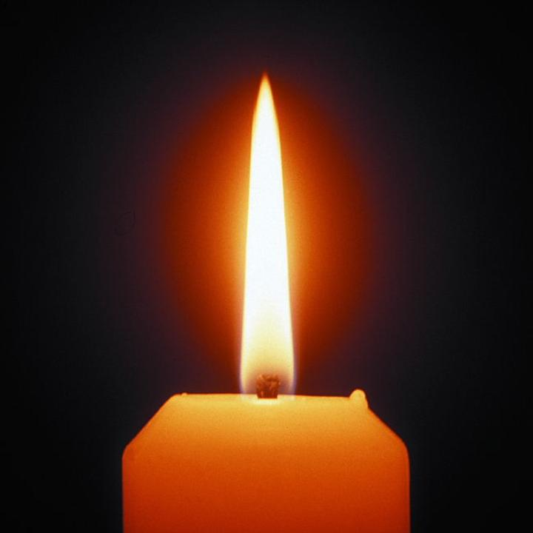
Notes:
3

Slide 4
Gayatri Mantra (x11)
Om bhur-bhuvas-suvah
Tat-savitur-varenyam bhargo devasya dhimahi
dhiyo yo nah pracodayat
"O Mother! Who subsists at all three kalas (past, present, future), in all three lokas (physical, subtle, and causal worlds) and all three gunas (universal qualities; harmony, agitation, and inertia), I pray to You to illumine my intellect and dispel my ignorance, just as the splendorous sunlight dispels all darkness. I pray to You to make my intellect serene and bright." (Baba)
Notes:
4

Slide 5
om śantih śantih śantih
om peace peace peace
Notes:
5

Slide 6
Asatoma Hymn
From untruth, lead us to Truth
From the darkness, lead us to the Light
From death, to Immortality
Asatoma Sadgamaya,
Tamasoma Jyotirgamaya,
Mrityorma Amritamgamaya,
Notes:
6

Slide 7
om śantih śantih śantih
om peace peace peace
Notes:
7

Slide 8
Announcements
Introductions
Please pass the nearest microphone to new members
New members
Please introduce yourselves
Kindly speak in to the microphone
Notes:
8

Slide 9
Significance of Aarati
It has been said that the camphor flame has itself has been endowed by Bhagavan with the value and validity of a grand prayer, the culmination of the hour-long yearning (during the bhajan session) of all devoted hearts. Bhagavan says, "While it is being waved, pray: O Lord! Make the allotted span of my life as pure, as fragrant, and as transparent as camphor; let it consume itself in the fire, scattering light and the warmth of love to all around me, and, at the end of it all, let there be nothing left of me (as the camphor leaves no ashes or residue) to render me liable to another sojourn amidst pleasure and pain.”
- Baba
Notes:
9

Slide 10
Aarati
All praise to You, Lord of the worlds
Swami Sathya Sai, our Lord
You protect devotees who cling to You
Show Your Mercy to us who sing to You
Knowing You are God in human form
All praise to You, Lord of the worlds
Notes:
10

Slide 11
Aarati
With captivating Grace and Loveliness
You do everything to bring us happiness
You're aware of all through infinite consciousness
You are Master of every living thing
For devotees You're wish-fulfilling
Helping us when we are in distress
All praise to You, Lord of the worlds
Notes:
11

Slide 12
Aarati
Mother, Father, Teacher and Lord
You remind us there is only one, not two
Swami, there is truly no one else but You
Master of creation, You are adored
People of all nations are striving toward
Realization of our true reward
Our unity with You, Lord of the worlds
Notes:
12

Slide 13
Aarati
You are the Word of God pure and bright
The Embodiment of all that is true and right
Sathya Sai, You fill our hearts with pure delight
Do accept our prayer and heed us
From darkness we can't bear, please lead us
You have the might to make our burdens light
All praise to You, Lord of the worlds.
Notes:
13

Slide 14
Aarati
Om Jai Jagadisha Hare,
Swami Sathya Sai Hare
Bhaktajana Samrakshaka (2x)
Parti Maheshwara [Om]
Shashivadana Srikara Sarvapranapate,
Swami Sarvapranapate,
Ashrita Kalpalatika (2x)
Apadbandhava [Om]
Notes:
14

Slide 15
Aarati
Mata Pita Guru Daivamu Mari Antayu Nive,
Swami Mari Antayu Nive
Nada Brahma Jagannatha (2x)
Nagendra Shayana [Om]
Omkara Rupa Ojaswi, O Sai Mahadeva,
Sathya Sai Mahadeva,
Mangala Arati Anduko (2x)
Mandara Giridhari [Om]
Notes:
15

Slide 16
Aarati
Narayana Narayana Om Sathya
Narayana Narayana Narayana Om
Narayana Narayana Om Sathya
Narayana Narayana Om Sathya
Narayana Narayana Om,
OmJai Sadguru Deva
[ Narayana ] (2x)
Notes:
16

Slide 17
om śantih śantih śantih
om peace peace peace
Notes:
17

Slide 18
Prayer for World Happiness
May all living beings in all the worlds have happiness and peace.
Samastha Lokaaha Sukhino Bhavanthu (3x)
Notes:
18

Slide 19
om śantih śantih śantih
om peace peace peace
Notes:
19

Slide 20
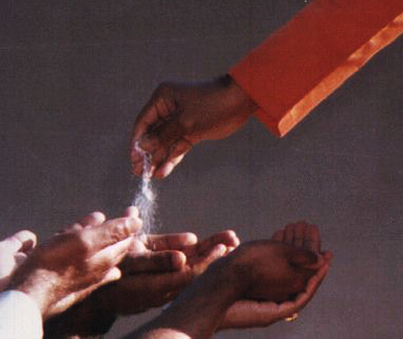
Vibhuti Prayer
Sacred, holy and supreme is Baba's Vibhuti
Pouring forth in endless stream - this play of Vibhuti
So auspicious is its might, it grants liberation
Baba's Vibhuti - its power protects me.
Paramam Pavitram Baba Vibhutim
Paramam Vichitram Lila Vibhutim
Paramartha Ishtartha Moksha Pradanam
Baba Vibhutim Idam Asrayami.
Notes:
20

Slide 21
Aum
Aum
Aum
Notes:
21

Slide 22
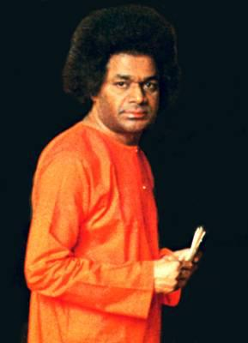
Silence Please……..
22
Notes:
22

Slide 23
Announcements
Region
GAB 2015 – 5:00PM 14-Nov through 6:00PM 15-Nov
Four Points Sheraton, 399 Silicon Valley Blvd, San Jose
Book your rooms now at GAB Discount Rates (valid until 2-Nov )
Reservations at
Phone: (408) 972 7800 (mention SAI for discount rate)
e-mail: reservations@fourpointssiliconvalley.com https://www.starwoodmeeting.com/events/start.action?id=1509286450&key=2F6ACE5F
Birthday Celebrations 2015
4:00PM – 8:00PM on 21-Nov-2015
6:30AM – 4:00PM on 22-Nov-2015
Sunnyvale Hindu Temple and Community Center, Sunnyvale, CA
New: Region 7 Devotion Wing Resource Database at
http://www.region7saicenters.org/devotion/index.html
Notes:
23

Slide 24
Announcements – Events
What: Swami’s Birthday Celebrations 2014
When: 8:00AM to 11:00AM, 22-Nov-2014, Saturday
Where: Divine Sciences Center
1540 Hicks Avenue,San Jose
Details in center e-mail.

Slide 25
Announcements – Devotion Guidelines
Singer(s)
Songs/Scales are to be provided week in advance; coordinate with DCs and Harmonium player(s) for review
Prefer bhajans which have been offered already so following is easy
New bhajans to be practiced during the monthly bhajan practice; if a bhajan is new, please coordinate with the DC to ensure it is ok to be signed up
Lead Singers should be seated at the center 15 min prior for easy passing of microphones
Backup singers to be ready with Chorus mics to assist lead singer(s) if necessary
Instrumentalist(s)
Only assigned instrumentalists should accompany, if multiple instrumentalists are available then they should share the responsibilities of accompanying the bhajans

Slide 26
Announcements – Events
What: Swami’s Birthday Celebrations 2014
When: 23-Nov-2014, Sunday
Where: Sunnyvale Hindu Temple
450 Persian Drive, Sunnyvale
Also at
Ben Ali Shrine
3262 Marysville Blvd, Sacramento
Website: http://www.region7saicenters.org/birthday/
Details in center e-mail.
What: Morning Prayers
When: August 25th to Nov 23rd, everyday from 5:45-6:30 AM
Dial-in: (513) 386-0000, Conference ID: 934183#
Format: 21 OMs, English Suprabhatam, Multi Faith Chants, Veda Chanting

Slide 27
Announcements – Events
What: Swami’s Birthday Celebrations 2014
When: 8:00AM to 11:00AM, 22-Nov-2014, Saturday
Where: Divine Sciences Center
1540 Hicks Avenue,San Jose
Details in center e-mail.

Slide 28
om śantih śantih śantih
om peace peace peace
Notes:
28

