Slide 1
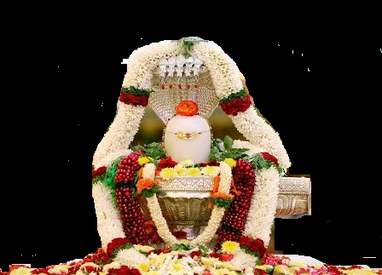


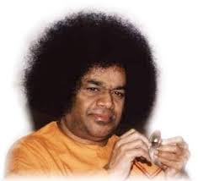
Scale
Bhajan
Meaning
Next:
NextBhajan
NextScale

