Slide 1
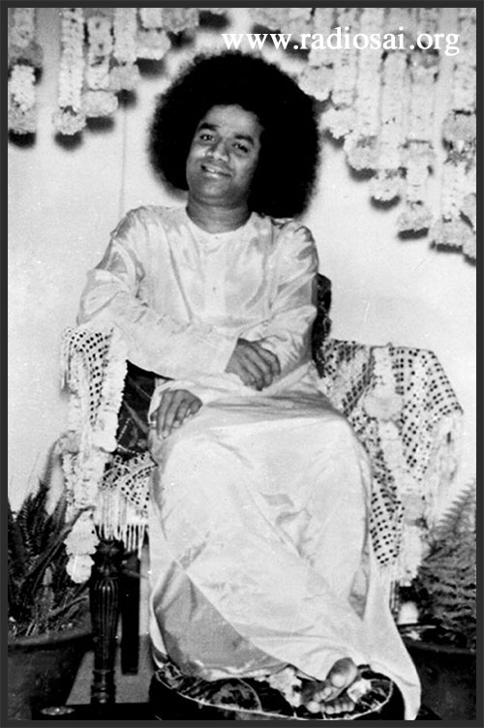
Bhajan
Meaning
Scale
Next
Notes:
1

