Slide 1

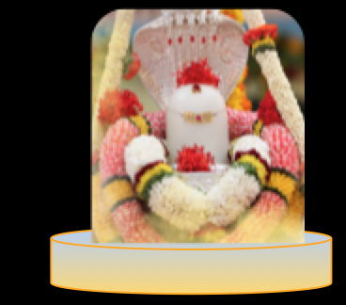
Maha Shivaratri
Bhajan
Meaning
Next Bhajan
NextBhajan
Scale

