Slide 1
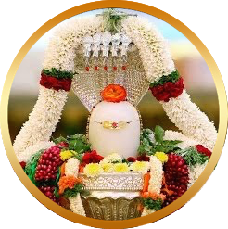
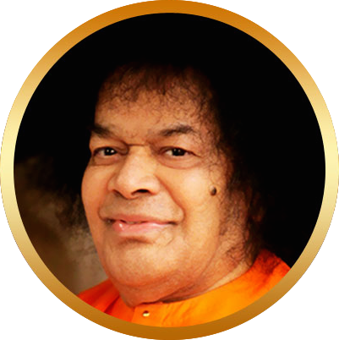
Bhajan
Shiva is inherent in every thought, word and deed, for He is the energy
Meaning
Scale
NextBhajan
NextScale

