Slide 1

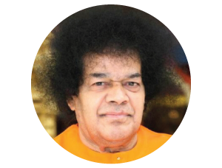

Bhajan
Meaning
Scale
NextBhajan
NextScale

