Slide 1
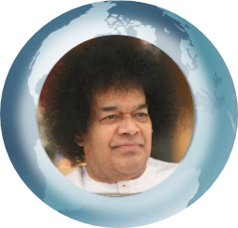

Prayers for Global Peace and Purification
Bhajan
Meaning
Scale
NextBhajan
NextScale

