Slide 1
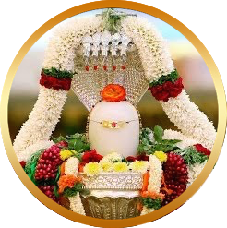
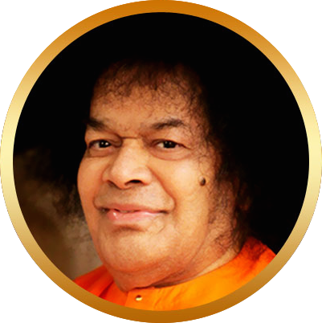
Bhajan
Burn your viles, your vices, your bad habits; worship Shiva,
rendering yourselves pure in thought and word and deed.
Meaning
Scale
NextBhajan
NextScale

