Slide 1
Brief Description of the Feature Extraction and DTW
12-9-2017

Slide 2
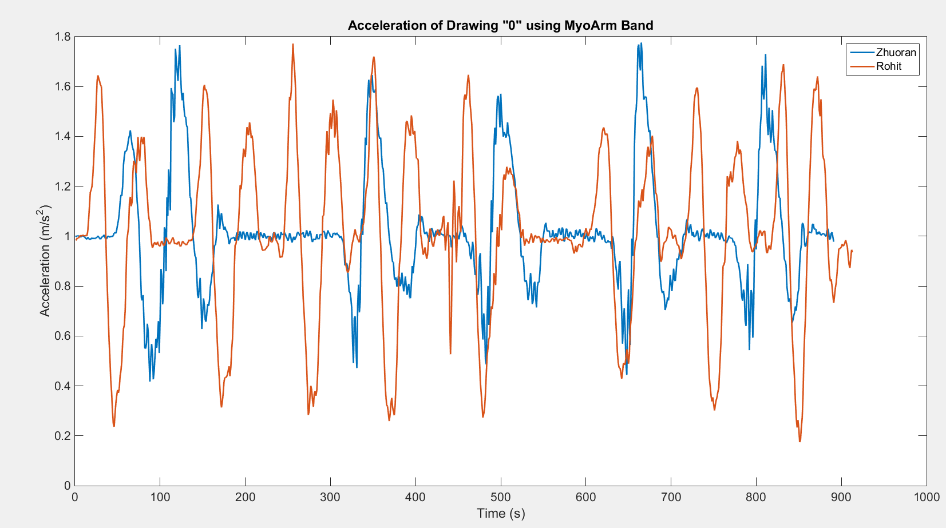
First, take a look at the raw data from armband. This is the time series of Zhuoran and Rohit drawing 0

Slide 3
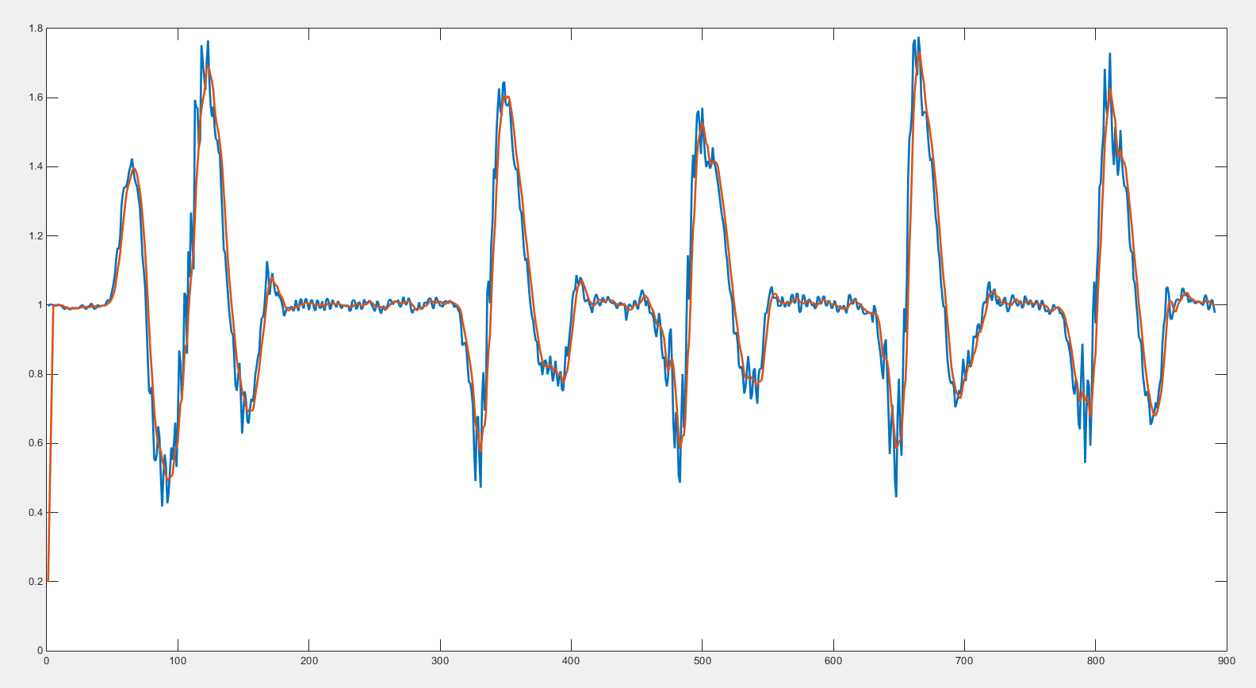
This is the data of zhuoran after noise reduction

Slide 4
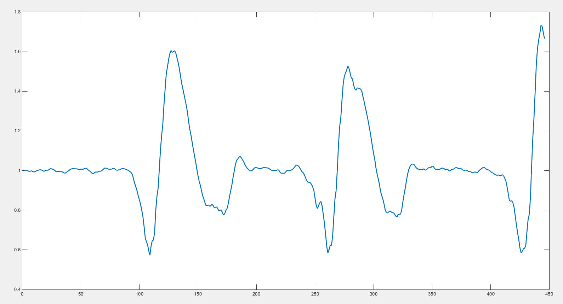
Choose the data from ¼ to ¾ , because we don’t want to use the data at start or end point since it’s unstable

Slide 5
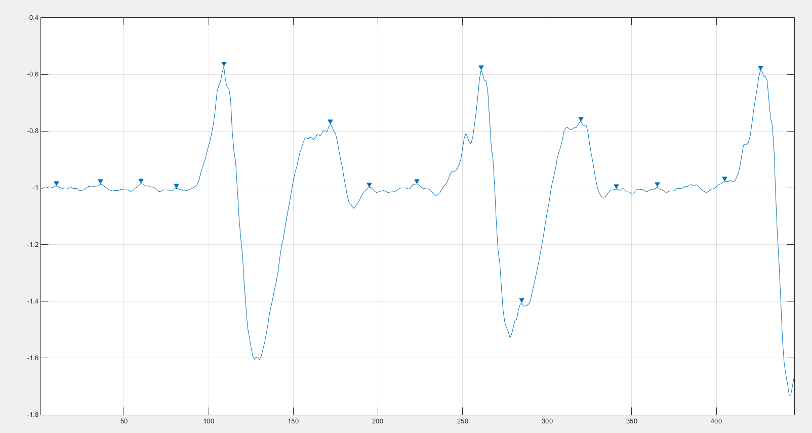
Calculate the local point for finding the start point and each cycle, so we can see that there are two cycles in the figure below

Slide 6
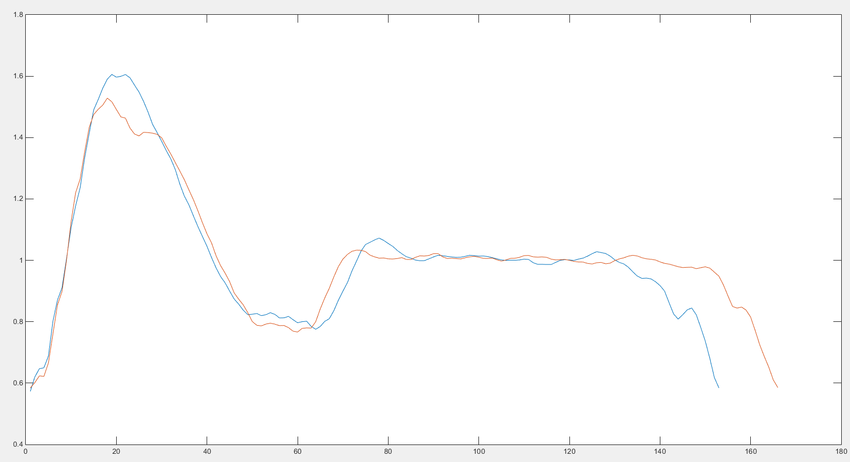
We choose the local minimum point as the start point. So here are the two cycles we extracted.

Slide 7
Dtw.m is used to compare the result between the user and the attacker, the input are two array and a threshold value. The two array is extracted from the user and the attacker respectively
Extact.m can apply on any time series (cycles must > 2). The input is raw_data (stored as an array, like the acceleration/gyro) and the output is an array of averaged cycle. So basically it’s the average value of all cycles instead of the values (every cycle) shown in previous slides
Noise_Reduction.m is served as a library, using moving average method
Import an record from the excel and saved as an array such as “data1”. Run “Extract(data1)” you will get an averaged data/pre-processed data. Import another record from different person, saved as “data2”. Run dtw(data1,data2,2) you will get the compared result shown as “distance”. “2” is the threshold value as the warping path, this value could be changed depending on different situation

